Slide 1
The SATORI Framework for Ethical Impact Assessment
Trilateral Research Ltd.
Crown House
72 Hammersmith Road
W14 8TH, London
+ 44 (0)20 7559 3550
@Trilateral_UK
Information Infrastructuring for Disaster Risk Management. 26 January 2017
Dr David Barnard-Wills Senior Research Analyst david.barnard-wills@trilateralresearch.com @dbarnardwills

Slide 2
Trilateral Research Ltd

Slide 3
The SATORI project
Stakeholders Acting Together on the Ethical Impact Assessment of Research and Innovation (SATORI).
Received funding from the European Commission’s Seventh Framework Programme (FP7/2007-2013) under Grant Agreement n° 612231.
45-month project (2014-2017).
Co-ordinated by University of Twente. Trilateral Research is deputy coordinator.
Objective: To develop a framework for common basic ethical principles, and joint approaches and practices, to help harmonise and improve ethics assessment practices of research and innovation in the EU
www.satoriproject.eu
@SATORI_EU
Notes:
CSA
The aim of SATORI was to contribute towards harmonising and improving ethics assessment of research and innovation.

Slide 5
Key outputs
Comparative analysis of ethics assessment practices in the EU and beyond
Ethics assessment framework for research & innovation (the “Common Ethics Assessment Framework”)
CEN Workshop Agreement: Ethics assessment for research and innovation
Notes:
Ethics assessment: Any kind of assessment, evaluation, review, appraisal or valuation of practices, products and uses of research and innovation that makes use of primarily ethical principles or criteria.
Three outputs to highlight
Comparative analysis of ethics assessment practices in the EU and beyond – a frankly huge piece of comparative analysis. -
a detailed picture of the de facto ethics assessment landscape in the European Union and other countries with regard to approaches, practices and institutions for ethics assessment
across scientific fields (natural sciences, engineering, medical and life sciences, social sciences and humanties),
different kinds of organisations that carry out assessment. (research ethics committees, national ethics committees, research funding organisation, national science academies, universities, government and government-funded organisations, civil society organisations, standards bodies and industry).
, and different countries - The study is based on in-depth study of ethics assessment in ten countries in the European Union, and the United States (US) and China, as well as studies of particular organisations in other EU countries.
All accessible on the SATORI website – the value here for international project is perhaps in understanding the current state of play, scoping research (particularly across disciplinary boundaries and national borders) and understanding national differences.
It highlights the intense variation in this field.
The SATORI Common Ethics Assessment Framework
The CEN SATORI Workshop Agreement – Ethics assessment for Research and Innovation.
Also other interesting deliverables - Report (Handbook) of participatory processes, report on international differences in research cultures, ethical standards and legal frameworks.

Slide 6
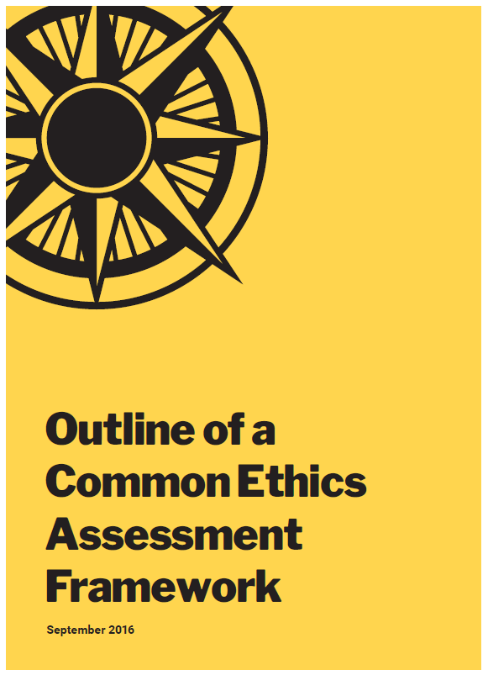
Expectations and main challenges
Framework of ethical issues and principles
Recommendations for best practices in Ethics assessment units
Common Framework for Ethical Impact assessment
Recommendations for specialised forms of ethics assessment (including technology development)
Specific recommendations by organisation type.
Proposals for institutional structures.
Compatibility with existing frameworks
Notes:
The EIA framework was constructed collaboratively by the SATORI WP4 partners.
Result of a synthesis of literature on ethical impact assessment and foresight studies.
Followed extensive consultation with stakeholders from a wide range of disciplines (interviews, workshops etc)
Adaptable – applicable to a wide range of R&I.
Not a complete ELSI solution – It’s focused on ethics, but the approach is flexible – As an example, the PULSE project, we added additional methods (lit reviews, interviews etc) to cover the legal and social elements.
Unfortunately, not yet public – the consortium is in discussion with the European Commission about making it so – and anticipate it should be available on the SATORI website in the near future.
In the meantime, we’re happy to share it upon request
Common Framework – is the methodology for ethical impact assessment
This section can be used by governance bodies to set up new regulations with regard to ethics assessment in R&I; by research funding organisations to set up new procedures for conducting EIAs in the projects they fund; local research organisations and companies for setting up internal procedures for conducting an EIA in the R&I projects they organise.

Slide 7
1 | Conduct an EIA Threshold analysis | 3 | Evaluate the EIs
Write a project proposal for the R&I project. Complete the EIA questionnaire Send the finished documentation to the ehtics assessor or conduct a self-assessment The threshold analysis is either accepted, rejected for there will be a request for amendments Complete preparatory steps: budget allocation, HR allocation, Road mapping. (Optional) Repeat the threshold analysis at different stages of the project, critically when there are significant changes in the project |  | Decide which methods should be used (desk research, expert consultation or participatory methods) Conduct a contingency analysis to evaluate the likelihood of EIs to occur Assess the relative importance of Eis Identify potential or actual value conflicts, and if possible aim at resolving these Formulate workable conceptualisation of the relevant EIs Document and present the EIs evaluation
2 | Set up and execute an ethical impact anticipation and determination assessment | 4 | Formulate and implement remedial actions
Assess the Technology Readiness Level of the R&I project’s outcomes Review existing work on EI anticipation and determination in the relevant R&I field Selection appropriate methods for conducting the EI anticipation and determination based on the TRL and the threshold analysis Gather relevant data (evidence based, by consultation experts, by interacting with stakeholders, based on creativity) |  | Gather relevant information about remedial actions proposed by other R&I projects Formulate and implement design interventions Formulate different types of recommendations Document and present the remedial actions
 |  | 5 | Review and audit the EIA outcomes
 |  | At the beginning of the EIA: set the milestones and criteria for the review and audit process During the EIA: evaluate the EIA documentation and the agreed upon criteria and milestones At the end of the EIA: ensure proper documentation, follow-up and signing off of the EIA. Document and present the review and audit outcomes.

Slide 8
CEN SATORI Workshop Agreement
CEN – European Committee for Standardization
A participative agreement, developed through a series of open workshops
Not quite a standard – can be developed into one.
Currently being finalised (this week).
Two parts:
I – Recommendations for composition, role, function and procedures of an ethics assessment unit.
II – Guidance on how to conduct an ethical impact assessment
Notes:
CEN, the European Committee for Standardization, is an association that brings together the National Standardization Bodies of 34 European countries.
CEN is one of three European Standardization Organizations (together with CENELEC and ETSI) that have been officially recognized by the European Union and by the European Free Trade Association (EFTA) as being responsible for developing and defining voluntary standards at European level.
A CEN Workshop Agreement is an agreement developed and approved in a CEN Workshop that is open to the direct participation of anyone with an interest in the development of the agreement. The development of a CWA is quick and flexible, and takes on average between 10-12 months.
Just like other CWAs, the SATORI CWA is not a full-fledged Standard. It is a consensus based, collaborative effort to bridge the gap between the vision and implementation of effective ethics assessment and responsible research & innovation (RRI).
The SATOWI CWA has two parts. Part 1 outlines recommendations for the composition, role, functioning and procedures of an ethics assessment unit (i.e. any institution or committee that performs ethics assessment – this includes, but is not limited to, research ethics committees, institutional review boards, ethical review committees, ethics boards, and units consisting of one or more ethics officers). Part 2 of the SATORI CWA provides stakeholders with guidance on how to conduct an ethical impact assessment. Together, both parts aim to help ethicists, policy-makers and other stakeholders deal effectively with the ethical issues and impacts of research and innovation.
Standards support policy-making goals by providing techniques, means and other requirements to support the achievement of such goals. The International Organization for Standardization (ISO) sees standards as “valuable support to public policy initiatives”. The European Commission Single Market Communication 550/2015 states, “Standards are crucial for innovation and progress in the Single Market: they increase safety, interoperability and competition and help remove trade barriers. They are essential for European competitiveness”. The move towards standardisation of ethics assessment in the EU through the development of the SATORI CWA is one step towards showcasing the EU globally as a leader in enhancing ethics and developing RRI standards.
Ethics has high priority in EU research policy. The SATORI CWA could support policy in many ways. The CWA could serve as a reference point in the European Commission’s and national Member State polices on ethics assessment. It could help ethics assessors in formulating effective and efficient ethics assessment processes and structures, particularly in scientific disciplines where they are next to non-existent, and guidance is required. It can facilitate compliance with ethical and legal obligations, established standards and good practice. Marlou Bijlsma, of the Netherlands Standardization Institute (NEN), comments that “The SATORI CWA could make the outcomes of research and innovation more acceptable and desirable for society.”
ftp://ftp.cencenelec.eu/CEN/News/2016/WS/SATORI/CWA-SATORI_part2_WD2_20160914.pdf

Slide 9
Key contacts
Dr Hayley Watson Practice Manager
Crisis and Security
Hayley.watson @trilateralresearch.com
Dr Rowena Rodrigues Senior Research Analyst
Ethics, Privacy and Data Protection
Rowena.rodrigues @trilateralresearch.com

