Slide 1
COncORDE and Incident Data for EMS
Brussels, 26th January 2017
Dr. Toni Staykova
Takis Kotis
COncORDE Coordinator Team
Cambridge University Hospitals
This project has received funding from the European Union’s Seventh Framework Programme for research, technological development and demonstration under grant agreement no. 607814 “COncORDE”.
Notes:
Thank you for coming to our workshop in which we would like to present our project, receive your feedback and hopefully engage you to collaborate with us.
I am Dr Toni Staykova, the coordinator of the project. I also want to thank the IMPRESS project consortium for collaborating with us to showcase how two EU projects working on the same topic can support each other and explore cross-fertilisation of results. The two projects have a lot in common as far as the main topic and ideas are concerned. However as you will see, there are also some major differences, especially regarding the level of response which we are trying to improve with technical solutions. Thus our tasks and starting points also differ.

Slide 2
The COncORDE project partners
Notes:
Concorde is a project funded by the Security Call of the FP7. It started over 2 years ago and is planned to be completed mid-2017. We are 14 partners from 12 EU countries.

Slide 3
Purpose of our participation
Discuss the type of ELSI issues we have encountered
Present our general approach to addressing ELSI issues at design time of the CIS in the COncORDE project
Present our user view of how ELSI issues can be avoided/reduced
Contribute with case examples to the ELSI platform

Slide 4
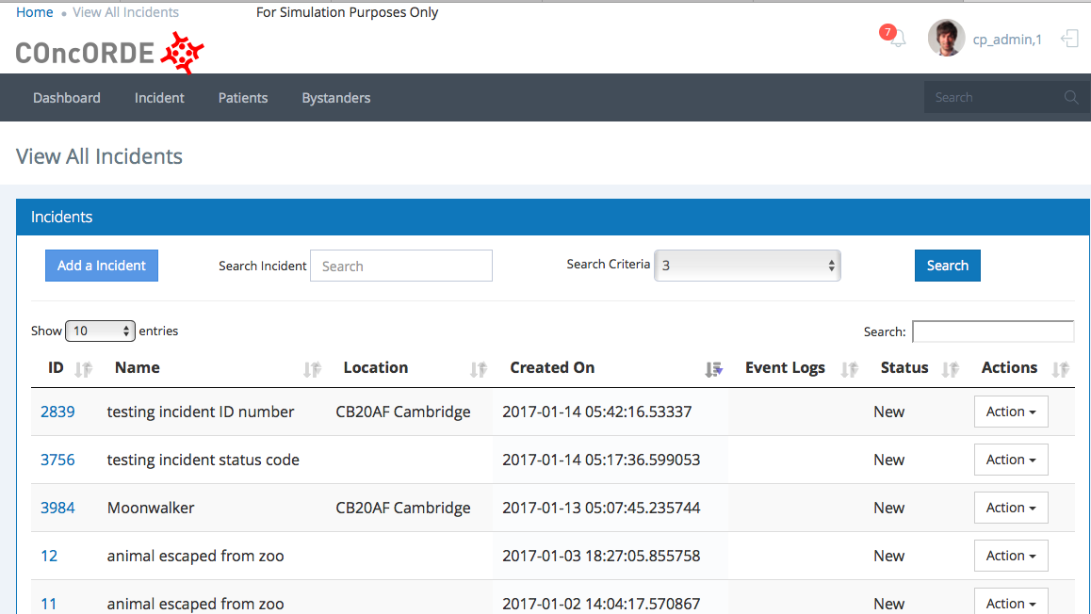
The project task
Design, develop and test a Pan-European system
Improve coordination in health system response in any size and kind of emergencies
Aim to leverage existing efforts in the domain, i.e. allow other solutions to integrate
Creation of a common
information space for EMS
one CIS per incident

Slide 5
Aims of the CIS
Connect EMS responders to know the following
Operational information exchange
Which responders are involved in the incident
Who is where and doing what in real time
What is the core information as it comes in
Where are the patients and what is their status in real time
Post-action review of events

Slide 6
Potential domains for ELSI issues in the COncORDE CIS - examples
Access to information
Privacy
Personal data protection
Responder identity – do we need to know personal details of responders on the field?
Which responder should know what and why?
Which information should be made available to which responder?
Patient information – what patient data do we need to know?
Trust
What is reliable information provided to the CIS?
How can you build decision support models based on incomplete or unreliable/unverified information?
Is historical data reliable for predictions?
How can a responder trust predictive models to make decision on patient lives?
! And many more …. !, e.g. Should bystanders be in a public CIS of the incident and know incident details ? Who decides on access rights ? Who is allowed to audit ? Should responder identity be known during audits?

Slide 7
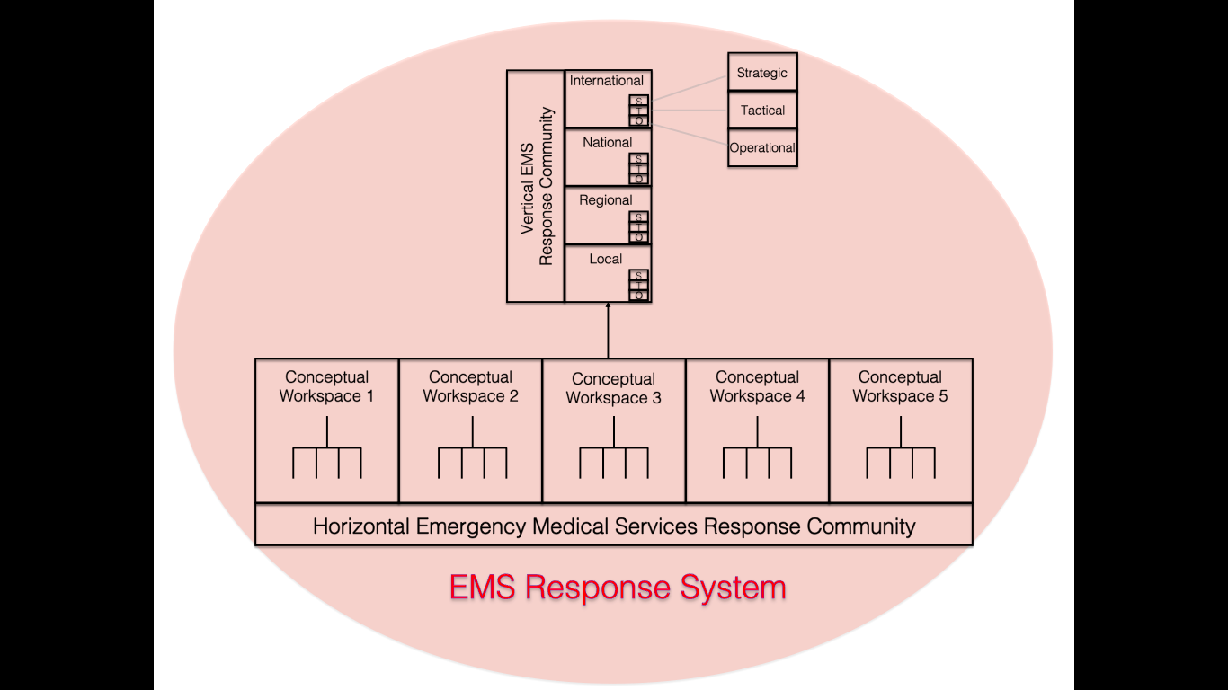
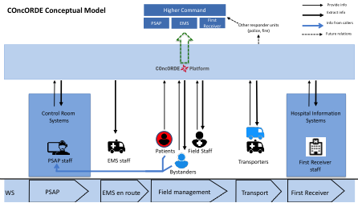
Approach to the CIS design
Process analysis
The common concepts:
1. Work spaces
2. Actors
3. Incident information
4. Patient information
Gap analysis
Minimum data set analysis
Notes:
There is always a control room
There are dispatched responders – they drive to scene
There is always an incident scene
There are always responders who take patients from the scene to the hospitals
There are hospitals

Slide 8
The COncORDE concept of the common incident space
First there needs to be a system that links all the EMS organisations and responders participating in an incident. Such a system did not exist.
Our first task was to design and develop a system which:
connects meaningfully all the participants
has the workflows for each participant
allows each participant to provide and obtain information related to his task and to be able to see what is going on across the entire response pipeline.

Slide 9
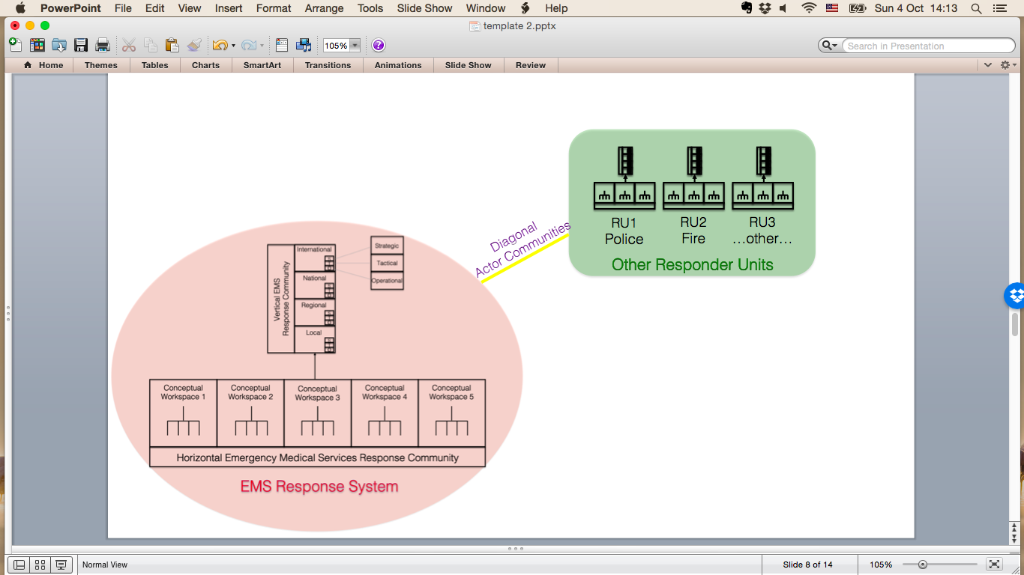
Who is not in the common information space (for now) ?

Slide 10
Incident information - which actor needs to know what
Two approaches in parallel:
A) Approach to technical system design and initial system testing
Step 1: All actors need to be able to know everything for a start to ensure that all system functionalities are there and function.
Step 2: Then we start limiting information (access rights) based on analysis of usual workflows.
Step 3: In addition this can be customised to different legal systems.
B) Approach to CIS content design and decisions on access
Several cycles of analysis
After integration of both approaches, scenario testing and validation adds additional insights.
ELSI scrutiny and monitoring

Slide 11
Analysis prior to CIS content design and decisions on access
General principles of the analysis:
1. AN ACTOR NEEDS TO KNOW ONLY THE INFORMATION NEEDED TO PERFORM THE ROLE IN THE INCIDENT.
1.1. Thus we need to know what are the tasks in the role. Our initial process analysis defined each role with its list of tasks in order to determine the need for knowledge. Importantly, the task definition is patient centred, simply because the goal of the EMS is to manage patients in emergencies.
1.2. We also need to know the minimum data set an actor needs to know in order to fulfill his role. This was derived both from the process analysis as well as from mapping of real life cases – evaluation of real life incident reports, logsheets, sitreps, ambulance forms and literature reports, incl. lawsuits.
1.3. The analysis in 1.2 resulted in a set of knowledge concepts related to the minimum data sets. Then we map each task vs. each knowledge concept and ask which concepts are needed to perform the task.
2. AN ACTOR NEEDS TO KNOW ANYTHING THAT WOULD ENDANGER HIS SAFETY AND PATIENT SAFETY
2.1 Important - Responder safety comes first – because if you have a dead responder, then patient safety is not really possible either.
2.2 Patient safety
The analysis question is: Is it possible that barring Actor X (e.g. hospital) from access to the information in concept Y (hazard – chemical spill) because in general terms he does not need this information for his role, that this missing information might endanger his safety or his patients’ safety?
Overall our step by step analysis has revealed that our concepts are sufficient to provide the operational knowledge required for each role, but at the same time they represent a safe minimum of what each actor needs to know and very little access limitation is actually needed.

Slide 12
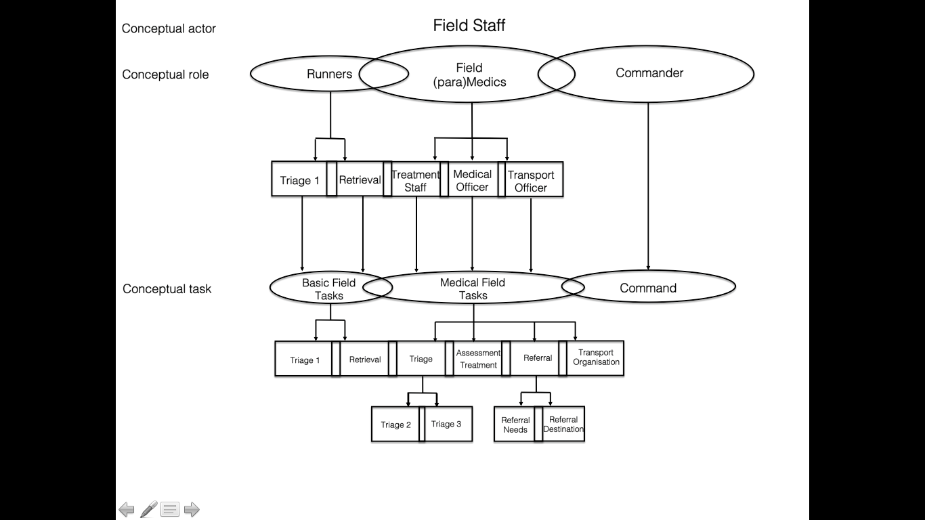
Actors
Actors only necessary in relation to patient
Many more actors will participate in various incidents but these are the fixed ones

Slide 13
What does a responder need to know
Incident information
Team information incl. resource
Patient information
+ of course his Role (Tasks) in the incident

Slide 14
MDS of Incident information – only the common concepts
Initial information at time of first dispatch
Incident short name / Incident description
Incident number
Incident status code
Type of emergency
Caller
Patients involved
Hazards/dangers
Location, access
Reason for dispatch
Priority dispatch code/urgency
Not all of the above have to known, but the bold are more or less obligatory in order to dispatch
Dispatched resource – ongoing
Ongoing incident information – SITREPs
Incident short name / Incident description
Incident number
Incident status code (M)
Type of emergency (T)
Patients involved (N)
Hazards/dangers (H)
Location, access (E, A)
Emergency services present/required (E)
Responders provide additional info
Field commander decides which info to add to SITREP

Slide 15
Team information - Tabular view of participants in the CIS - Teamtable
The issue of responder identity

Slide 16
Team information - Map view of participants in the CIS
The issue of responder location

Slide 17
Responder privacy issues - examples
What needs to be known about responders participating ?
Name ?
Level of expertise ?
Special skills ?
Affiliation/employer ?
Age ?
Gender ?
Location ?
Task ?
Contact details ?
What details are needed as minimum to be able to work with another responder?
How do we know someone is not an imposter? verification
Is one role allowed to know more about responders identity than the others?
Should all responders be able to see the location of the other responders?

Slide 18
Patient information
We as users /Trauma centre have proposed a minimum data set of patient information that needs to be known and documented in mass casualty situations. This set is based on our own expertise, plus analysis on patient ambulance forms from different sources and multiple real life situations
Patient personal data are not needed. Anonymous ID is enough. All medics need is gender and estimated age.
Triage data and vital signs
Location
Medical assessment/minimalistic – insert patient Assess screen
Treatment – insert Treat screen
Needs – referral diagnosis, time to hospital - insert Needs screen
In mass casualty situations we also need a patient summary screen – insert

Slide 19
Initiating patient monitoring

Slide 20
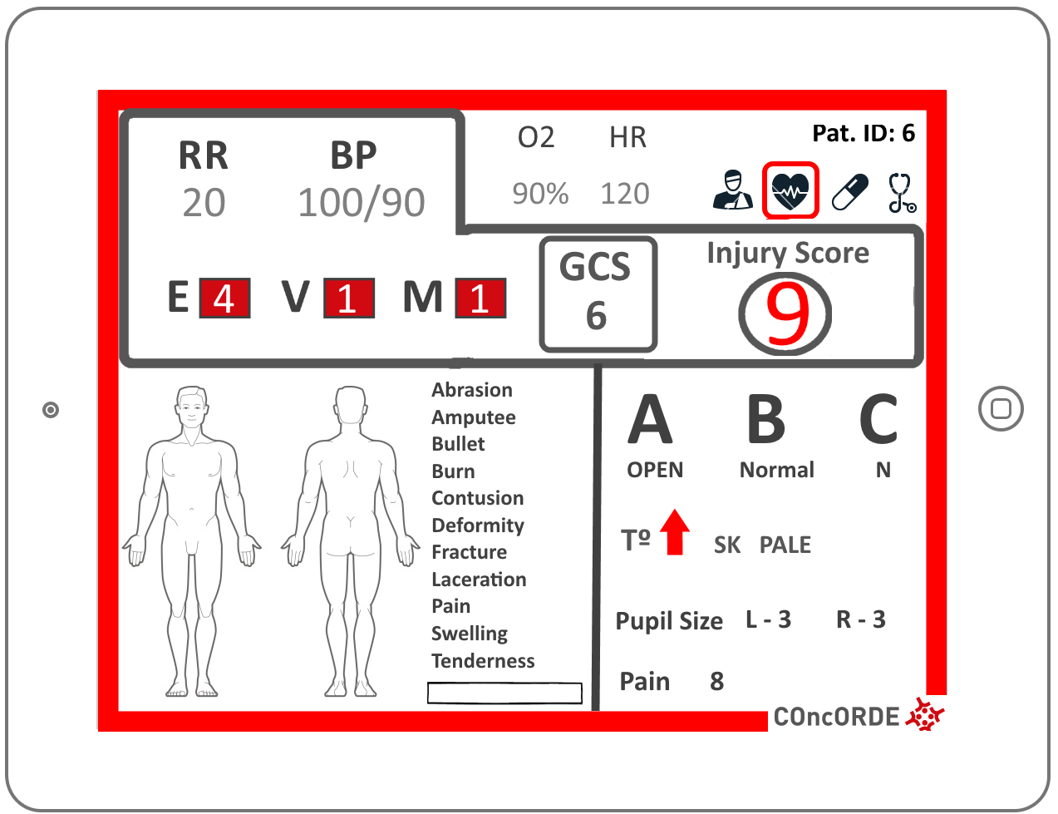
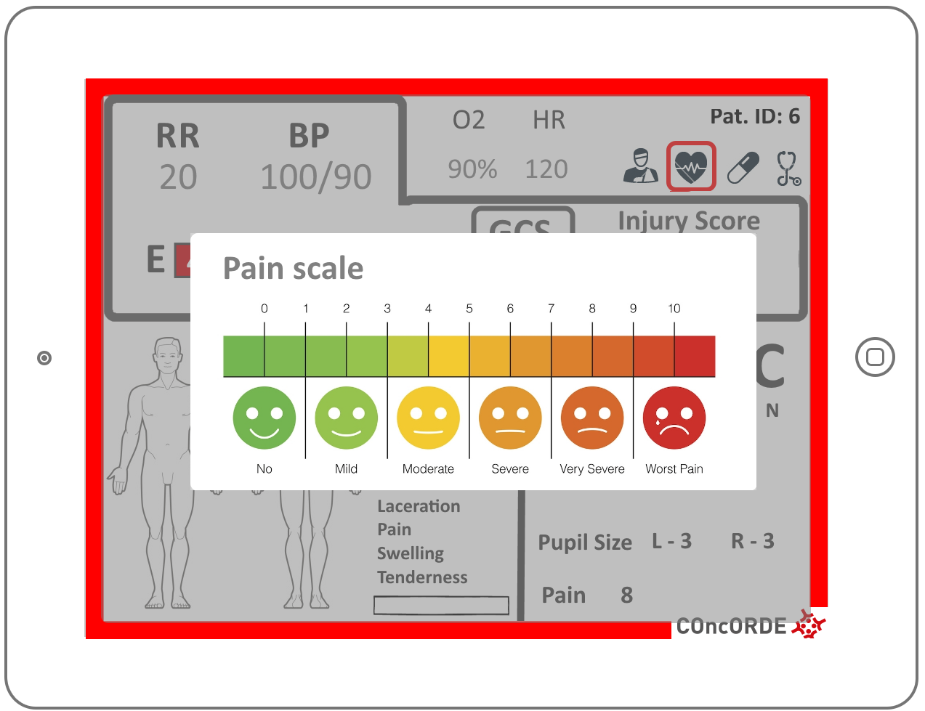
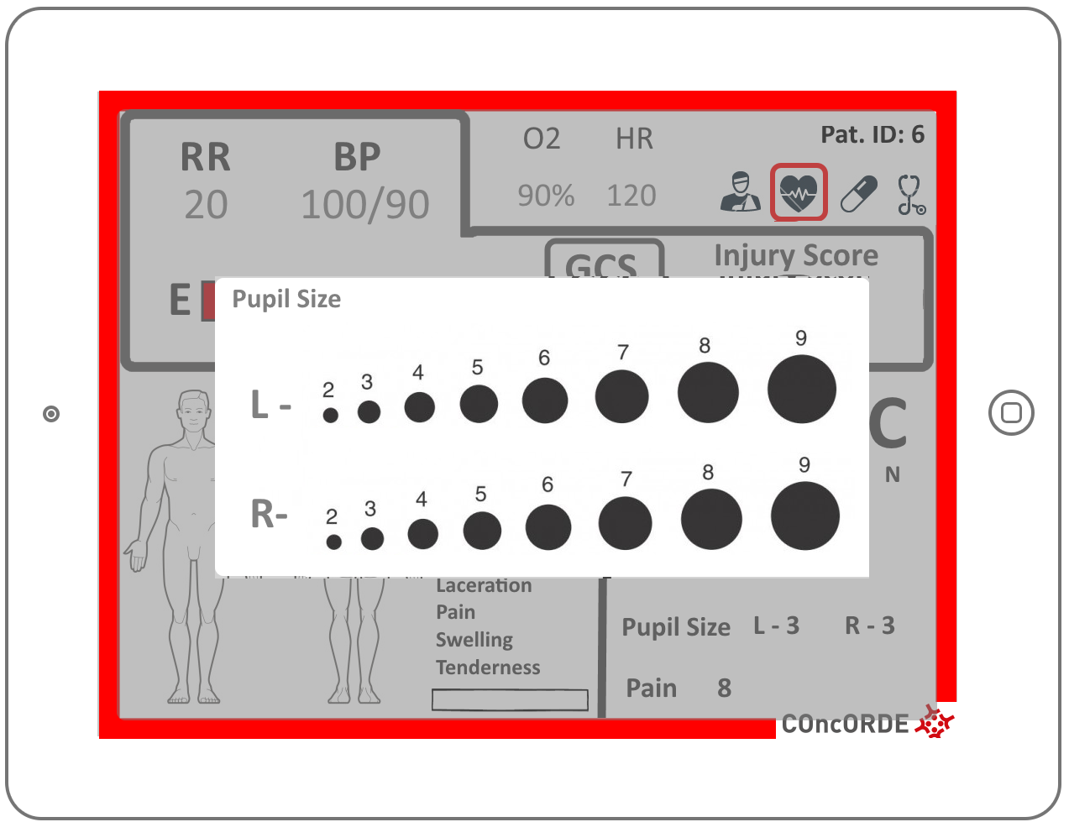
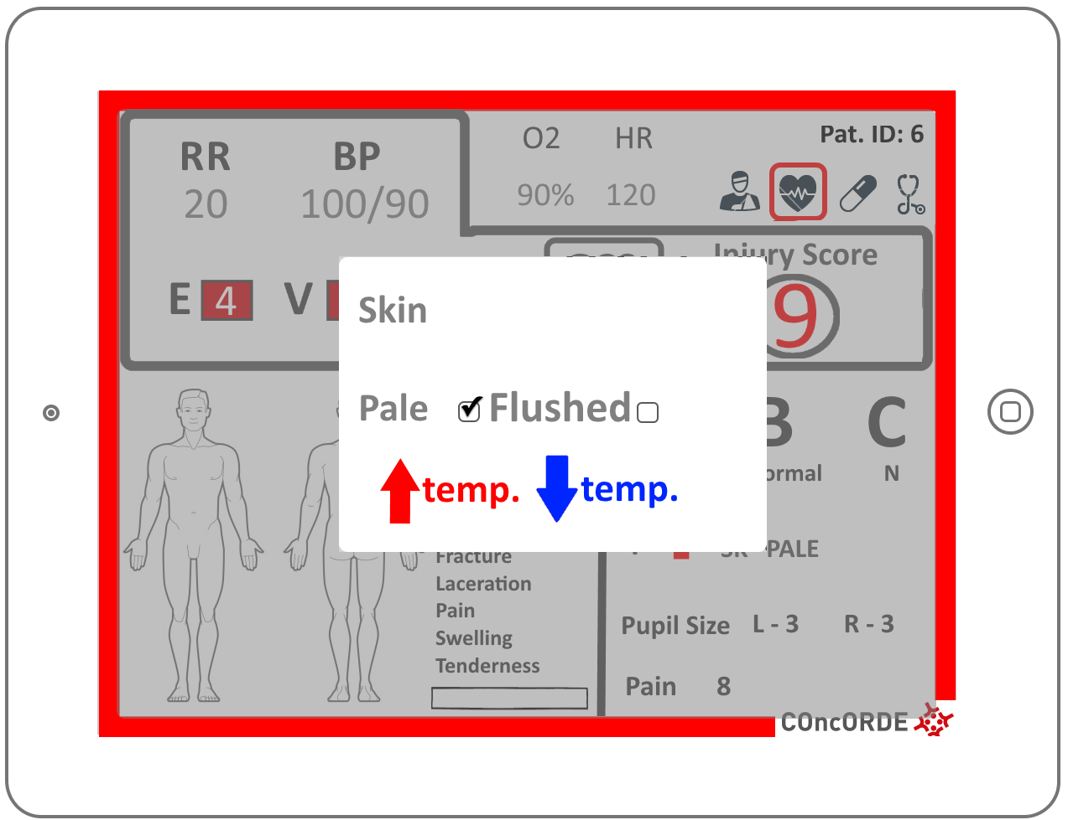
Patients

Slide 21
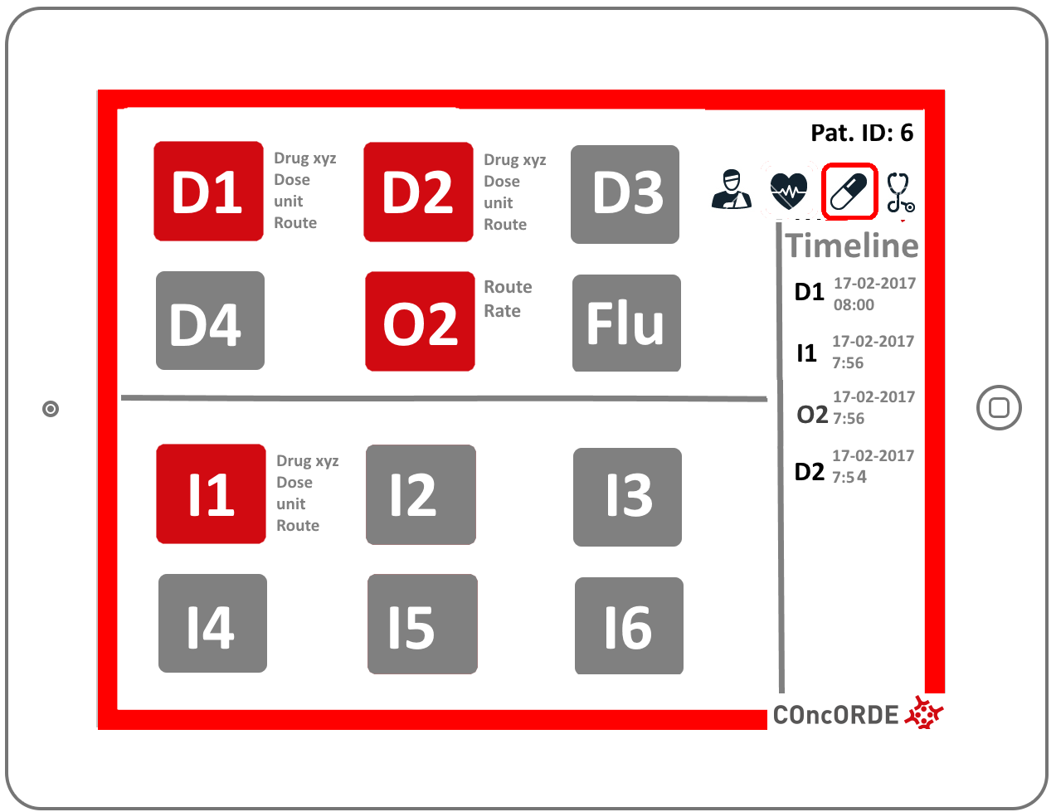
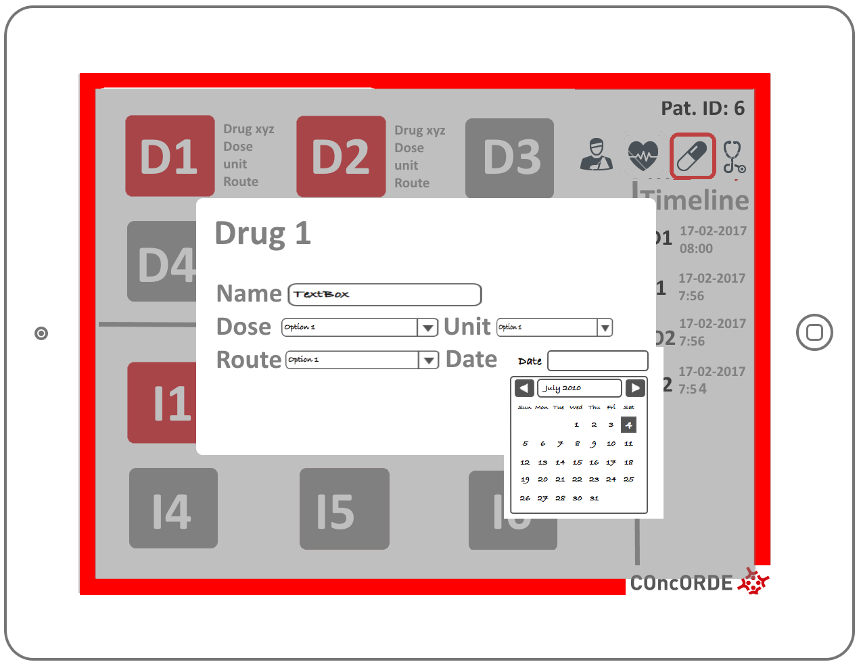
Patients

Slide 22
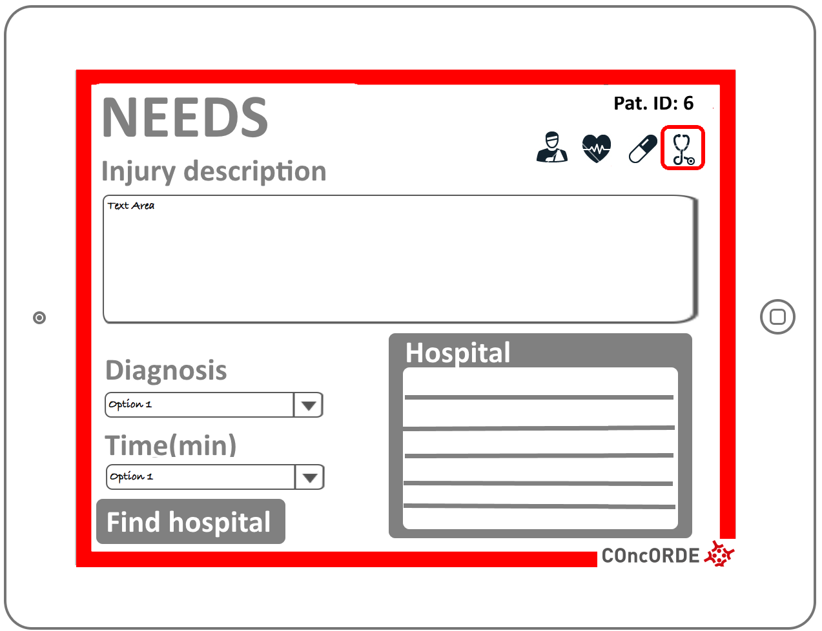
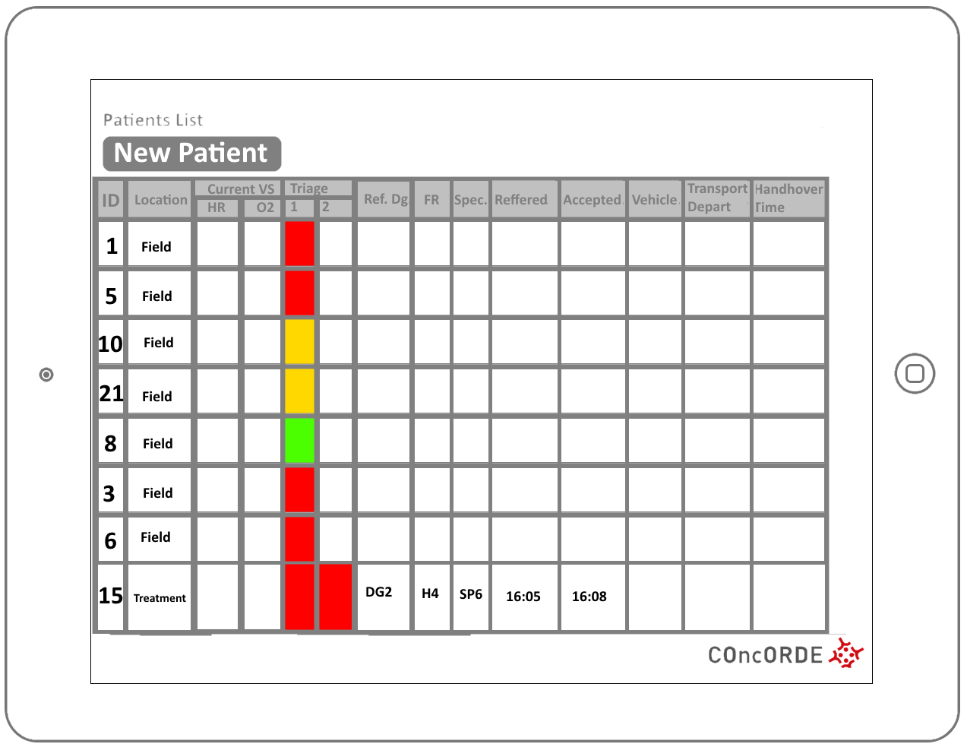
Patients

Slide 23
Patient summary table
Who should see what patient information?

Slide 24
Who should see what patient info
Open for discussion
Hospital rules:
Every medical professional in the hospital can access patient information (except when barred). But one should only access the information of the patients to whom medical care is provided.
In COncORDE:
Field EMS staff (as in hospitals) can access patient information, especially since many staff can be involved in the same patient’s care.
Transport staff only access the information of their patient
Hospitals only access information of the patients who have been referred to them

Slide 25
The next steps after COncORDE
We have been proactive in the design aiming to minimise ELSI issues but we do not have a panacea to solve all
Our cases are yet to be validated and scrutinised
Collaborative discussions are welcome
Our approach opens a wide field for further research and developments, SMEs

Slide 26
Thank You

