Slide 1

BROADMAP
Mapping Interoperable EU PPDR Broadband Communication Applications and Technology
PSCE Conference
Athens
23th November 2016

Slide 2
PSCE = Public Safety
Communications Europe Forum
established as a result of a European Commission funded project in 2008.
evolved into an independent forum,
public safety user organisations, industry and research institutes
discuss and exchange ideas and best practices, develop roadmaps and improve the future of public safety communications.

Slide 3
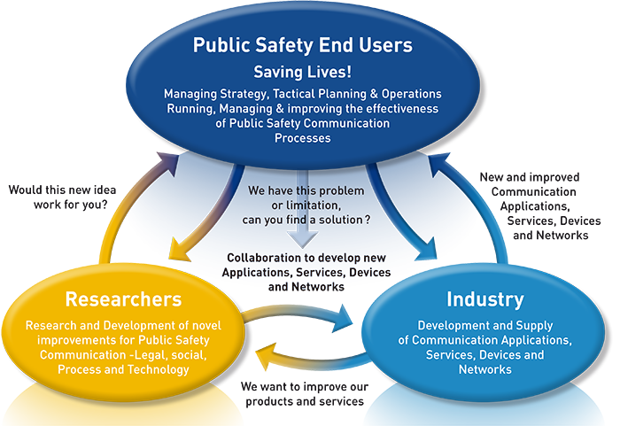

Slide 4
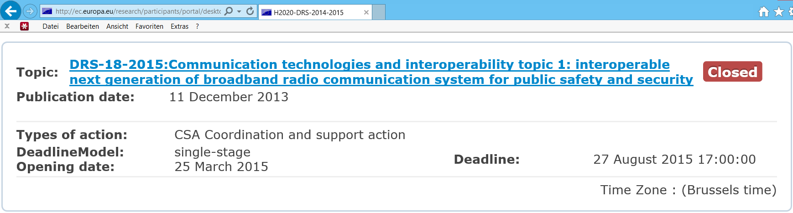
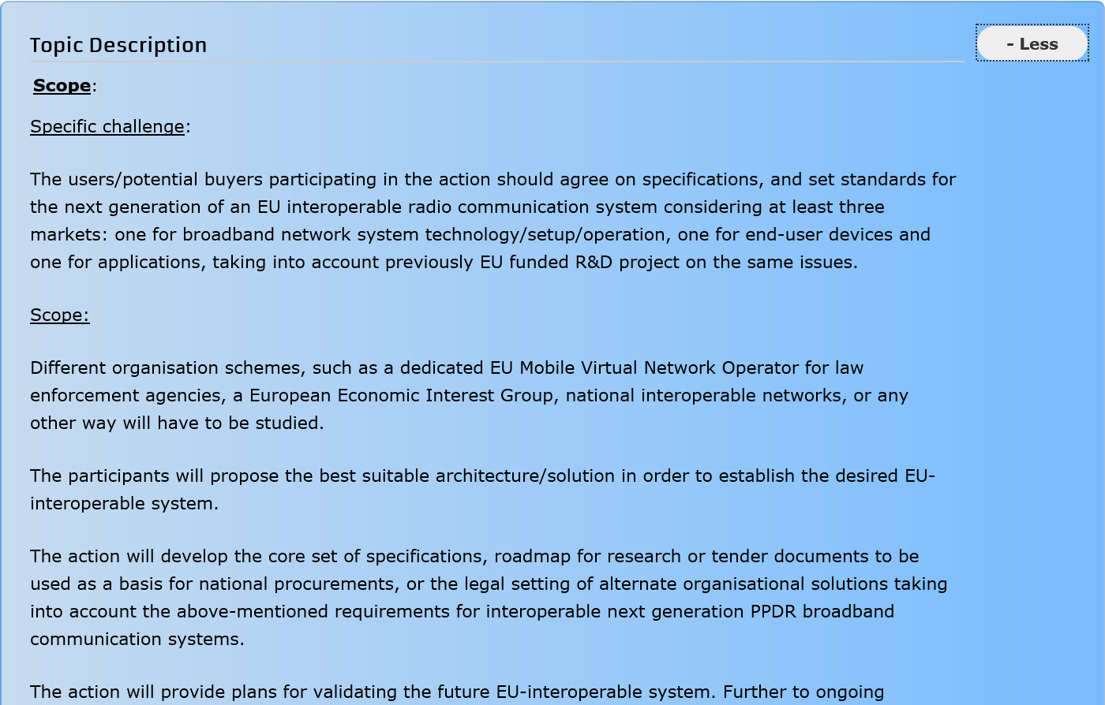
EC‘s Horizon2020 project call

Slide 5
A Cornerstone for future Critical
Mobile Broadband Communications

Slide 6
Our goal
Establishing the PPDR requirements,
a core set of specifications and
the roadmap for procurement to achieve future evolution of
European broadband applications and
interoperable radio communication solutions

Slide 7
Objectives
To collect, assess and validate the PPDR’s wireless broadband communication requirements
To establish a core set of specifications to fulfil the requirements
To define transition roadmaps for research and standardisation for future evolution of European interoperable radio communication solutions, within legal procurement constraints
To prepare the ground for a new eco-system to catalyse new applications, services and processes making use of broadband capabilities for Public Safety and Security

Slide 8
Consortium

Slide 9
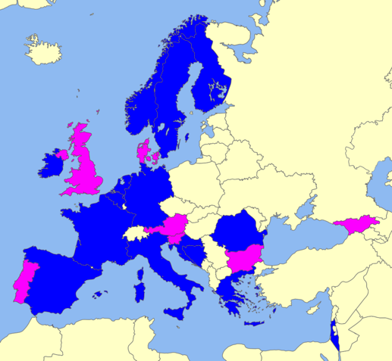
A Broad Map
Involved partners
PSCE providing project coordination and support, Consortium Leader:
  Dr. David Lund, PSCE
15 potential buyers/end users, of which
  12 represent EU Member States
  3 represent Associated Countries
  8 represent the responsible Ministry within their country
  7 represent end user organizations and/or operators of emergency service networks
48 external supporters
  7 extra countries
DGFLA providing legal expertise
Supporting partners

Slide 10
Principles
All output is generated from a PPDR end user perspective
The views of the widest possible reach across Europe of Critical Communications needs and use.
To utilise all existing and relevant materials from previous and on-going activities
To utilize the combined experience on PPDR communications
To foster cross fertilization and avoid duplication of ideas and plans between Member States and associated countries
To influence EU Policy and standardisation to support the future roadmap of future evolution of EU broadband applications and interoperable radio communication solutions
To take account of legacy investment in state of the art radio communications by PPDR

Slide 11
Work-Packages
WP 1 - Ethical and Social issues
WP 2 - Project Management
WP 3 - Requirement
Consolidation
WP 4 - Candidate
Solutions
WP 5 - Transition
Roadmap
WP 6 - Outreach and Dissemination

Slide 12

Time line
Aug 2015 proposal submitted
Jan 2016 EC decision
10-12 May 2016 Kick-off Meeting
May – Aug. 2016 National User Workshops
10th Nov. 2016 European User Workshop
Autumn 2016 Interim reporting
6th April 2017 Final Project Conference
30th April, 2017 Project end
2018 SEC-04

Slide 13
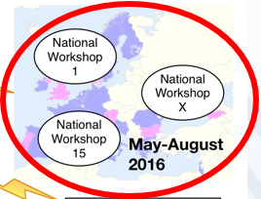

15 project partner countries
25 workshops - validate user requirements
276 PPDR organisations from 18 countries
600+ practitioners (users) involved

Slide 14
Results ?
Identification of gaps in standardisation
=> Input to 3GPP
Set of user requirements, potential solutions, plan for transition, ..
Input for next project (PCP, tender for pilot/test systems)
=> „Restricted R-UE“ info at the moment

Slide 15
Industry? Research?
Industry participation restricted – to avoid conflict with the tender process later
Project group decided: now Users only
Define open research issues
Final Conference April‘16 open for all stakeholders

Slide 16



Phase 0
Requirements
Solutions
Transition
Roadmapping
2018
BROADMAP has received funding from the European Union’s Horizon 2020 research and innovation programme under grant agreement No 700380.

Slide 17
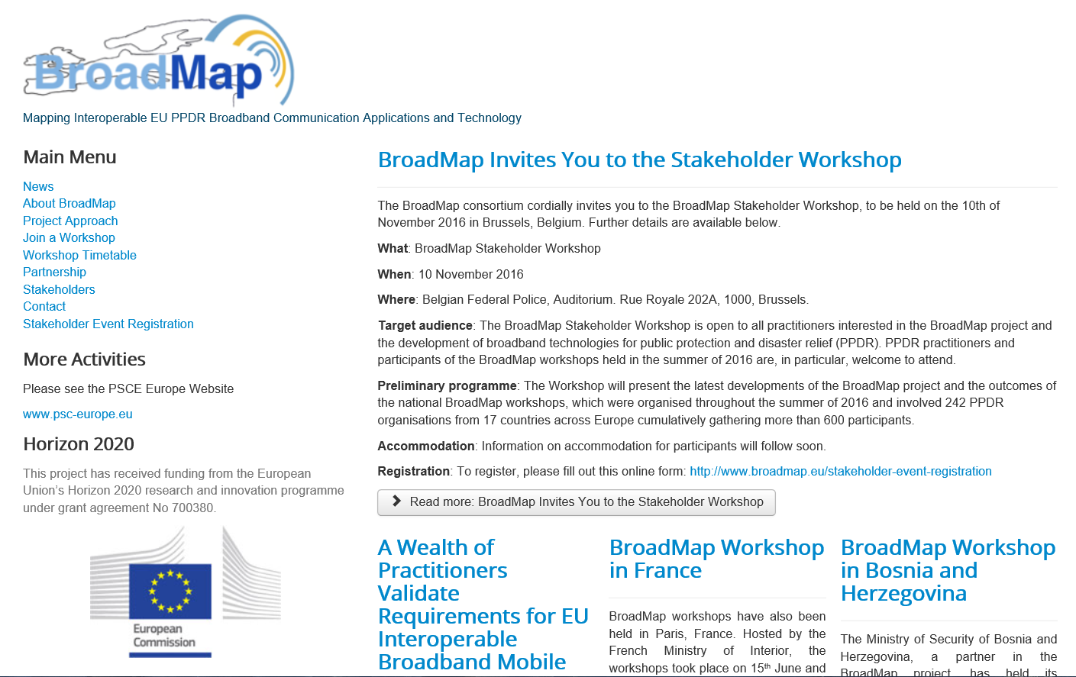
www.broadmap.eu
6th April 2017

