Slide 1
Distance Learning
Facilitating Student Presentations within the Moodle Course Framework
Philip Pedley

Slide 2
Project background
MA Distance Learners interact with their other course colleagues via Moodle
An MA student task is to compile a narrated video PowerPoint and upload this to the Moodle course unit.
This has proved problematic
A large percentage of students consistently fail to produce a PowerPoint presentation which can be shared and discussed.
This project sought to understand the reasons and provide possible interim and longer term solutions

Slide 3
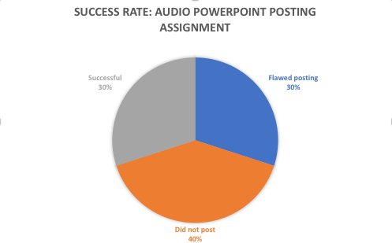
Analysis: DL Sample
Sample taken of one MA Distance Learning(DL) module in 2014-15
Twenty one participants in module.
Wide geographical range (Europe, Central Asia, Middle East, N & S America).
Wide age range (early twenties to sixties)
Result…
Only 30% could upload a working PowerPoint video with audio that could be shared with fellow module students. Why so low?

Slide 4
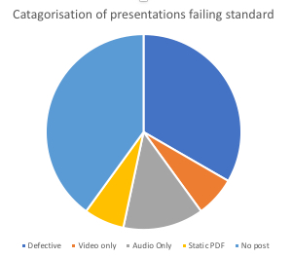
Analysis: Student issues
“Compatibility” issues with Impress (OpenOffice)
“Wrong recording software”
Just couldn’t record audio
Couldn’t figure out how to set to record
Version used couldn’t be viewed by other students due to variety of given reasons e.g. Plug-ins.

Slide 5
Analysis: Platforms
Use of platforms by MA Distance Learners since inception of Course

Slide 6
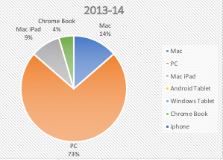
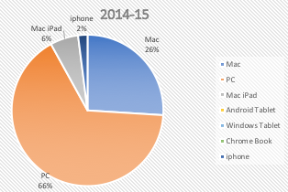
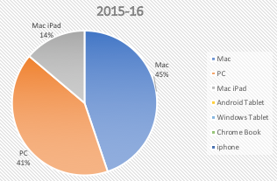
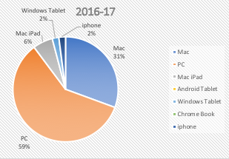
Analysis: Platforms
Windows based PC’s & laptops is usually dominant platform
However, Mac based platforms have grown.
In 2015/16 Mac platforms overtook Windows
2016-17 saw the appearance of iPhones & non-Mac tablets as some student’s primary choice of device for accessing the course

Slide 7
Conclusions
Wide divergence of skill sets in student’s ability to use PowerPoint
Complicated by use of outdated versions, non PowerPoint product’s & limitations on functionality created by certain platforms
Possible merit in University insistence on use of latest PowerPoint version (available to students on Office 365)
Training/help resource could then be made available to assist in recording visual & audio presentations.
However, this assumes students use platforms that allow full PowerPoint recording functionality.
The issue is not necessarily PowerPoint per se but its [audio/visual] recording functionality on some platforms.

Slide 8
Solutions
Short Term - interim
Longer Term
Require students to use latest PowerPoint version (Office 365)
Produce training resources
Issues:
Any help material will not be future-proof against new versions and platforms
PowerPoint will still not have full audio-visual recording functionality across all existing platforms
Therefore only a partial solution
Explore alternative audio/video recording possibilities
Will need to be:
Multi-platform
Inexpensive
Offer secure hosting
Shareable to assigned groups
Easy to administer
Minimal training for students and administrator
Future-proof

Slide 9
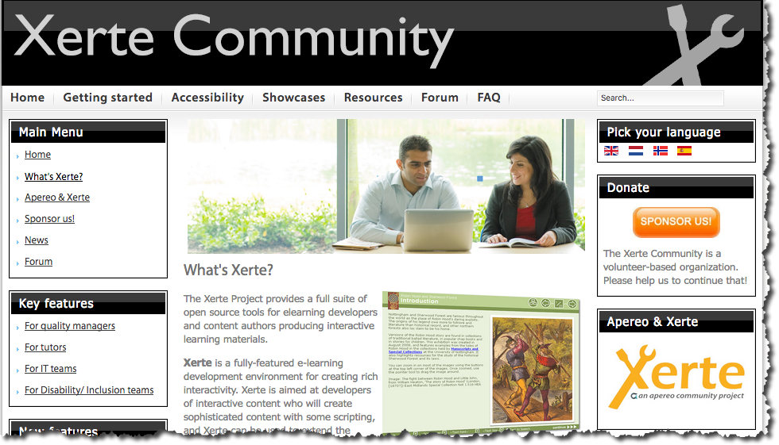
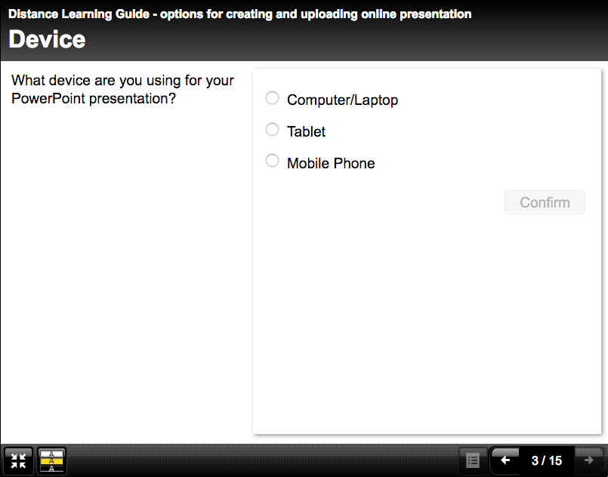
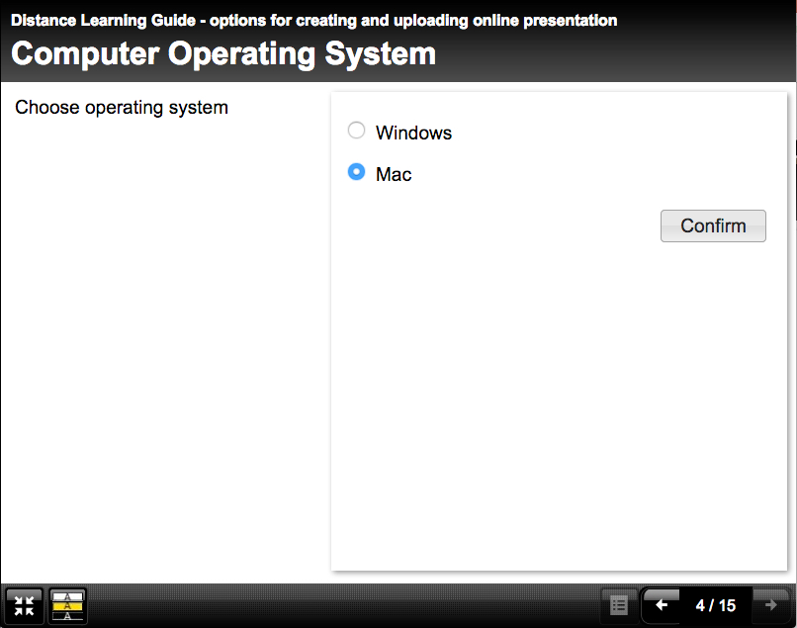
Short Term Solution
Implementation of a ‘help resource’
Utilisation of Xerte open source learning software to host ‘help’
‘Help resource’ for each current different PowerPoint operating system
Decision Tree flow to guide user to correct help resource

Slide 10
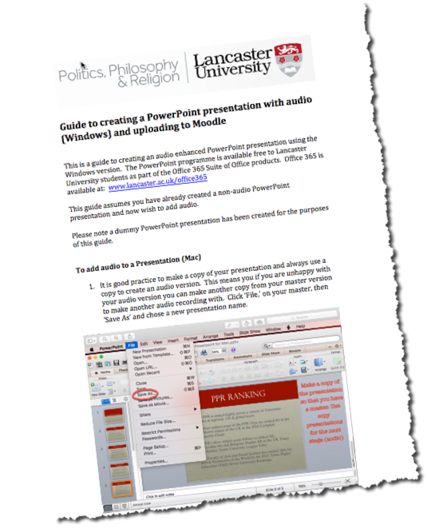
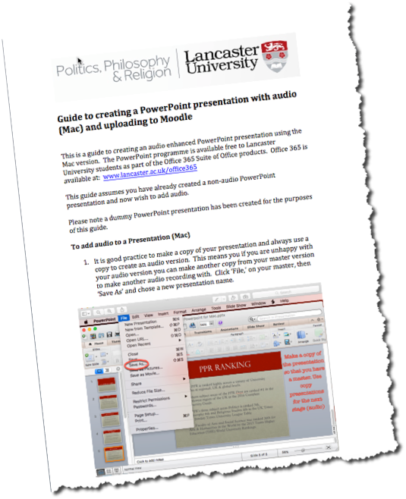
Short-term solution
In addition to the Xerte resource help, two additional & separate PDF Guides were produced
Accessible by DL students
Focused PowerPoint Versions for on Mac and Windows PC/laptop operating platforms

Slide 11
Longer term solution
Options for recording PowerPoint

Slide 12
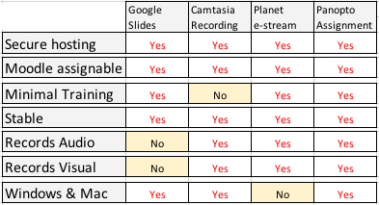
Options
Various options considered against a number of key criteria.
These included:
Cost, support issues, third party hosting & the ease of use, and whether the finished student recording can be assigned to the relevant Moodle group.
Other options were considered but discounted as they failed on hosting, security, and privacy issues.
All the above could be assigned to a specific Moodle group and kept confined to the students/lecturers in the group.
Ref Planet e-stream, there is some cut-down Mac functionality and requires use of the Chrome browser.

Slide 13
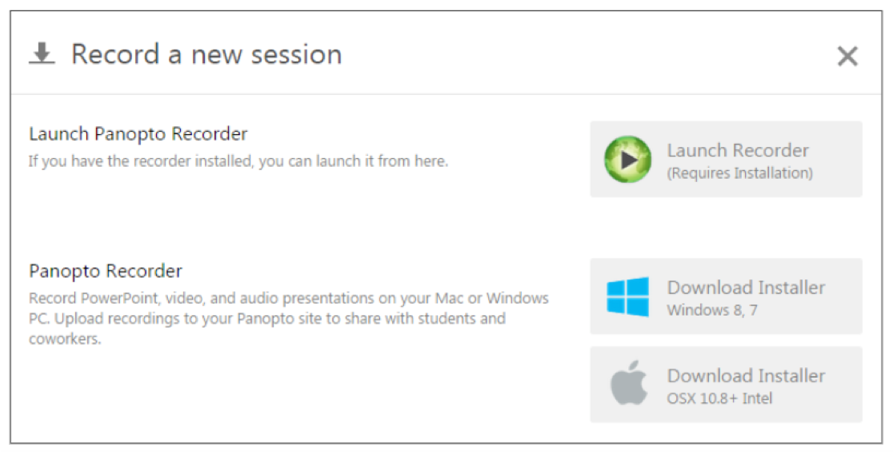
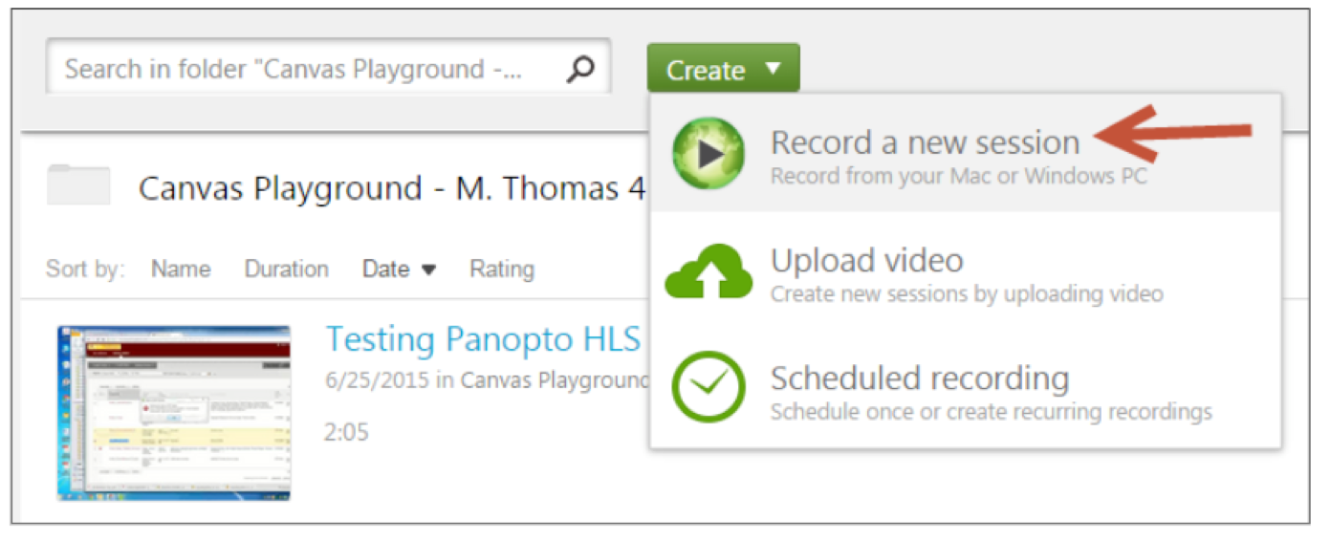
Panopto
Panopto allows students to create a ‘standard’ [non audio/visual] PowerPoint presentation.
Panopto functionality allows recording & uploading of a student PP presentation to Moodle.
Achieved by the creation of a student ‘assignment folder’ by the Administrator unique to each student on a specific course.
Recording rights are thereby granted to students participating in that specific Moodle module
Students would continue to use PowerPoint (PP) but by downloading an app would record and upload via Panopto using a simple interface.

Slide 14
Panopto Student Assignments: Usage in other universities

Slide 15
Panopto Student Assignment Benefits
Relatively simple for student to use
Relatively easy for administrator to set up student folder
Easy access for module lecturer/tutor to evaluate student presentation
Students can still use basic PowerPoint
No platform (or version) issues
Secure (Lancaster) hosting
Existing Panopto systems already used in Lancaster (expertise)
Student functionality already used in other universities (track record).

Slide 16
Testimonial
“We’ve also begun to allow students to use Panopto to film their own assignments and submit to a tutor via Panopto’s ‘drop box’ style functionality. This is definitely an increasing use case for the video platform and lots of academics are now asking for their students to be able to create recordings for assessment.”

Slide 17
Next Steps
Roll out the Basic Guide and the Xerte ‘decision tree’ help guide to the PPR Distance Learning Hub page
Trial the Panopto Student ‘upload facility’ to a PPR Distance learning MA module to assess.

