Slide 1
Not a very good day, feeling very low because nothing seems to be getting done

Slide 2
The clean-up
31-35

Slide 3
Feeling quite alone. Really don’t want to speak about the house but every conversation seems to get around to that. People must think me really boring

Slide 4
Not much has happened this week, we seem to be in limbo and waiting for telephone calls. I am sure that our project manager is sick and tired of me emailing him!

Slide 5
Where to live now?
36-42

Slide 6
Where to live now?
36-42

Slide 7
Meet the kitchen fitter again and get lots more done. Don’t feel like I’ve had a weekend but at least there is progress

Slide 8
The strip out
43-46

Slide 9
Still unable to contact loss adjuster. Not sure what is going on. No work done in the house – feel so despondent and useless

Slide 10
Went as usual to see my sister and her family. They have been doing my washing since the floods. Am really happy that since the floods I have got back into a regular routine of seeing my family

Slide 11
Insurers
47-52

Slide 12
Builders
53-62

Slide 13
My son has been asked if he wants to join Cubs and his rugby training starts up again so once again I have been promoted to taxi driver, not that I mind as it gets me out of the house

Slide 14
Feeling a bit low and depressed. I think it is something to do with the weather. All the rain we are having lately, it just makes you worry in case it settles, as the ground is so very waterlogged

Slide 15
Didn’t do much today except get excited that my new cooker will be delivered next weekend

Slide 16
Builders
53-62

Slide 17
Every time I go past our old house I just feel so gutted that all this has happened. That was going to be our family home and now it makes you sick when you see all the mould and debris climbing the walls

Slide 18
Insurers
47-52

Slide 19
Not happy at all as a referee has robbed Arsenal of being in the semi finals. Decide that I should sulk for at least 2 days

Slide 20
Went this morning to pick a new carpet for the small bedroom. Came back, had some dinner then started to take the paper off ready for painting

Slide 21
Utilities companies and other agencies
63-69

Slide 22
We have started to pick our colour schemes. The only problem is everyone’s house that has been flooded has got the same colour scheme browns and creams! Either we all have good taste or bad taste!

Slide 23
Choosing new things
70-73

Slide 24
Not much longer to go now, people have told me not to keep dwelling on moving back as I might be disappointed as I have built it up so much but I think they are wrong!

Slide 25
Wardrobe arrived. What a job to fit it together. It took three of us 6 ½ hours to get it right. Looks great now thanks to my son and my husband

Slide 26
Moving back home
80-87

Slide 27
Read with interest on Teletext service that last year’s floods was not related to climate change but was a one off event. We’ll soon see, summer’s not far off

Slide 28
The day. Wembley is awe inspiring. So many Hull fans – it is like the whole city is here. We win 1 – 0! Promotion after 104 years – A dream come true. Travel back – celebrate into early hours

Slide 29
The weather
74-78

Slide 30
The End?
88-93

Slide 31
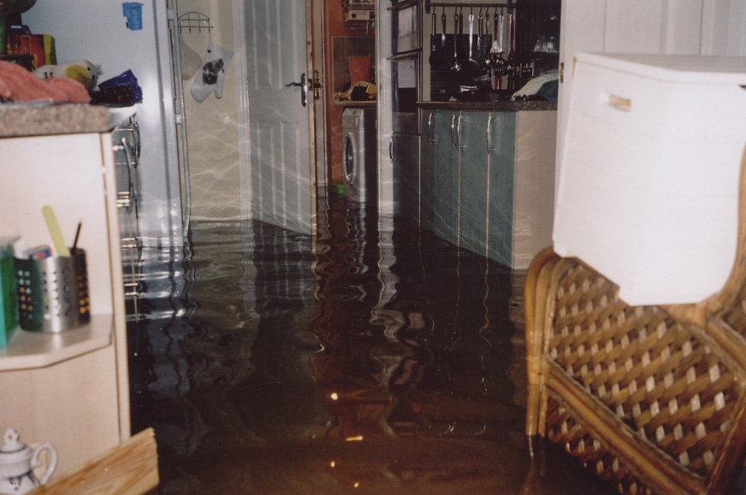
In the morning I was sat in the hall with everything done and paper on my walls and cosy and comfy. And then by the tea-time my home had gone. I couldn’t believe that your home can just go like that in a matter of an hour. It’s so distressing to think everything you’ve worked for has just gone straight out your back door
Go back 2 spaces

Slide 32
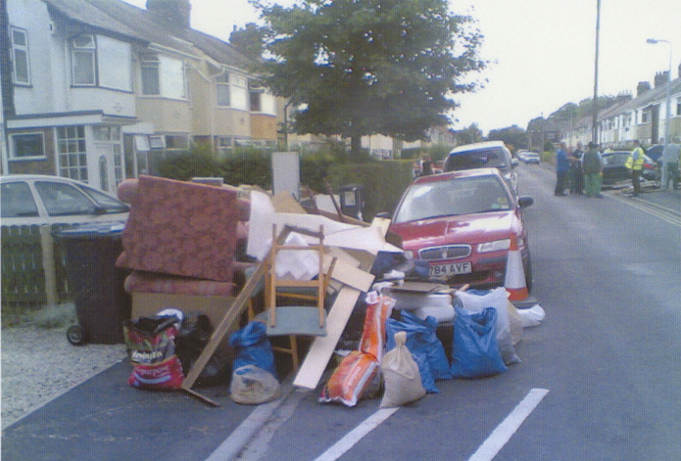
A big white van came and six or seven guys jumped out wearing these white suits, which had hoods and masks and everything. And they start throwing all your worldly goods out on the drive. Then this huge wagon comes and they crush all your possessions. I was trying to save stuff and they kept saying, ‘No, no, contaminated, you can’t have that’. And bringing it back out
Go back 2 spaces

Slide 33
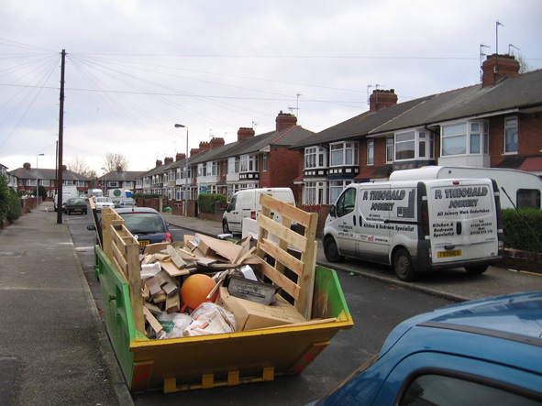
The biggest thing is when you see all your work going in a skip – you can’t describe it. This was the dream, our family house, and it’s gone. And it broke our hearts. I can’t bear to go back and look at the house
Go back 2 spaces

Slide 34
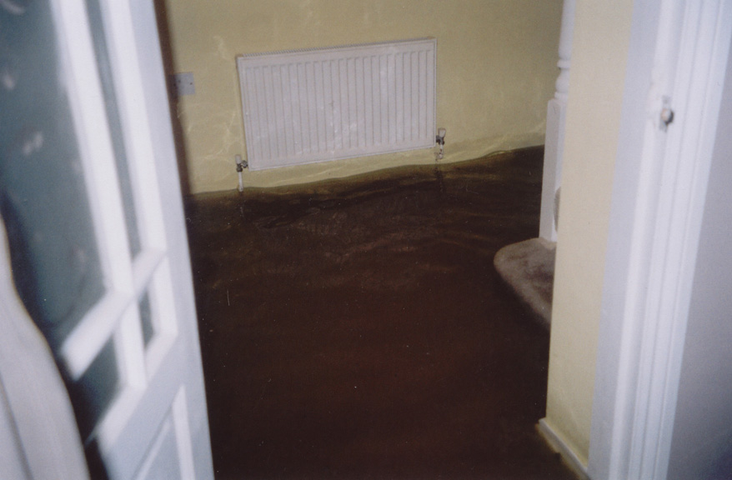
When the water drained away I came downstairs and tried to take in what had happened. Then I started to cry. The smell was awful. It stank. I pulled myself together and started to clean what was left of my home. The cleaning took all week, carpets thrown out, all floor coverings gone, plus skirting boards, sofa damaged
Go back 2 spaces

Slide 35
Hull City Council organised for some prisoners to come down and clear everybody’s front gardens. They were brilliant. They cleared everything off our front gardens for us and all the white goods were taken away separately. These prisoners were really helpful
Go forward 2 spaces

Slide 36
My son was at my brother’s, which was so traumatic. He just cried, he didn’t sleep all night - “I want my mum, I want my mum”. But I daren’t leave the house because of the looters - people were thieving. I had to protect my property
Go back 2 spaces

Slide 37
When we went in the hotel my husband was on shifts so he had to get up at five in the morning. We were all in one room and we had both the girls there. We had no facilities to make any packed lunch and he couldn’t go down and have breakfast because it was too early. When we moved in my husband just sat with his head in his hands saying ‘how can we cope?’
Go back 3 spaces

Slide 38
At the moment I am very happy and my flooded house is not very important. Work is busy, football is great and I’m happy in this rented house. If the insurers are not pressing and are prepared to keep paying my rent – I’m not complaining. Funny how the floods are in the distant past now and how I have adapted to a new life
Go forward 4 spaces

Slide 39
I have a feeling of despair in the flat. In any other circumstances I would have enjoyed living in the old town – close to the town centre, museums and pubs, but I want my house!! The builders have still not started and I doubt they will before Christmas now. It makes me feel sick when I think of it – and sometimes I feel really alone, even though I know I have loads of friends and family to turn to
Go back 2 spaces

Slide 40
They said we could find our own rented house if we wanted so we just drove round one Sunday and found this, which had only just come on the market. It didn’t have a board up or anything, so we were really lucky that we got this because our house is only two minutes away
Go forward 4 spaces

Slide 41
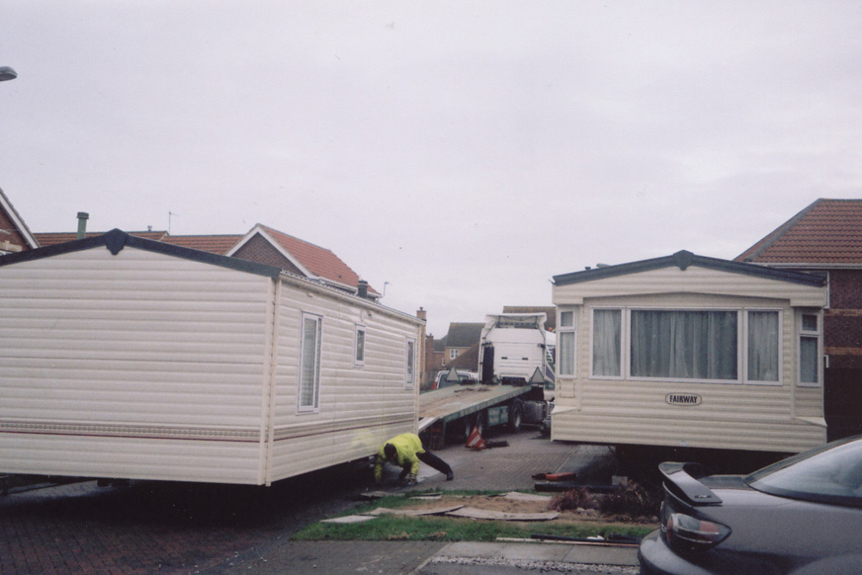
In a way I am lucky because a few of my neighbours got caravans. I didn’t fancy that because I wouldn’t want to be stuck in a caravan on the front garden in the middle of winter
Go forward 2 spaces

Slide 42
The way we were treated by estate agents was awful. Rental prices rocketed and there was one day where, twice within one hour, viewings that I had booked for had already been let. It was the overall feeling of frustration and impotence because people were treating me like a non-person. That’s how it made me feel, like it doesn’t matter
Go back 2 spaces

Slide 43
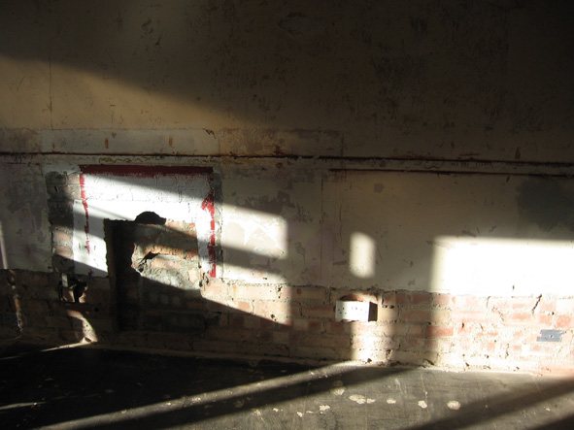
The house seemed worse after they came in and gutted it. It didn’t seem so bad when it was flooded. I know it had to be done. That was the heartbreaking part of it. When they walked down the drive with crowbars in their hands I thought, ‘they aren’t going to be nice about this’
Go back 3 spaces

Slide 44
Good news. House is now back in ‘pre-flooding condition’. Have arranged for them to remove dryers and leave us the certificate of drying at the house. Progress at last. Phoned builder to let him know he can start work whenever he’s ready
Go forward 5 spaces

Slide 45
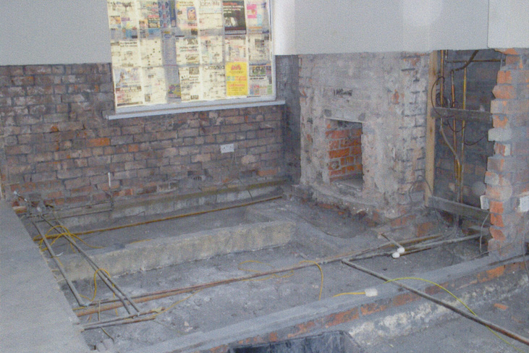
We had to pull the wallpaper off the walls because it was changing colour. Now we were left with no floor covering and bare walls. We was given cleaning materials to disinfect the house but what baffles me is why they left the kitchen units, even though they were underwater, because we had to throw our other things away
Go back 3 spaces

Slide 46
The neighbours have been great and I think we’ve all helped each other along. So if you are having a bad day, you go and tell them and you know you are not the only one there. You actually go through exactly the same as other people are
Go forward 2 spaces

Slide 47
We met the loss adjuster, she was a nice lady. I made a conscious effort to get on with her because by this point I’d heard all the stories, ‘oh the loss adjuster won’t let us do this and won’t pay for that’. I’ve had none of that, she’s a smashing lady and they’ve been understanding
Go forward 5 spaces

Slide 48
The incompetence of the loss adjusters is soul destroying. Every loss adjuster, you’ve got to start at the beginning again and they’ve lost the file and they’ve lost the papers. So every time you copy everything and take it again. They must have so many papers from me, it’s unbelievable
Go back 5 spaces

Slide 49
Without exception, the people who have come to help us, including the insurance company, have all been extremely nice. Often quite humorous with it and that was just fine as far as we were concerned. We’ve found that helpful
Go forward 4 spaces

Slide 50
I couldn’t sleep because I was worrying all the time about my home: What was going to happen? Where I was going to get the money from to replace it all? Because I wasn’t insured – I couldn’t afford insurance being on income support. So I thought, ‘what am I going to do’?
Go back 3 spaces

Slide 51
Left another message with the loss adjustor – no response. If he would just call me back – it’s so frustrating. This seems to be taking up my whole life – God, what did I do before the flood?
Go back 1 space

Slide 52
The contents people have been wonderful, they ring us to see how we are and they’ve said, “Do you need any money putting in the bank? Are you OK for cash? Is there anything you need?” And they’ve been absolutely brilliant – when we’ve asked for something we’ve had it within a week
Go forward 4 spaces

Slide 53
Spoke with a resident today who is with the same insurance company as we are. He will not be back in his house until at least April. They decided to use the insurance company’s builder who has not started the work yet. I am glad we decided to get our own builder or we might not have been back in our house yet
Go forward 3 spaces

Slide 54
Lovely – central heating restored, could have kissed plumber, he really worked hard. Went in house after tea, had bath, did nails and pottered about, bliss! To be warm again. Project manager called in and I thanked him for getting heat on. Slept really well, warm and cosy
Go forward 2 spaces

Slide 55
The windows and door man finally came to fix the door and blamed the carpet fitter. Why I don’t know but he was very nice and managed to seal the space between the carpet and door. Also he changed the lock as I have 4 times asked the builders for the key to be returned. Feel a lot happier now
Go forward 3 spaces

Slide 56
Get a plastering quote today from one of the sub-contractors I know from work. I’m not sure what position I would be in if I didn’t do the job I do and have the contacts in the area
Go forward 2 spaces

Slide 57
Very bad week. Depressed most of the time. Painters finished painting kitchen and garage. Poor workmanship. Cracks not filled in prior to painting. Garage door white instead of burgundy. Said I am nit-picking. Builders say they have finished but they have not returned our front door key after numerous requests for its return. Now afraid that we will be burgled as furniture is due to arrive shortly. Hope that I can overcome this feeling of despair. The house doesn’t seem our home anymore
Go back 4 spaces

Slide 58
Haven’t heard when builders are going to start on our house. I sometimes think we spend half our lives lately waiting for other people to make decisions about our lives. It takes control out of our hands and I struggle with that. It’s all about waiting
Go back 1 space

Slide 59
What a transformation at my house! New floorboards installed. Walls all plastered, stairway wallpaper taken off. New electrical sockets in kitchen and pipes for a new combi boiler. Afterwards go to B&Q – collect lots of brochures so we can select tiles
Go forward 3 spaces

Slide 60
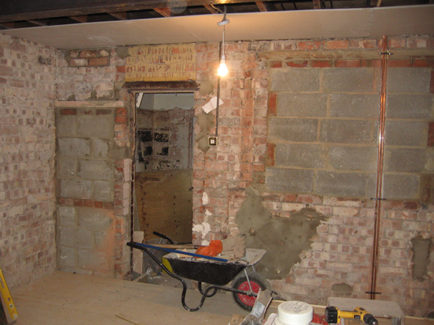
When it’s in the middle of a job it can be quite frightening to see what’s happened to your house. It was where you felt secure, it was your special space that you could shut the door and remove yourself from everything. And at the moment it’s been invaded by people that you wouldn’t normally have there
Go back 3 spaces

Slide 61
Absolutely gutted. Builders have really excelled themselves big time. Work was due to start on the new kitchen so the last few days I’ve been clearing the cupboards and moving things for them. I waited till 11o’clock but no sign of anyone, so I rang and was told that the work has been cancelled. No apology – why did they not notify me 2 days before then I could have saved myself the trouble of clearing the kitchen? I think that they have treated me very badly. I am so sick of them letting me down time and time again
Go back 5 spaces

Slide 62
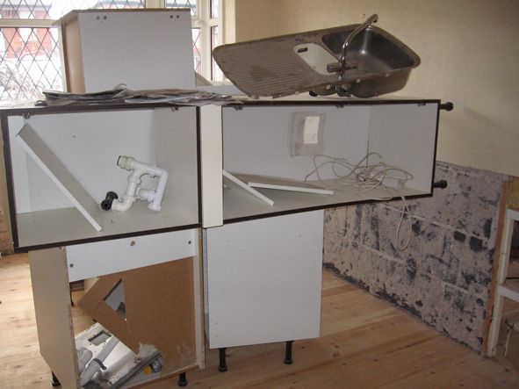
Before the flooding, the house was our home. We loved it, we felt secure there, that’s where we relaxed. And people have come in and they’ve not really bothered. Now the kitchen has to be ripped out, all the walls have to come off and all the floor has to come up again because the builders have done it wrong
Go back 5 spaces

Slide 63
What is annoying is that we have to pay 2 lots of bills for everything which is putting a real strain on us financially. We have got to pay the gas, electric and the water bills for the rented property and for our own. The insurance company have stated that this will form part of the claim but how long will we have to wait for it?
Go back 2 spaces

Slide 64
The gas company won’t let us drop the payments to anything less than £50 a month when we are not even living in the property. So we are paying for that as well as the property we are using. When we get back to our home we are going to change suppliers. They’ve not been sympathetic
Go back 2 spaces

Slide 65
It suddenly occurs to me - since the floods I never cancelled my direct debit maintenance contract for my central heating. This has meant I have paid £653.11 for something that had been condemned. Gas company tells me it was my responsibility to cancel the direct debit so they cannot refund me. Am annoyed as I did tell them about the flood but they never advised me
Go back 2 spaces

Slide 66
Got yet another letter from gas company (who are really stressing me out). They keep sending me a bill of £250.15 because of a mistake they made on our meter readings. Keep getting letters from debt collection service saying they’re planning on taking court action. We just don’t need this at the minute!!
Go back 1 space

Slide 67
My wife is at work today and I have to stay in to wait for the table to come. They said it will be anywhere between 8am and 6pm. Well now it’s 7.30pm and – guess what? – the table never arrived! I am very angry – they have had £800 of my cash for weeks now, it’s blowing my mind
Go back 3 spaces

Slide 68
Nice man rang and said he will deliver washer at 7am Thursday morning. Hallelujah! No more launderette. I asked him if it was a problem to lift washer over the wall only 16 inches high? ‘Not at all,’ he said, ‘I’ll put extra sugar on my porridge!’, bless him
Go forward 3 spaces

Slide 69
Woman from flood team visited us this week. Asked if there was any help that we needed. Said she might be able to help us out financially by applying for some grant. Also said she could help us get hold of some second-hand furniture because all our clothes are still in boxes
Go forward 3 spaces

Slide 70
Went to husband’s friends this morning. Feel really mad over friend’s comments! ‘At least your house will be done up and you won’t have to pay for it. I wish we could have that. I’ll swap you!’ I felt so mad I wanted to scream at her ‘you don’t know what it’s like having your home destroyed by something you can’t control. You try and upset your family environment on purpose and see how it feels’. I bit my tongue and quietly asked my husband if we could leave
Go back 2 spaces

Slide 71
They give you this choice, which isn’t really your choice – it’s a choice of their choices. I went out and sourced some doors that I liked and he said, ‘Oh we don’t deal with them’
Go back 2 spaces

Slide 72
At least I’m able to go out and buy things – that’s not really a hardship – that’s quite nice. Obviously I’d much rather not have been flooded and not have had to go through all this but, in a way, it’s kind of balancing – once I’ve moved back in, it will have helped, if that makes sense?
Go forward 3 spaces

Slide 73
Still feels a bit strange with everything new indoors, guess it will take time to feel settled again. When we get our photos and pictures back up we’ll feel more like home. We can buy new furniture but peace of mind is going to take a lot longer
Go forward 1 space

Slide 74
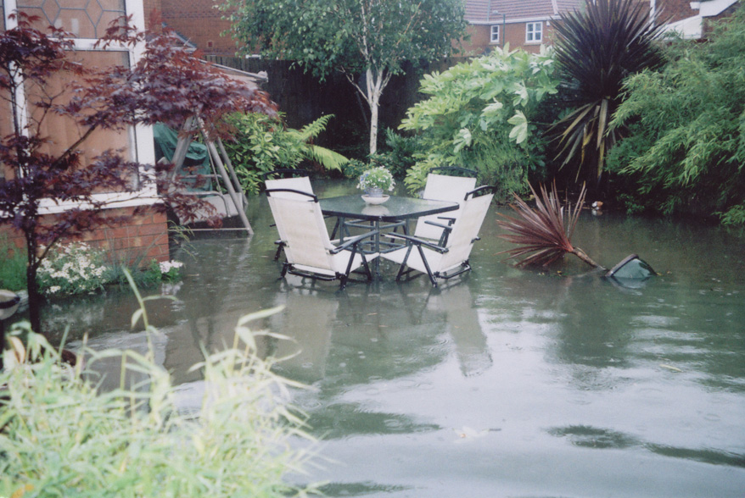
It’s pouring down with rain again – we are on a flood warning. It’s difficult to concentrate on anything other than the rain and the garden is flooded – is it going to be the house next?
Go back 2 spaces

Slide 75
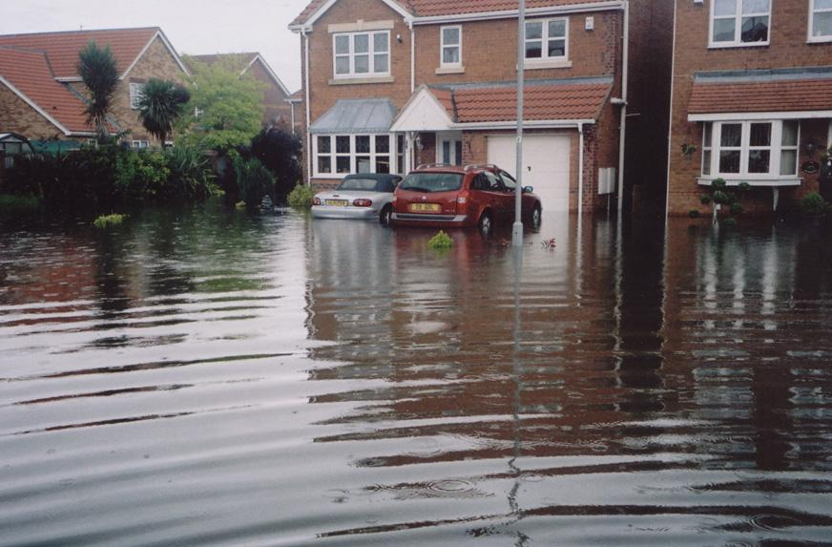
It’s raining heavy and it’s worry time. I’ve had to sweep the water onto the road. I’ve checked the drains and they look as though they are working.
Watched with heart in mouth at the news. Tewksbury and Gloucester, as it starts to flood – please not again…
Go back 1 space

Slide 76
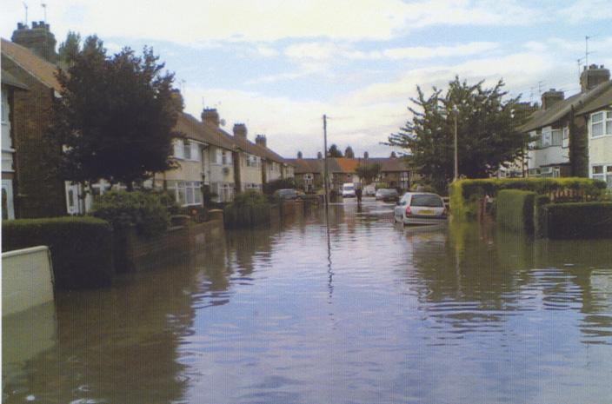
Yesterday it rained quite bad. The drain at the front is blocked and that was starting to fill. If it happened again I think I’d just walk away – I’d set fire to the house, walk away and just never come back I think. I couldn’t do it again
Go back 3 spaces

Slide 77
If you lived in fear of it happening all the time you’d drive yourself insane. You’ve got to let that go. You’ve got to try and be a bit positive – it might be a bit ignorant, but I’d rather deal with it my way
Go forward 1 space

Slide 78
We had some heavy downpours of rain this week but it looks like the drains are coping well, which is a good thing
Go forward 1 space

Slide 79
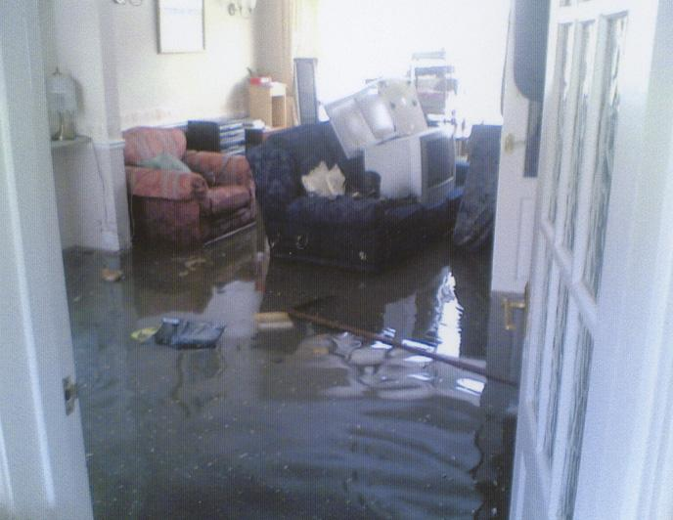
First week of December my home was back together and I was back living in it with my beautiful family. After six months we were settled back in our routine, stories after school, drawing on the easel and back to our lovely family unit. Three weeks ago we had the dreaded flood alerts once again across Yorkshire. Oh my word, I felt so sick! Parked our cars in a high area and put an emergency bag together. When I came home I had a look under my floors – nightmare, around 4 inches of water under my house!! Oh my God here we go again!
Go back to square 1

Slide 80
We have started to notice small cracks appearing in the plaster work so have started to make a list as the builder stated that we have 4 months to notice these things and they will come back and sort them out
Go back 2 squares

Slide 81
Today I went to see some people regarding me getting insurance. After we discussed all the possibilities they told me that if I waited one or two years then apply again I might be able to get contents cover. I was so annoyed because I am being penalised for something that was not my fault
Go back 4 squares

Slide 82
Everything seems to be so much better now that we are home. Me and my husband are our normal selves again and not arguing and my son is able to play outside with all his friends
Go forward 3 squares

Slide 83
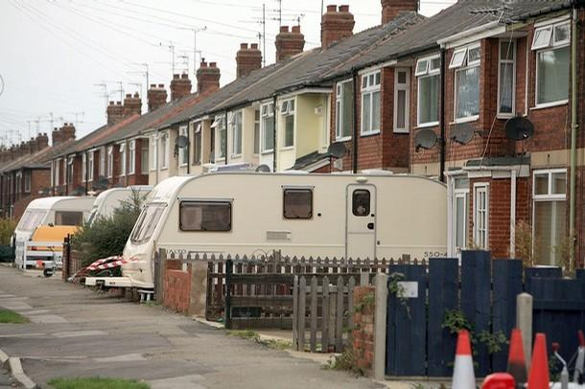
Hip, Hip Hooray! Caravan moving off drive today. It’s been a constant reminder of all the stress and heartache of the last year. Please God I can move on now. I wave it off with a sigh of relief. Garden and drive seem bare now. Lot lighter in kitchen too. Take dog for a long walk
Go forward 3 squares

Slide 84
Friday came and the move went really well, the removal company was really good and my mum and dad came to lend a hand to help unpack
Go forward 2 squares

Slide 85
I still don’t feel that the house we have ended up with is ours, I still feel detached from it, as though it’s not ours. This is a feeling that I’ve had from the beginning
Go back 2 squares

Slide 86
It really felt great to be in our own house after 8 months of living in that dirty rented one. On Sunday night it felt great just doing normal things like getting the girls’ clothes ready for school and putting them where I would normally put them.
I feel like me again, and I haven’t felt like this for a long time. Even though there is still a lot to do – we are finally where we all belong
Go forward 3 squares

Slide 87
Had a problem in the kitchen this week from a pipe in the cupboard. This feels like the final straw after so many tiny things have started to happen or not been finished off.
The shower still un-repaired.
The gas hob leaking gas.
The alarm still not fitted.
Leak in kitchen, ruined door.
We have to get quotes now to have everything finished off
Go back 4 squares

Slide 88
But is it really over? Some diary entries from the anniversary…
It’s coming up to the anniversary of the floods and, guess what, it’s raining. My son starts to panic about being flooded again but after some reassurance he seems to have calmed down. I can’t believe that it has been a year already and that a lot of people are still out of their homes. We may not be finished but we have to be glad that we are in our own home again and things aren’t as bad as they are for other people.

Slide 89
But is it really over? Some diary entries from the anniversary…
People might be back in their homes but have they completely recovered? I still sit and watch the rain out the window if I’m at work. I don’t think there’s anyone that’s going to get over that for quite a while. It’s the psychological and the emotional side that’s going to take many, many years to recover from I think. My life isn’t normal from what it was

Slide 90
But is it really over? Some diary entries from the anniversary…
It was good to be away on the anniversary of the floods – if I had been at home I think I would have been dwelling on last year. I know for others it will have been a horrible day – especially for those still not back in their properties or those just having to move out. This has affected everyone in the city in some way – even a year on

Slide 91
But is it really over? Some diary entries from the anniversary…
This is the week – ONE year on since the flood. It feels like yesterday – still very fresh in my mind and scary too. Looking back seems like a nightmare – I’m a totally changed person – lost a lot of confidence, health and fight – my tolerance level is zero. I’m short tempered – and the least little thing can tip me over the edge into despair

Slide 92
But is it really over? Some diary entries from the anniversary…
I have mixed feelings about today one year on. This has been a very difficult year and has tested us as a couple and individuals. We as a family have had some very low points and they will stay with us forever. I think overall it has made me a stronger person and I am now looking at life very differently. You never know what can happen that you have no control of whatsoever

Slide 93
But is it really over? Some diary entries from the anniversary…
Went to see Hull City at Wembley. Was good to get out of Hull. I’m not sure if it’s because it’s coming up to the anniversary of the floods but I keep thinking about what I was doing this time last year and how my life would be different if all of this hadn’t happened. There was loads of celebrations in the city centre to welcome the team back – after the horrible year a lot of people have had it was good to have something positive to celebrate

