Slide 1
The participation of adults with learning disabilities in photographic research
Dr Jo Aldridge
Loughborough University

Slide 2
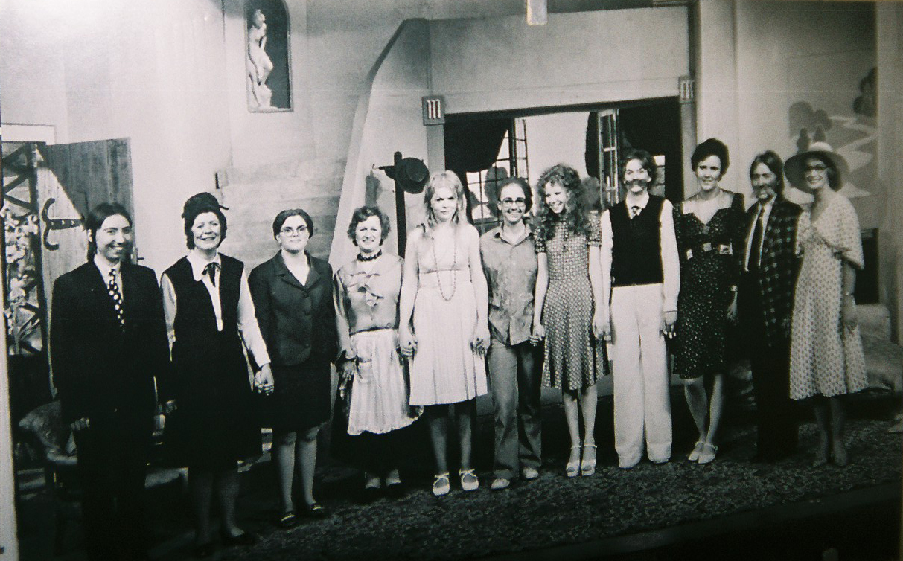

Slide 3
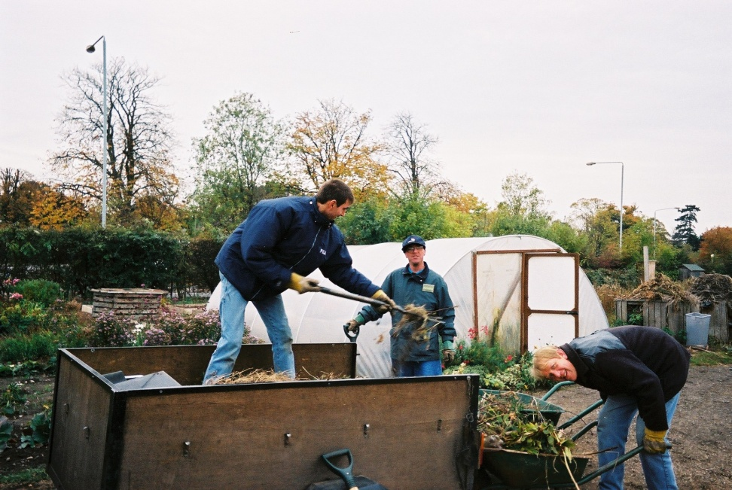
Promoting participation
Ensure socially excluded, ‘hard to reach’ participants are included in research investigations
Genuine dialogue between researchers, participants, policy makers, practitioners
Research with people with learning disabilities should not rely on verbal exchange

Slide 4
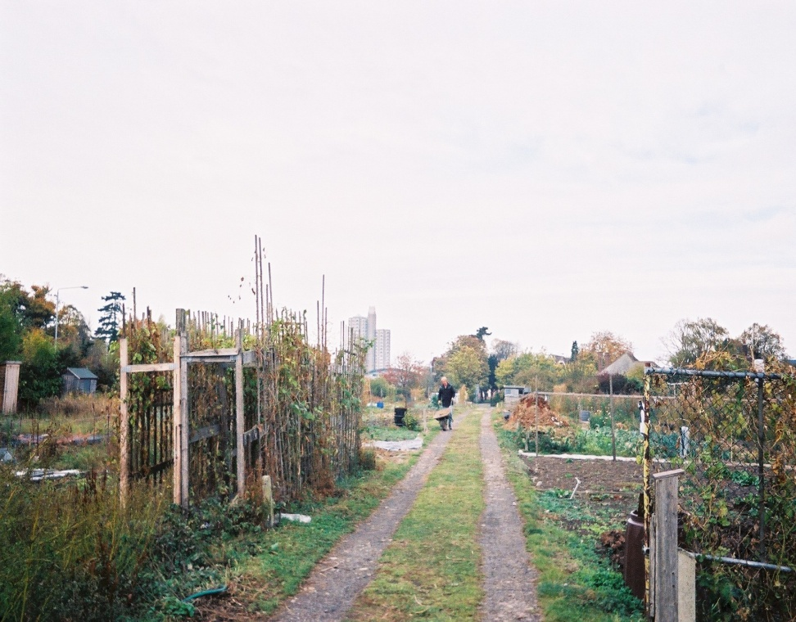
Participation in STH research
Research into the benefits of social and therapeutic horticulture for people with learning disabilities and other vulnerable groups
Aims were to promote wider understanding of learning disability and therapeutic role of STH projects and to help transform perceptions of learning disability

Slide 5
Advantages of photographic participatory techniques
Provide insight into unseen or ‘hard to reach’ locations
Help to ‘bridge the gaps’ between researcher and researched
Help to challenge fixed perceptions and stereotypical representations of disability
Provides ‘a direct entry into respondents’ point of view’

Slide 6
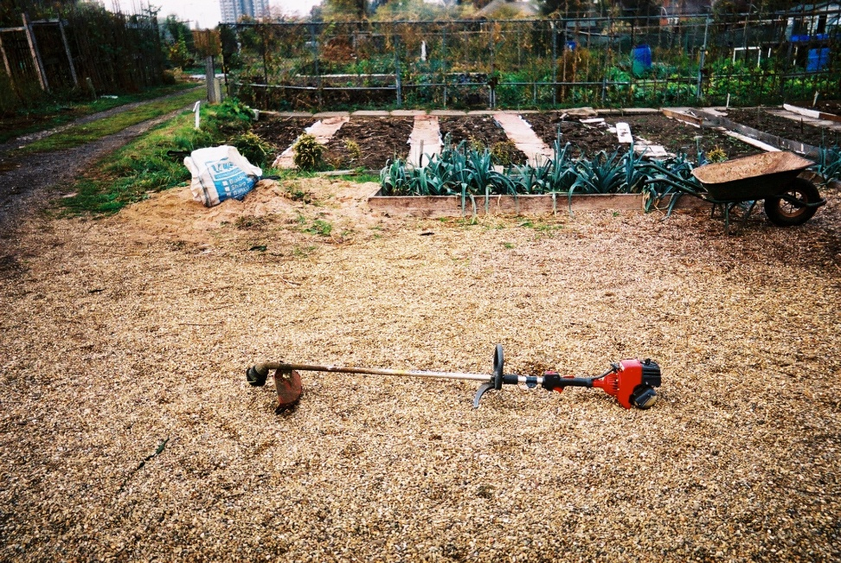
Analysis of visual data
Content and thematic analysis
Elicitation phase – ‘favourite’ images
In STH, social activity valued as well as activities; particular focus on tools and structures

Slide 7
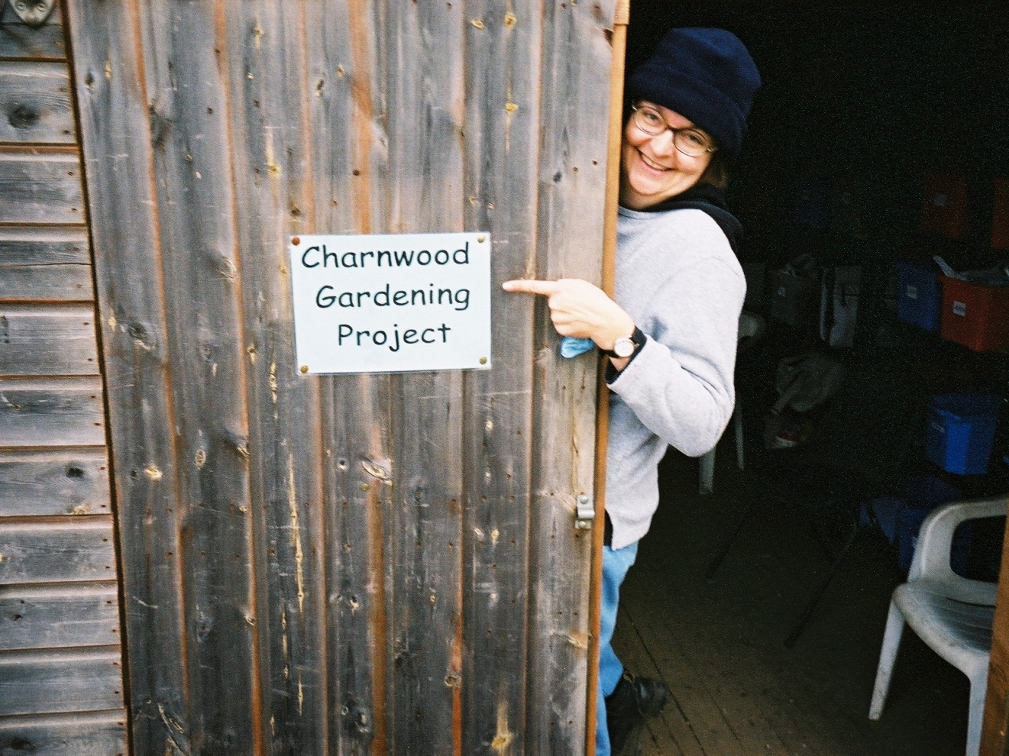
‘That’s my friend, Diane’ (Ted)
‘

Slide 8
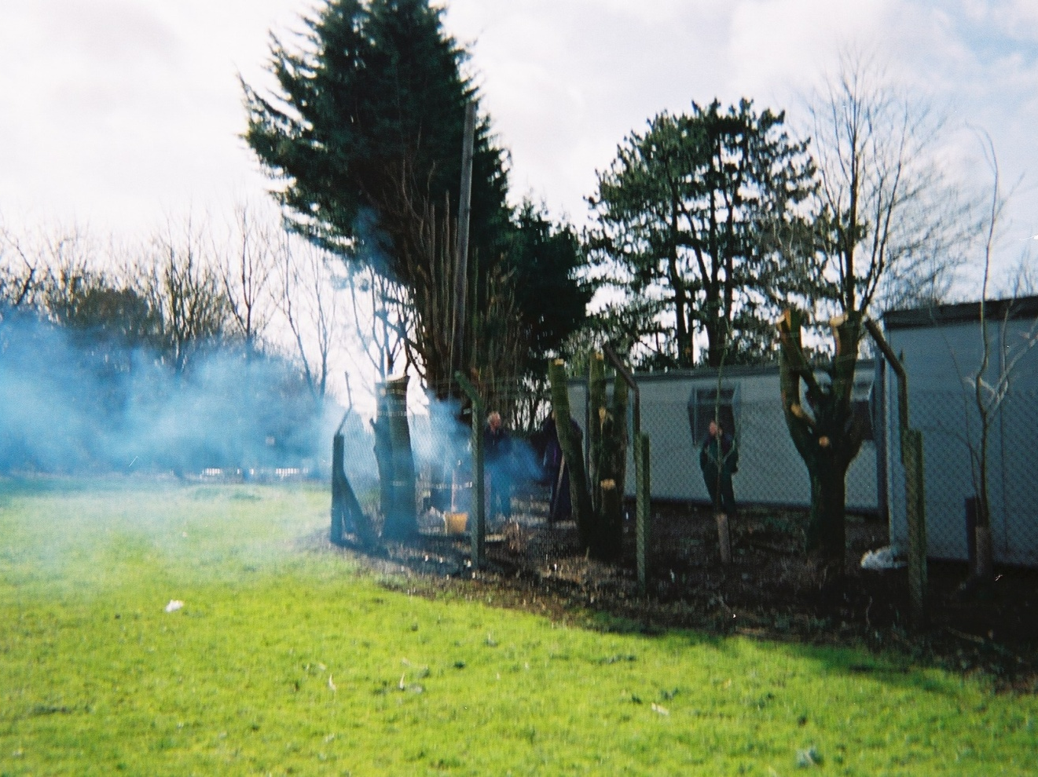
‘We had a fire, I like having fires’ (Carl)

Slide 9
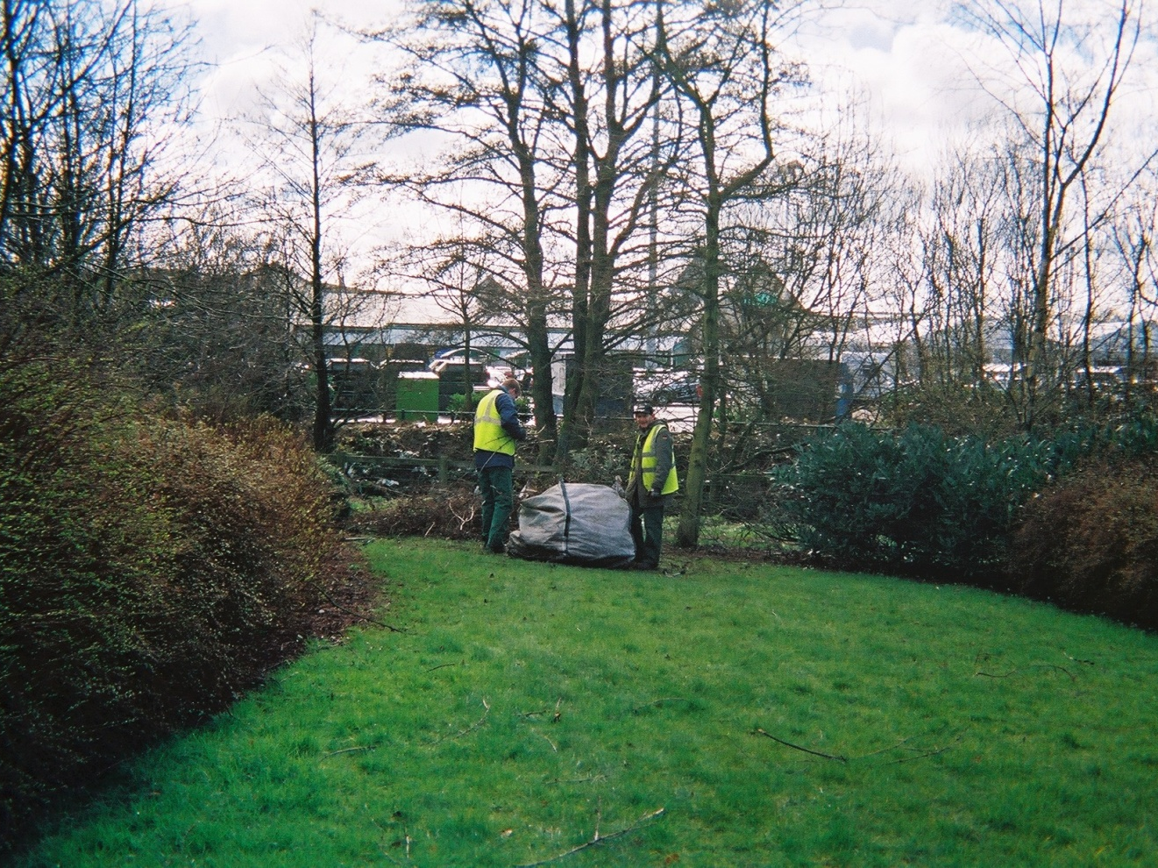
‘That’s on contract work, I like contract work’ (Ted)

Slide 10
Photo participation - challenges
Ethical considerations:
Photography’s loss of privacy
Intrusion, exploitation
Confidentiality and consent procedures – more challenging when respondents do not understand these concepts

Slide 11
Addressing these issues
Use of advocates for safeguarding and support
Ensure participants ‘own’ the visual data
Consent from respondents and advocates – ascertain legal responsibility; consent from all photographic subjects
Follow recognised ethical guidelines and procedures
Ensure participants are willing and happy to participate and engage in research processes
Outputs must be about participants as well as for them

Slide 12
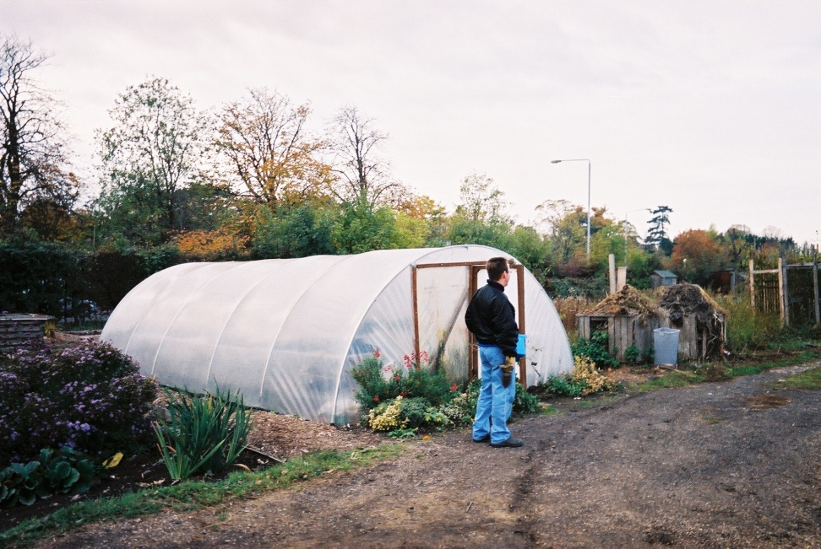
Success of the method
People with learning difficulties can demonstrate their skills (as photographers)
Mixed approaches (participation, elicitation) can overcome interpretative challenges
Participants enjoyed the process and visual approaches adopted by project workers

Slide 13
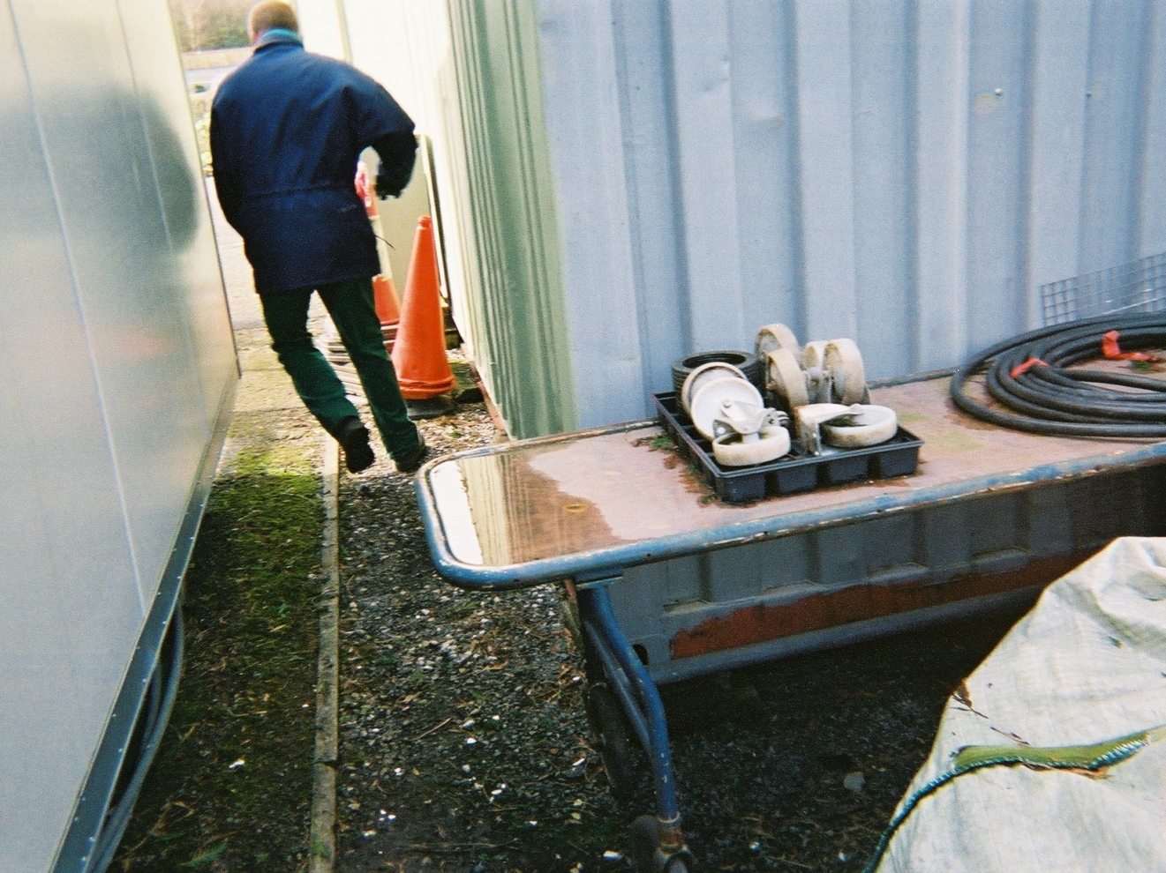
‘I took this of my friend David because he doesn’t like having his photograph taken and I caught him between the Portakabins’ (Colin)

Slide 14
Sempik, Aldridge and Becker (2005) Health, Well-Being and Social Inclusion: Therapeutic Horticulture in the UK, The Policy Press.

