Slide 1

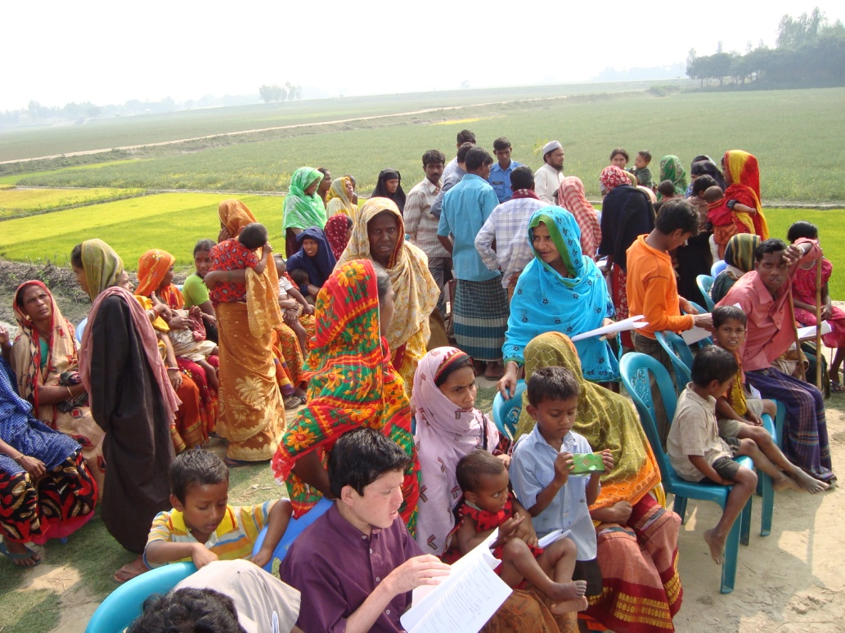
Using Key Informants to identify children with disabilities in Bangladesh and Pakistan
Sue Mackey & GVS Murthy

Slide 2
Original Research Question:
Are KIs an effective and sustainable method to identify children and adolescents (0-18 yrs) with specific disabilities to help in planning services for children with disabilities in developing countries?

Slide 3
Objectives:
Adapt KIM for a range of childhood conditions (visual, hearing, physical & epilepsy)
Evaluate the effectiveness of using KIs to identify these children in Bangladesh & Pakistan
Estimate prevalence and causes of specific conditions for district planning
Develop service and rehabilitation referral networks appropriate to the setting

Slide 4
What is key informant method?
An approach to identify disabled children by using trained volunteers from the community
Suitable for those ‘difficult to reach children:- multiple disabilities, girls, pre-school (0-5 years), rural, poor & illiterate families
Community based & participatory through training & discussion with key informants (KIs)
KIs spread messages through their daily activities and then list any children identified with target impairment

Slide 5
Local council Chairman
Imam
Local council Member
Teacher
Health worker
Government Officer & employees
NGO worker

Slide 6
Need for a method that is:
Inexpensive
Quick
Effective
Sustainable
Applicable in developing countries
Enhances the awareness, skills and knowledge of the community members

Slide 7
Methods
Key Informants from the community to be identified and trained
Children identified by KIs will be examined by a group of specialists to:
  confirm diagnosis
  identify cause
  refer for appropriate services

Slide 8
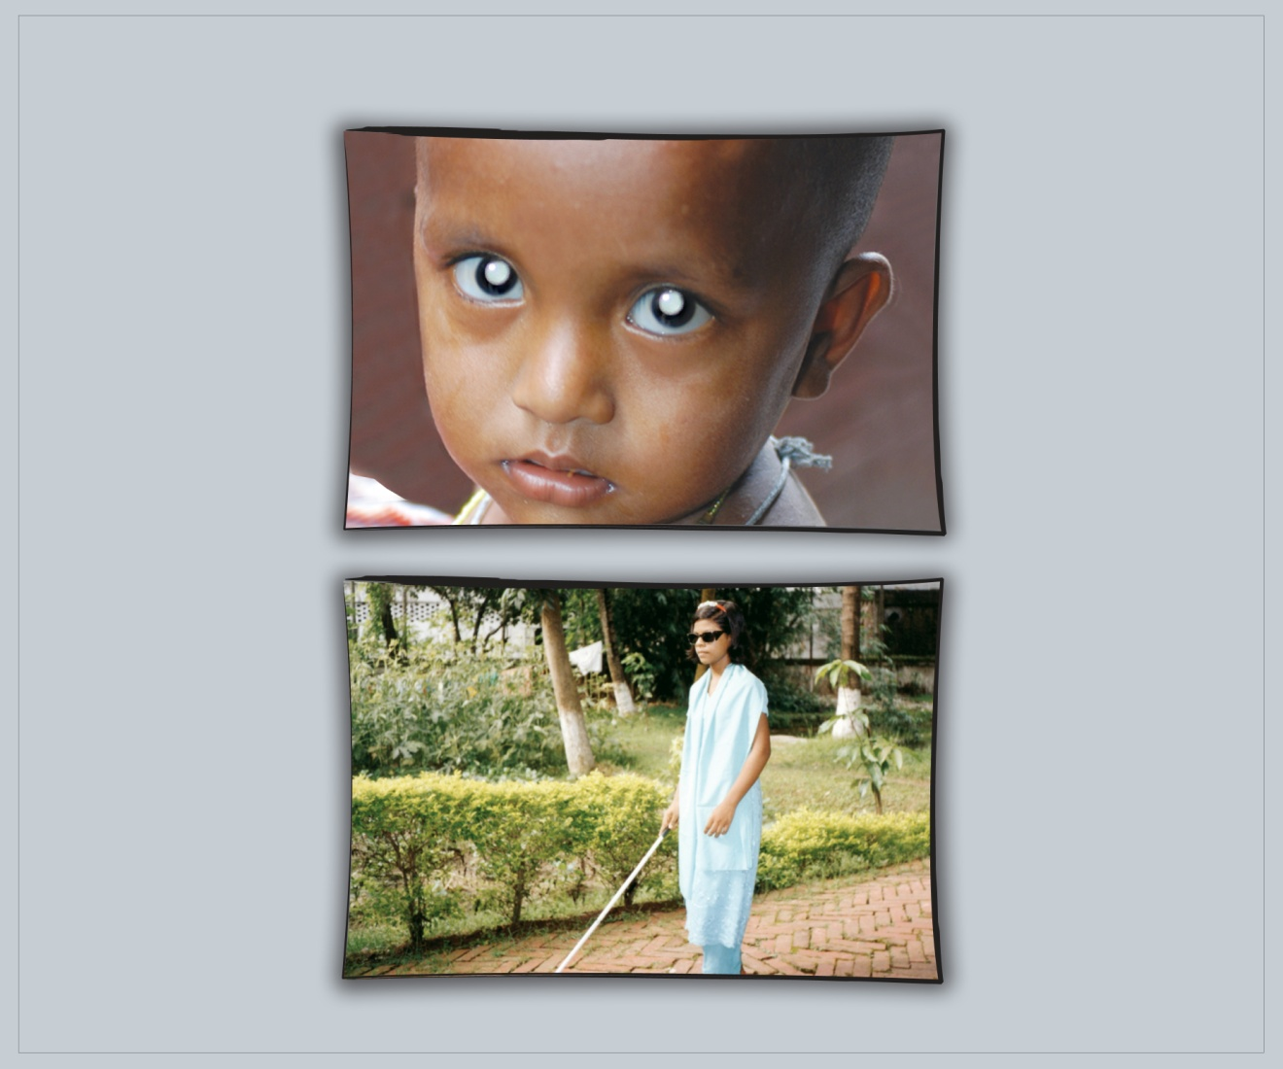
Training Materials
Flip chart - visual impairment page

Slide 9
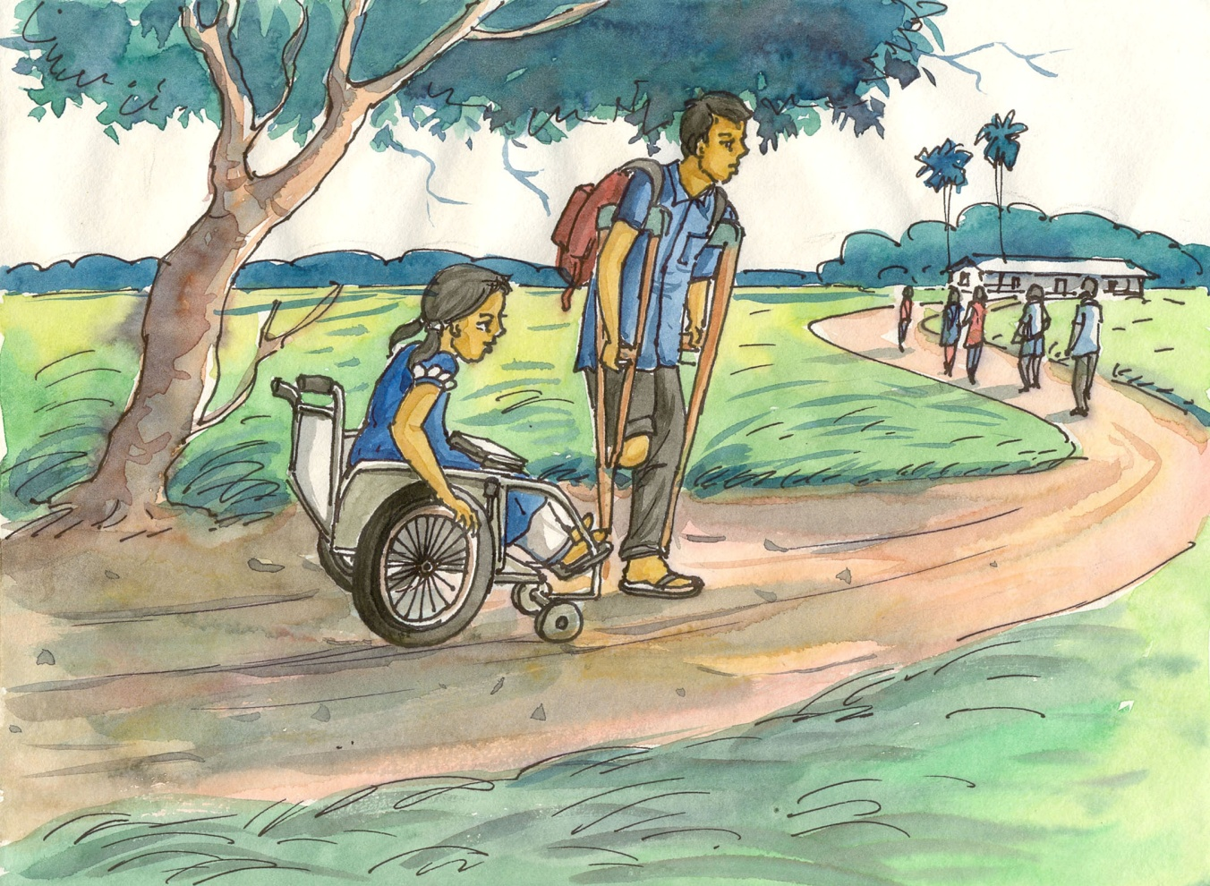
Physical impairment – many types
Handouts also made for all groups - one side of text with illustrations on reverse

Slide 10
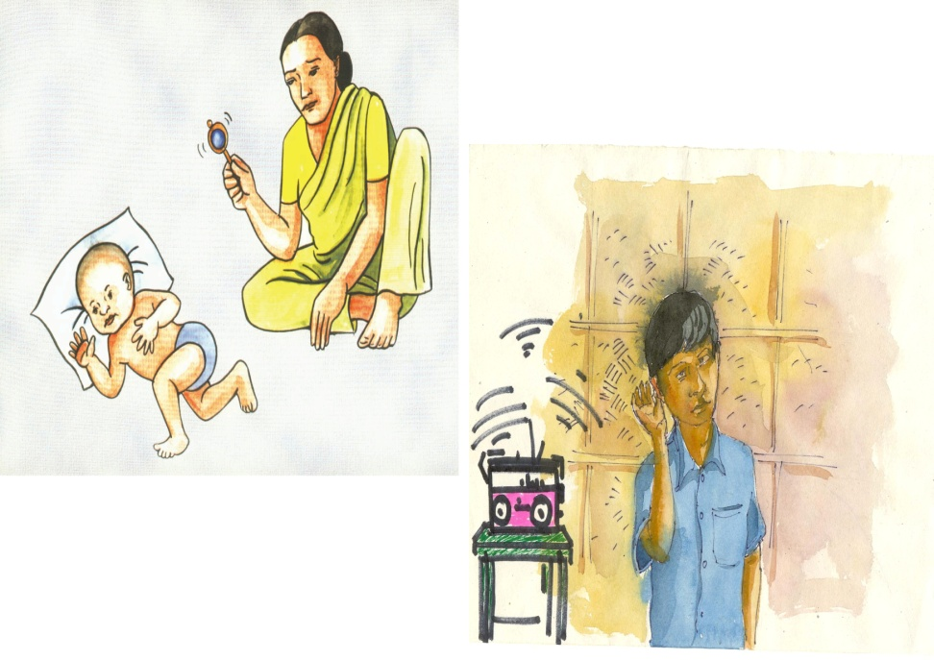
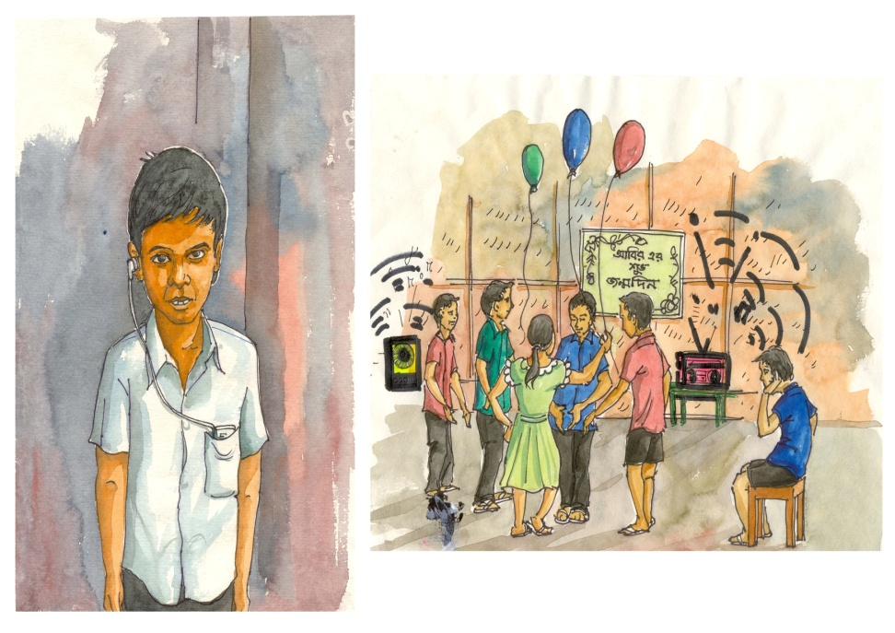
Flip Chart hearing impairment examples

Slide 11
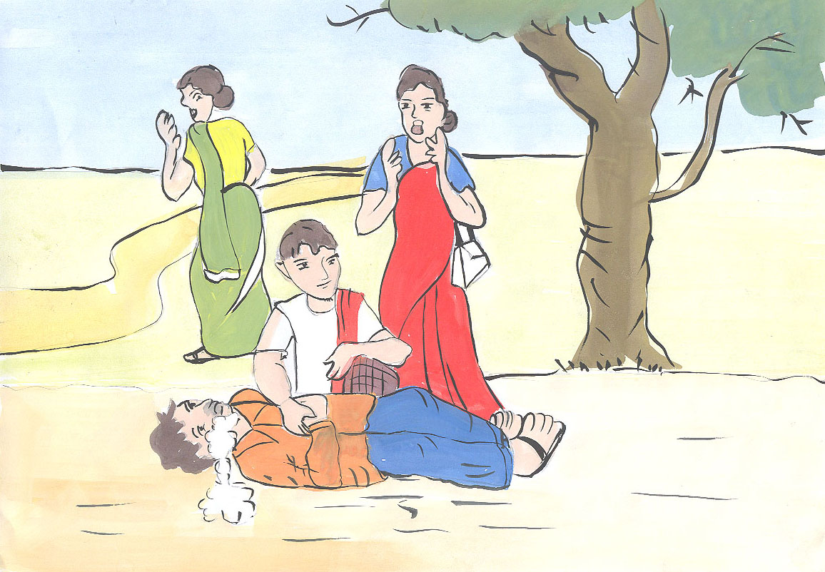
Flip chart example for epilepsy

Slide 12
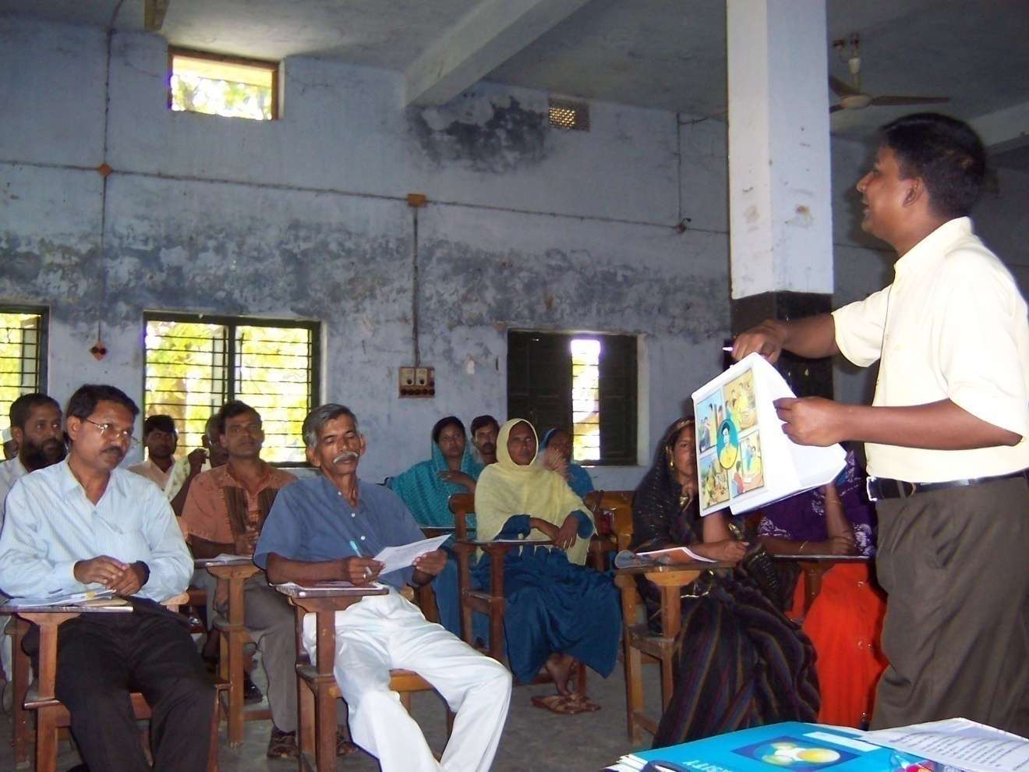
Key Informant training
In each of the sub districts for groups of 20 with the aim of one KI per village

Slide 13
Process
Implemented in a phase wise manner: sub-district by sub district (sample population 100,000),
Each community mobiliser gets 4-6 weeks to encourage communities in a sub district to detect and refer children for examination.
Detailed and planned set of activities are undertaken according to a 6 week schedule of field work in each sub district

Slide 14
Medication
Follow up (doctor)
Epilepsy
Further Investigation (EEG)
Specialist (neurologist)
Medication (Camp)
Wax /Foreign Body Removal
Discharge (CSO M Follow up Locally
Hearing impairment (HI)
Further investigating /Audiology Test
Mould/Hearing Aid (donating CBM)
School/Speech
therapist
Refraction
Refraction
Assistive Devices (Low Vision Aids)
Assistive Devices (Low Vision Aids)
Operation (Cataract)
Operation (Cataract)
Referrals to Schools
Visual impairment
Referrals to Schools
Assistive devices
Surgery & Plasters
Follow up
Physical impairments
Assistive devices
Wheel chairs
Mobility Sticks/Walkers
P&O (artificial Limbs etc)
Club Feet (ortho)
Contractures
Cleft lips Palate (plastic)
Spina Bifida & Hydrocephalus (Neuro)
Advice to Parents
Surgery
Advice to Parents
Parents Training / therapy
Parents Training / therapy
Cerebral Palsy (CP)
Special Furniture
Assistive devices (wheel Chair/Walkers / Crutches)
Referral to School

Slide 15
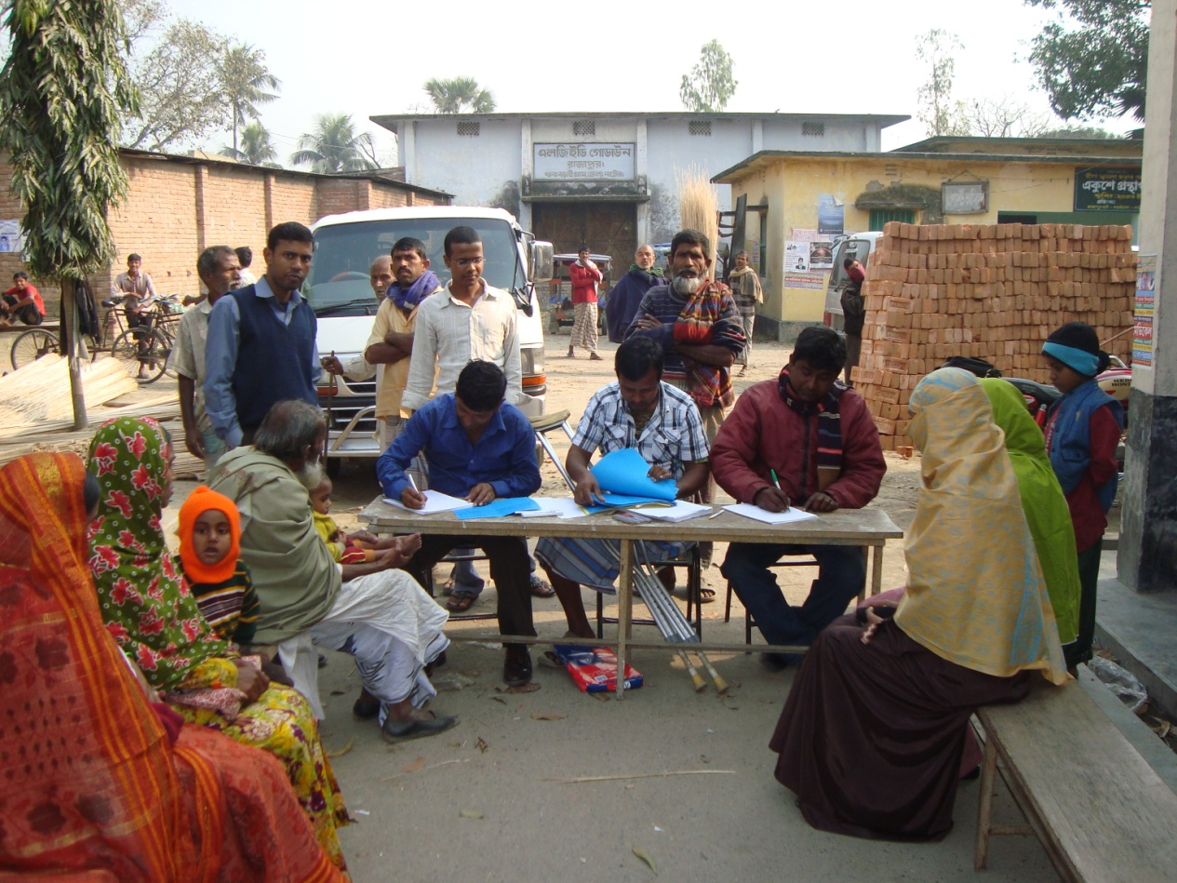
Medical camps set up with support from local SHGs & NGOs – registration process

Slide 16
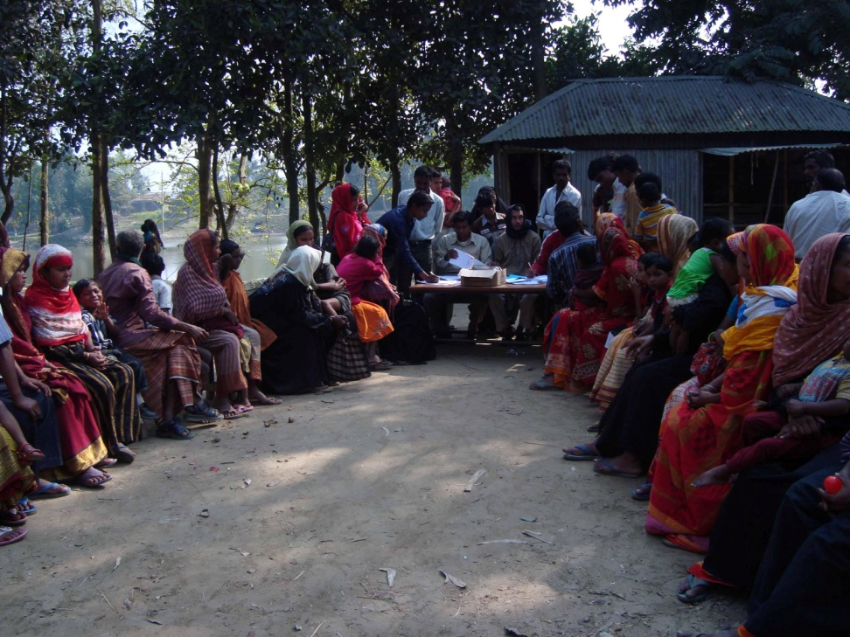
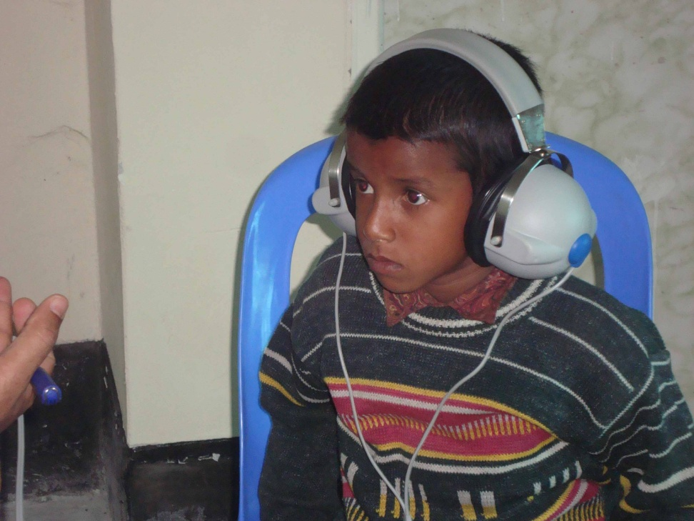
Combined KIM camps
Combined camp brings
very large numbers
Hearing impairment poses more challenges

Slide 17
Results of 1st Pilot in Bangladesh
100+ key informants trained in each sub district
Number seen at camps = 1,272
  Visual – 115
  Hearing – 327
  Epilepsy – 156
  Physical – 634
  Total with disability = 972
  (some children have > 1 impairment)
Local service provision network activated
Specialist treatment for children in Dhaka
National level Dhaka Task Force

Slide 18
Breakdown by impairment
From the KI lists - 972 children had 1,232 disabling impairments amongst 1,272 examined
Gives KI rate of 76% for ID disabling impairment
Number of disabling impairments
No disabling impairment | 300
1 impairment | 768
2 impairments | 157
3 impairments | 38
4 impairments | 9
Total number of children with disabling impairment | 972

Slide 19
Activity Limitations (n=873 KI children aged >5)
Type of Difficulty | Some/ Lots/ Unable to do
Seeing | 81 (9%)
Hearing | 240 (27%)
Mobility | 264 (30%)
Talking | 273 (31%)
Self Care | 243 (28%)
Activity limitations with Cerebral Palsy (n= 146 aged >5)
 | None | Some | Lots | Unable | Total with limitations
Seeing | 136 | 3 | 2 | 5 | 10 (7%)
Hearing | 133 | 6 | 1 | 6 | 13 (9%)
Mobility | 33 | 27 | 26 | 60 | 113 (77%)
Talking | 26 | 26 | 28 | 66 | 120 (82%)
Self care | 25 | 14 | 25 | 82 | 121 (83%)

Slide 20
Challenges
Attendance at camps
Take up of referral services
Referral network at local level
Trained counsellors and peadiatric therapists
Follow up in the community

Slide 21
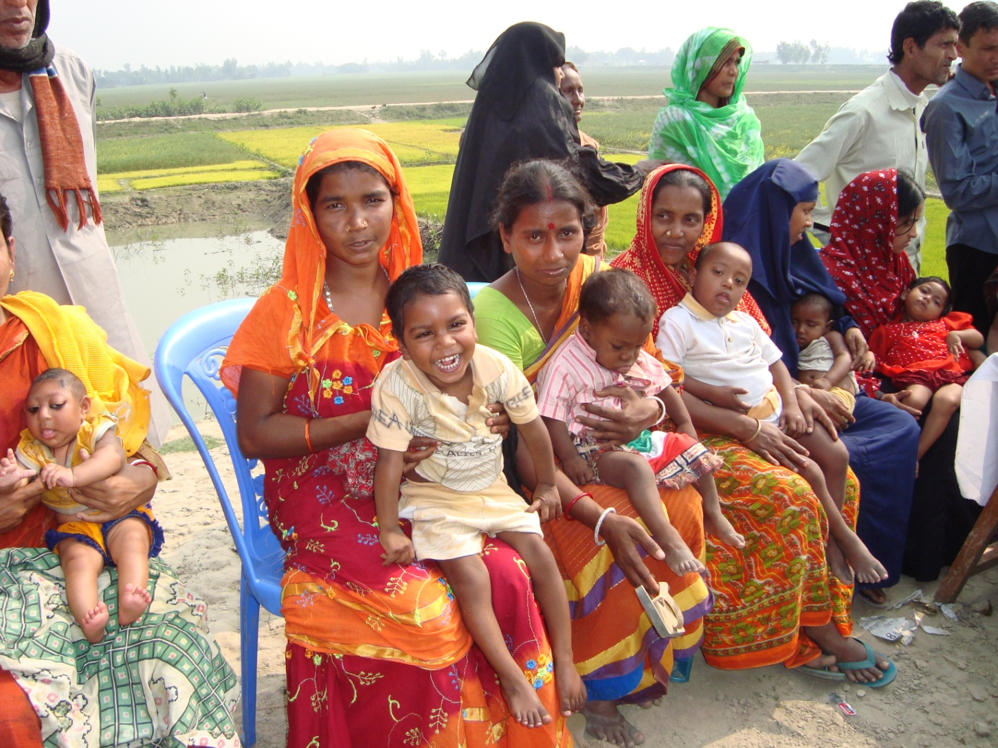
Thank you

