Slide 1

Towards a cautious use of a social model of disability in general nursing
Philip Scullion RN

Slide 2

Have you got any honey?
Notes:
I’m delighted to be here to discuss my topic with you because I have good reason to suspect I will find honey- Well if not honey, then gems of collective wisdom to me with provide direction. (I attended the first UK Conference back in 200?) and have followed proceeding via the web site.

Slide 3
When you are a Bear of Very Little Brain, and Think of Things, you find sometimes that a Thing which seemed very Thingish inside you is quite different when it gets out into the open and has other people looking at it.
Winnie the Pooh
The House at Pooh Corner
Notes:
Inside me, across my career as a nurse and mostly as a nurse educator, I have a thing about disability- and MAYBE it will look very different when exposed to the scrutiny of others. So I come as a learner. But one who subscribes to the goal of “radical socio-political transformation” (Kellner 1998;7). The thing is I think health professionals, nurses included, MAY become part of the solution to disability discrimination whereas they are largely defined as part of the problem. In his recently revised ‘Understanding Disability’ Michael Oliver (2009;176-7) warns that, contrary to appearances, nurses are not to be viewed as allies, since they “are the beast itself”. However, as we are in Lancaster, an academic institution, so far I feel fairly safe admitting that I am on the UK Nursing register.

Slide 4
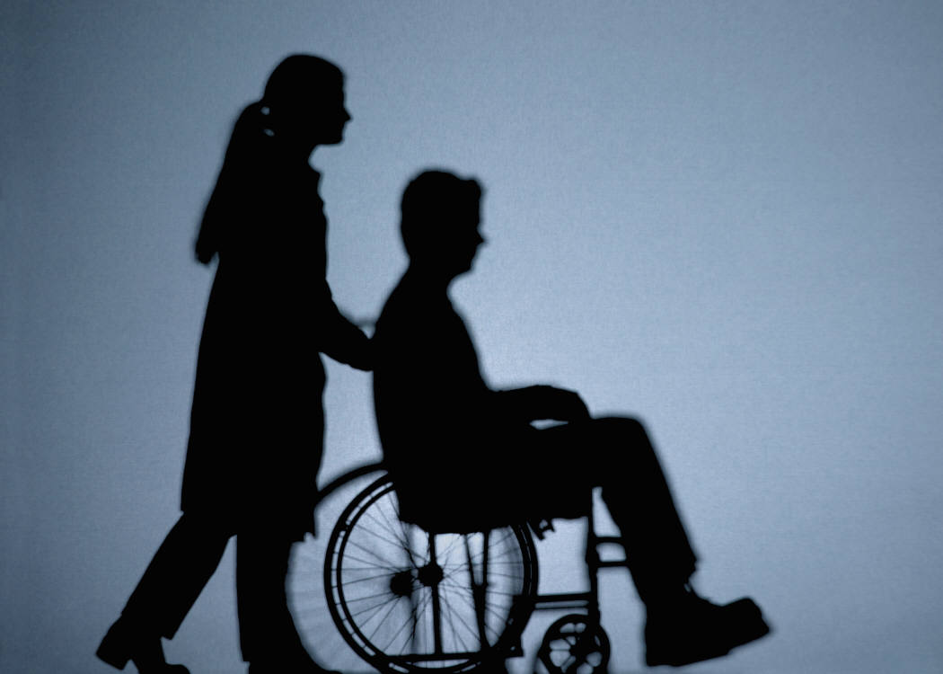
Nursing as Professional
Notes:
It may be useful to outline the UK system of Nursing
The title is protected by law.
Midwifery is NOT nursing!
There are different branches
Child
Mental Health
Learning Disability
Adult
My background and focus today is this last category- the most populous, the general one. This type of nurse is found on the end of the NHS-direct telephone advice line (incidentally- some of whom are blind, others wheelchair users and some have bad backs), in the GP surgery (the quicker and more human option compared to the GP perhaps), Occupational health departments, the general hospital wards where you may find yourself if you have a physical aliment, and of course on our UK TVs in ER and Holby City or Casualty.
ALL branches have daily contact with disabled people- though most do not realise it

Slide 5
Production line.......
Notes:
Some see Adult nurses like this.... Nurses play a role in the production line of disability. Model citizens, [people who have or aspire to health], from time to time acquire impairments – curtsey of Leprosy, Laddish behaviour (often around cars, sports or alcohol) or various Long-term conditions. (depending of course on where you live). They eventually enter a health /medical setting where nurses conspire, with others, via a socialisation process, to change the citizens identity [which may traverse Victim, Patient, Disabled Person]. The citizen emerges from this sausage-machine as a medical failure, dependent, deviant and rather devalued regarding their citizenship, [Dwyer (2004;115) examined the concept of citizenship and concluded that “Citizenship rights for disabled people remains firmly anchored in rhetoric rather than reality”. ] .....thus disabled people emerge as a 'perpetual patients‘.
The slightly paranoid amongst us will now question the motives of nurses and all health professionals; but should we question a professionally qualified nurse they would be horrified at the preposterous notion that they are implicated in ‘disabling people’ in this way – there is little of consciousness in the process- it’s in their social genes- furthermore the citizens who are thus processed into perpetual patients themselves have no real cause to notice the process- they have yet to be enticed or converted by the radical social model of disability.

Slide 6
Around 75%
Conceptualise
disability as
‘medical’
Notes:
Since as we know most legally disabled people want nothing to do with the label, it it may show nurses to be surprisingly enlightened to note that only 75% dismiss the rights dimension of disability!

Slide 7
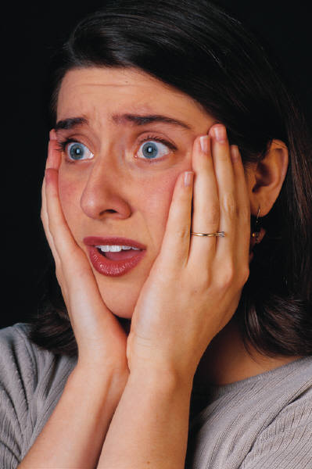
There is a need for evidence of all kinds to show the extent and nature of the problem in nursing;
EBP
EBN
Critical Theory
What ! Nurses discriminate against disabled people!?
Notes:
As nursing aspires to professional status (certainly there is considerably more autonomous practice in the past 10 years) and follows the lead of Evidence Based Practice (which has been conceived by some as Eminence based Practice) and its sister Evidence Based Nursing; we Need
Facts of science- Statistics and counts
Facts of Experience- the deadly impact of diagnostic overshadowing
Nurses to engage WITH disabled people in research
Surveys, Historical, Ethnographies, Phenomenology, Participatory Action research, Evaluations, Narratives, National Enquiries, Case Study, RCTs
Rather than an eclectic mess, above all we need CRITICAL THEORY
AND in line with an overarching aim of critical theory to “free people from overt and covert forms of domination” (Johnson and Buberley 2003;120).

Slide 8
There is a pressing need to convince those within the profession that disability should be conceptualised within a rights framework.
Notes:
There is a pressing need to convince those within the profession that disability should be conceptualised within a rights framework. Because, as in many areas of life disabled people, irrespective of their own identities, face discrimination- including in the area of healthcare

Slide 9
Cognitive Dissonance
Legal requirements
Rights agenda
Study
Champions
Barriers
Advocate role
Notes:
We need nurses to be disturbed and confused as opposed to contented or complacent! People are losing their lives, diagnostic overshadowing gives others poorer quality healthcare, the expectations of nurses is picked up, almost by osmosis by people in transition. In just the sort of environment where one may expect a safe haven of disability friendly attitudes (Harrison 1999), disabled people actually face poor access to primary care, denial of treatments, human rights violations, lack of dignity and a medically dominated socialisation process which leaves those with acquired impairments accepting that their problems almost entirely stem from their own dysfunctional bodies or minds (Bowers, 2003; Brett, 2002; Carter and Markham 2001; Harrison, 1999; Northway, 2003; Scullion, 2000a).
However ‘Disability’ cannot be both illness and equality issue (lowest ranking amongst them it would seem) and the following list may disturb adult nursing;
Legal requirements
Rights agenda
Study
Champions
Barriers
Advocate role

Slide 10
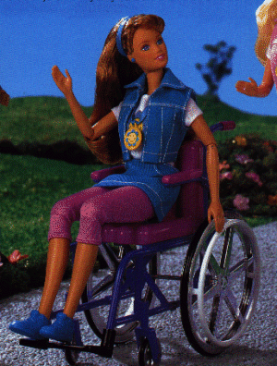

Social Model-
BIG Idea in Adult Nursing
Notes:
WHAT may be useful is Becky (the wheelchair user Barbie Doll) – this is the thing inside which seems very thingish (potentially Powerful). It is of course the Social Model of Disability- a spanner or imprecision tool fix the problem. Oliver (2009) agrees that it is simply a tool- and I wish to use it to fix adult nursing- or at least to challenge disability discrimination.

Slide 11
Why cautious?
Partial coverage-neglects those with learning disabilities (Scullion JAN 2010)
Impairment has significance
“impairments are painful, debilitating or even fatal” (Beckett 2006;116)
Many seek solutions to troublesome impairments

Slide 12
Advocacy: does Nursing have a role?
little a- that which concerns itself with individuals,
big A- concerning itself with wider social illnesses or issues (Brandon et-al 1995)
Need to extend concerns beyond the institutions walls / away from the clinical focus (Fowler 1989).
Notes:
Oliver (2009;176-7) warning that, contrary to appearances, nurses are not to be viewed as allies, since they “are the beast itself”,

Slide 13
Nursing and the ‘Disability Movement’
a loose collective of organisations and individuals seeking to accomplish social change; its’ various strands being “united in their view that we live in a ‘disabling society’ in which many people with impairments are socially excluded in a number of ways” (Beckett 2006;17)
while castigated by the ‘disabled people’s movement’ (Oliver 2009)
Notes:
Oliver (2009;176-7) warning that, contrary to appearances, nurses are not to be viewed as allies, since they “are the beast itself”,

Slide 14
Nursing as a force Challenging Discrimination?
Nursing as Social Advocacy
Disabled people as nurses
Champions within
Merging / collaboration with Disability Studies
Curriculum to incorporate Social Model
Role of Disabled people in the curriculum
Further studies (e.g. impact of Social model)
Notes:
Oliver (2009;176-7) warning that, contrary to appearances, nurses are not to be viewed as allies, since they “are the beast itself”,

Slide 15
Towards a cautious use of a social model of disability in general nursing
Philip Scullion RN

