Slide 1
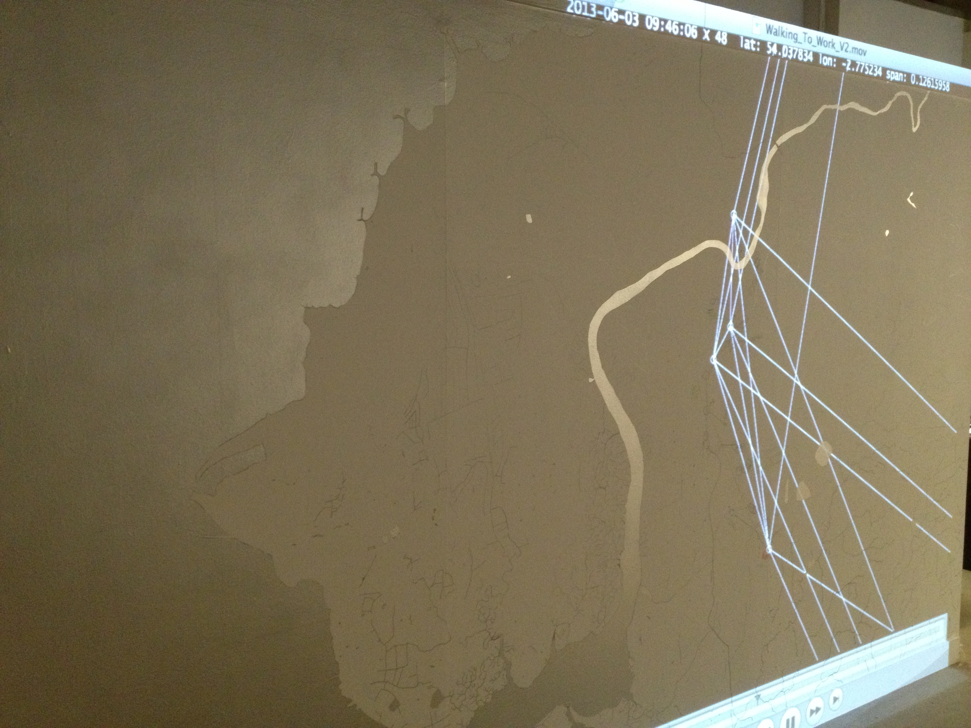
Between Things:
Mobilities, Design & Art
Jen Southern
Lancaster Institute for Contemporary Arts (LICA),
Centre for Mobilities Research & Mobilities Lab, Lancaster University.
Notes:
Conversations between things – in practice – as objects.
Exploring ideas and data in and through material practice is central to how they might be understood and articulated by being ‘made’, and being ‘made palpable’ (Büscher et al., 2007), as artworks that are observed and experienced as ‘technologies-in-use’ (Suchman et al., 2002) at each stage of the research process.

Slide 2
“Imagine a fluid and decentered social science, with fluid and decentered modes for knowing the world allegorically, indirectly, perhaps pictorially, sensuously, poetically, a social science of partial connections.”
Law & Urry (2004:400)
Notes:
Law, J. & Urry, J. (2004) ‘Enacting the social’ Economy and Society. 3(3) pp. 390-410.
Within the sociology of mobilities mobile methods have been developed in order to study the unfolding, messy, ephemeral and elusive nature of mobility and movement (Law & Urry, 2004; Law 2004; Büscher et al., 2011a; Sheller, 2011b).
Fleeting, temporal, spatial, on the move

Slide 3
Locative Media
Artists ‘raise fundamental questions about the nature of public space and surveillance’ in a way that was unprecedented in the development of any other technology.
Townsend, 2006
‘A history of art and research projects….that have influenced the current condition of location awareness.’
Gordon & De Souza e Silva, 2011
Notes:
Locative Media Art used to talk about mobile media in books such as: Mobile Interface Theory, Jason Farman, 2012

Slide 4
“If artistic modalities are indeed producing new organisational forms, constellations and situations, how can these be used to generate new research methodologies, new interventions in networked spaces and even new ontologies of what constitutes the empirical”
Mimi Sheller
Mobile Art: Locating Mobile Network Cultures
IT University of Copenhagen. 29 April 2011
.
Notes:
Mimi Sheller asks

Slide 5
‘Mobile Methods’
Büscher, Urry & Witchger, 2011.
‘Live Methods’
The Sociological Review, 2012 60:SI, Beck & Puwar, 2012
‘Inventive Methods’ that are both creative and enact new social realities.
That “enable the happening of the social world – its ongoingness, relationality, contingency and sensuousness – to be investigated.”
Lury & Wakeford, 2012
‘Living Experiments’
Marres, 2012
Notes:
– writing about the ‘Spiral Sunrise Series’ by Esther Polak
Mobile Methods (Büscher, Urry & Witchger, 2012)
Inventive Methods (Lury & Wakeford, 2012)
Live Methods (Beck & Puwar, 2012)
What does it mean to do both art and social science together?

Slide 6
Conversation between things
Experiences of the everyday
Real-time systems
Situated practices
Participation

Slide 7
Experiences of the everyday
‘Not satisfied with the suggestion through paint of our other senses, we shall utilize the specific substances of sight, sound, movements, people, odors, touch.‘
Kaprow 1958
‘the modernist practice of art is more than the production of artworks; it also involves the artist’s disciplined effort to observe, engage, and interpret the processes of living...’
Kaprow 1958
Notes:
These relationships go back a long way… the art of the everyday, artists engagement with everyday process, practice and space.
The artists walk developing at the same time as the sociologists go-along
Participatory practices in art, design and social science.

Slide 8
Situated practices
‘Street Phenomenology: The Go-Along as Ethnographic Research Tool’
Kusenbach 2003
‘If knowledge and footprints appear equivalent, it is because knowing is doing, doing is carrying out tasks, and carrying out tasks is remembering the way they are done.’
Ingold & Vergunst 2008:7

Slide 9
Design research
‘Critical Design’ (Dunne & Raby, 2001)
‘Design-in-use’ (Suchman et al., 2002)
‘Future Laboratories’ (Büscher at al, 2007)
A ‘designerly way of knowing’ (Cross, 2010) a process of envisioning possibilities and trying them out in physical materials and embodied practices
‘Speculative design’ research which ‘promotes designed objects as tools for critical reﬂection’ (Mitter, 2011)
Notes:
Speculative design projects like Comob Net, Space Metronome and Walking to Work put functioning objects and apps into active and public situations in order that participants can reflect on them through their own physical engagement with them, as used in practice, rather than as imagined by artists and designers.
Similarly Dunne and Raby (2001) use this approach in their critical design work in order to reflect upon individual orientations to (for example) electromagnetism, through using an object that materialises this phenomena in everyday living arrangements and practices.
Future Laboratories - enable technology design to develop side-by-side with participant practices in situations that are ‘as realistic as possible’ using a combination of participatory design and ethnography. Through this process opportunities, constraints, problems and possibilities ‘arise concretely’ in action.
A ‘designerly way of knowing’ (Cross, 2010) is a process of envisioning possibilities and trying them out in physical materials and embodied practices
perform as working artefacts; artefacts whose significance is not given in advance, but is discovered through the unfolding activity of co-operative design-in-use’ (Suchman et al., 2002: 127).

Slide 10
Participation
Relational Aesthetics (Bourriaud, 2002)
Dialogical art (Kester, 2004)
Participatory art (Bishop, 2006)

Slide 11
Collective Experimentation
‘situations emerge or are created which allow [people] to try out things and to learn from them, i.e. experimentation’
Felt & Wynne, 2007: 26
Notes:
‘collective experimentation’ as proposed by Felt & Wynne (2007) in relation to public engagement with science,

Slide 12
An evolving combination of mobilities research, speculative design and art practice.
Involving people in creative experiences of embodied participation with emerging technologies.
Making the invisible available for collective experimentation and discussion.
Notes:
Across the disciplines of art, design and anthropology, then, the detailed study of everyday life exhibits the situational, practically achieved and socially organised nature of action, and it is this form of revealing engagement that involves audiences as participants in situated interaction with technologies and art works, that I attempt to produce within both my research methods and participatory art practice.

Slide 13
Comob
Collaboration with Prof. Chris Speed (programmed by Jochen Enhes & Henrik Ekheus)
Speculative mapping of social and spatial relationships together
Development through workshops, collaborative reflection and analysis, and participant observation, combining ethnography and coproduction.

Slide 14
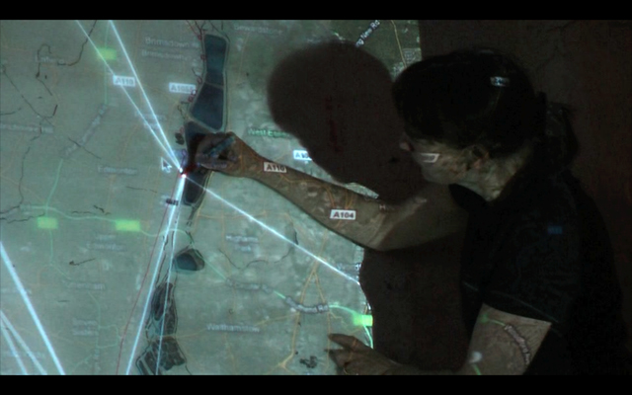
‘From Reservoir to Tap’ (2010)
Distance festival,
Stoke Newington International Airport performance space, London.
‘Walking to Work’ (2010)
The Experimental Society
conference exhibition, Peter Scott Gallery, Lancaster.

Slide 15
Comobility =
Being mobile with others
at-a-distance

Slide 16
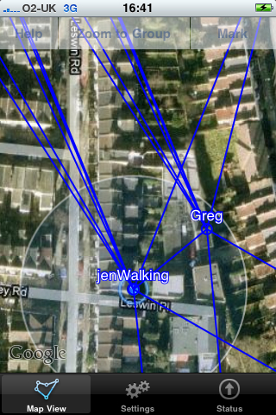
Comobility:
Locationally present
‘if we turn this corner they’ll be right there‘
Temporally present
‘You moved guess you’re walking!’
Virtually co-present
‘I knew where everybody else was’

Slide 17
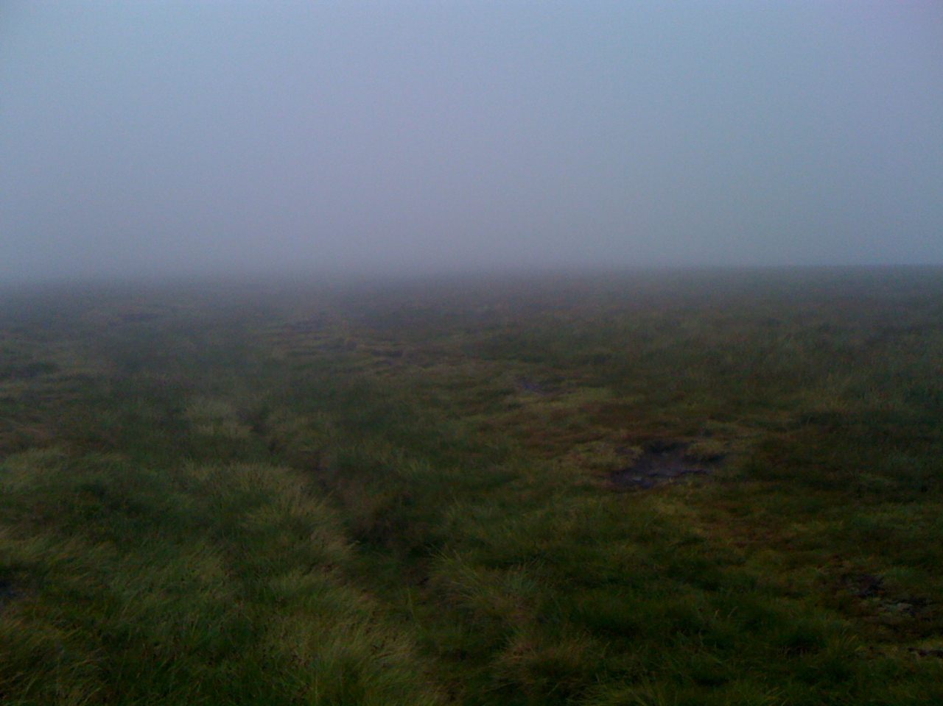
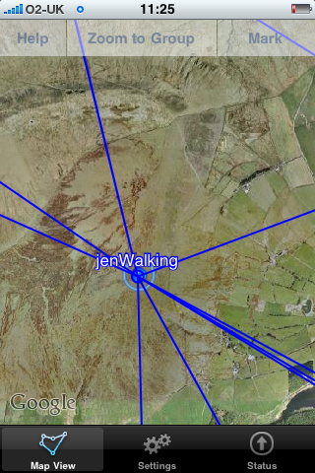
Analysis in relation to proximate interaction:
Goffman, Boden & Molotch
Urry, Licoppe.
Sharing time at a distance
Side by side interactions
Context read through:
maps & satellite images, movement patterns & sequential action

Slide 18
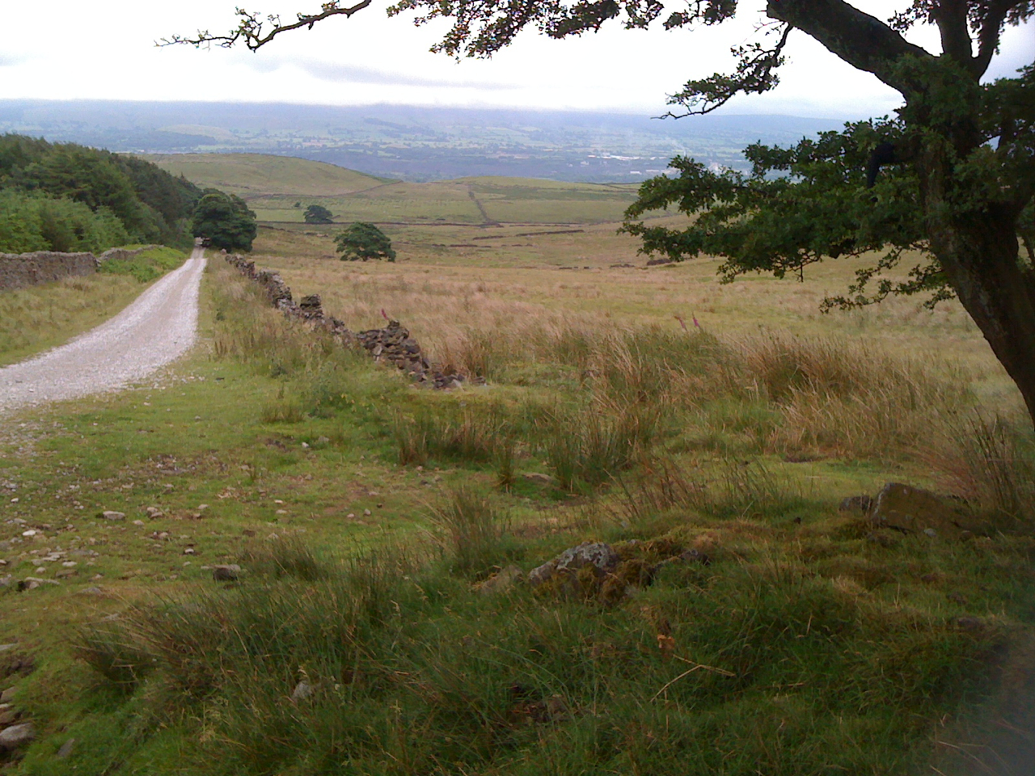
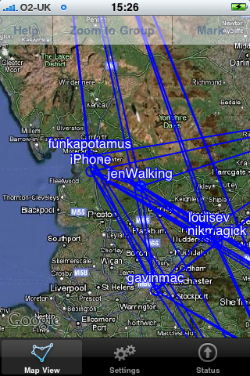
‘The density of interactional detail of copresent encounters thus both engages and entraps us.’
Boden & Molotch, 1994:259
“the process of looking at the screen takes you away from the street anyway, for me personally” (participant in Dundee workshop)
Comobility extends ‘response presence’ beyond line of sight, in which both the potentials and the fears of proximity exist at a distance

Slide 19
Comobility in the Wild
Privacy
I was very aware of being intrusive to start with.
They had nothing to hide so no problems at all and now I find it a real comfort to know where they are!
I appreciate and accept that they have a need to be private at times.

Slide 20
Locational presence:
I click on everyday. I look to see where they are when I get up.
I feel there’s someone else there. Someone I’m close to…it almost brings them closer to me.

Slide 21
Temporal presence:
…it really did make me feel part of his cycle trip. He knew I was watching as well… I felt I was actually there.

Slide 22
Virtual co-presence:
They were getting closer and closer and I was photographing the images on Comob and their actual position. Scrolling out and scrolling in depending on where they were. I was just sort of watching them getting closer and closer. And then I messaged the images to them.

Slide 23
Imagined co-presence:
…when I know where they are with Comob, I have this mental image. I can see a body. I have an image of them. Not something that is tangible and you can sort of put your hand out and touch. It’s something in the mind. That’s kind of spooky!
…you know he’s stuck on the side of the road and I can hear him huffing and puffing. ‘oooh this blinking rain!’ [laughs] head under the bonnet of a car somewhere. I can imagine him, you know, I think he’s brilliant with his customers.

Slide 24
Communication
Because we live in the country no one comes past us except from the sheep and the cows. So it is another method of communicating without interfering with anything.

Slide 25
“Trying to move with, and to be moved by, the fleeting, distributed, multiple, non-causal, sensory, emotional and kinaesthetic.”
Büscher, Urry & Witchger, 2011.
Notes:
Engaging with emphemeral and mobile subjects, through experimental design and art practices – enables an engagement with technology through production and experimentation.

Slide 26
Download Comob Net
from app store
groupname = designmobs
j.a.southern@lancaster.ac.uk
Monika mobile +44 7890 847166

