Slide 1
INTELLECTUAL PARTY 2011
Lancaster Sociology Summer Conference
PHOTO GALLERY
© Karolina Papros

Slide 2
Registration time....

Slide 7
Welcome!

Slide 8
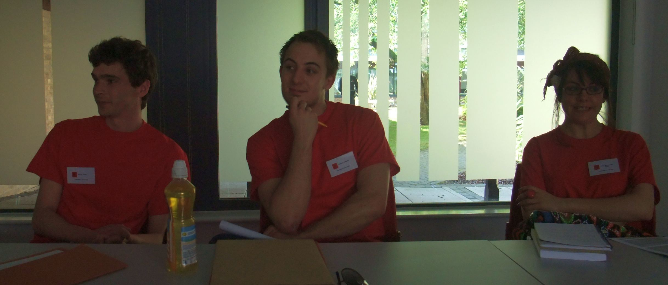
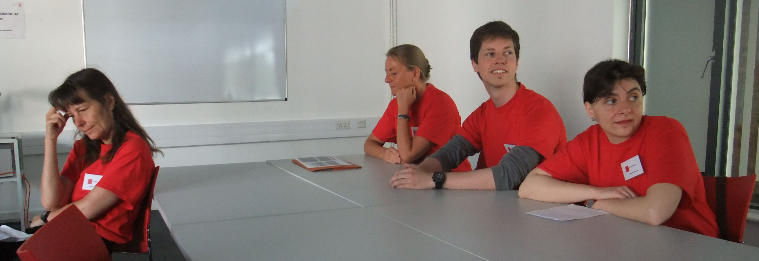
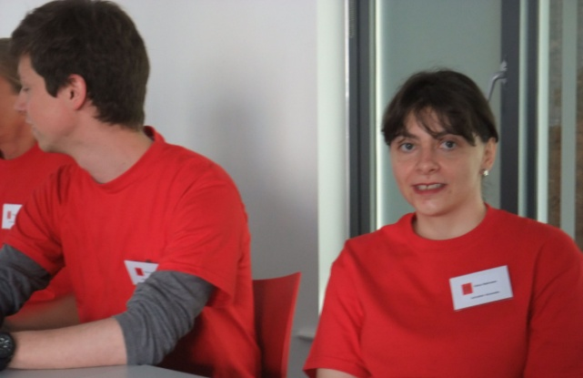

Slide 9
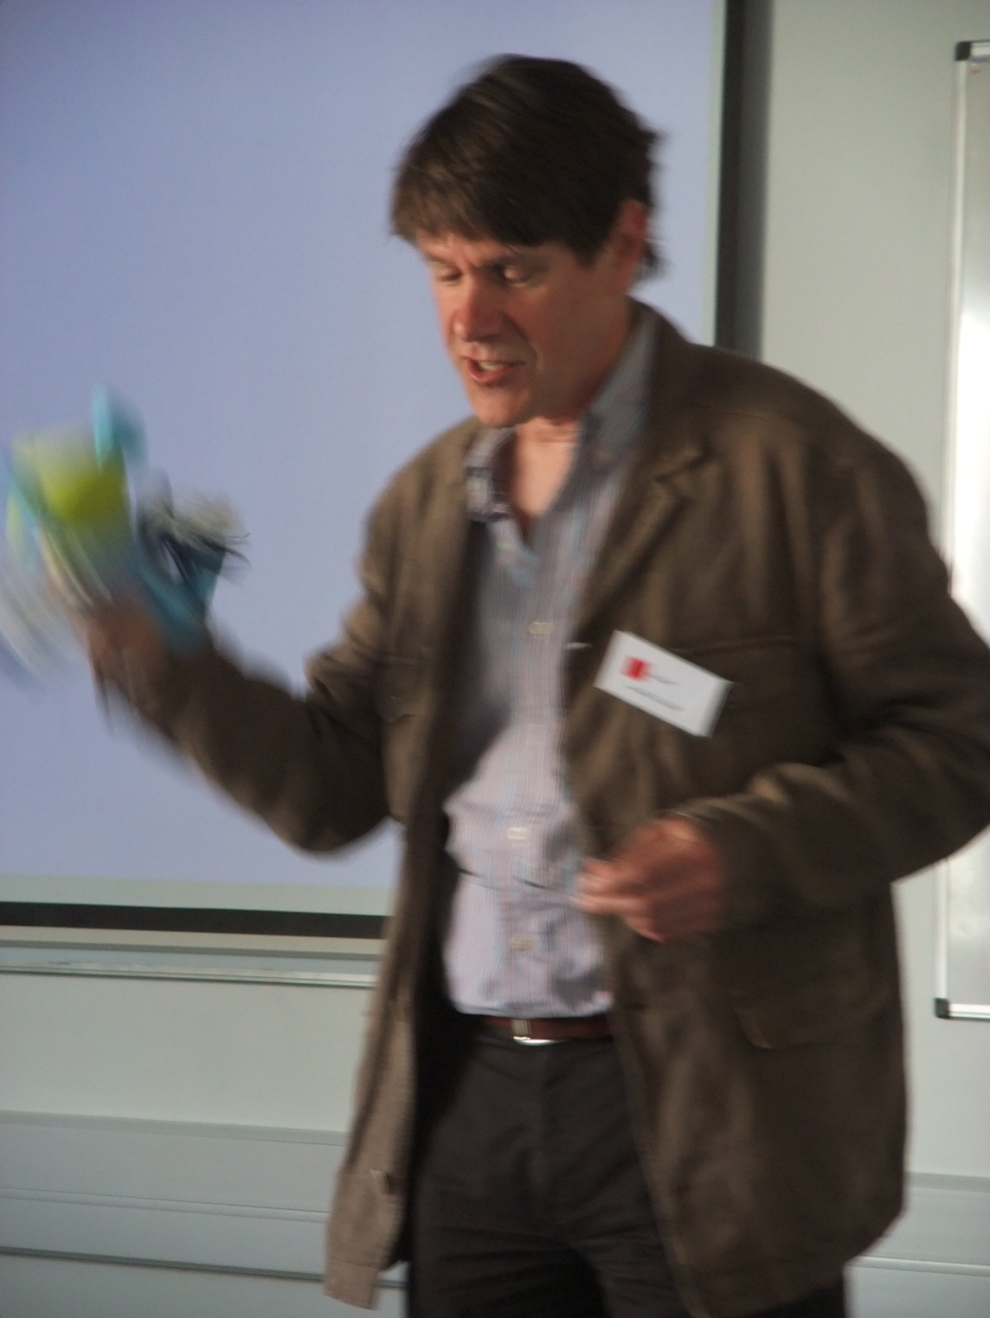
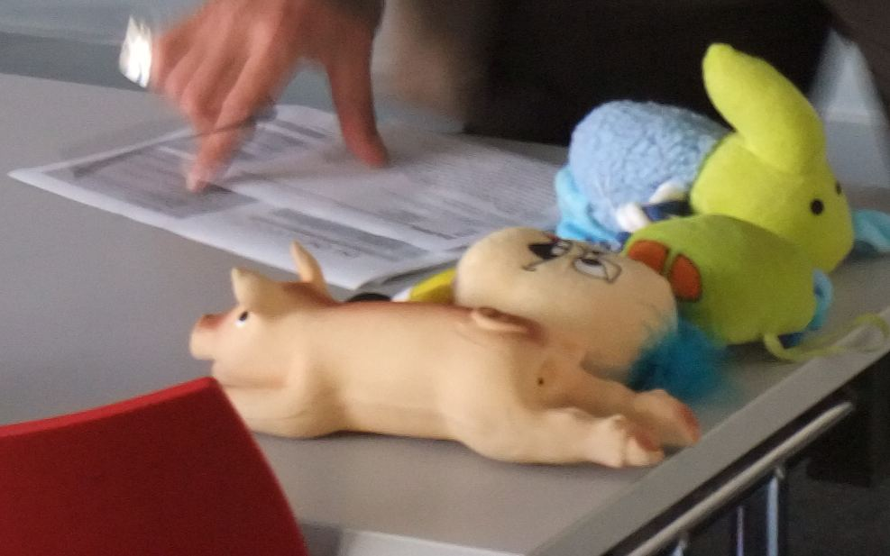

Slide 12
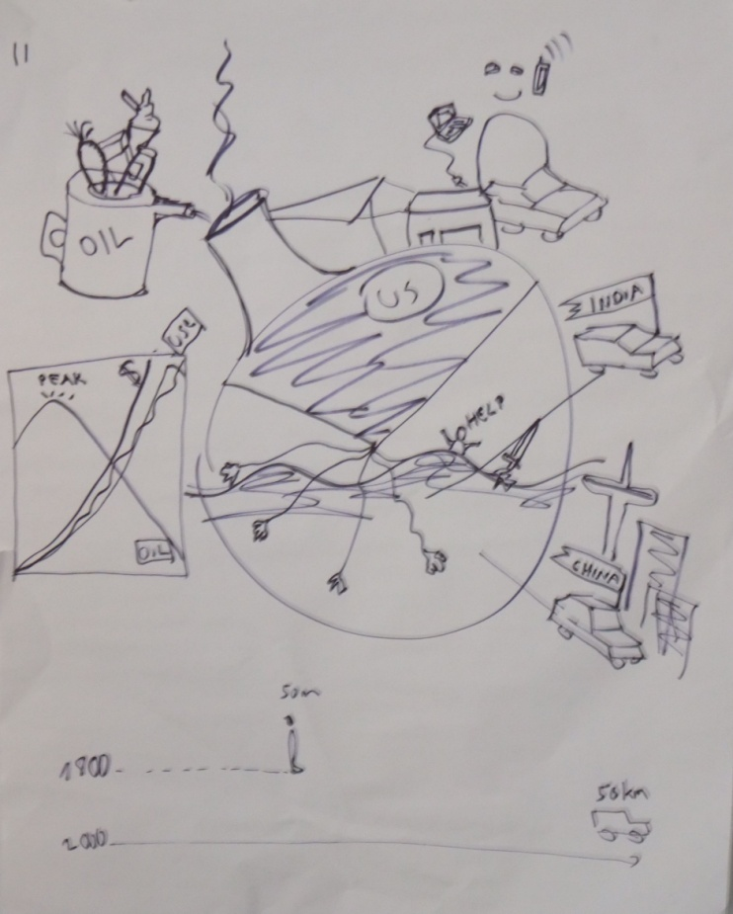
Poster Presentations

Slide 13
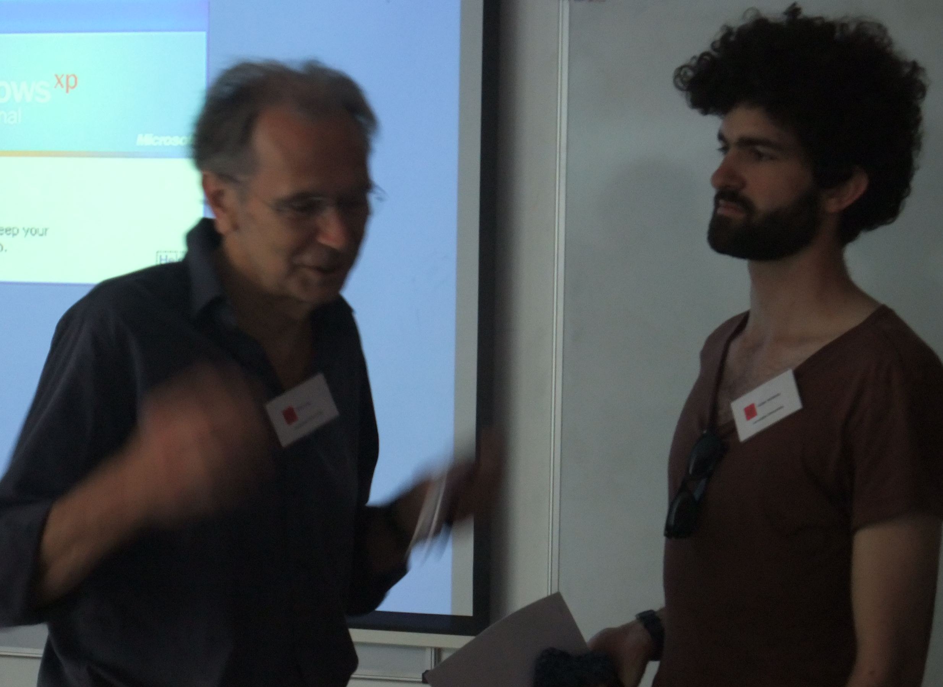
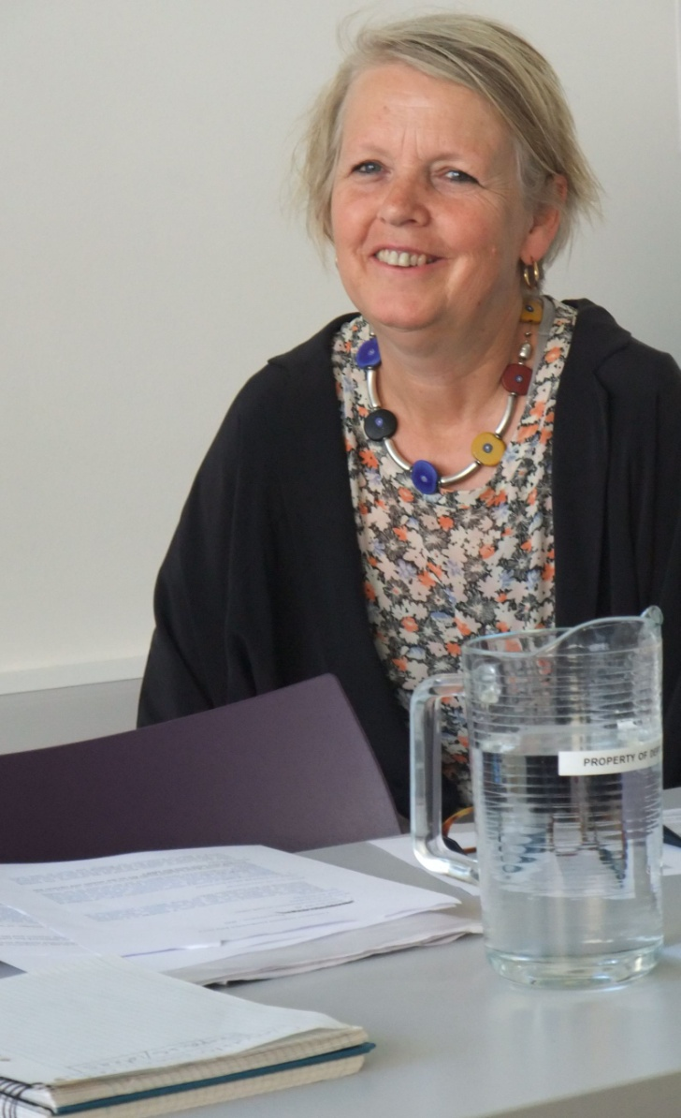

Slide 15
Paper Presentations

Slide 17
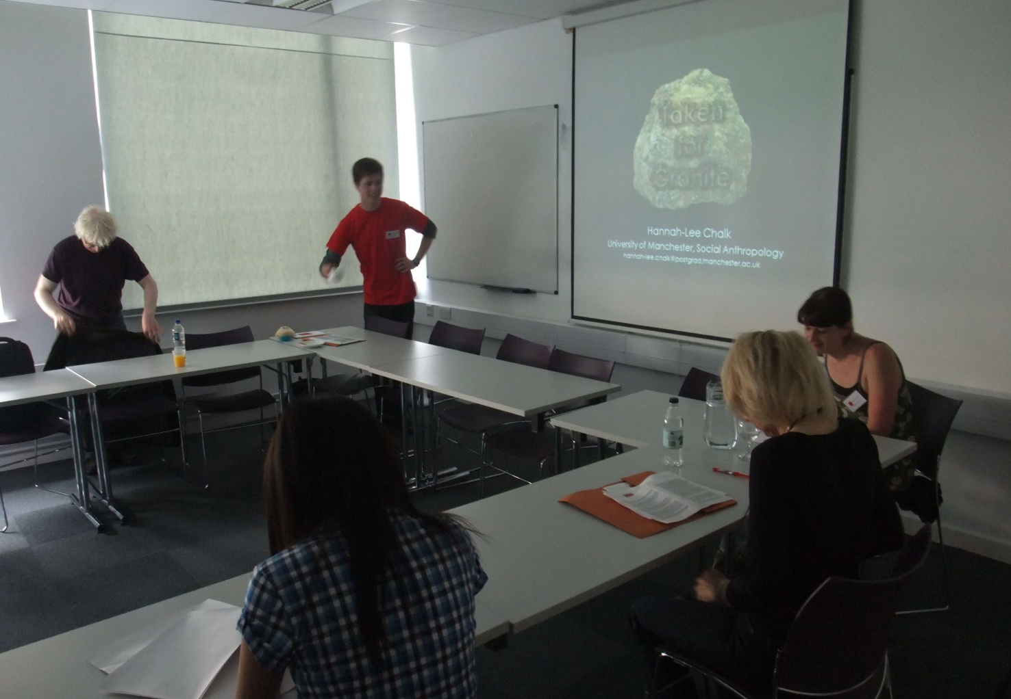
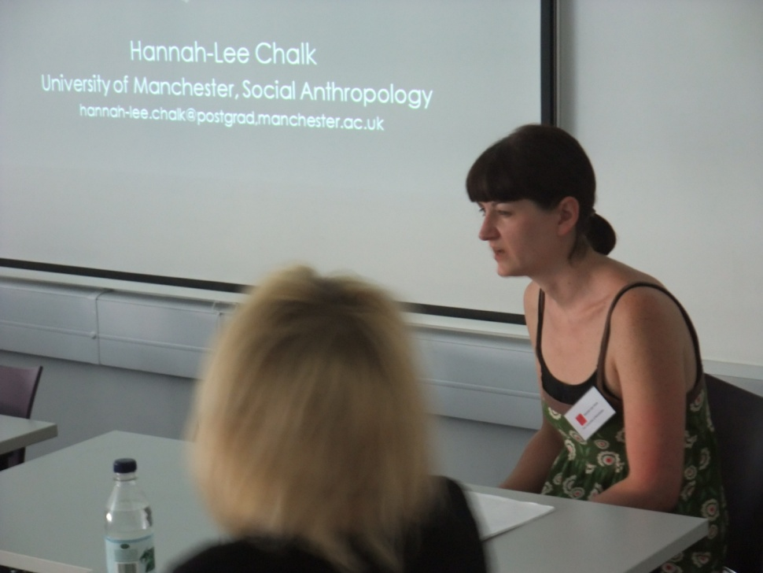

Slide 20
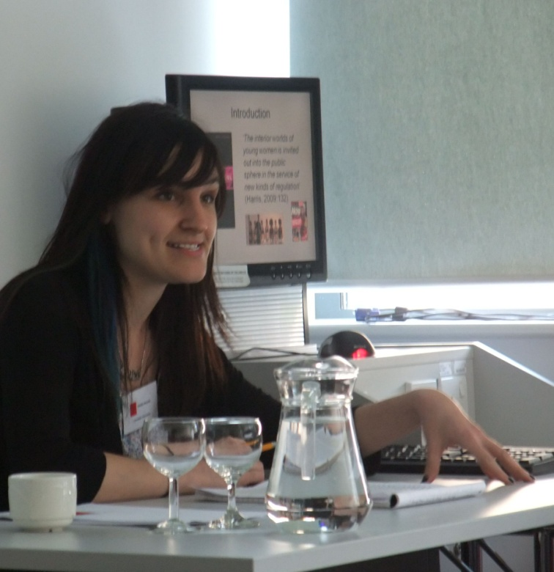

Slide 21
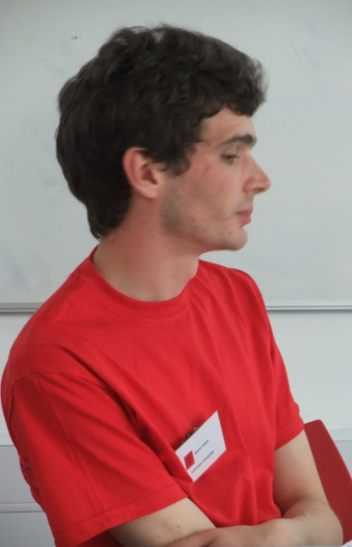
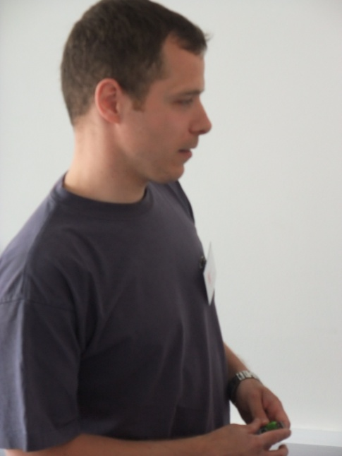
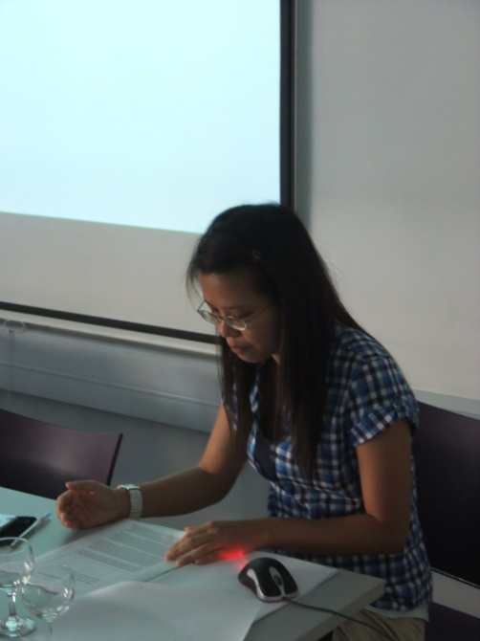

Slide 22
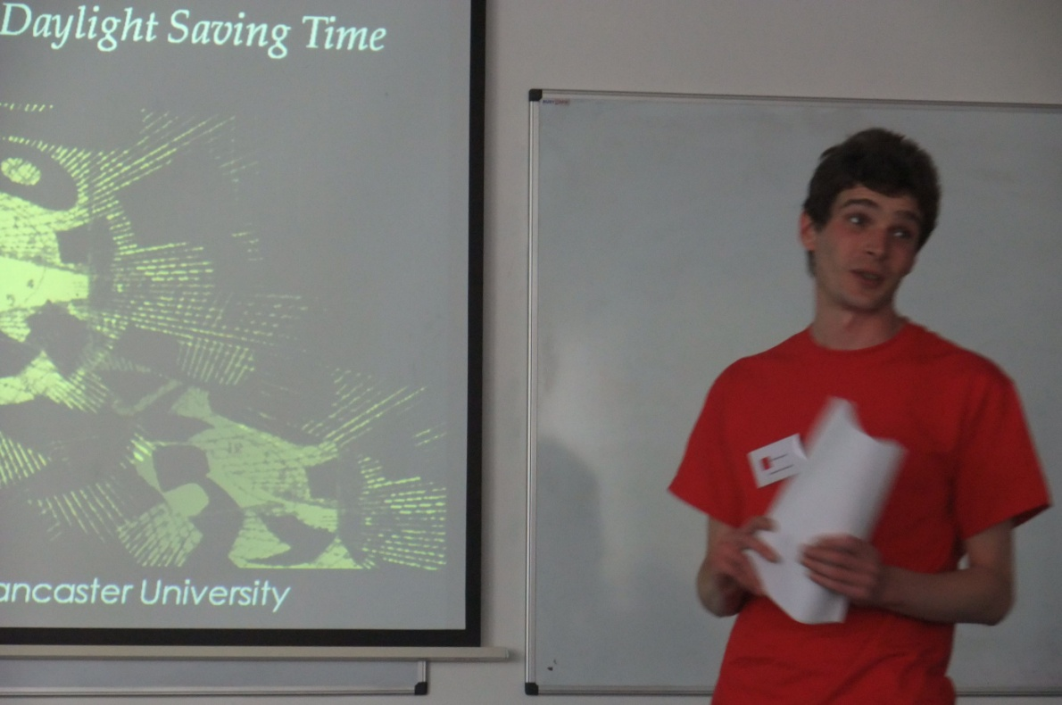

Slide 23
Coffee and Lunch Breaks

Slide 42
‘Performance and Reviews’

Slide 44
BBQ :)

Slide 60
THE FINALE

Slide 62
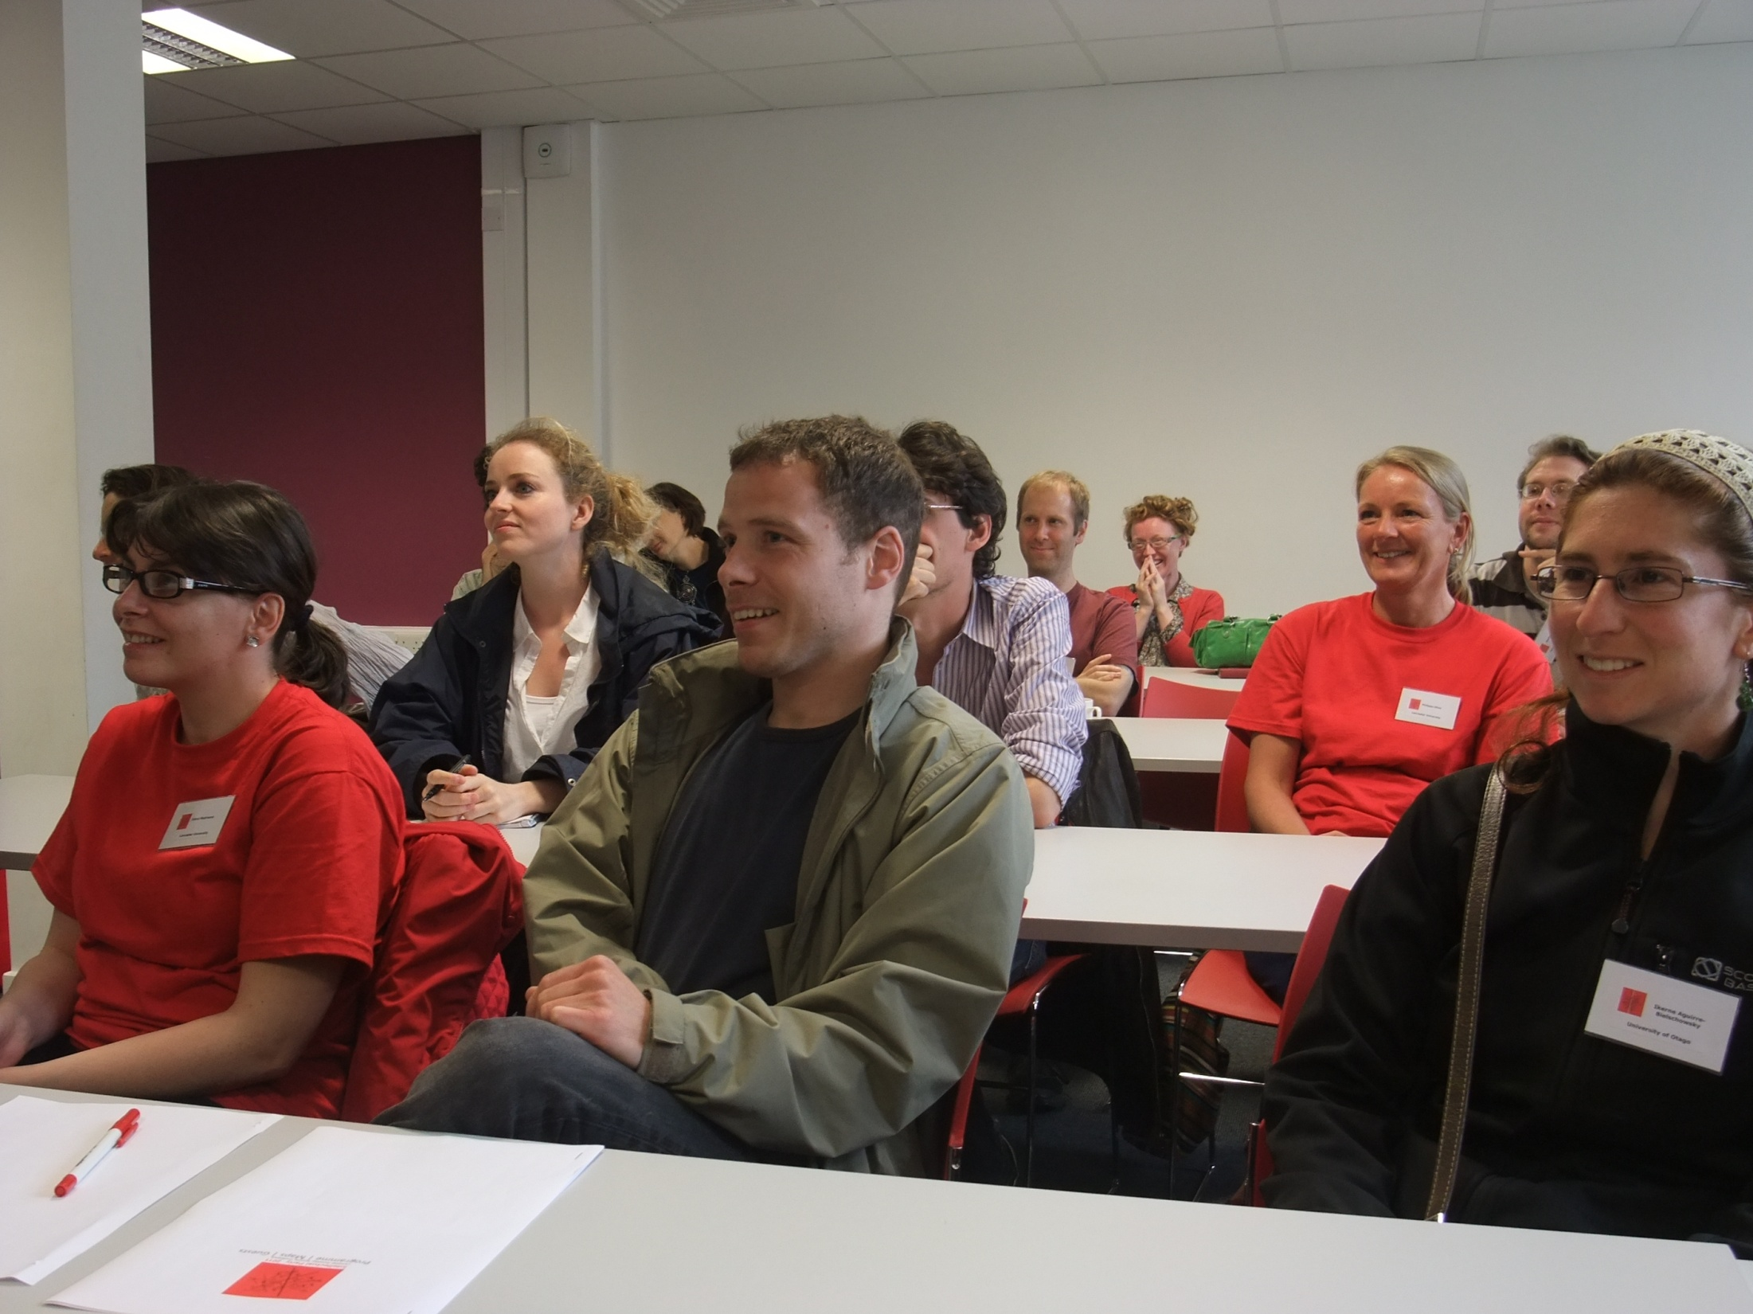

Slide 73
The Lancaster University Team would like to...

Slide 74
...thank you for your participation and...

Slide 75
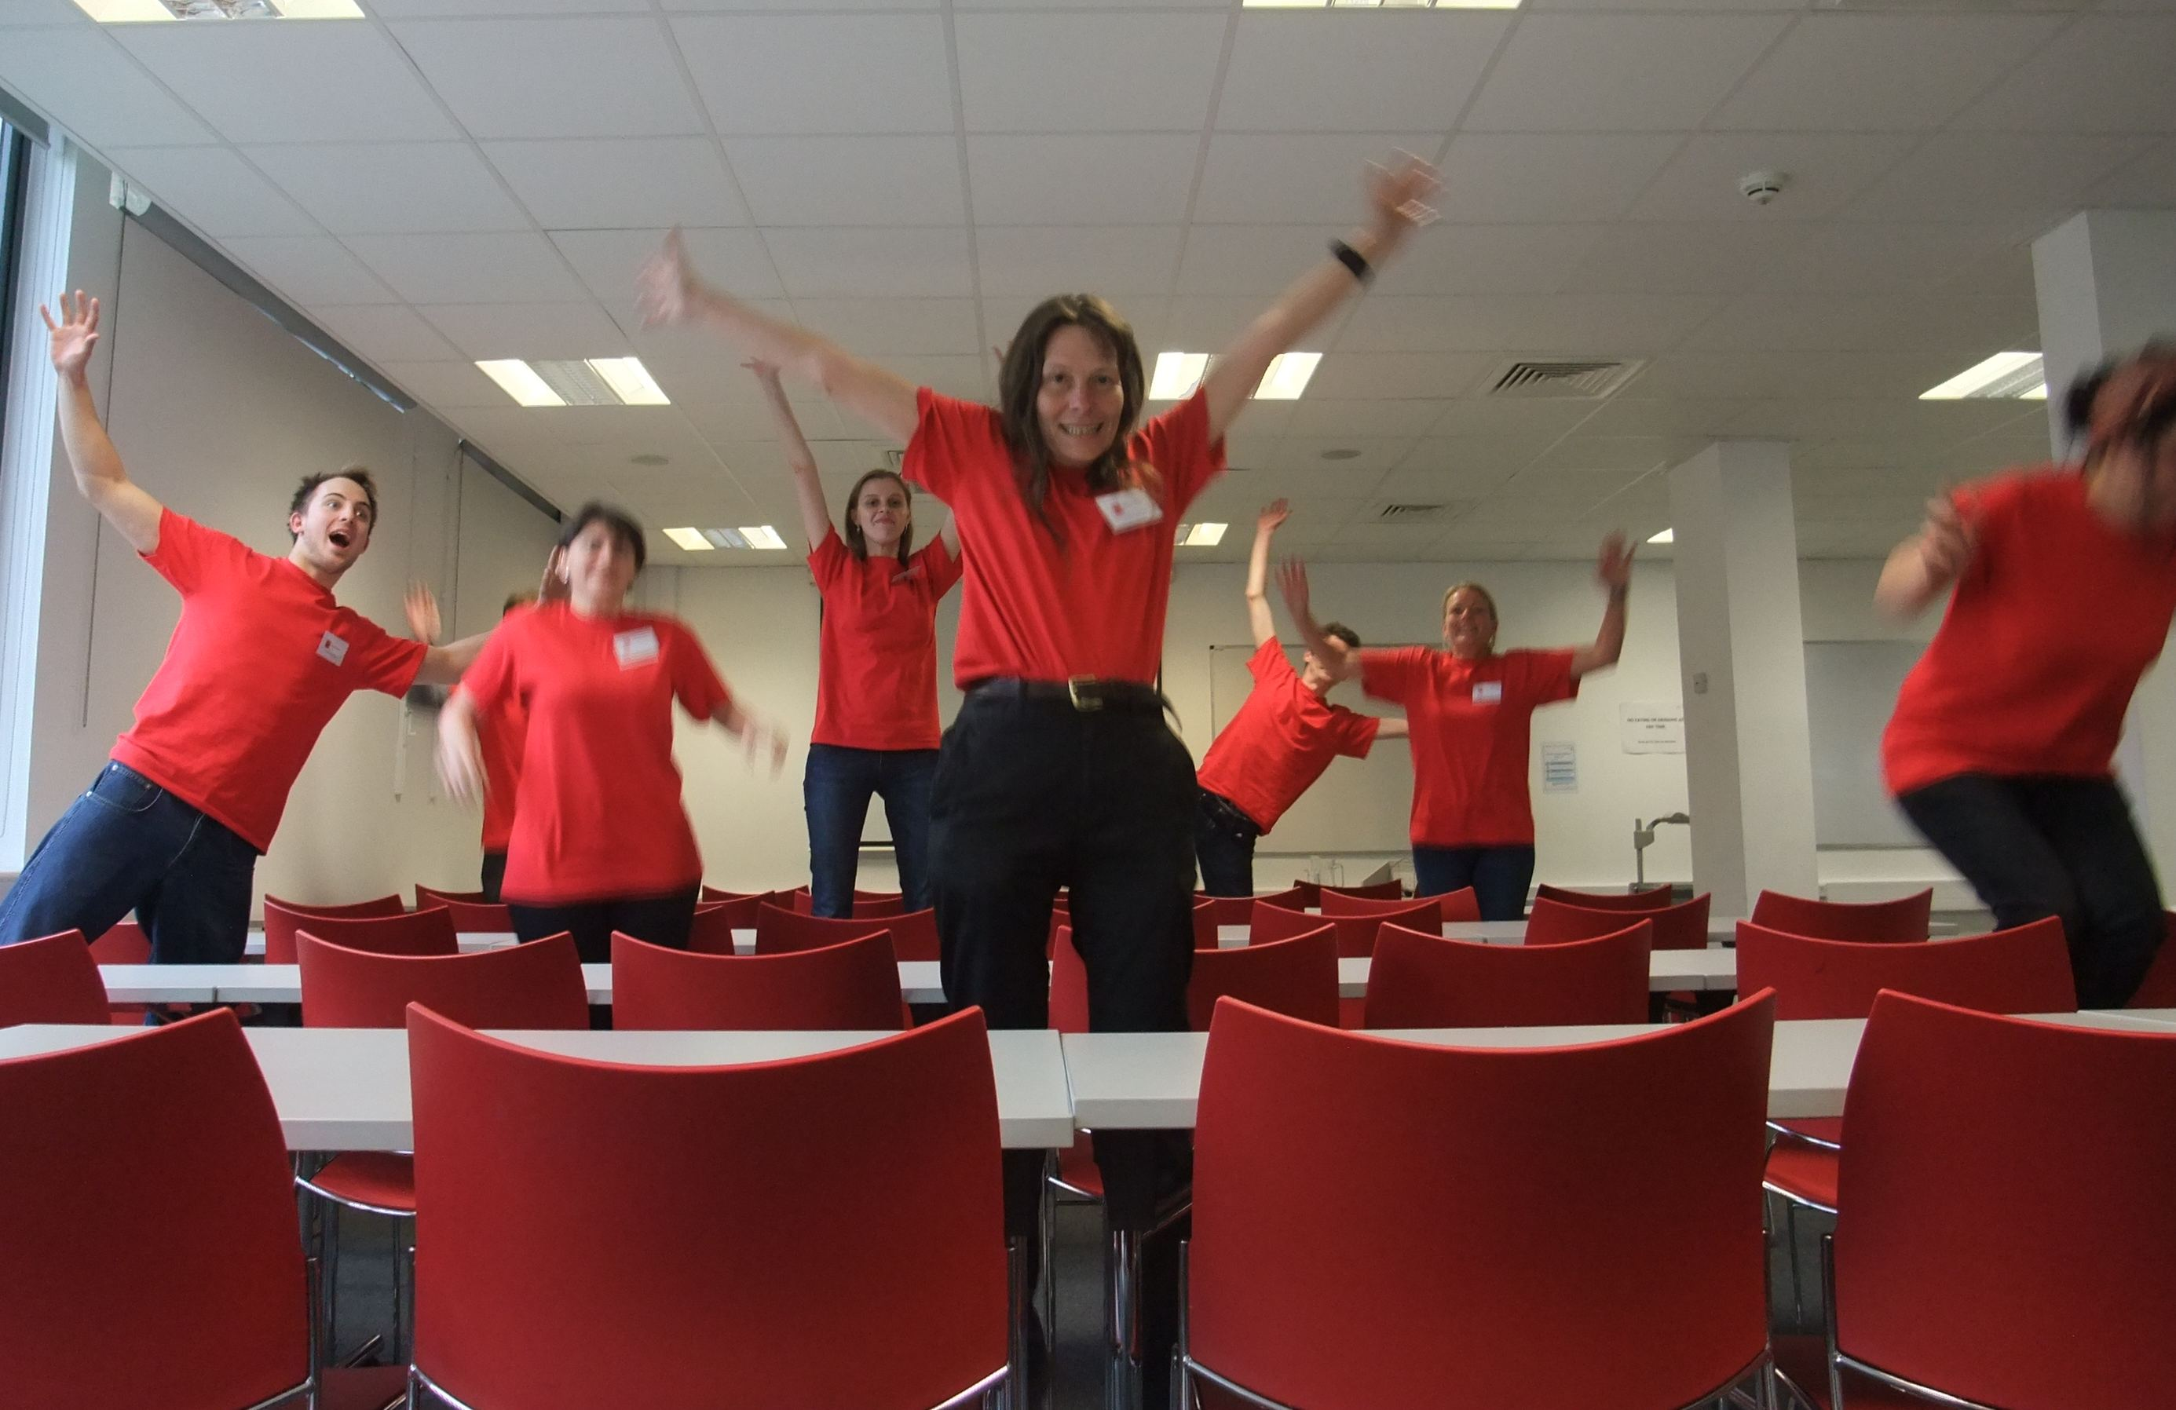
... we hope to see you next year!

