Slide 1

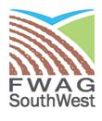
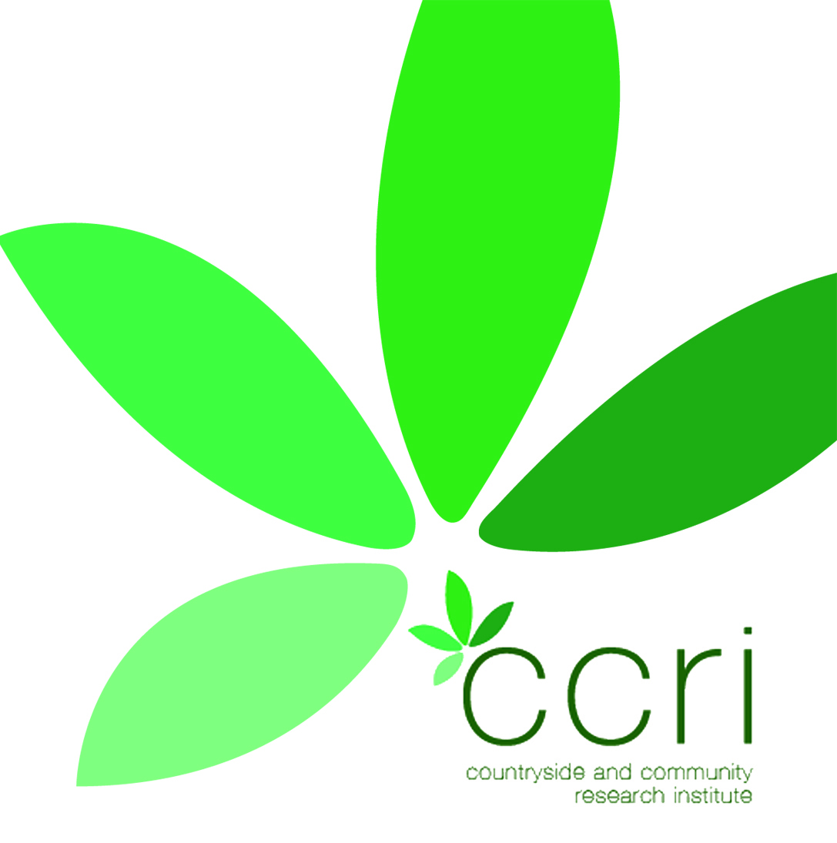
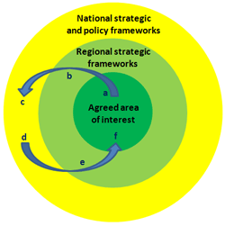
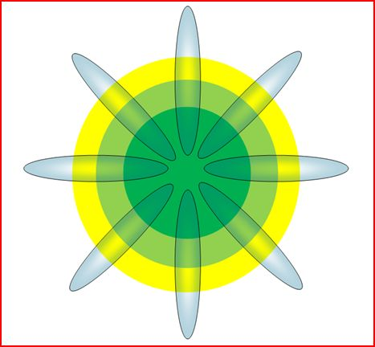
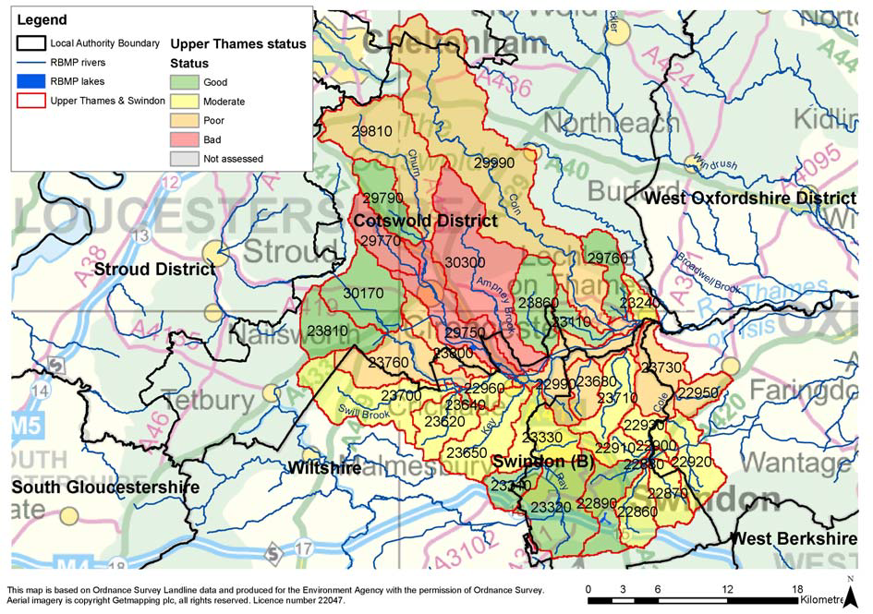
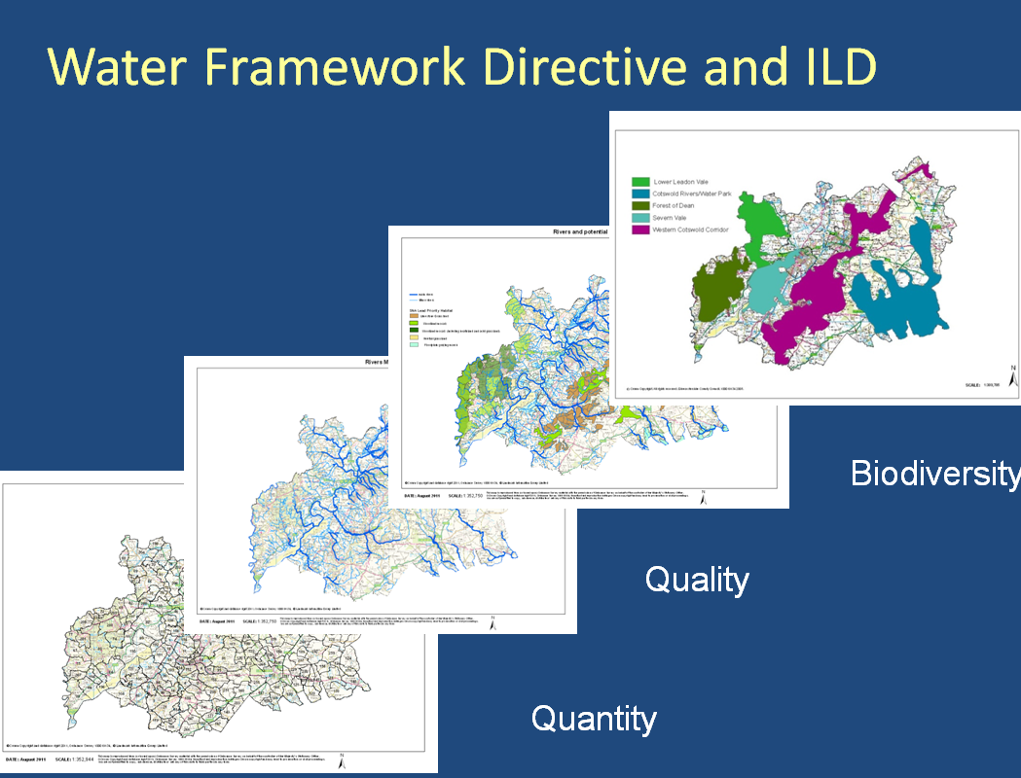
Context
Delivery
Using ILD, partners can work up projects and business plans together, levering in wider opportunities to strengthen and match funding. This enables all partners and communities to deliver their local plans, statutory duties and constituted aims together. The approach pieces the landscape together farm by farm, parish by parish, joining the landscape up like a jigsaw, where all organisations can play their part working to a shared WFD delivery strategy
The Cotswolds (Upper Thames) Catchment Pilot Project is an excellent opportunity to further embed the Integrated Local Delivery Framework
( ILD). This is an innovative approach. that works by valuing and respecting local knowledge and resources of the farming community,. http://www.ccri.ac.uk/Projects/HeritageandLandscape/Images/IntegratedLocalDelivery.pdf
It enables local communities to be inspired to take action to lead on the protection of their local environment, with an all inclusive list of organisations working together in true partnership in support.
Local
to
National
back to
Local
Cotswolds (Upper Thames) Catchment Pilot
Cotswolds (UT) Catchment is a small/medium sized catchment predominantly rural in character but with some urban pressures. The northern part of the catchment falls within the Cotswolds Area of Outstanding Natural Beauty and the southern catchments fall in the Cotswold Water Park, with many small to medium market towns located throughout the catchment
Embedding WFD
The Cotswolds (UT) Catchment Pilot is creating a framework for accredited Farming and Integrated Environmental Local Delivery (FIELD) advisers that are coordinated by a FIELD Adviser Coordinator hosted by the County Council:
FIELD advisers will:
Work to champion farmers and support cross cutting environmentally sustainable productive farming
Sign post to all stakeholders
Work in support of the Rural Community Council to reconnect the farmed environment into parish planning to build true resilience.
FIELD Adviser Coordinator will :
GIS over layer all partner strategies and projects and provide local data sets of an all inclusive partnership to work in support of local delivery.
To enable ILD to be a delivery mechanism for LEPs and LNPs
Objectives of the pilot
The Cotswolds (U T) Catchment pilot will evaluate Water Framework Directive (WFD) delivery using ILD that enables the development of community led environmental resilience that also achieves multi objective delivery for all partners, including the delivery of Local Development Frameworks and EU Directives.
Focus of the pilot
The range of pressures in the rivers systems include: high phosphate levels; poor fish populations and habitats; low levels of phytobenothos and high pH. This is thought to be caused by many factors including high levels of water usage, abstraction, lack of management, overshading, siltation and diffuse pollution from agriculture.
.

