Slide 1


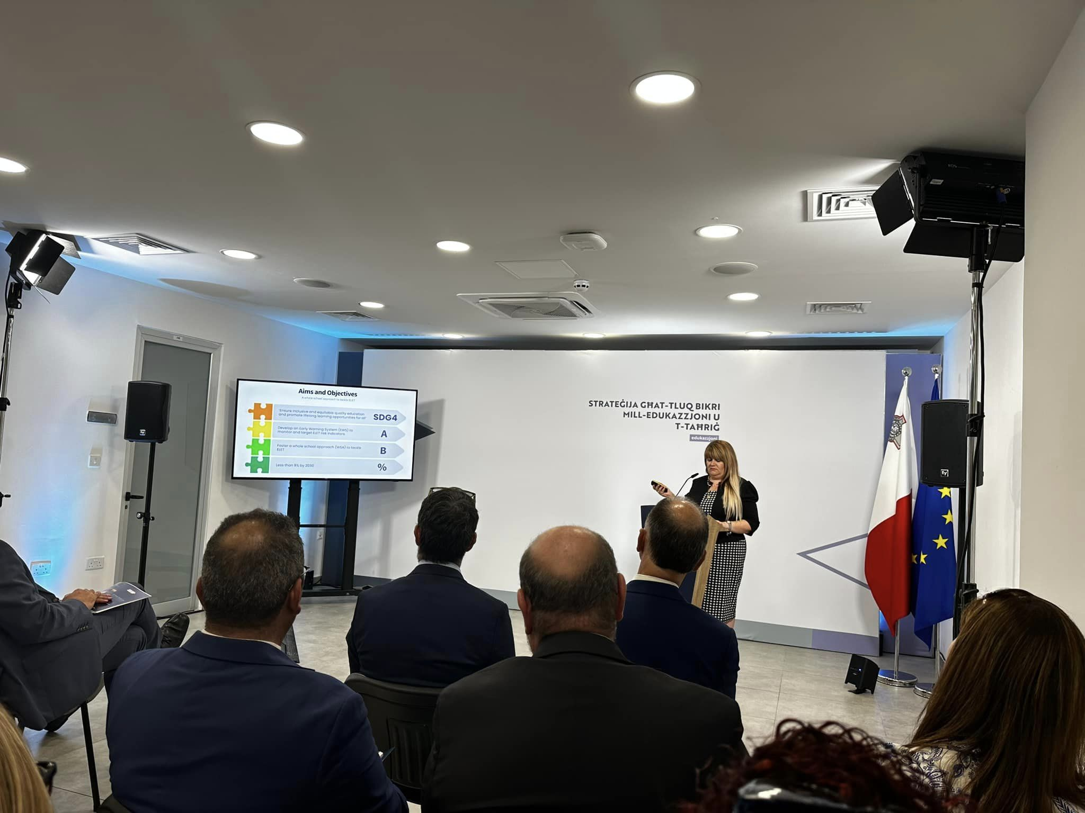

National Impact of my ESJ research
Tackling educational inequalities in relation to Early Leaving from Education and Training (ELET) –
Pamela Marie Spiteri – MALTA
2020 – Policy Draft:
consultation document
2021-2023 National
Strategy in ELET
01
02
2019 – organised
an international symposium
03

