Slide 1
Recognising Mature Students’ Unpaid Care Work as a Form of Work-based Learning
Dr Sally Welsh
sallywelsh2003@yahoo.co.uk
Bluesky:@sallywelsh2003.bsky.social
20th November 2024

Slide 2
Overview
The idea behind the research project
The research design and the Listening Guide
Patricia Gouthro’s homeplace theory
The main findings
Conclusion

Slide 3
Background to the research
HE in FE: vocational, work-readiness and employability
The valorisation of paid work over unpaid care work in HE
Holistic emphasis of lifelong learning (UNESCO, 1972)
Lifelong learning as skills acquisition and individual prosperity
Research subquestion: How does the learning of mature students interact with their care work at home?
Notes:
Lesson descriptions should be brief.

Slide 4

Foundation degrees as an example
Introduced in 2001
An FdA/FdSc is the equivalent of 2/3 of a Bachelor’s degree
63% are taught in English FECs (AoC, 2022)
Strong emphasis on demand-led skills from local employers
Mandatory work-based learning (WBL) components
66% of Foundation degrees were awarded to women in female-coded occupations (HESA, 2020)
But when it comes to care-related degrees…
Mature students do not believe their private experiences are appropriate for HE learning

Slide 5
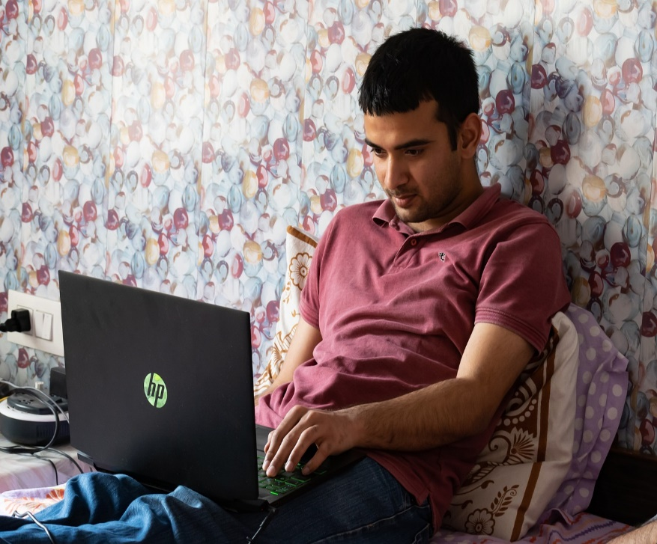
Research Methods
SAMPLE
15 volunteers from FECs in north-east England
Age range from 25-53
Range of degree types and subjects
10 in full-time paid work
9 parents
1 cared for her mother
4 lived alone
5 men, 10 women
4 LGBTQI+, 11 straight
LIFE HISTORY INTERVIEWS AND A JOURNAL
Between April- June 2021
Semi-structured
Online, recorded

Slide 6
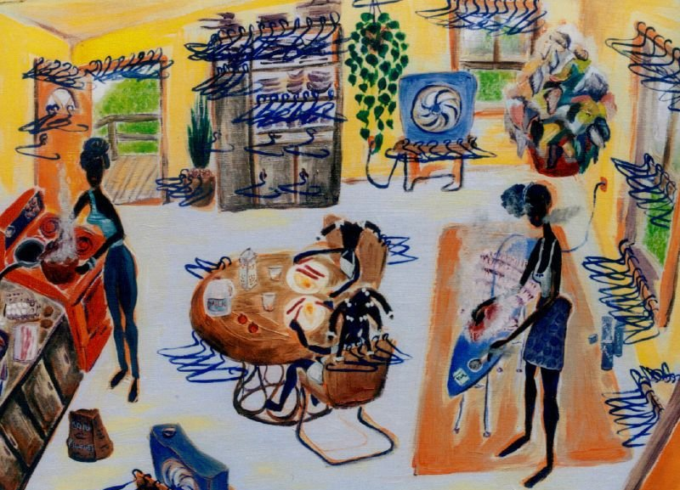
A critical feminist theory of the homeplace
Considerations
Feminist troubling of the private/public realm division
A site for learning and work: COVID-19
Corrosive effect of the marketplace on education
Gouthro’s theory of the homeplace:
Identity
Relationships
Labour
Critical approaches to learning
Harris, Z. (2003) Saturday Morning Ironing Begins. [Oil Painting]. Available at: https://cargocollective.com/zealharris/Saturday-Morning-Ironing-Begins [Accessed 23/10/2024].

Slide 7
Data analysis: the Listening Guide
Transcribed interviews in full
Four separate readings of the transcripts
Restorying, recurring language and reflexivity
Creating I-poems/ pronoun poems
The self-in-relation
Enabling and disadvantaging structures

Slide 8
How to present the findings
Decisions
Issues
Multiple readings led to the recognition of patterns and labelling of story types
The role of outliers
I-poems bring the reader into a different relationship with data, different voices visible
Focus on language and metaphor
Transparency, validity: journal extracts
What about less prominent stories, e.g. use of alcohol, disability, rebellion?
Certain ones ‘call out as needing to be written about’ (Frank, 2015, p.10)
Selective empathy? Can make reader think the “I” directs the verb
Subjectivity
Messy, constant state of not knowing, uncomfortable feelings

Slide 9
‘Proper mams’: care work as a threat to learning
Things haven’t been great in that respect... a lot being put on me with the housework… the majority of the housework which is an absolute state at the moment. It’s just with papers everywhere. But yes, housework, making sure that the children are fed, and they go to activities, so I’m taking them to activities and so a lot falls on me. He’ll put the dishwasher on occasionally.
[Liz’s transcript]
My mam stayed at home. And dad was a labourer, he grafted. He worked really, really hard…. My mam, when she had us obviously, she stayed at home which back then was the done thing, I think. It was like the norm, and I remember going home from school to lovely home-cooked meals and lovely, you know, just she was a proper mam.
[Sue’s transcript]

Slide 10
The impact of home-schooling
22.5 hours/ 12 hours pw on home-schooling & childcare
Consistent across Europe
A fourth dimension added to ‘the triple shift’
Home-schooling discussed in detail by 5 women
Isolation
Disruption
Expectation that women prioritise care for others
For care-giving women, their central identity is familial and student identity is peripheral (Gouthro, 2004)
It is often care labour which threatens HE learning
Need for recognition
And then COVID happened
I wasn't Kim
I was a full-time mam
I was
I was home-schooling two children
I had
I had my children
I had my degree
I thought
I thought
I have to
I have to stop the degree
I can't say
I'm not going to be a mam. [Kim’s I-poem]

Slide 11
Gendered narratives
The ‘strong, independent woman’
‘The children always come first’
My interview question about guilt

Slide 12
The ‘juggling’ metaphor
I've managed fine the last two years
I've been on track
I managed absolutely fine
I don't know what happened
I just
I haven't coped in all honesty.
[Liz I-poem]
Accepts the premise that individuals are responsible for balancing work/ family/ study
Excessively long hours
Expectation tends to apply to women
‘Boundarylessness’ assumed in lifelong learning (Blackmore, 2006, p.22)
Physical boundaries

Slide 13
Institutional recognition of care work as a contributor to learning
Impossibility of work placements in lockdowns
Adverse adolescent experiences
Caring and ‘fighting’ for disabled family members
Why is workplace experience deemed to be objective and legitimate for assessment in vocational HE whilst unpaid care work is not?

Slide 14
Critical social literacy
Skills-led approaches to learning can squeeze theory out
Understanding power relations in the home and workplace
Questioning the values ascribed to their labour and experiences: stigma/shame
Being a mum has helped me
We've had to
I've been able to relate it to situations
I've been through [Nicky’s I-poem]

Slide 15
The student parent
They’ve got children. They want to better themselves. They’ll start to go and do this FE course; will not get much support and they’ll drop out. And on an emotional level as a parent, imagine thinking that you want to do something so much better for your child and you try, you make an effort, you make that big step, but then there’s a big wall there. There’s something that doesn’t work, finance or childcare or something. Imagine that feeling of stepping back and thinking: ‘I really tried, but I couldn’t. I tried to be the best mam I could, but I couldn’t do it.’ [Kim’s transcript]

Slide 16
Limitations and recommendations
One interview per participant only
Fewer men recruited than I envisaged
Only 6/15 were part-time students
3 FECs in northeast England
Let’s…
Assume paid working and studying from home are likely to continue
Embed respect for homeplace learning in HE curricula
Listen to carers in HEI settings
Consider how HEIs can best support mature students’ needs
Admit employability/ skills discourses obscure structural barriers
Try to reverse the retreat of adults from HE in England
Share research findings in accessible language

Slide 17
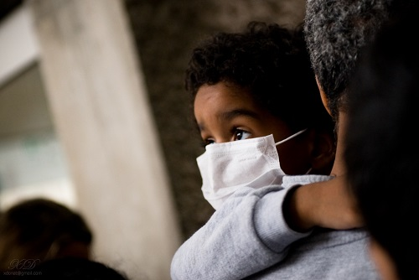
Is the tide turning on unpaid care?
UN International Day of Care and Support (29th October)
Counter-narratives published, e.g. Madeleine Bunting, Kathleen Lynch, The Care Collective
Research which listens to the voices of mature students who often go unheard in the FE sector

Slide 18
Thank you!
Some useful references
Blackmore, J. (2006) Unprotected participation in lifelong learning and the politics of hope: a feminist reality check of discourses around flexibility, seamlessness and learner earners. In: C. Leathwood and B. Francis (eds.) Gender and Lifelong Learning: Critical feminist engagements. Abingdon: Routledge.
Doucet, A. and Mauthner, N. (2008) What can be known and how? Narrated subjects and the Listening Guide. Qualitative Research, 8(3), 399-409.
Frank, A. W. (2015) Practicing Dialogical Narrative Analysis. In: J.A. Holstein and J.F. Gruber (eds.) Varieties of Narrative Analysis. Thousand Oaks: Sage Publications Inc.
Gouthro, P. A. (2004) Assessing power issues in Canadian and Jamaican women's experiences in learning via distance in higher education. Teaching in Higher Education, 9(4), 449-461.
Gouthro, P. A. (2009) Neoliberalism, lifelong learning, and the homeplace: problematizing the boundaries of ‘public’ and ‘private’ to explore women's learning experiences. Studies in Continuing Education, 31(2), 157-172.
Riessman, C.K. (2008) Narrative Methods for the Human Sciences. London: Sage Publications Ltd.
Welsh, S. (2024) Recognising and reimagining mature students’ unpaid care work as a form of work-based learning. Access: Critical explorations of equity in higher education, 12(1), 9-28.

