Slide 1
Timeline

Slide 2
What is the timeline?
Welcome to The Future of Human Reproduction Timeline! This timeline shaped, and was shaped by, some of our conversations about the future of human reproduction. It represents a messy and partial speculative exploration of the topic area. It is not intended to be viewed as a prediction or to be in any way regarded as being comprehensive. It was made to be scribbled on and scribbled out, to be edited and added to, and most importantly, it was made to prompt other conversations about the future of human reproduction.

Slide 3
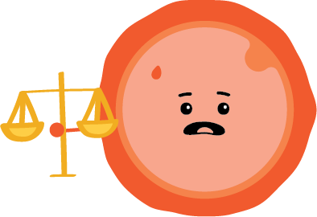






Types of Information
The timeline includes different types of information which are marked with different icons as follows:
Cultural Impact
Regulatory Development
Historical Event
Popular Figures, Media and Literature Speculation
Science Development
Technological / Scientific Impact
Linguistic Event

Slide 4


1818
1800s
Mary Shelley’s novel Frankenstein was published in London, UK. A foundational text in the development of Science Fiction as a genre, it continues to have significant influence on the cultural imagination of artificial creation.
Notes:
Image source read more books

Slide 5

1835
1800s
An infant warming device intended to improve the care of infants was developed by Johann Georg von Rueh for use at the Imperial Foundling Hospital in St. Petersburg, Russia.

Slide 6
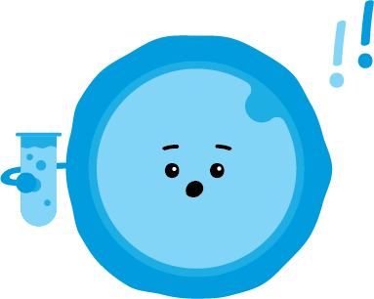
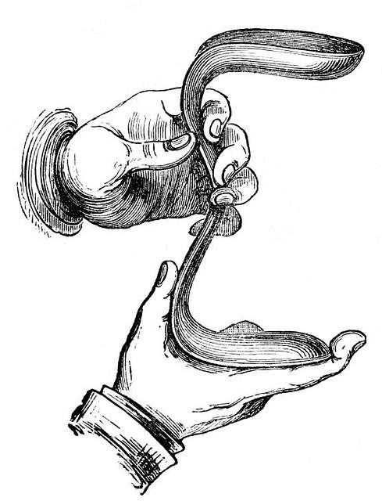
1845 - 1849
1800s
The vaginal speculum was developed by J. Marion Sims in the Southern USA. This device was developed to treat vesicovaginal fistula, a complication which occurs during childbirth causing a hole between the bladder and the vagina. The device was tested through a series of experimental operations on enslaved women in plantations.
Notes:
Image source collections get archive

Slide 7

1856
1800s
Gregor Mendel, an Austrian Abbot, began experiments on pea plants to study how traits were passed down from generation to generation. His work was not recognised during his lifetime, but its significance was recognised in the early twentieth century.

Slide 8
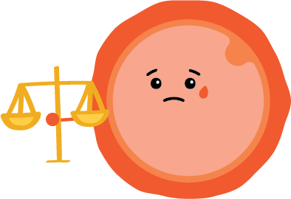
1861
1800s
The UK's Offences Against the Person Act criminalises abortion. Anyone found guilty of administering or procuring drugs or using instruments to abort a child, could be sentenced to up to life imprisonment.

Slide 9
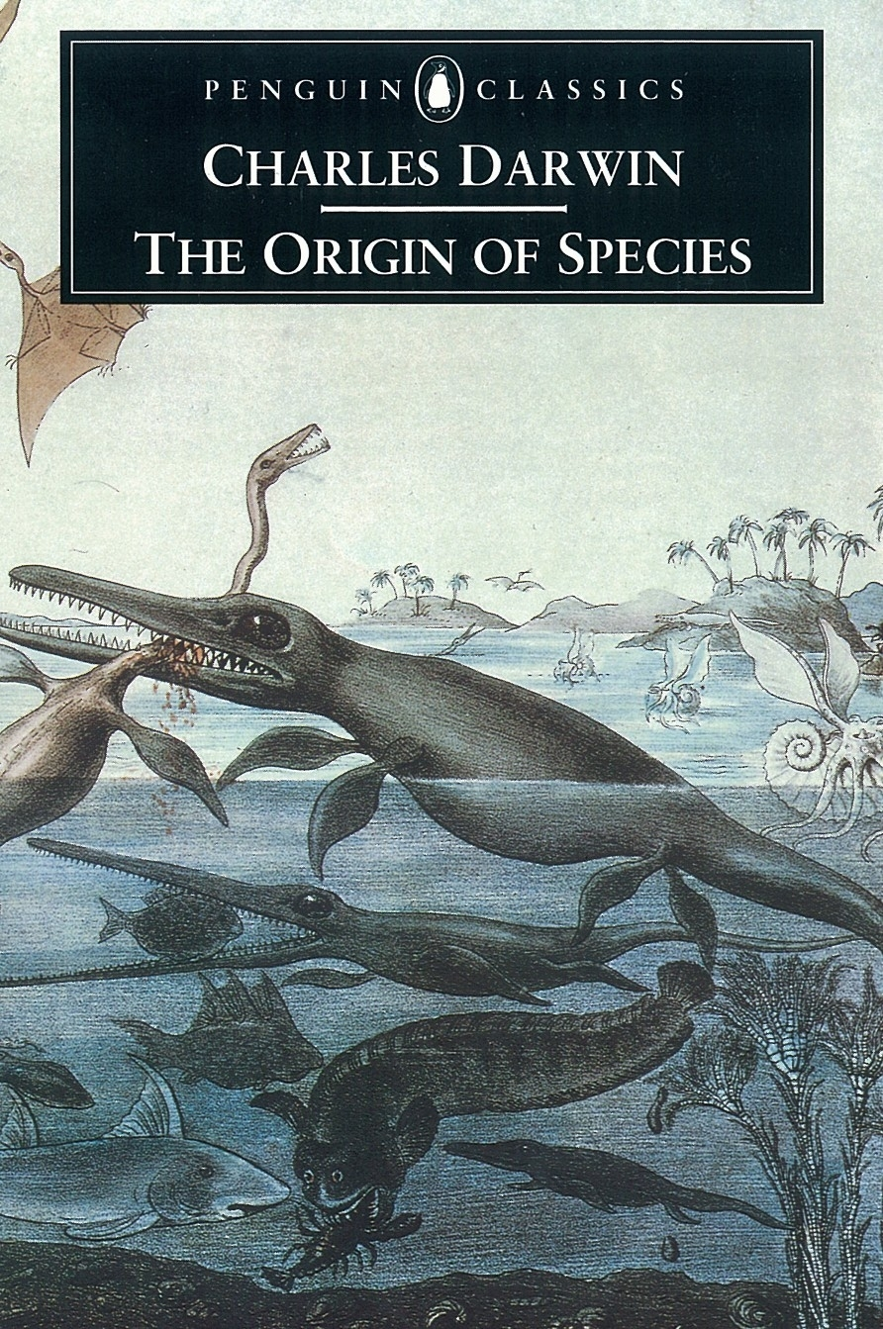
1818
1800s
Charles Darwin’s On the Origin of Species was published in London, UK. This revolutionised understanding of life on Earth.
Notes:
Image source penguin

Slide 10
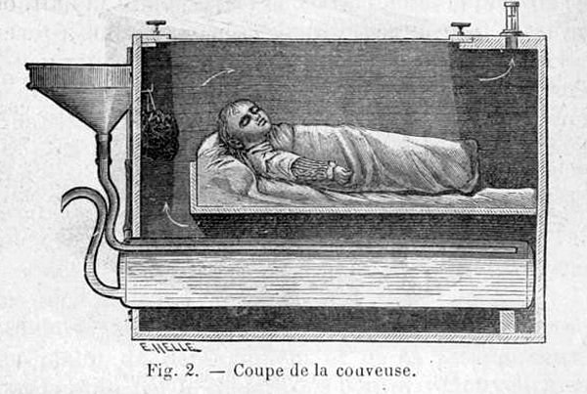
1881
1800s
Infant warming device prototype was developed by Etienne Stephane Tarnier at the Maternité Port-Royal in Paris, France. These incubators became a standard in neonatal care, used by doctors to save many infants, particularly premature infants.
Notes:
Image source neonatology on the web

Slide 11

1883
1800s
Francis Galton coins the term ‘eugenics’ to mean ‘good breeding’ or to ‘improve the inborn qualities of a race’.

Slide 12

1884
1800s
The first documented case of successful artificial insemination in humans was undertaken by William Pancoast in Philadelphia, US. He performed the procedure, without consent, on a woman whose husband was infertile, a condition for which they were collectively seeking treatment. The ‘patient’ was chloroformed before being inseminated with the sperm of a medical student via syringe after which her cervix was packed with gauze. Nine months later she gave birth to a baby.

Slide 13
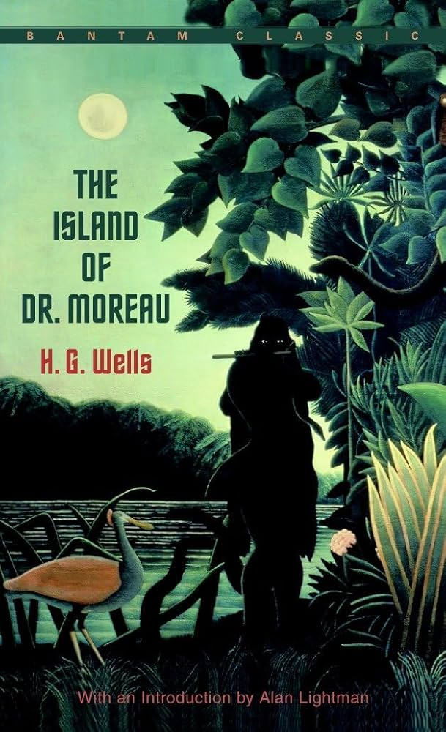
1896
1800s
Publication of H. G. Wells’ The Island of Doctor Moreau. This novel builds on the trope of the mad scientist that Mary Shelley originated in Frankenstein to question the ethics of scientific ambition and artificial creation. Wells’ Doctor Moreau, an exiled vivisectionist, splices together animals to create humanoid creatures.
Notes:
Image source goodreads

Slide 14

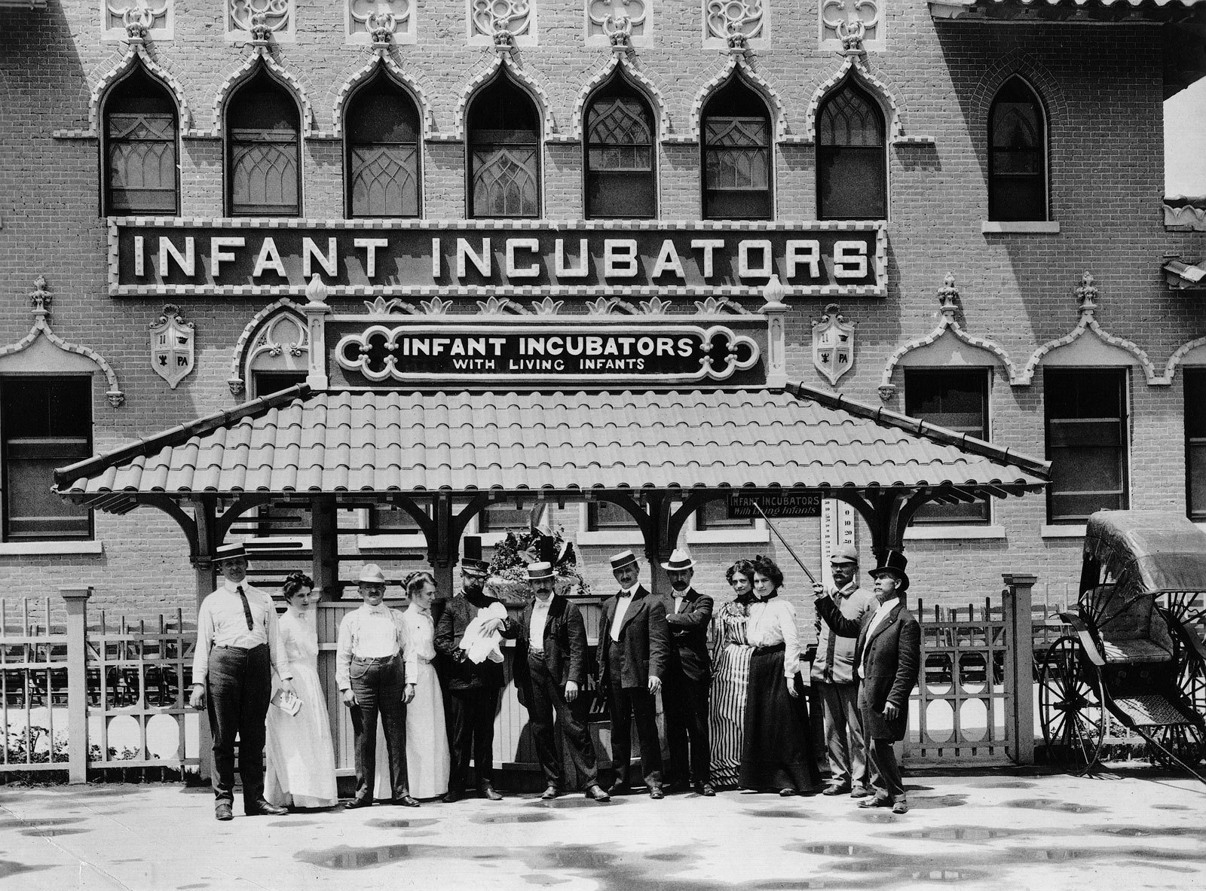
1903 - 1943
1900s
‘The Infantorium’ run by Martin Couney at Luna Park, Coney Island, US. This attraction allowed visitors to see premature babies in incubators with entry fees helping to fund staff and incubator costs to save these babies’ lives.
Notes:
Image source the new York times

Slide 15
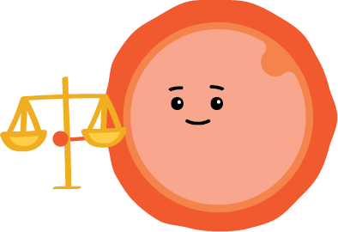
1911
1900s
The first maternity benefit laws were passed in the UK, offering 30 shillings to cover maternity costs.

Slide 16
1912
1910s
The first International Eugenics Congress was held by the Eugenics Society at the University of London, in South Kensington, London, UK. This conference was held to disseminate and advocate for eugenicist ideas.

Slide 17
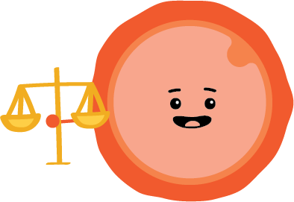
1918
1910s
Women over 30 gained the right to vote in parliamentary elections for the first time in the UK, if they already voted in local government elections or were married to men who did.

Slide 18
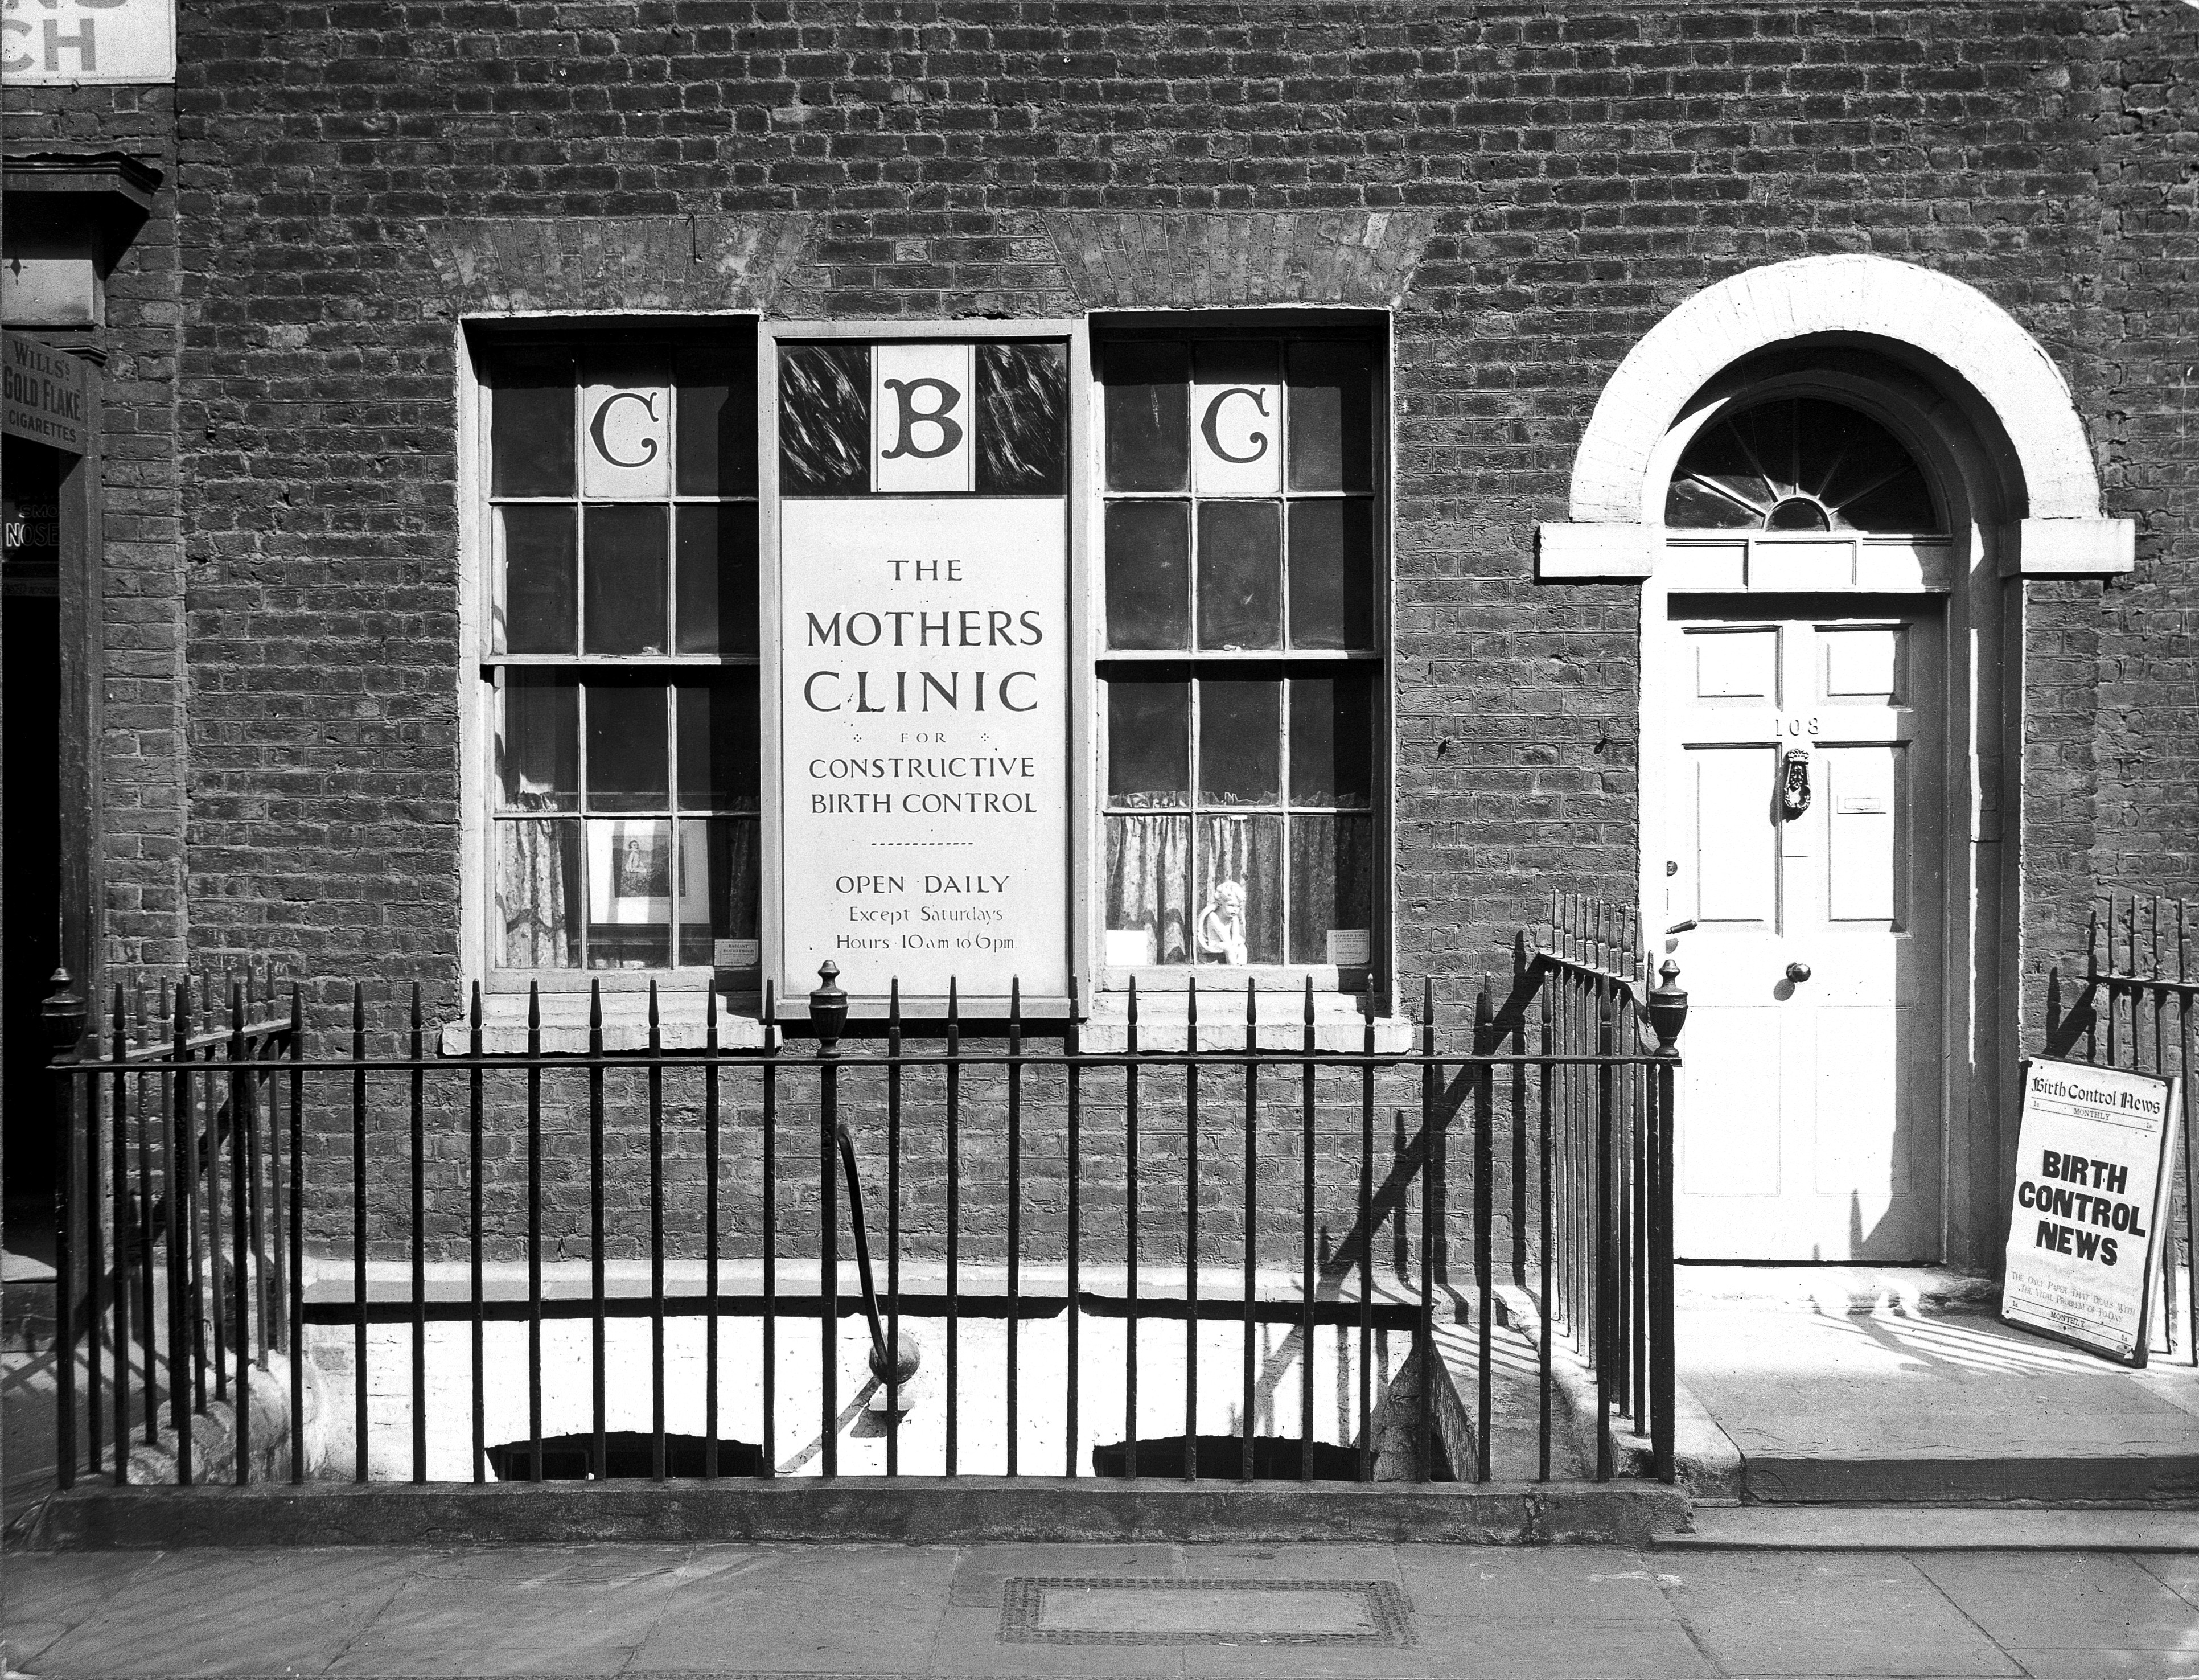

1920s
1920s
The first birth control clinic was opened by Marie Stopes in London, UK.
Notes:
Image source Wikimedia commons

Slide 19
1923
1920s
JBS Haldane gives a speech to the Cambridge Heretics Society that presents a speculative timeline of ectogenesis.

Slide 20
1929
1920s
The Infant (Life Preservation) Act 1929 creates the offence of child destruction at or before birth, punishable with up to life imprisonment. It introduces a rebuttable presumption that a fetus of 28 weeks or more is capable of being born alive. The Act applies to England and Wales.

Slide 21
1930s
1930s
Widespread forced sterilisations under eugenic programs across Germany, Japan and the US, used to control populations considered ‘undesirable’ or ‘unfit’ to procreate. This included immigrants, ethnic minorities, those considered mentally unwell, and poor people.

Slide 22
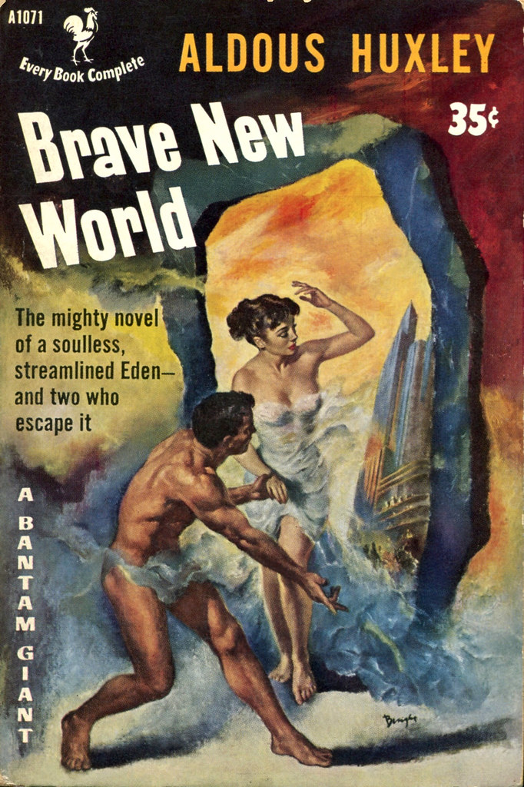

1932
1930s
Aldous Huxley’s dystopian novel Brave New World was published in London, UK. Set in a world in which reproduction takes place in a factory setting, Huxley’s novel includes one of the most famous representations of an artificial womb in Anglophone culture.
Notes:
Image source flickr

Slide 23
1948
1940s
The National Health Service (NHS) was established in the UK.

Slide 24

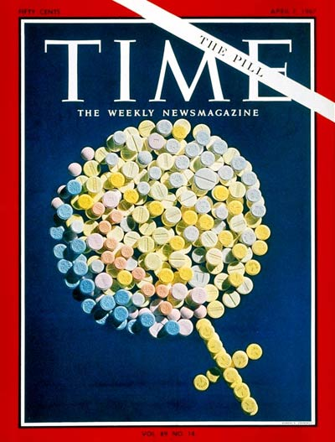
1951
1950s
Development of the contraceptive pill by scientists begins in the US, led by Dr Gregory Pincus. It works by mimicking the hormonal response to pregnancy to counteract conception.
Notes:
Image source time magazine

Slide 25
1951
1950s
Henrietta Lacks was treated for an aggressive cervical cancer at John Hopkins Hospital, where samples were taken during diagnosis. These cells –later known as HeLa cells– were passed to another researcher without Lacks’ knowledge or consent. The first immortal human cell line, HeLa cells have been used extensively in biomedical research, with over 50 million metric tonnes produced.

Slide 26
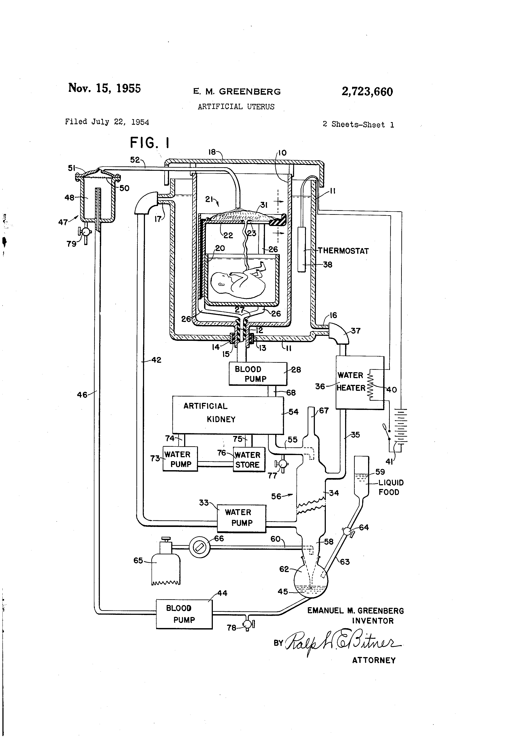
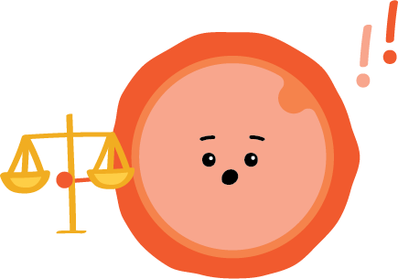
1954
1950s
A patent for artificial wombs is filed by Emanuel Greenberg in New York, US. The artificial womb is used to ‘support a prematurely born fetus and to provide nourishment and elimination of waste products in a manner similar to that employed by the mother’s uterus’.
Notes:
Image source google patents

Slide 27

1955
1950s
Human trials of contraceptive pill trials are held in Puerto Rico, a US territory, by John Rock and Gregory Pincus. The trials took place here due to strong opposition to birth control in America, whereas officials in Puerto Rico supported birth control as a form of population control.

Slide 28
1956
1950s
Ian Donald at GRMH (Glasgow Royal Maternity Hospital) first used ultrasound in diagnostic medicine to determine the diameter of the fetal head in 1956. This became essential for prenatal care throughout the 60s and 70s, and represented a step change in understanding fetal development.

Slide 29

Did you know? - The Pill
Initial reaction: The Pill is seen as a major disruption to traditional gender roles, family planning and morality, empowering women to have more control over their bodies. There were also fears that this would promote promiscuity with the pill initially only prescribed to married women, reflecting societal concerns. Across the 1960s and 70s it was covered extensively, often with headlines like ‘The Pill: Freedom or Moral Decline?’. Time Magazine featured the Pill on its cover, reflecting its impact on women’s liberation.
Now: The Pill is widely accepted as a standard form of birth control. It has empowered women in family planning, education, and career choices. It also sparked the development of other long-term contraceptive methods such as implants and IUDs.

Slide 30
1960
1960s
The contraceptive pill is approved by the Food and Drug Administration (FDA), in the US. It was later approved for use on the NHS in the UK in 1961, initially only to married women.

Slide 31
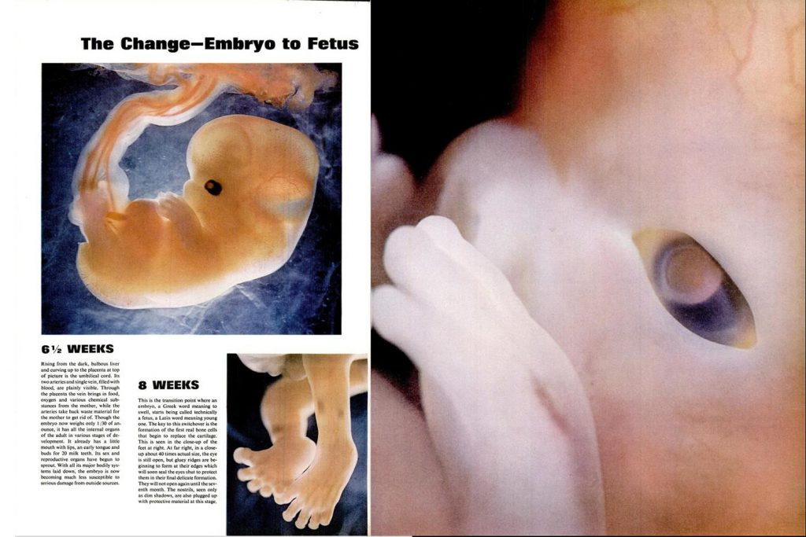
1962
1960s
The photoseries ‘Drama of Life Before Birth’ by Lennart Nilsson was published in Life Magazine. This was a series of photographs which depicted the stages of human fetal development from fertilisation to just before birth.
Notes:
Image source life

Slide 32
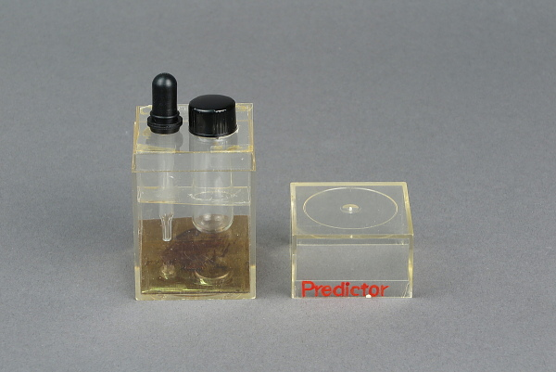
1967
1960s
Design prototype of first home pregnancy test by Margaret Crane in New Jersey, US. The kit allowed women to test whether they were pregnant or not without needing to consult a doctor.
Notes:
Image source smithsonian

Slide 33
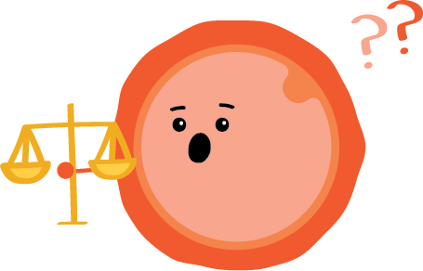
1967
1960s
The Abortion Act introduces two grounds on which a registered medical practitioner can terminate a pregnancy if two registered medical practitioners are of the opinion, formed in good faith, that one of these grounds has been met. The Act applies to England, Scotland and Wales.

Slide 34
1969
1960s
The first time a human egg was fertilised in a test tube by Robert Edwards in Oldham, UK. This started in vitro fertilisation (IVF) attempts in research labs across the UK and US.

Slide 35

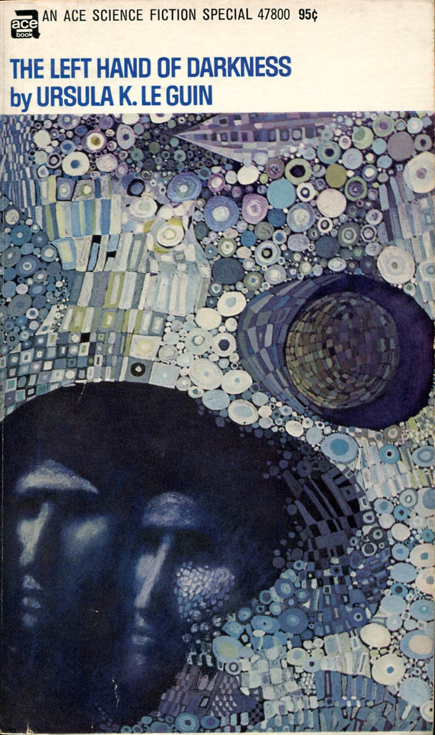
1969
1960s
Ursula K. Ke Guin’s novel The Left Hand of Darkness was published in the US. Set on a planet where the population is ambisexual (with no fixed sex), Le Guin’s novel explores how relationships between gender and reproduction shape society and politics. It’s most famous line, 'the King was pregnant' signals the vast difference between this world and Le Guin’s.

Slide 36
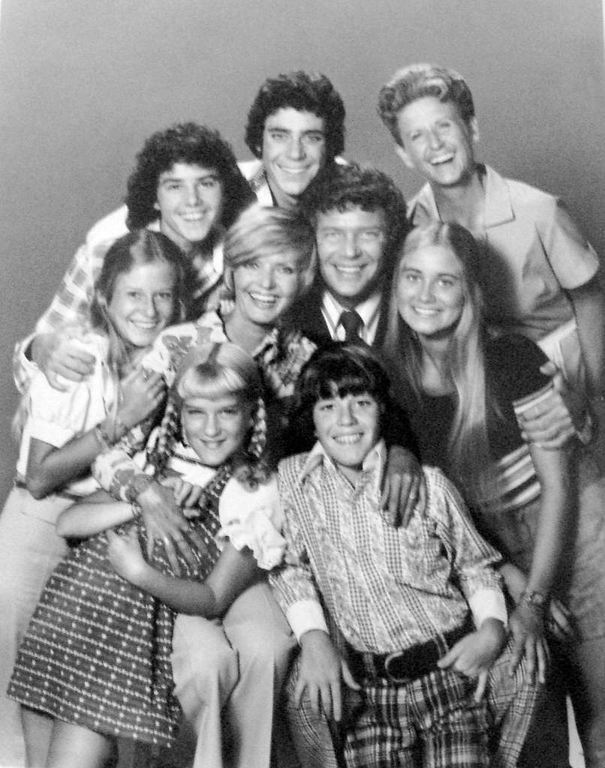
1969 - 1974
1960s
The TV show ‘The Brady Bunch’ was broadcast on ABC in the US. The show portrayed a blended family formed by the marriage of a man and a woman with children from previous marriages, introducing the concept of blended families to mainstream audiences. It showed how families could thrive despite non-traditional structures and was a reflection of societal changes, as divorce rates rose, and remarriage became more common.
Notes:
Image source flickr

Slide 37
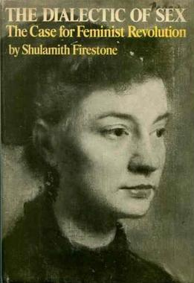
1970
1970s
Shulamith Firestone’s work of feminist theory, The Dialectic of Sex was published in the US. Often cited as an example of techno-optimism, Firestone argues that reproductive technologies such as artificial wombs have the potential to advance gender equality.

Slide 38
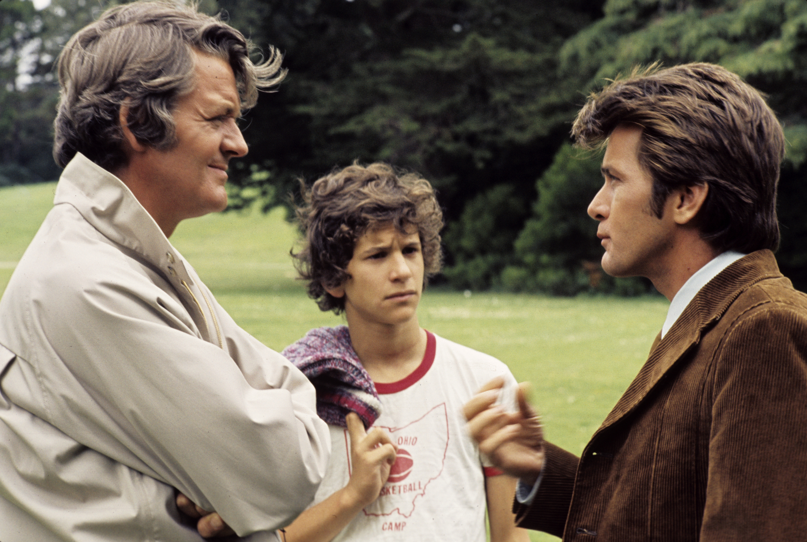
1972
1970s
First broadcast of ABC’s That Certain Summer. This made-for-TV movie about a father who comes out to his teenage son was the first sympathetic depiction of gay parenting to appear on US television.
Notes:
Image source in magazine

Slide 39
1973
1970s
In Roe v Wade, the US Supreme Court establishes a woman's constitutional right to have an abortion in the first trimester of pregnancy.

Slide 40

1973
1970s
Woman on the Edge of Time, a novel written by Marge Piercy, was published in the US. It envisions a future with gender-equal reproduction via artificial wombs.

Slide 41
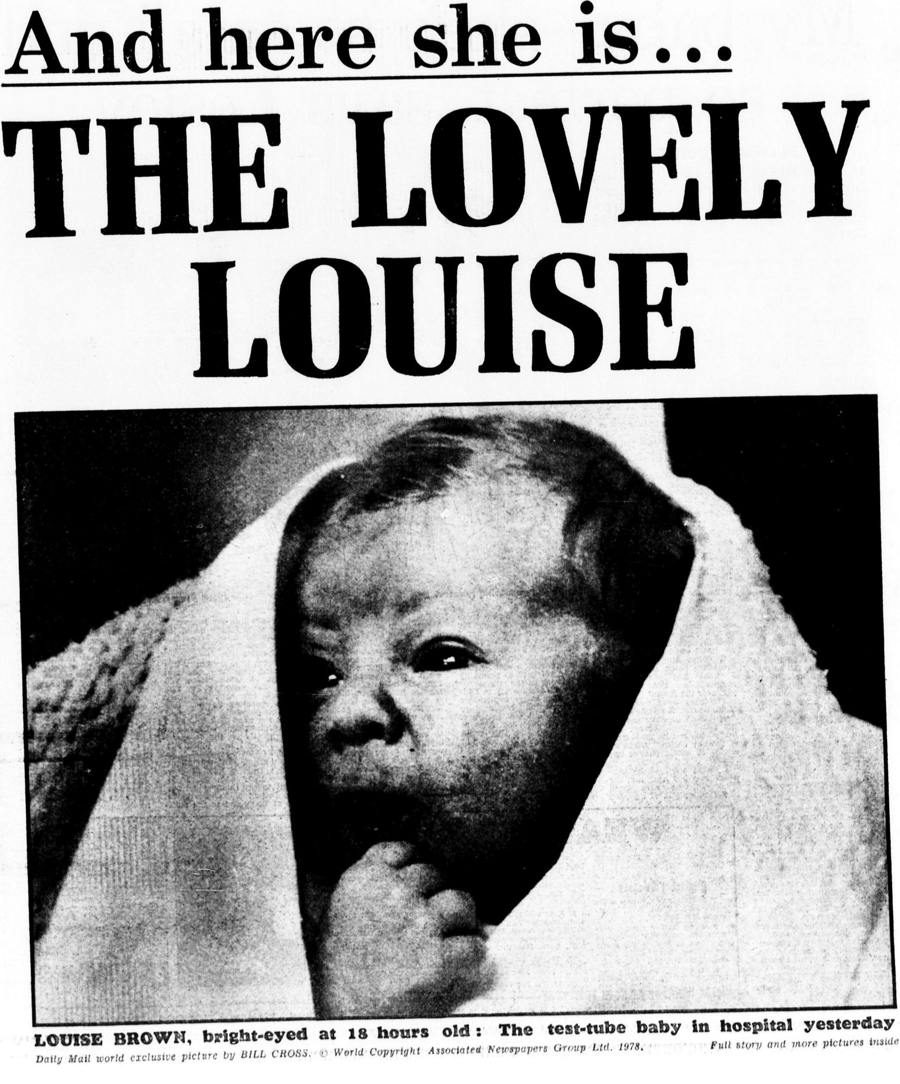
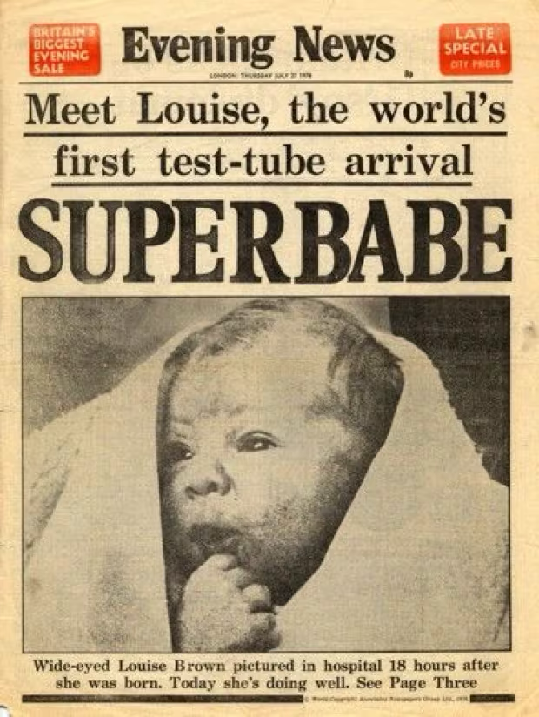
1978
1970s
The world’s first IVF baby, Louise Brown, was born in Oldham, UK.
Notes:
Image source daily mail and in magazine

Slide 42
1978
1970s
The second ever IVF baby, Kanupriya Agarwal, nicknamed ‘Durga’ was born in Calcutta, India. This birth occurred 67 days after Louise Brown.

Slide 43
Did you know? - IVF
Initial reaction: When the world’s first IVF Louise Brown was born in 1978, the birth made global headlines with The Daily Mail calling her a "miracle baby" while religious groups warned of ‘unnatural’ reproduction that was ‘playing God’. This resulted in infertility becoming a medical rather than just a social stigma and feminist movements pushing for reproductive autonomy, influencing policy changes.
Now: IVF is a mainstream fertility treatment, with over 8 million IVF babies born worldwide. Advances in genetic screening and embryo freezing have further normalised its use.

Slide 44
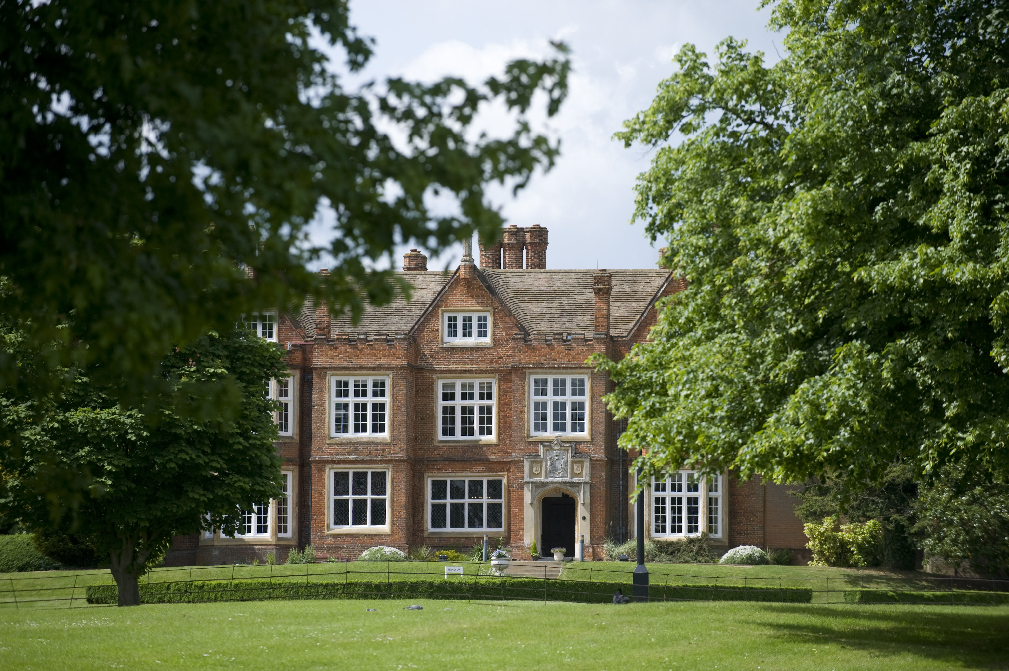
1981
1980s
The first in vitro fertilisation (IVF) clinic was founded by Patrick Steptoe, Robert Edwards and Jeane Purdy at Bourn Hall, Cambridge, UK. This clinic created the first ethics committee for discussing IVF.
Notes:
Image source Wikimedia commons

Slide 45
1981
1980s
The first IVF academic conference takes place at newly opened Bourn Hall. This brought together IVF specialists to discuss this emerging field.

Slide 46
1983
1980s
The first NHS-funded IVF service was established at Saint Mary's Hospital, in Manchester, UK.

Slide 47
1983
1980s
The first ever child conceived with a donor egg was born in Australia.

Slide 48
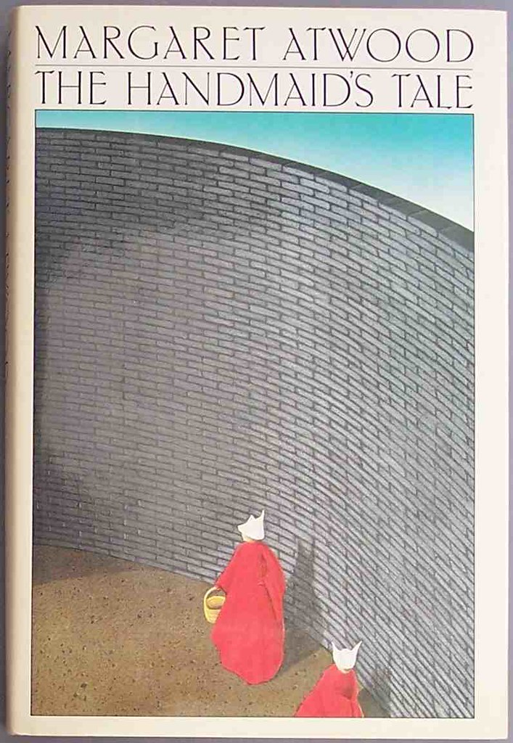
1983
1980s
The Handmaid’s Tale by Margaret Atwood was published in Canada. This dystopian novel critiques forced pregnancy and theocratic control. It has had a lasting legacy in US reproductive activism.
Notes:
Image source flickr

Slide 49
1985
1980s
The UK's Surrogacy Arrangements Acts regulates surrogacy arrangements.

Slide 50
1986
1980s
First study to show neonatal preference for listening to stories that had been heard in the womb - Fetuses can learn (DeCasper and Spence)

Slide 51
1989
1980s
The inception of ICSI (Intracytoplasmic Sperm Injection), aiding male infertility by Gianpiero Palermo in Brussels, Belgium. This treatment provides assistance to couples who were unable to have a baby where the father was the genetic parent.

Slide 52

1989
1980s
Octavia E. Butler’s Xenogenesis trilogy was completed. This series of novels depicts the invasion of an alien species who are able to modify the genetic makeup of other life forms. It explores relationships between power and genetic modification, critiquing Cold War politics and nuclear armament.
Notes:
Image source books2door

Slide 53
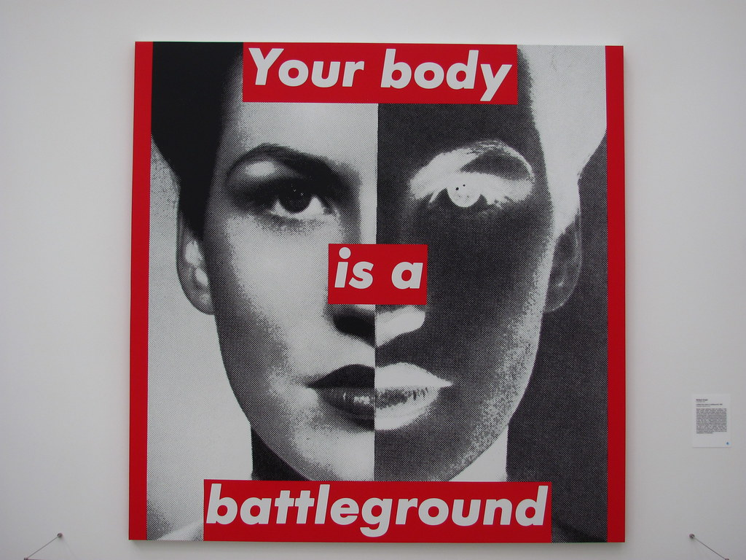
1989
1980s
Barbara Kruger makes bold text-based art that critiques abortion bans, such as ‘Your Body Is a Battleground’.
Notes:
Image source flickr

Slide 54
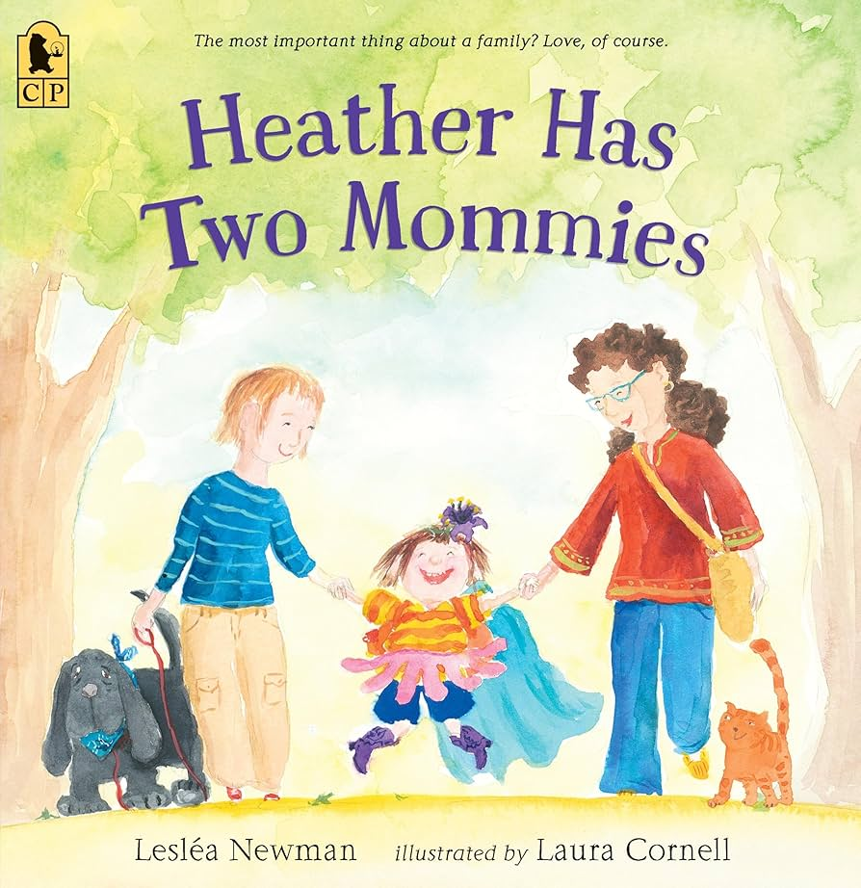
1989
1980s
Publication of Heather Has Two Mommies in the US, a children’s book by Lesléa Newman depicting a family with lesbian parents.
Notes:
Philadelphia museum of art

Slide 55
1990s – Internet & Social Media
Initial reaction: Seen as a niche tool for academics and tech enthusiasts. There were early concerns about safety, fraud, and its impact on social skills. Social media was initially dismissed as a fad or a distraction.
Now: The internet is fundamental to communication, work, shopping, and entertainment. Social media is a dominant force in politics, business, and personal interaction.
cultural context

Slide 56
1990
1990s
The UK's Human Fertilisation and Embryology Act regulates the creation and use of human embryos, including in fertility treatment and research. It creates and establishes the Human Fertilisation and Embryology Authority (HFEA) as the regulatory body. It also amends the Abortion Act 1967 to introduce two further grounds on which a pregnancy can be terminated, with a 24-week time limit included in one of those grounds.

Slide 57
1990 - 2003
1990s
The Human Genome project took place. This was a major scientific project that figured out the genetic makeup of a human organism (DNA).

Slide 58
1991
1990s
The first edition of the HFEA’s Code of Practice is published.

Slide 59
1992
1990s
Birth of first child following preimplantation genetic testing (PGT) reported by clinicians at Hammersmith Hospital, London, UK including Andy Handyside and Robert Winston. This procedure is used to prevent genetic disorders from passing from a parent to their child.

Slide 60
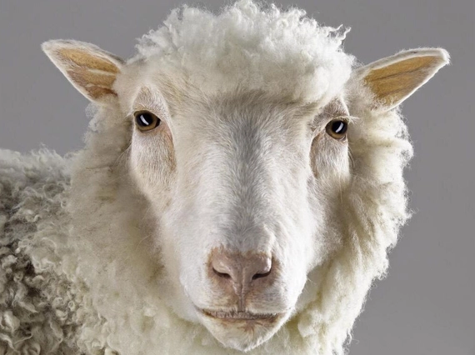
1996
1990s
Dolly the sheep is the first cloned mammal created from an adult cell. This was part of the Roslin Institute’s research into genetically modified farm animals or livestock at the University of Edinburgh, Scotland, UK, led by Ian Wilmut.
Notes:
Image source the national museum of scotland

Slide 61

1999
1990s
The Wackowski’s science fiction film The Matrix was released by Warner Bros Entertainment. This explores relationships between technology, control and human identity. It includes one of the most famous cultural representations of an artificial womb.
Notes:
Image source imdb

Slide 62
2000s – Online Banking & Contactless Payments
Initial reaction: Many feared online banking was too insecure to be widely adopted. Contactless payments were met with scepticism about fraud risks.
Now: Online banking is the norm, with many banks shifting to digital-first services. Contactless payments are now the preferred payment method in the UK, boosted by COVID-19.
cultural context

Slide 63

2000
2000s
The first report of a human uterus transplant, performed in Saudi Arabia. The transplantation failed after 99 days.

Slide 64
2001
2000s
The UK's Human Reproductive Cloning Act prohibits placing in a woman a human embryo created other than by fertilisation.

Slide 65
2005
2000s
The UK's Gender Recognition Act enables transgender people to have their gender legally recognised, including by changing their recorded sex on their birth certificate.

Slide 66
2008
2000s
The Human Fertilisation and Embryology Act introduces new provisions about who can be treated in law as the parents of a child born following medically assisted reproduction. It also amends the Surrogacy Arrangements Act 1985, the Human Fertilisation and Embryology Act 1990, and repeals the Human Reproductive Cloning Act 2001.

Slide 67
2010s – Ridesharing & Gig Economy
Initial reaction: : Traditional taxi drivers protested Uber's disruption of their industry. Concerns are raised over worker rights and regulatory loopholes.
Now: OnRide-sharing services are a major part of urban transport. Gig work has become a widespread employment model, despite ongoing debates over labour rights.
cultural context

Slide 68

2010
2010s
Growth of FemTech, for example period-tracking apps such as Clue, Flo, and Ava, which revolutionize individuals’ knowledge and awareness of their menstrual cycles.

Slide 69

2013
2010s
Margaret Atwood’s Maddaddam trilogy was completed. These speculative novels are set shortly before, and in the aftermath of, a bio-engineered apocalyptic event. They explore how relationships between the art, nature and technology change under a system of advanced capitalism and imagine some possible effects of genetic engineering.
Notes:
Image source abebooks

Slide 70
2014
2010s
First publication on CRISPR titled ‘The new frontier of genome engineering with CRISPR-Cas9’ by Doudna and Charpentier showed a link between bacteria and genome editing.

Slide 71
2014
2010s
‘Social’ egg freezing (done for non-medical reasons) becomes a workplace benefit at Apple and Facebook to attract women into the workforce.

Slide 72
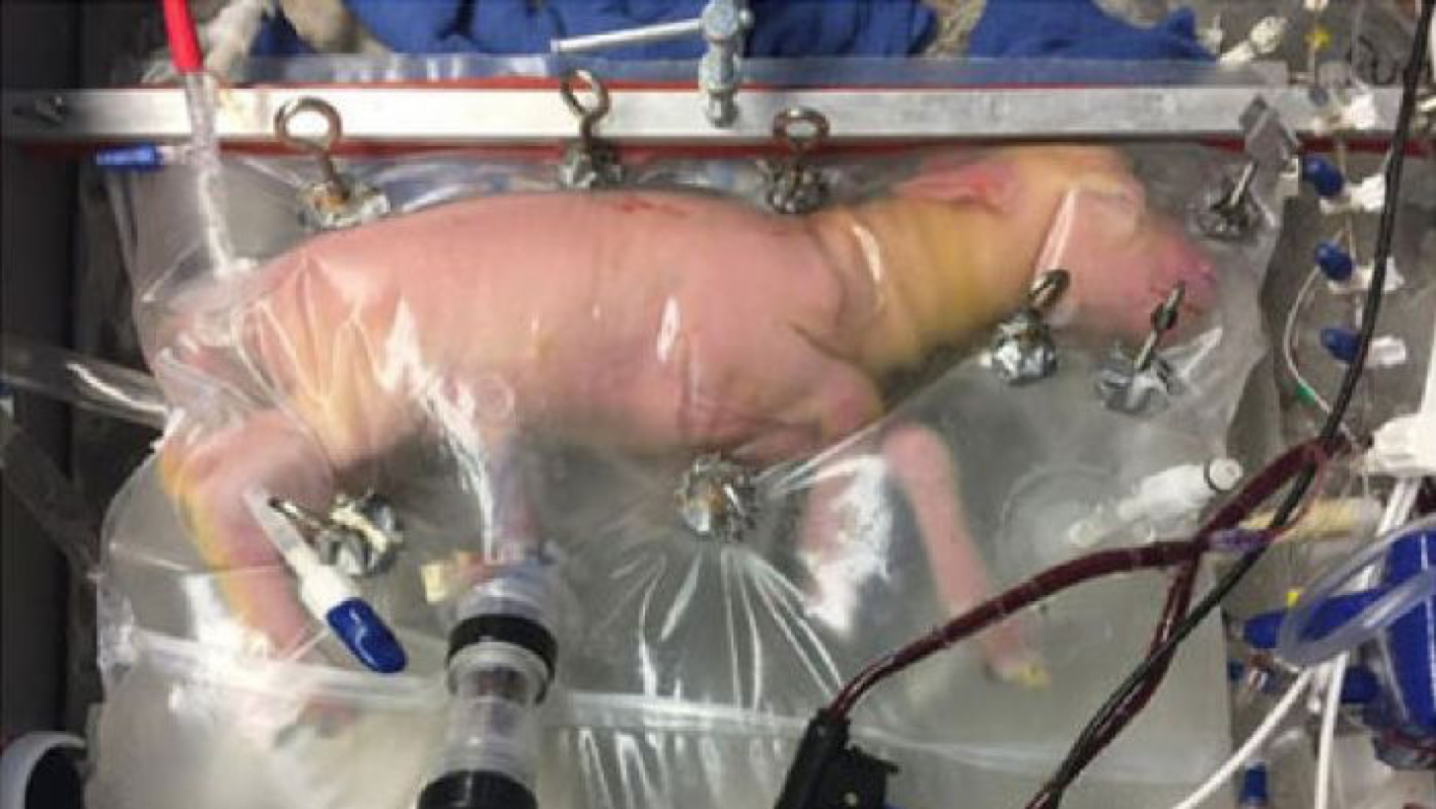
2017
2010s
A team from The Children’s Hospital of Philadelphia (CHOP) reported the development of the Biobag, an external gestation environment that closely reproduces the conditions of the womb. The Biobag is a sealable polythene bag containing sterile, synthetic amniotic fluid, with catheters delivering nutrients and removing waste products.
Notes:
Image source: Partridge, E., Davey, M., Hornick, M. et al. | Nature Communications.

Slide 73
2017
2010s
First experimental study to use light and 4D shows that fetuses can process and show preference for visual patterns: can have 4D ultrasound images and light sources used as artefacts.

Slide 74
2018
2010s
Only one baby born with Down Syndrome in Iceland due to prevalence of selective termination after pre-natal tests.

Slide 75

2018
2010s
Chinese scientist He Jiankui announces that he has created the world’s first gene-edited babies using CRISPR-Cas9. He claimed to have edited a gene in embryos from twin girls (known as Lulu and Nana) to make them resistant to HIV, since their father was HIV-positive. He Jiankui was later sentenced to 3 years in prison by a Chinese court for “illegal medical practices.’

Slide 76
2019
2010s
Abortion in Northern Ireland is decriminalised, with the relevant sections of the Offences Against the Person Act 1861 repealed. Abortions can now be legally performed across the UK.

Slide 77
2020
2020s
Human induced pluripotent stem cells re-programmed to the stage before they become eggs.

Slide 78
2020
2020s
Early home abortions (before ten weeks) temporarily approved in England during the COVID-19 pandemic. In 2025 this change was made permanent.

Slide 79
2021 - 2025
2020s
Potential movement away from the 14-day rule for embryo research

Slide 80
2021
2020s
ThermoFisher, sued by the Lacks family, for unjust enrichment in the use and commercialisation of the HeLa cell line, which was obtained without the consent of the donor, Henrietta Lacks, during a medical procedure in 1951.

Slide 81
2021
2020s
International Society for Stem Cell Research (ISSCR) removes support for the rule from its 2021 guidelines, recommending public conversations about the societal and ethical issues.

Slide 82


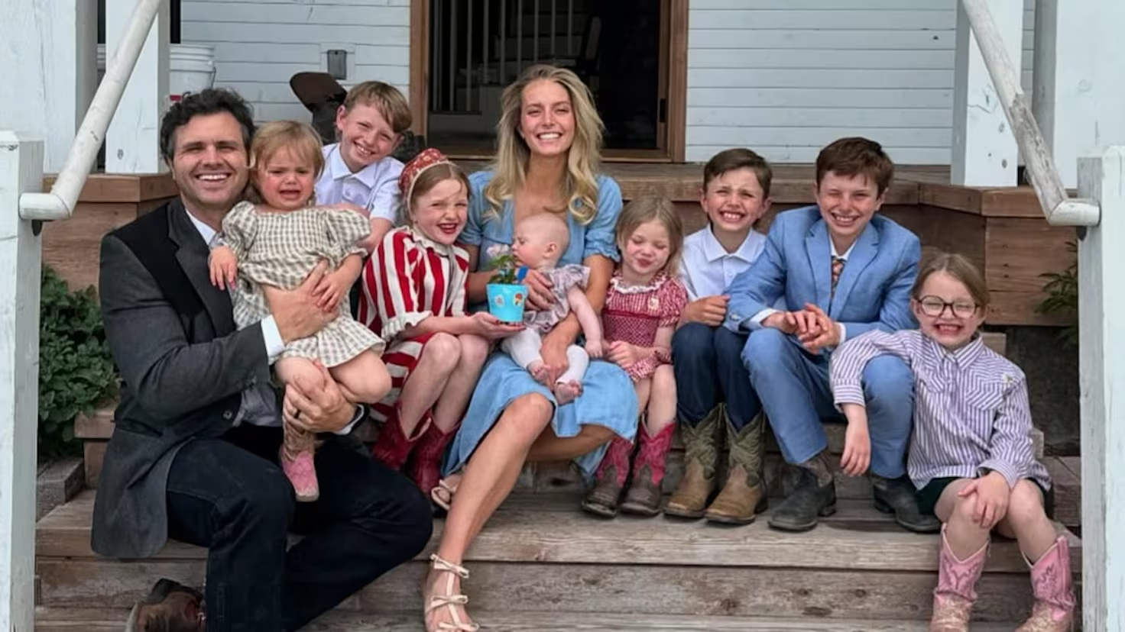
2022 - 2023
2020s
The rise of the trad-wife movement online. Content creators such as Nara Smith and Ballerina Farm advocate for a return to traditional gender roles, particularly women taking on domestic roles like looking after the children and the home.
Notes:
Image sources (top) Nara Smith - Image Source: Food & Home Magazine (bottom) Ballerina Farm - Image Source: AS USA – Diario AS

Slide 83
2022
2020s
The 1973 decision in Roe v Wade is overturned by the US Supreme Court, enabling individual states to enact or enforce laws restricting, banning or permitting abortions.

Slide 84
2023
2020s
Teams based in the UK/US and Israel report having created of the first human stem cell–based embryo models.

Slide 85
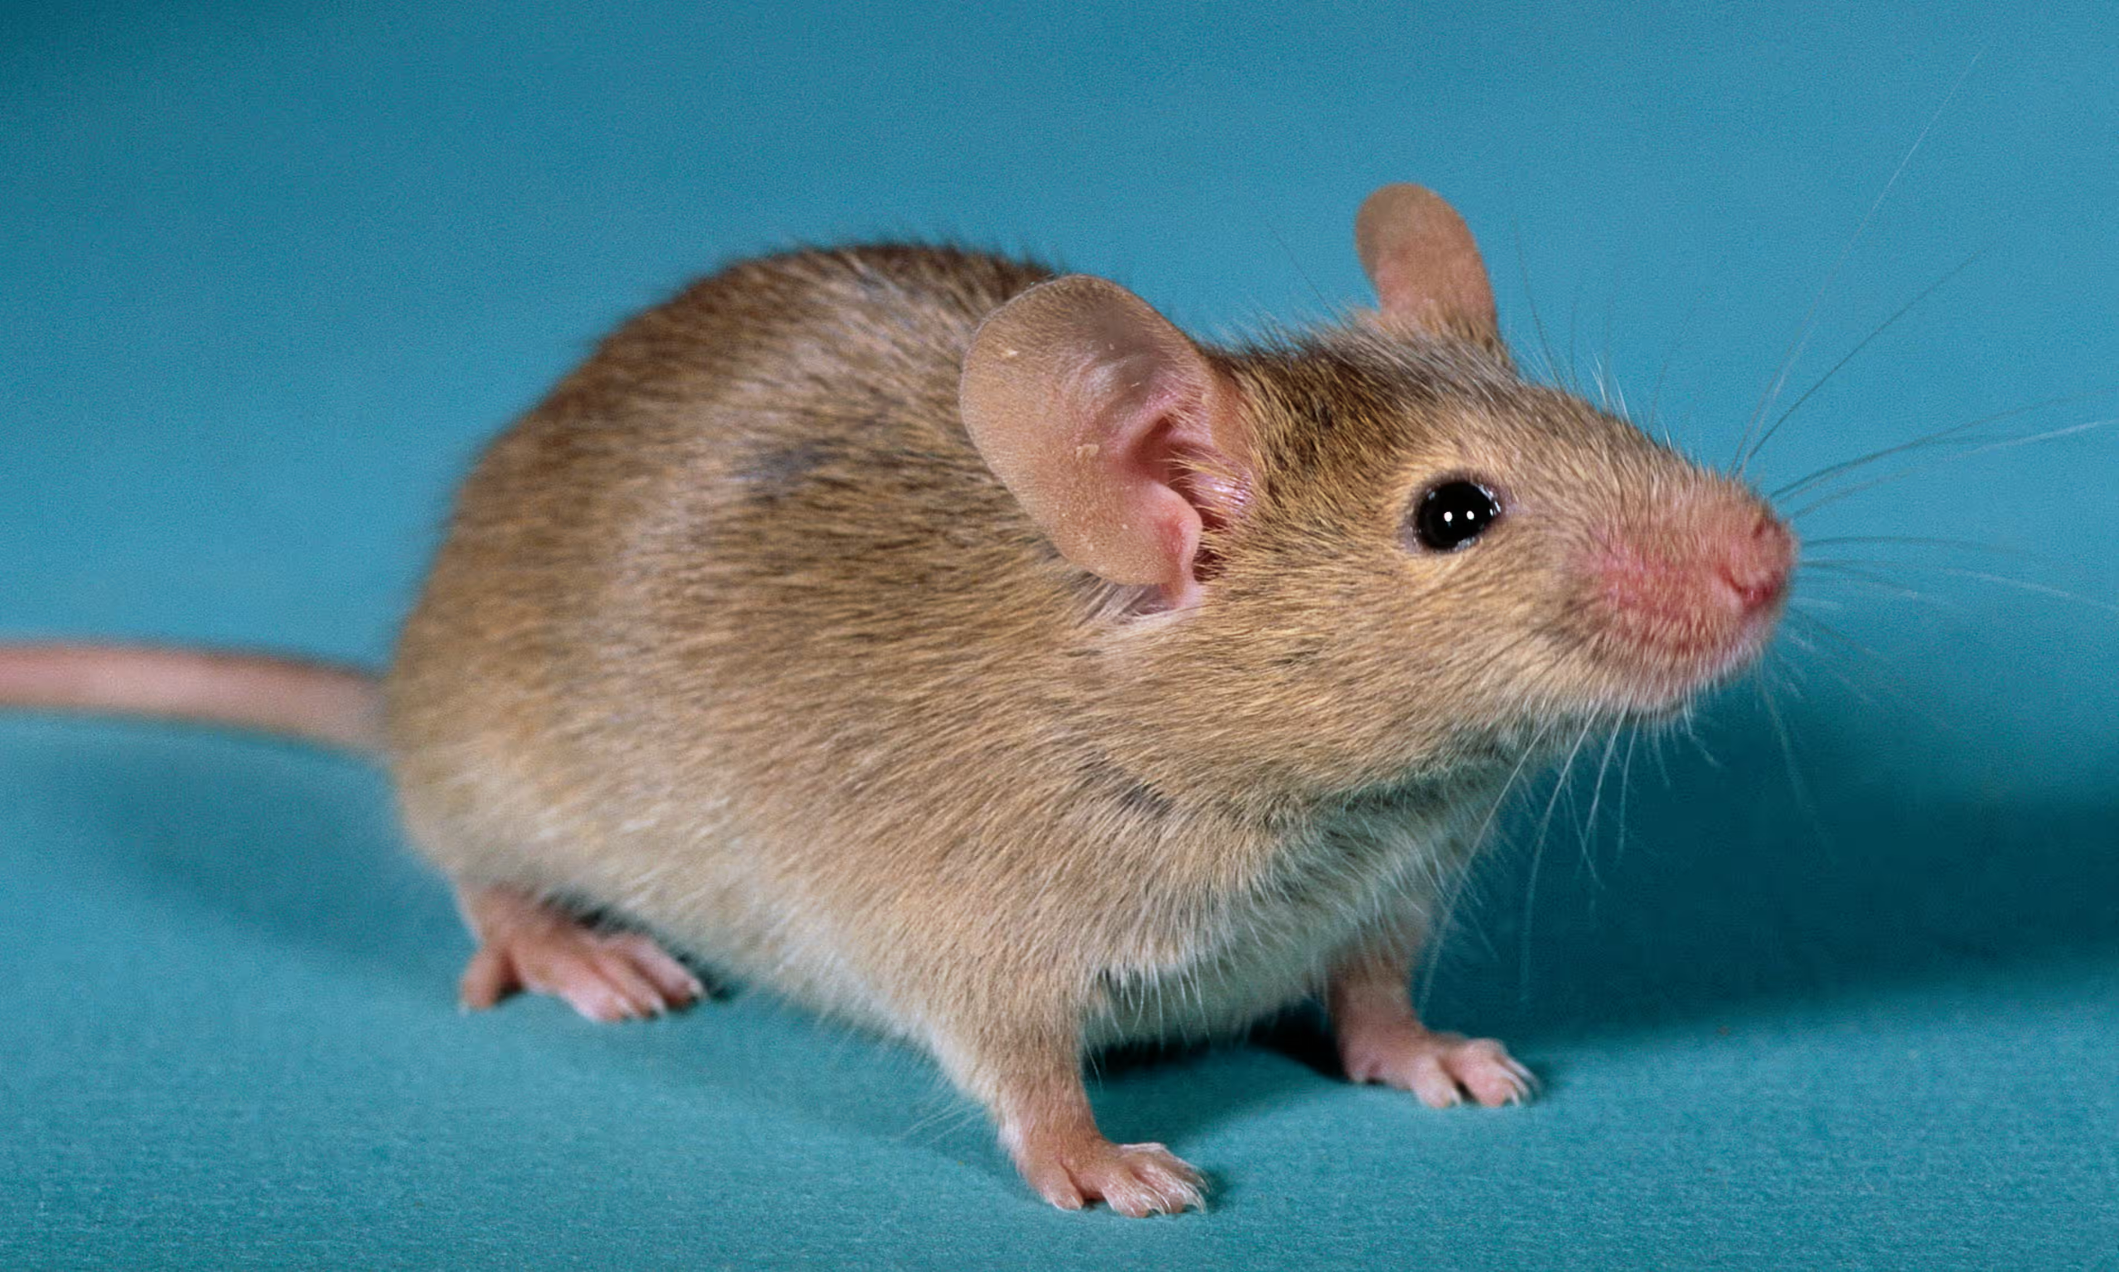
2023
2020s
Scientists create mice with two fathers after making eggs from male cells, opening up new opportunities for reproduction.
Notes:
Image source the guardian

Slide 86
2023
2020s
MHRA authorisation for gene therapy through CRISPR that aims to cure sickle cell anaemia + Beta Thalassemia.

Slide 87
2023
2020s
The Health Council of the Netherlands recommends that the 14-day rule for embryo research be extended to a 28-day rule.

Slide 88
2023
2020s
Nuffield Council on Bioethics publishes its report on stem cell-based embryo models and recommends setting up a distinct a governance framework (separate from that for embryos).

Slide 89
2024
2020s
HFEA recommends that the law is changed to extend the time limit on embryo research.

Slide 90
2025
2020s
Nuffield Council on Bioethics commences a major review of the 14-day rule for research on human embryos.

Slide 91
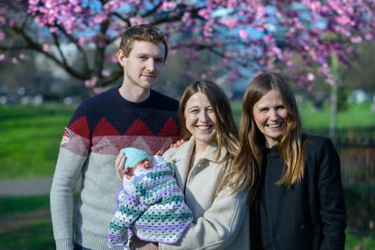
2020s
2025
For the first time in the UK, a woman (Grace) has given birth following a womb transplant. The baby is called Amy Isabel, named after Grace’s sister Amy, who donated the womb. This follows over 25 years of research by a team led by Professor Richard Smith.
Notes:
Image source the guardian

Slide 92
2025
2020s
The UK Supreme Court unanimously rule that, under the Equality Act 1990, the terms ‘woman,’ ‘man,’ and ‘sex’ refer exclusively to biological sex.

Slide 93
2030
2030s
Human trials of artificial womb technology begin in the US in extremely premature neonates who would have died without intervention.

Slide 94
2030
2030s
First death of a fetus gestating in an artificial womb as part of US trial, at 24 weeks gestation. Further trials are suspended to allow for investigation.

Slide 95
2031
2030s
First birth following gestation in an artificial womb is recorded in the US as part of a trial at the Children’s Hospital of Philadelphia.

Slide 96

2032
2030s
Large scale protests occur in UK, France, Australia and Canada seeking reduction of gestational limits on abortion given recent advances in neonatal care and increased power of the pro-life movement.

Slide 97
2033
2030s
Human Fertilisation and Embryology Act substantially revised and updated. This includes new provisions on: ex utero gestation, IVG, embryo research and the governance of stem cell-based embryos, surrogacy, and the definition of legal parenthood.

Slide 98
2035
2030s
14-day rule on embryo research extended or abandoned in many countries, while some others prohibit embryo research altogether.

Slide 99
2036
2030s
First human egg cells created from stem cells via in vitro gametogenesis are reported by a Japanese team at The International Genome Editing Summit held in Barcelona, Spain.

Slide 100
2037
2030s
Children born as a result of early artificial womb trials show signs of delayed cognitive development.

Slide 101
2039
2030s
NASA establishes first permanently staffed base on the moon.

Slide 102

2040
2040s
The Association of British Insurers, facing increased costs resulting from insurance claims from individuals who take out life and health insurance after direct-to-consumer genetic testing has revealed a late onset genetic disorder opt out of England and Wales’ Code on Genetics and Insurance, allowing the denial of coverage in such cases.

Slide 103
2041
2040s
The Viable Persons Act introduces 22 weeks as the age of fetal viability. It amends the Abortion Act 1967, so that no pregnancy can be terminated after 22 weeks gestation.

Slide 104
2041
2040s
First successful wrongful life case in UK brought by the parents of Rupert Standerwick, a child born with Tay Sachs Disease after a clinic mix-up of IVF embryos following pre-implantation genetic diagnosis.

Slide 105
2042
2040s
Birth of Isla Anderson, the first child born with two male genetic parents in Melbourne, Australia. One of the fathers’ sisters acted as surrogate.

Slide 106
2045
2040s
The first global class action lawsuit, on behalf of children gestated ex utero and who have significant health problems, is registered at the World Biotech Court.

Slide 107
2048
2040s
Reboot of historical family drama The Waltons is released on streaming platforms. Depicting the lives of a family (the descendants of characters on the original series) during the Iraq wars and the 2008 financial crash, the show promotes traditional American values and family models.

Slide 108
2049
2040s
CRISPR is permitted in England and Wales for dominant genetic disorders where one or both parents have carrier status.

Slide 109
2052
2050s
First advance directive requiring fetal removal into an artificial womb in case of fatal accident is recorded in Glasgow, Scotland. Discussions in the media and the academic literature ensue regarding the validity of this request.

Slide 110

2054
2050s
NHS spending reports suggest that dealing with the aftereffects of reproductive medical treatments carried out overseas is costing now £800m per annum.

Slide 111
2057
2050s
Access to surrogacy and living uterus donor transplantation are restricted in the UK given recent advances in artificial womb technology which allow gestation from conception until birth.

Slide 112
2061
2060s
First human baby born on the moon, as part of a research trial into long-range space colonisation.

Slide 113
2064
2060s
Due to the risks associated with ovarian stimulation this procedure is outlawed in England and Wales. All eggs for IVF must now be created using in vitro gametogenesis.

Slide 114
2065
2060s
An underground 'natural' gamete market operated from a fertility clinic in London is raided by police following the hospitalisation and subsequent death of Lena Spetisbury from Ovarian Hyperstimulation Syndrome.

Slide 115
2071
2070s
The first child to be successfully gestated through ectogenesis is born in the Netherlands.

Slide 116
2079
2070s
Storyline in Coronation Street that involves an artificial womb in a case of unknown parentage.

Slide 117
2085
2080s
First forced removal of fetus to an artificial womb in Denmark, undertaken on the grounds of 'child welfare' due to maternal substance dependency.

Slide 118
2086
2080s
The 1000th baby born in space is recorded at a lunar colony.

Slide 119
2080s
2080s
Pulitzer Prize for Fiction awarded to Cosima Jackson for Terra Cimmeria, a realist novel depicting family life among settlers in the first Mars colony.

Slide 120
2095
2090s
A mix up of fetuses gestated ex utero at a fertility clinic in California is resolved amicably without litigation.

Slide 121
2103
2100s
First lawsuit filed against clinic in US for misrepresented genome editing, where child was not deemed to be as intelligent as the treatment had promised.

Slide 122
2100s
2119
Liu Wei’s historical thriller The He Jiankui Affair, which dramatises the fallout from the first use of CRISPR CAS-9 on human embryos in 2018, wins the Academy Award for Best International Feature Film.

Slide 123
2134
2100s
Fatal genetic disease identified in the offspring of genome-edited parents. Concerns resurface regarding the off-target effects of genome editing.

Slide 124
2141
2100s
French research facilities are established to conduct psychological experiments on human fetuses gestated by artificial womb technologies, exposing and depriving them of various environmental stimuli to observe the resulting effects on children.

Slide 125
2159
2100s
Use of CRISPR to alter 'social' traits such as skin tone, eye colour, and height is permitted in Brazil.

Slide 126
2174
2100s
A UK research study shows that school attainment gap has narrowed due to widespread optimisation of psychological input prior due to the widespread use of artificial womb facilities.

Slide 127
2202
2200s
CRISPR is used to create human-animal hybrids with sonar and gills.

Slide 128
2237
2200s
Isolationist community 'Children of the Earth’ is founded in Ethiopia. Members aim to preserve 'natural’ human reproduction.

Slide 129
2299
2200s
Gene edited populations in North Korea, Chile and The Isle of Man are no longer able to procreate with unedited populations.

