Slide 1
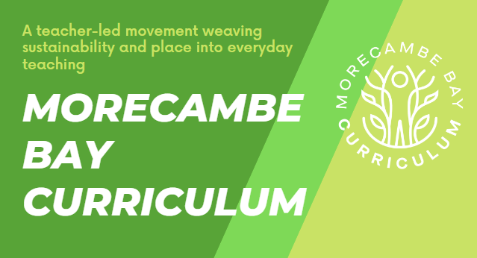
RESOURCES

Slide 2


Climate Literacy
Ways to use this resource:
Embed in form time for vocabulary tasks/starters or do nows
Could you use it in you assembly time?
Match key areas of vocabulary to your curriculum with pre-designed tasks and pre-populated context of our area!
It can be set online to support sustainable teaching in school
It can be embedded in your school rewards policy

Slide 3
Show off! Can you use this word correctly in your work this week?
Show a teacher to earn a _______
Word of the Month: December
Synonyms (words like) for ecosystem:
Biosphere
Environment
Ecological community
ecosystem
(noun)
a community or group of living organisms that live in and interact with each other in a specific environment
Examples of how we use this word:
An ecosystem is made up of all of the living and non-living things in an area.
In an ecosystem living things interact with each other and also with soil, water and air.
Ecosystems often contain many living things and can be as small as your garden or as large as the ocean.
Etymology (where did this word come from?)
“ECO” from
“OIKOS” (Greek)
Household/
home
=
+
“SYSTEMA” (Greek)
Organised whole
=

Slide 4
ecosystem
(noun)
A community or group of living organisms that live in and interact with each other in a specific environment
Create a visual representation of this word
Can you use the word correctly in a sentence?
Where in our bay can we explore this word further? Do we have different ecosystems here?
Can you create a question with the word ecosystem in that you want answering?
What's the difference between habitat and ecosystem? A habitat is a geographic location, an ecosystem is a set of interactions among species – including who-eats-whom in a food chain – and between the living and non-living (biotic and abiotic) parts of nature
Types of ecosystem: Grasslands, wetlands, rainforest, swamp, desert, ocean, forest

