Slide 1
Outline of HE-BCI return and link to HEIF

Slide 2
HE-BCI Return format
  Made up of 5 tables
  Table 1 Research Related Activities
  Table 2 Business and Community Services
  Table 3 Regeneration and Development Programmes
  Table 4 Intellectual Property
  Table 5 Social, Community and Cultural Engagement: designated public events
  Most require value and no. of organisations per category
  SME
  Non-SME Commercial
  Non-commercial

Slide 3
HE-BCI “Heads” (subcategories)
Table 1 Research
  1.1 Collaborative
  1.2 Contract
Table 2 Business and Community Services
  2.1 Consultancy
  2.2 Facilities and Equipment related services
  2.3 Courses for business and the community (CPD/CE)
Table 5 Social and Community Engagement
  1a Public lectures
  1b Performance arts (music, dance, drama etc.)
  1c Exhibitions (galleries, museums etc.)
  1d Museum education
  1e Other

Slide 4
Process
Covers the academic financial year August to July
RES extract data for 6000 and 7000 projects from Agresso
7000 codes will have been categorised at Pre-Award stage
Sent to Faculties who
  Check/assign HE-BCI categorisations as required
  Provide additional information such as CPD days
  Provide details of Table 1 and 2 activity not on those codes
  Provide details of Table 5 activity in addition to that on PURE
RES check and collate Faculty data into Tables
RES add Regeneration and IP income
Submit to HESA mid-December

Slide 5
HEIF calculation
Data from HE-BCI and elsewhere used to calculate ranking
Ranking determines HEIF allocation
+/-10% limit on HEIF change YoY, in cases of significant ranking movement
3 years’ weighted data used: 50% current year, 30% previous, 20% 2 years ago
Income for 3 year weighted total obtained from:
HE-BCI
Contract Research + Consultancy + Facilities & Equipment + Regeneration & Development + IP
HESA
Non-credit bearing course fee income
Innovate UK
KTPs
SME income within all of the above is double-weighted

Slide 6
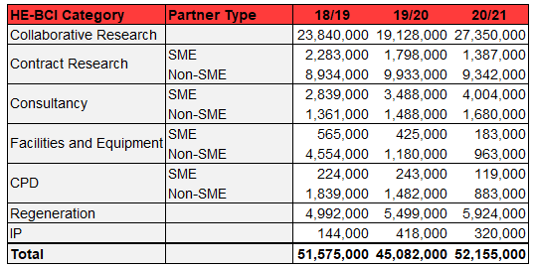
HE-BCI Data for 20/21 Submission

