Slide 1
The impact of the Covid-19 pandemic on people in Care Homes
11th May 2021
Jo Knight
Notes:
Main presentation title slide.

Slide 2
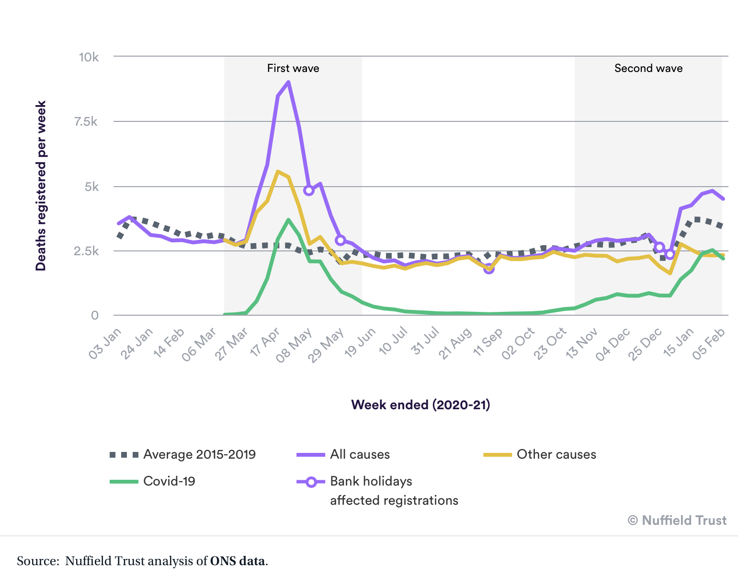
Death in Care Homes
https://www.nuffieldtrust.org.uk/chart/deaths-of-care-home-residents

Slide 3
COVID-19 Hospital Discharge Service Requirements
19th March 2020
Implementing these Service Requirements is expected to free up to at least 15,000 beds.
For patients whose needs are too great to return to their own home (…) a care home will be arranged.
https://assets.publishing.service.gov.uk/government/uploads/system/uploads/attachment_data/file/911541/COVID-19_hospital_discharge_service_requirements_2.pdf

Slide 4

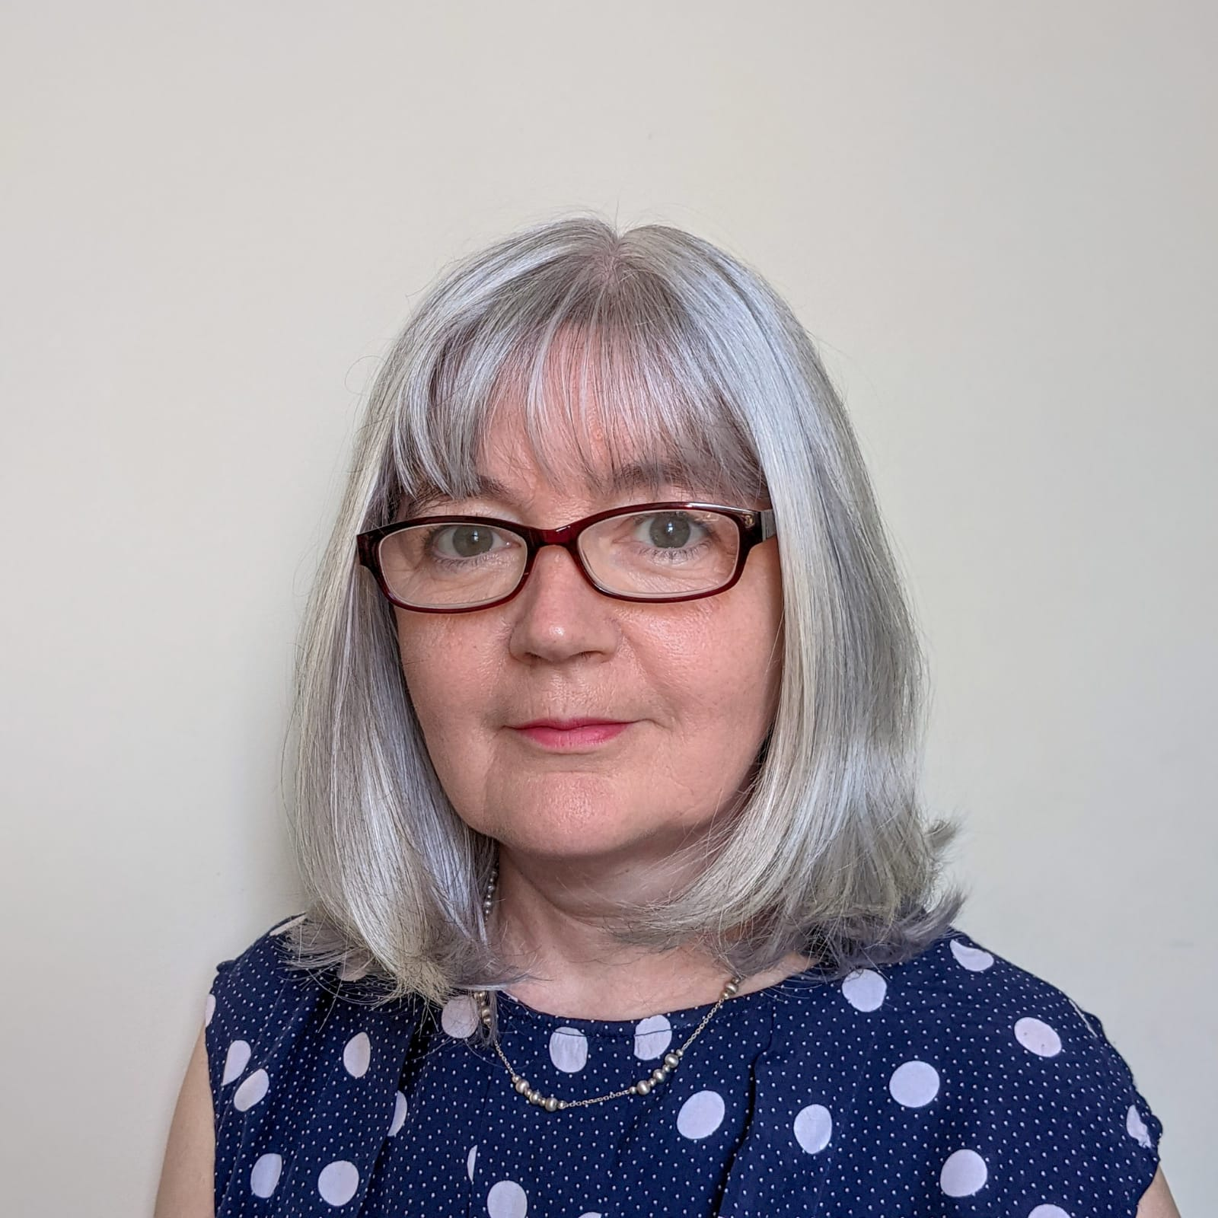

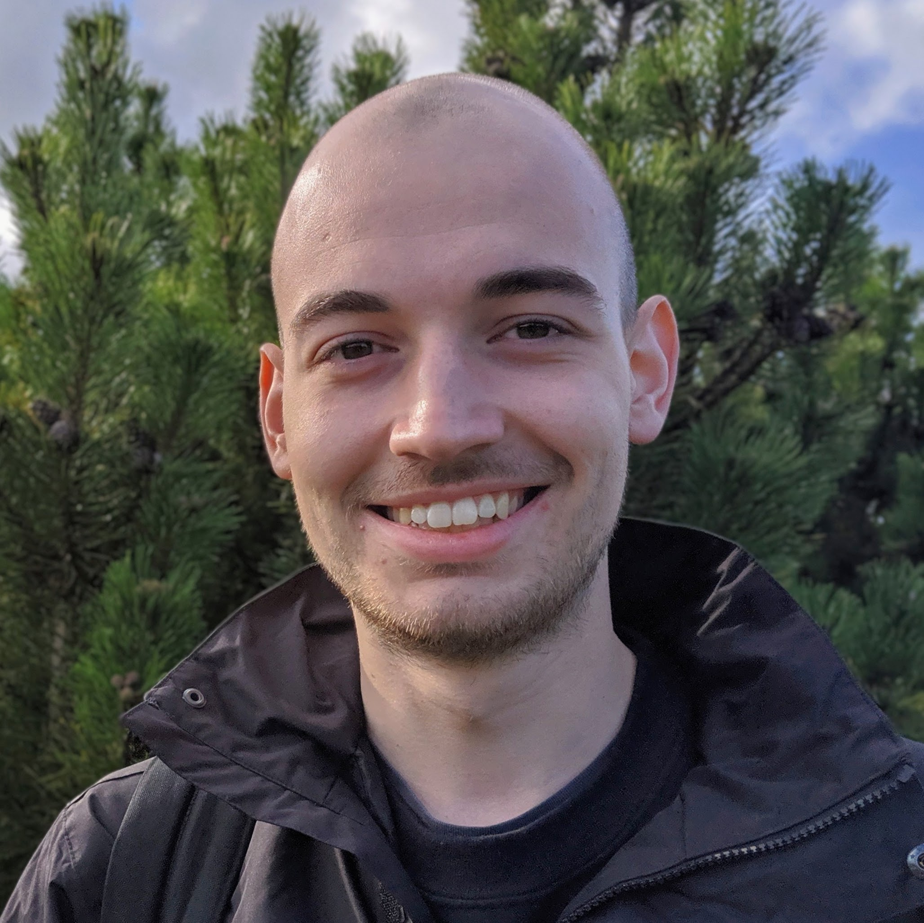
Our Project

Slide 5
Who did we talk to?
Organisation | Participant
Local HealthCall Team | Project Manager, Clinical Trainers x 2, Administrator
Local Authority | Commissioning Manager
NHS/Clinical Staff | Team Leader, District Nursing x 3, Community Nurse, Assistant Community Nurse
Care Home Staff | Managers x 3, Deputy Managers x 3, Senior Carers x 8
Care Home Residents and Relatives of Residents | Residents x 3

Slide 6
Care Homes Characteristics
Chain & independent
Residential & Residential and nursing
20-75 beds
Rating “good”
Co. Durham & Darlington

Slide 7
Care Homes Topics
Emotional impact on staff: resilience and it’s limits
Social, emotional and behavioural impact on residents and their families
Politics, policy and pressure: guidelines in flux and media coverage
Bridging the gap: Increased cross sector and community collaboration
Infection control becoming normalised

Slide 8
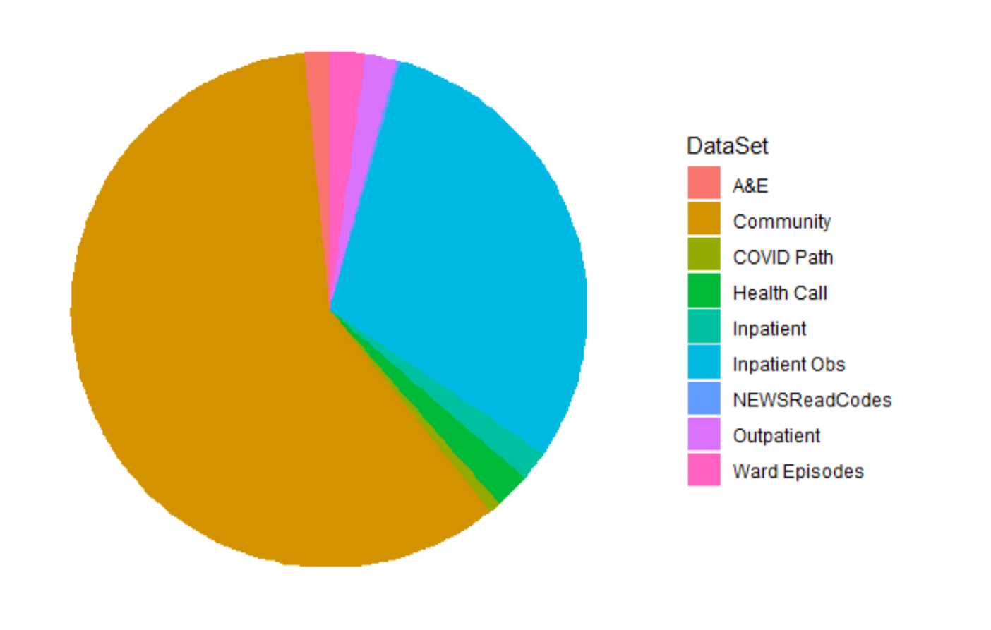
Individual based health care interactions – Source

Slide 9
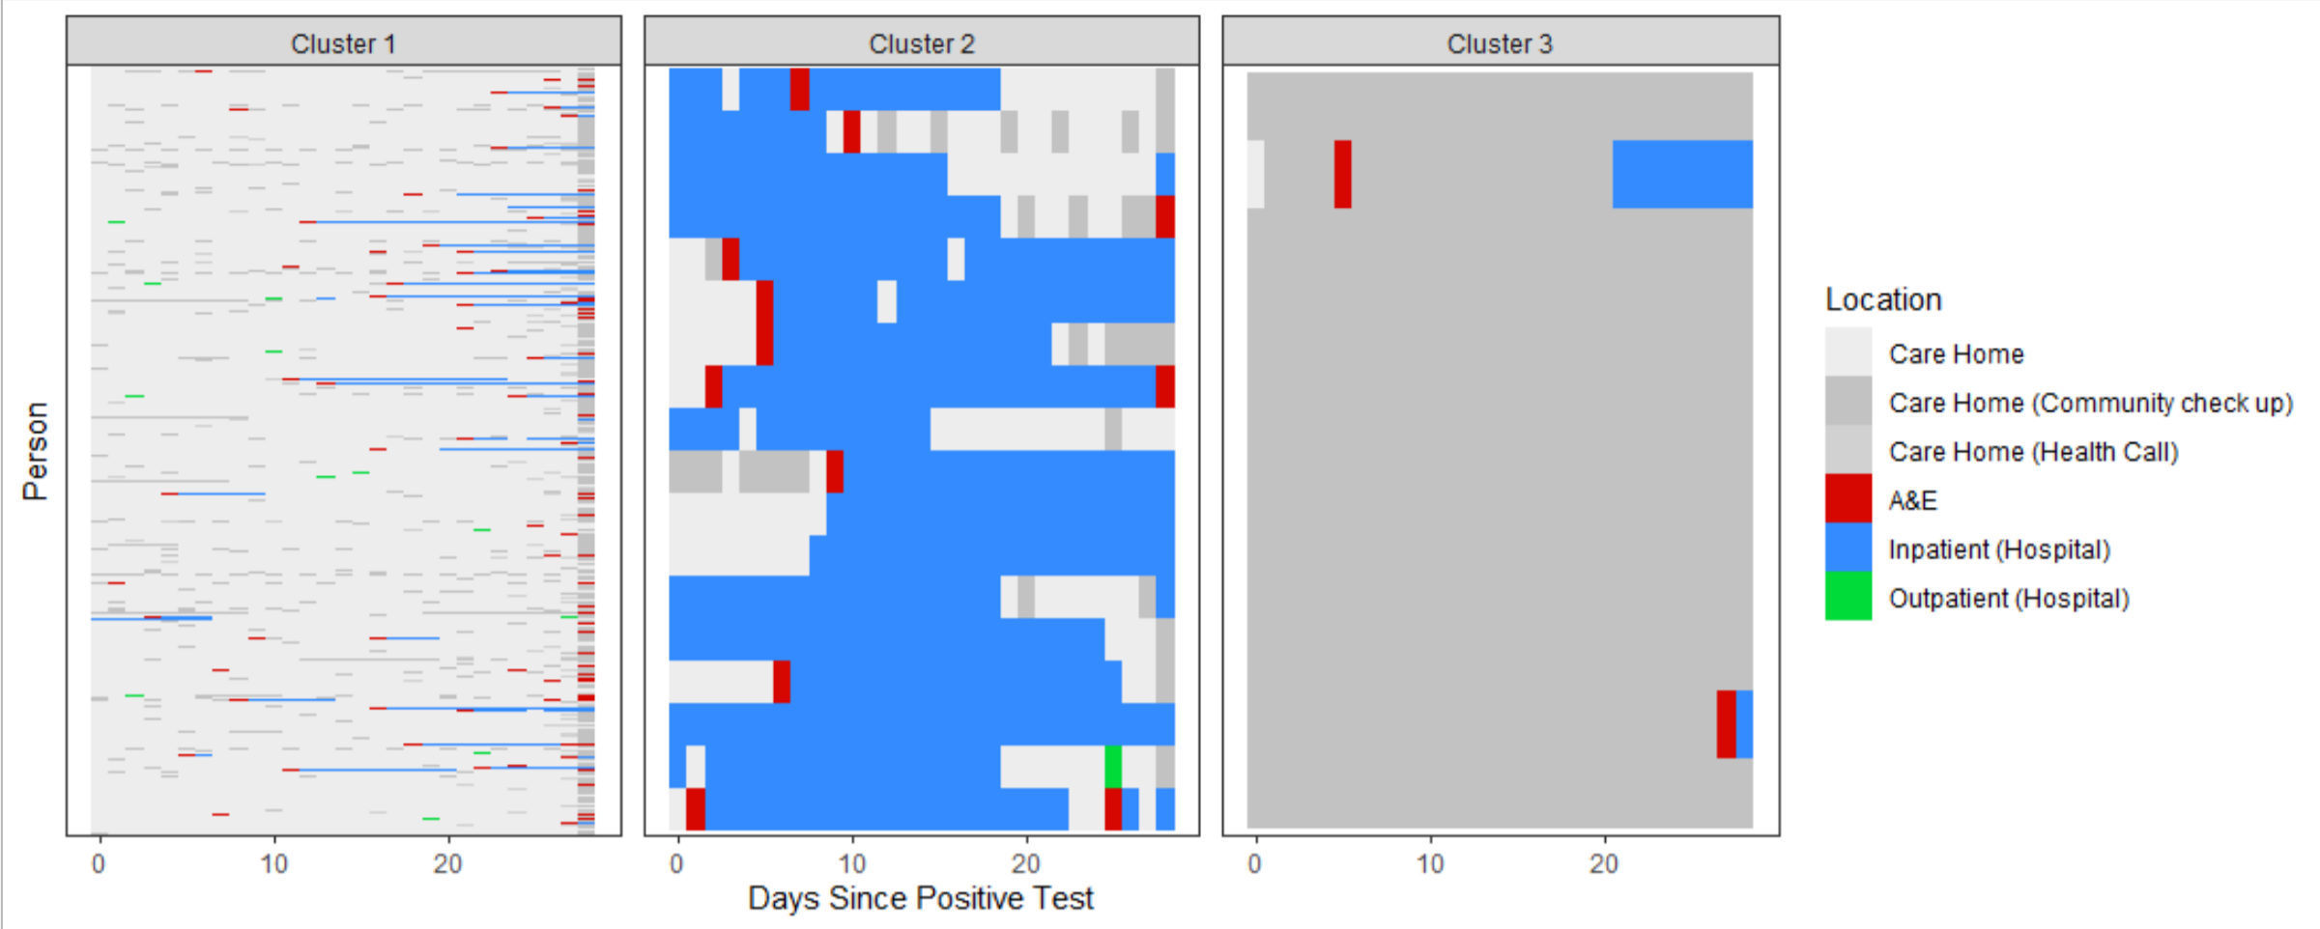
Individual based health care interactions – Raw data

Slide 10
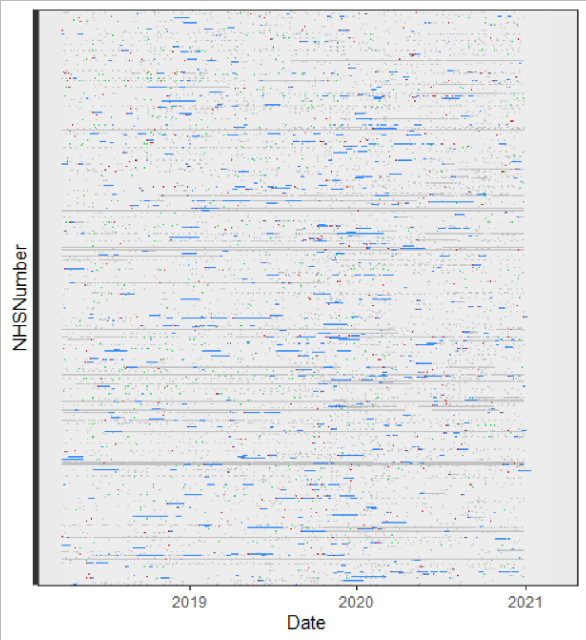
Individual based health care interactions – Raw data

Slide 11
Individual based health care interactions – Clustered data

Slide 12
Next Steps
What was happening:
at specific moments?
to specific people?
in reference to outcomes?

Slide 13
After the pandemic - Patterns remain relevant
Re – admission in under 30 days
Place of Death
What the frontline are thinking

Slide 14
Changing the world!
Talks – Public and Conferences
Academic Papers
Proactive Engagement with Decision Makers
  Doctors
  Innovation arms of the NHS
  Department of Health and Social Care

Slide 15
What was hard?
We were living through the pandemic!
Getting access to routinely collected data is complex!
The phones in the Care Homes were busy!

Slide 16
Thank you for attending, any questions?

