Slide 1


Title Slide for this tool
Notes:
Title Slide

Slide 2

Imagine If…
Imagine
Create an outline of a human form
Group or Focus: Any! – this tool could be used with a wide variety of community members
What is the tool trying to do specifically?
Invites participants to imagine something which then draws out how they see that thing/place/idea/problem
It hopes to gain a better understanding that person’s perspective or view point
It could be used individually or in groups
It’s asset based so doesn’t focus on the negatives
It helps to demonstrate ‘What matters to me?’
It could be used to challenge stereotypes
Or as a self-assessment tool
You could provide a set of prompting questions to help with the exercise
What are the instructions for using the tool?
Have some prompts or ideas ready to inspire discussion/engagement
Could use writing/drawing/collage or even just colours to express their feelings/thoughts
Have the outline pre-cut/pre-printed so there is no expectation to have to draw
If [ ] were a person they would look like
Version created by:
Date:

Slide 3
Contrast
Imagine If…
Create an outline of a human form
Group or Focus: Any! – this tool could be used with a wide variety of community members
What is the tool trying to do specifically?
By splitting the human form down the middle, you could encourage comparison, or contrast around a particular topic
This could draw out positive and negatives, conflicts, past and present, or present and future – the possibilities are endless!
What are the instructions for using the tool?
Have a specific question or prompt in mind – consider using this as a header at the top of each section to keep participants focussed
Could use writing/drawing or even just colours to express their feelings/thoughts.
Collage could also work well, and avoid barriers around literacy or confidence in drawing
Have the human pre cut or pre-printed
Eg.
Public Private
5 years ago Now
Now 10 years in future
Version created by:
Date:

Slide 4
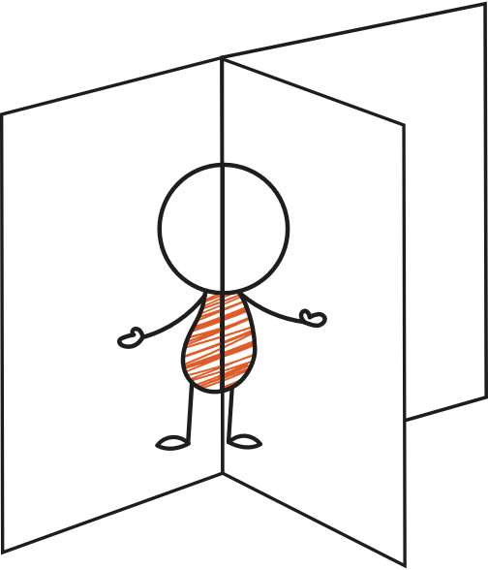



Multiple dimensions
Imagine If…
Create an outline of a human form
Group or Focus: Any! – this tool could be used with a wide variety of community members
What is the tool trying to do specifically?
Splitting into multiple elements again would help draw out comparisons.
Are there specific time periods you’re looking to discuss? Or feelings a different times of day? Multiple dimensions would help to break down the discussion
What are the instructions for using the tool?
Have some prompts or ideas ready to inspire discussion/engagement
Could use writing/drawing/collage or even just colours to express their feelings/thoughts
Have the outline pre-cut/pre-printed so there is no expectation to have to draw
3+ Cards
Family
Past/ present/ future
Best me, worst me, everyday me
3
4
Version created by:
Date:
5

