Slide 1


Title Slide for this tool
Notes:
Title Slide

Slide 2
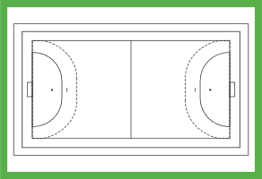
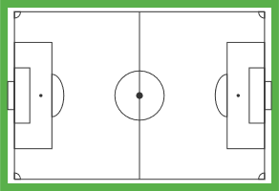
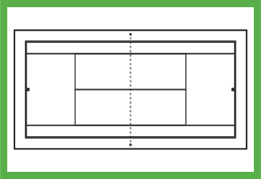
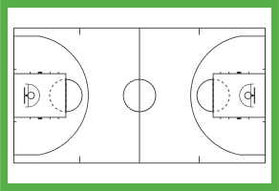
Team Talk
Think about their pitch, roles, relationships, management
Group or Focus: Any sports group or team. Limited audience but can imagine this working doing with familiar people - used to chatting - different dynamic. You go to their space and show you understand their bond.
What is the tool trying to do specifically?
Use a common theme like sport as the basis for a discussion about something else, using language that speaks to the team dynamics/roles etc.
Could you imagine the pitch as a set up for a different theme – e.g. the environment – your team are trying to score a big win for Net Zero, but the opposing team are trying to stop this – what roles could the attackers play, what could defence be doing?
Show how issues/topics interlink/work/ fit together – teamwork
Communicating in a way that people can understand and relate to.
What are the instructions for using the tool?
Ask specific questions that might relate to the sport directly
Think about their pitch, roles, relationships, management
Draw or represent their pitch, can you make it specifically their pitch?
If you can get them to add their names to the different positions.
CRIB sheet for each role i.e. Defender – stops the issue worsening, Attacker – Drives the issue forward
Version created by:
Date:

Slide 3

Passing Practice
Team Talk
Think about their pitch, roles, relationships, management
Group or Focus: Any sports group or team. Limited audience but can imagine this working doing with familiar people - used to chatting - different dynamic. You go to their space and show you understand their bond.
What is the tool trying to do specifically?
Take the metaphor of the team and use that to frame what you're talking about
More space for fun + laughing - specific questions only.
What are the instructions for using the tool?
Have a prompt that a small group responds to then ‘pass’ it to another group
You can have multiple prompts being passed around
Version created by:
Date:

Slide 4

Warm Up
Team Talk
Think about their pitch, roles, relationships, management
Group or Focus: Any sports group or team. Limited audience but can imagine this working doing with familiar people - used to chatting - different dynamic. You go to their space and show you understand their bond.
What is the tool trying to do specifically?
Take the metaphor of the team and use that to frame what you're talking about
More space for fun + laughing - specific questions only.
What are the instructions for using the tool?
Split the team into two
Give them either the same or a contrasting prompt
As a group, they decide on the winner
These groups know each other and are already ‘playfully’ competitive
Version created by:
Date:

Slide 5


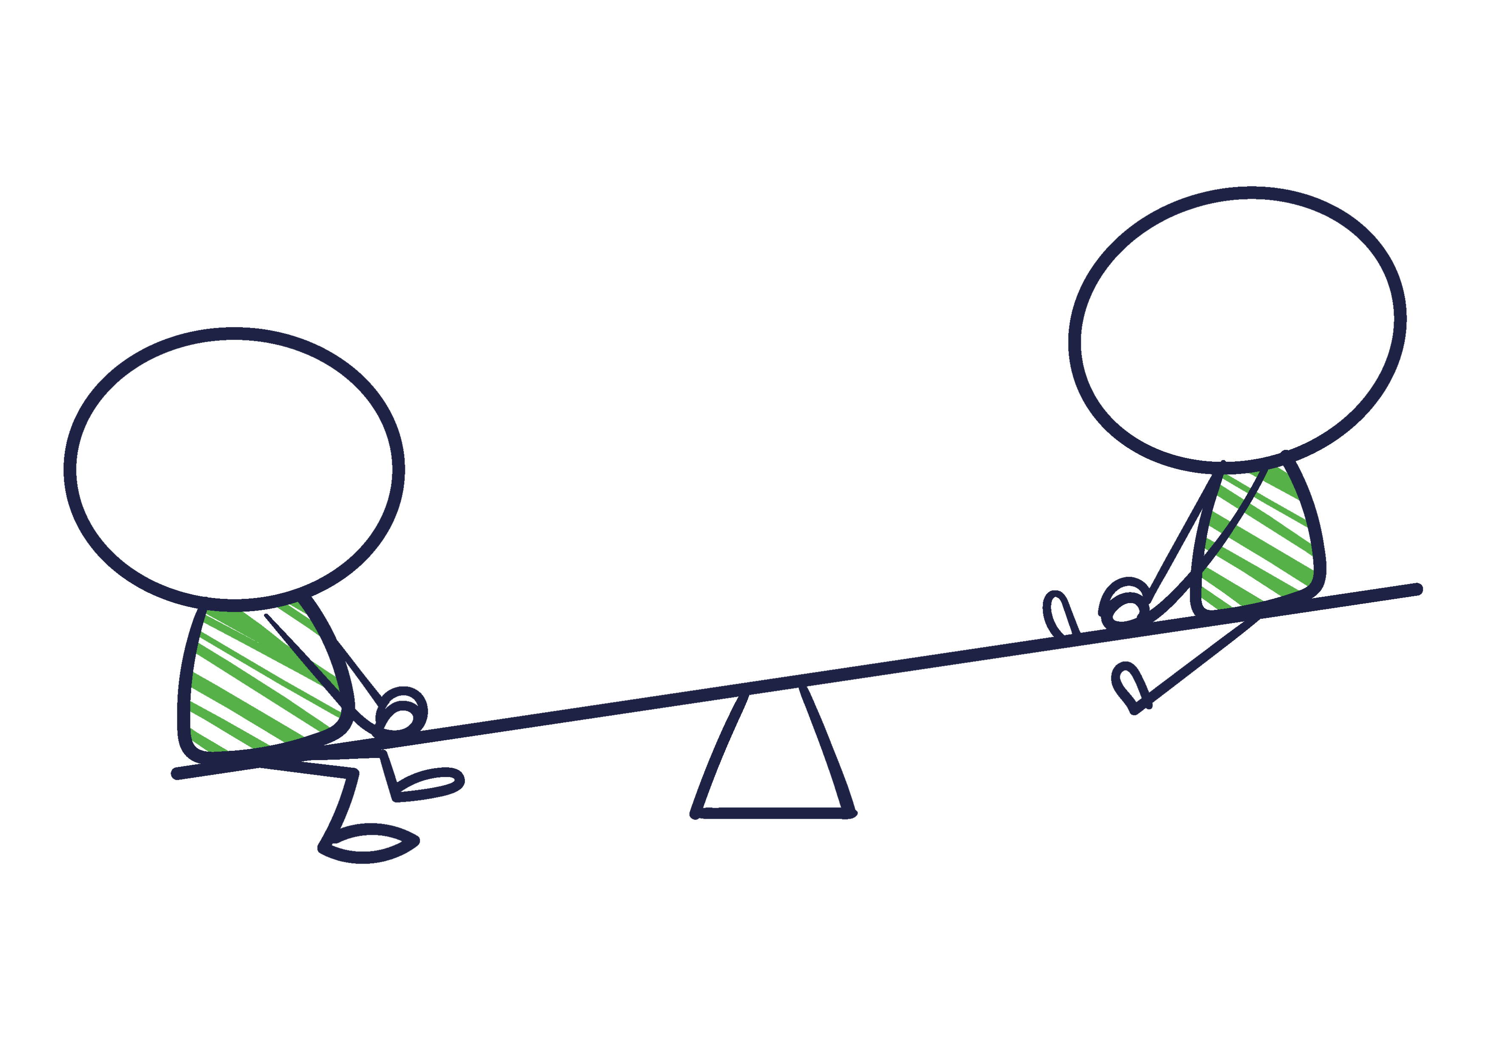

… and Chat
For non-sports based groups
Craft and Chat
Bake and Chat
Group or Focus: Any group or team. Limited audience but can imagine this working doing with familiar people - used to chatting - different dynamic. You go to their space and show you understand their bond.
What is the tool trying to do specifically?
Using the commonality of the group to discuss other topics. For example if it was a knitting group, could a knitting pattern analogy be used to connect on a topic like AI – the knitting pattern is the input, the jumper is what ChatGPT produces.
By using the common language, or touchpoints of the group, we can have conversations in trusted spaces that might unlock views that might not have been shared elsewhere.
What are the instructions for using the tool?
Use the language and interests of the group to form the basis of your discussion. Does this group offer a unique perspective because of their common interests?
Sew and Chat
Play and Chat
Version created by:
Date:
. . . and Chat?

