Slide 1
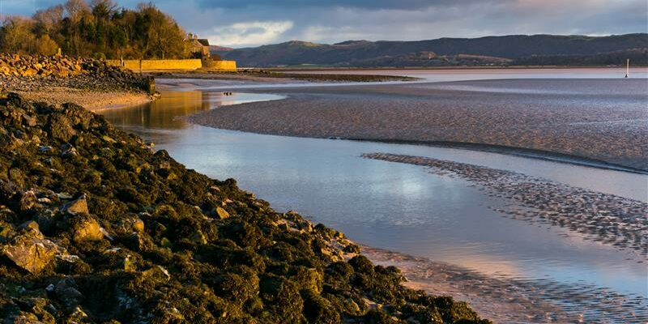





Morecambe Bay Curriculum
The Green Side Hustle Project

Slide 2
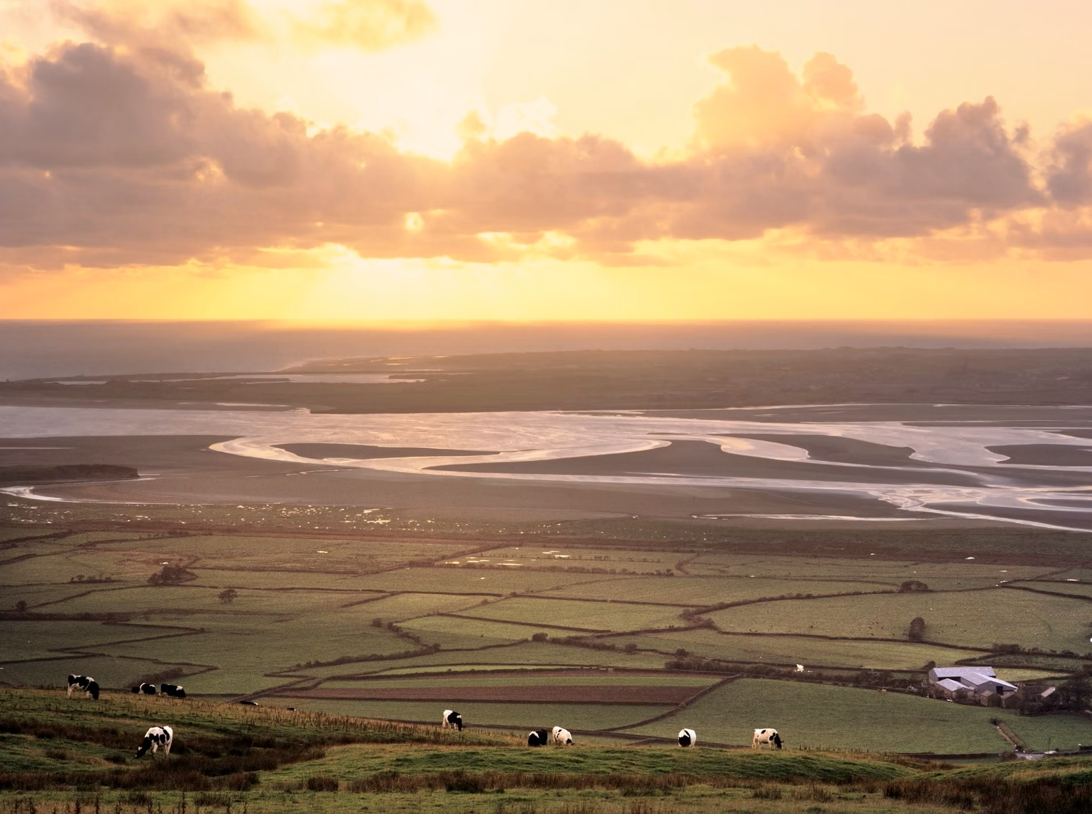
Welcome to the Morecambe Bay Green Side Hustle
Watch the Green Side Hustle Video

Slide 3
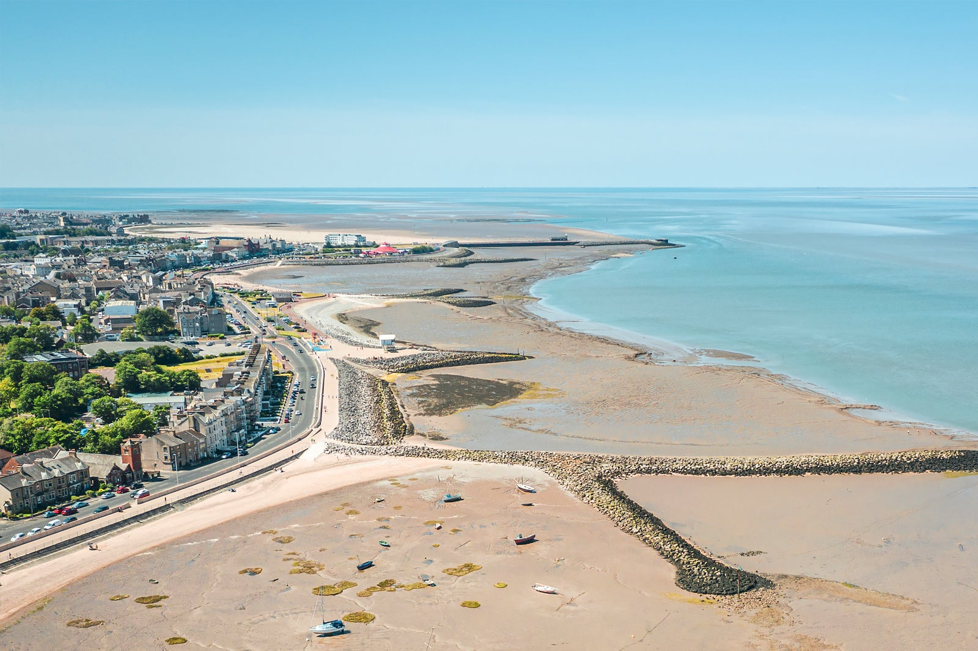
Morecambe Bay is a unique and beautiful place
And it's also changing rapidly due to new green tech, new businesses like the Eden Project and climate change and adapation
These changes are a challenge but also an opportunity for entrepreneurs and businesses

Slide 4
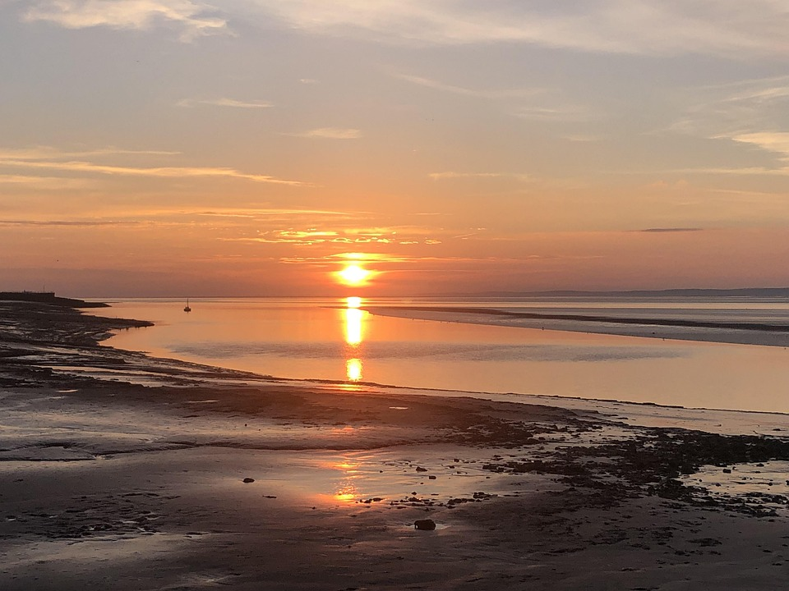
What is the Green Side Hustle?
We’re challenging you to create a green business idea based right here, around the unique and beautiful Morecambe Bay
We want you to create a Side Hustle business idea that links to nature, green tech or environmental opportunities
Create a business pitch video for your idea individually or in a group. The winning idea at each college will win a £200 prize which could be used to make your plan a reality!

Slide 5
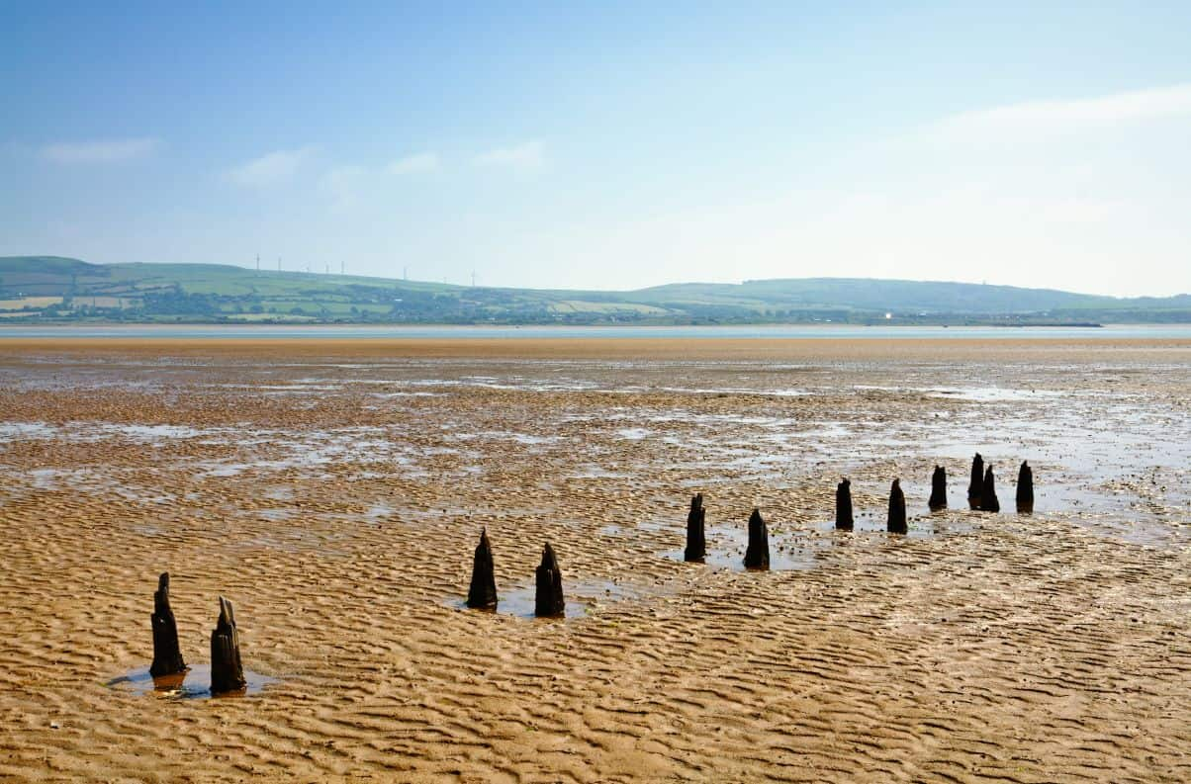
What you need to know
For submission you need to create a short video pitch
Your business pitch needs to be submitted by 8th June 2026
Upload the video to your college drive and email a shareable link to mbc@lancaster.ac.uk
Please include the names of all team members and the subject "Green Side Hustle"
Your business plan will be judged by local green entrepreneurs who will award the best projects with prizes and support which could make your idea a reality!

Slide 6
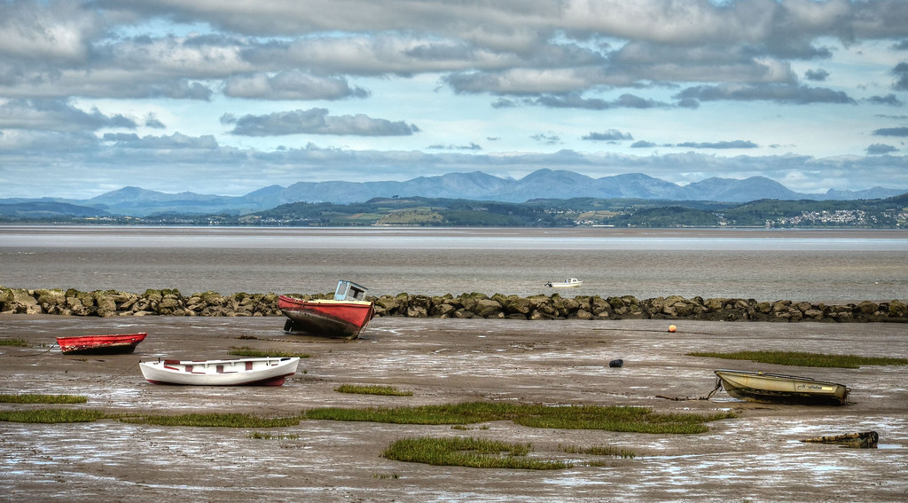







Local Green Business Success Stories
An electrical business which installs green tech like heat pumps and solar
A local entrepreneur providing guided nature walks to boost well-being
A business growing and delivering local organic veg
A sustainable business creating custom-made hand-dyed clothing
A long-established local business salvaging and recycling metal
A new restaurant selling fresh local seafood from Morecambe Bay
A social enterprise offering advice and support to help people cut their energy bills

Slide 7

Green Business Ideas
The Hyper-Local Model: Cuts transport and supports the community by building the business around local resources, skills, and products.
Animal Care: ​Premium pet food locally sourced in and around Lancaster and Morecambe
Hair and Beauty Business Idea: Sell hair clippings as a soil fertiliser for gardeners
Childcare Business Idea: Neighbourhood childminding- walking distance from parents for pick up and drop off.
Joinery Business Idea: Waste wood can be turned into sawdust for large animal bedding
The Circular Model: Cuts waste by reusing, repairing, or recycling materials back into new products.

Slide 8
Green Business Ideas
The Connect with Nature Model: Promotes care for the environment through education, experiences, and storytelling.
Childcare ​Nature Explorers after-school club
Engineering: E-bike and scooter repair business
Electrical Local solar-panel advice business
Sport
Wild fitness class in natural locations around the Bay
The Green Tech Model: Uses technology (like clean energy, apps, or smart systems) to solve an environmental problem or reduce waste.

