Slide 1
Measuring the e/m ratio

Slide 2
Motivation
In 1897 JJ Thomson set out to prove that cathode rays originating from a heated cathode (electron gun), were actually a stream of small negatively charged particles called electrons
From Maxwell's theory on electromagnetism he knew that charged particles could be deflected in electric and magnetic fields.
By deflecting electrons in electric and magnetic fields, Thomson was able to successfully determine the charge-mass ratio of an electron and provided the first evidence that atoms were in fact not fundamental building blocks of matter
Today you will carry out a very similar experiment and find e/m for yourselves!

Slide 3
Apparatus
In the box you will find:
2 Helmholtz's coils
A Spherical shaped glass container containing low pressure Hydrogen and distance measuring apparatus
An electron gun (cathode) aiming into the container
Power supply's for both the electron gun and Helmholtz coils
A sheet with the relevant circuit diagram

Slide 4
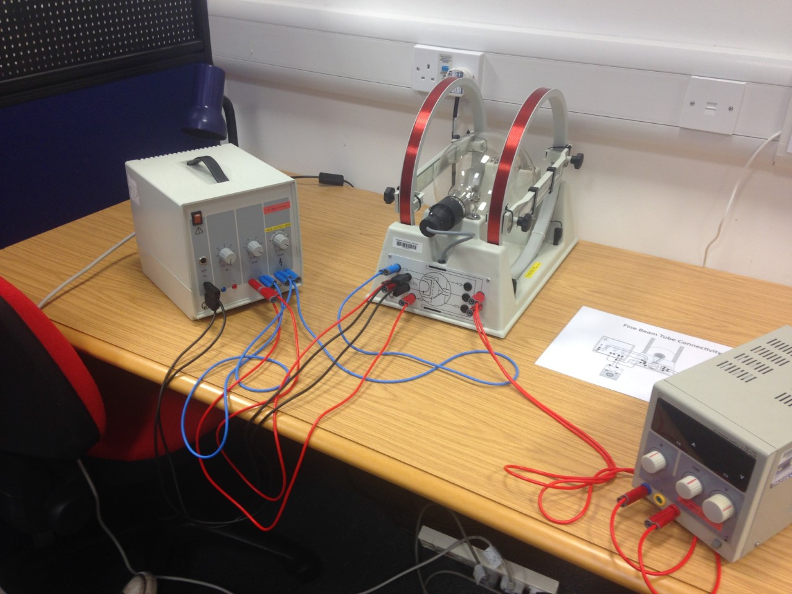

Slide 5
Physics Principles
First, the electrons are accelerated in a fine beam tube across a potential V.
Next, they enter a uniform magnetic field produced by the Helmholtz coils and experience a force due to the field
Question: What is the force on an electron in a magnetic field? What path will the electrons follow in the field?

Slide 6
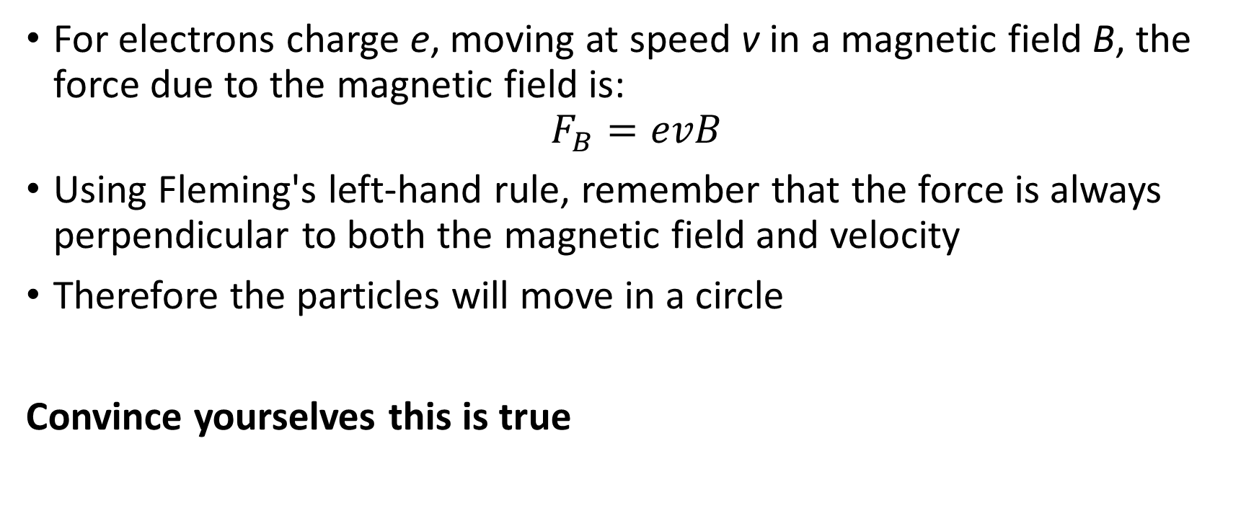
Answer
For electrons charge e, moving at speed v in a magnetic field B, the force due to the magnetic field is:
$$F_{B}=evB$$
Using Fleming's left-hand rule, remember that the force is always perpendicular to both the magnetic field and velocity
Therefore the particles will move in a circle
Convince yourselves this is true

Slide 7
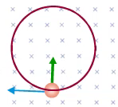
Animation
An Animation of the motion can be found here:
https://sites.google.com/site/physicsflash/ciclotronE.swf?attredirects=0

Slide 8
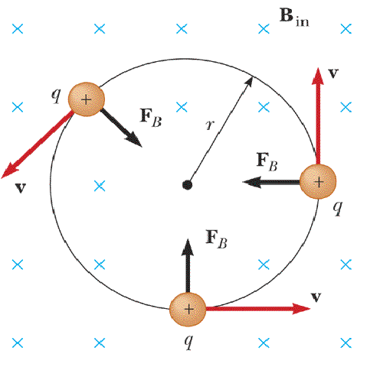
Remember the electron is negatively charged so it would move in a clockwise direction

Slide 9
The Hydrogen Interaction
Turn on the apparatus, play around the voltages and verify that you can see the “electrons”.
Question: The blue-purple tinge that you see isn’t the actual electrons, rather it is the product of an interaction between the electrons and the Hydrogen atoms. What is this interaction and how does it lead to the light we see?

Slide 10
Answer
The light we see is the light given off via the de-excitation of the electrons orbiting the Hydrogen atoms
The orbital electrons were excited by collisions with the cathode ray electrons
An animation of this effect can be found below. Note that in the animation photons strike the orbital electrons instead of the accelerated electrons but the effect is the same
http://www.upscale.utoronto.ca/PVB/Harrison/BohrModel/Flash/BohrModel.html

Slide 11
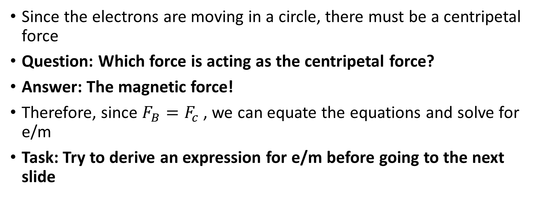
Circular Motion
Since the electrons are moving in a circle, there must be a centripetal force
Question: Which force is acting as the centripetal force?
Answer: The magnetic force!
Therefore, since $F_{B}=F_{c}$, we can equate the equations and solve for e/m
Task: Try to derive an expression for e/m before going to the next slide

Slide 12

Solution
$$F_{C}$$
$$=\frac{mv^{2}}{r}$$
$$F_{B}=$$
$$evB$$

Slide 13
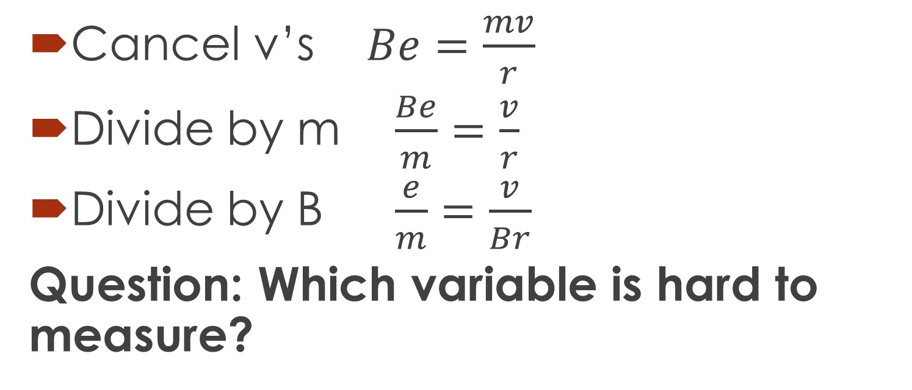
Cancel v’s $Be=\frac{mv}{r}$
Divide by m $\frac{Be}{m}=\frac{v}{r}$
Divide by B $\frac{e}{m}=\frac{v}{Br}$
Question: Which variable is hard to measure?

Slide 14
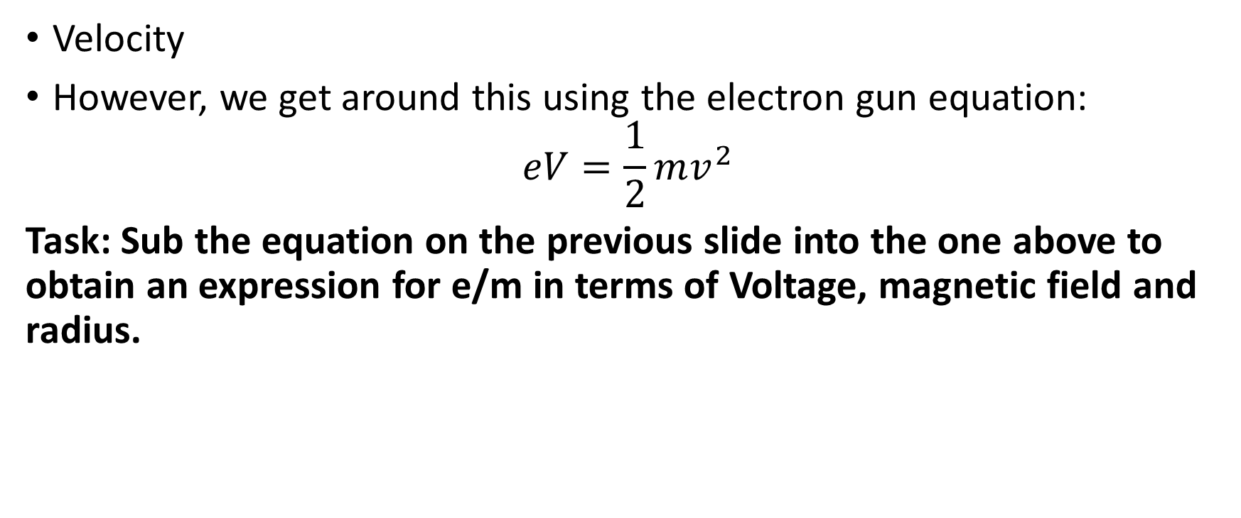
Answer
Velocity
However, we get around this using the electron gun equation:
$$eV=\frac{1}{2}mv^{2}$$
Task: Sub the equation on the previous slide into the one above to obtain an expression for e/m in terms of Voltage, magnetic field and radius.

Slide 15
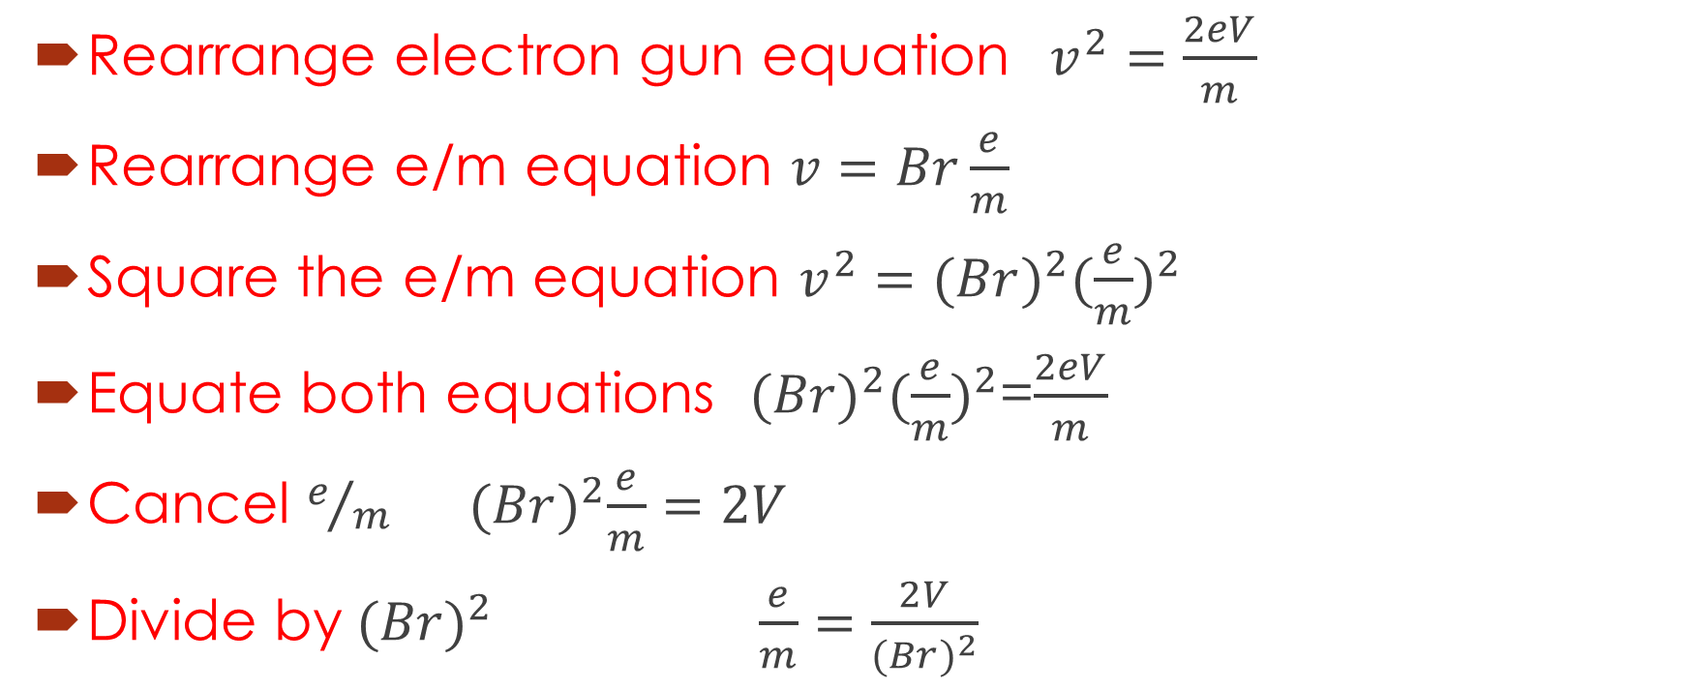
Answer
Rearrange electron gun equation $v^{2}=\frac{2eV}{m}$
Rearrange e/m equation $v=Br\frac{e}{m}$
Square the e/m equation $v^{2}={(Br)}^{2}{(\frac{e}{m})}^{2}$
Equate both equations ${(Br)}^{2}{(\frac{e}{m})}^{2}$=$\frac{2eV}{m}$
Cancel $e/m$ ${(Br)}^{2}\frac{e}{m}=2V$
${\text{Divide} \text{by} (Br)}^{2}$ $\frac{e}{m}=\frac{2V}{{(Br)}^{2}}$

Slide 16
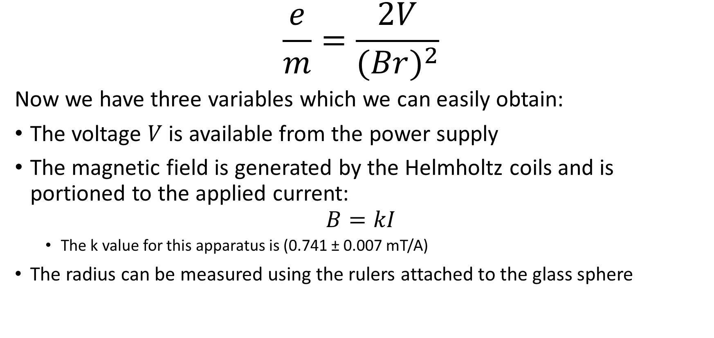
Almost There
$$\frac{e}{m}=\frac{2V}{{(Br)}^{2}}$$
Now we have three variables which we can easily obtain:
The voltage $V$ is available from the power supply
The magnetic field is generated by the Helmholtz coils and is portioned to the applied current:
$$B=kI$$
  The k value for this apparatus is (0.741 ± 0.007 mT/A)
The radius can be measured using the rulers attached to the glass sphere

Slide 17
Video

Slide 18
Procedure
Turn all dials to zero and switch on the power
Set the beam potential to V = 120V
Question: What does the beam look like? Can you explain it?
Now crank the voltage up to V = 250V (Don’t go higher than this!)
Question: What does the beam look like now compared to the 120V case? Can you explain why it is different?
Adjust the 50V display to give a narrow, well defined electron beam
Adjust the Helmholtz coils power supply and look for the current I at which the electron beam is deflected into a closed orbit

Slide 19
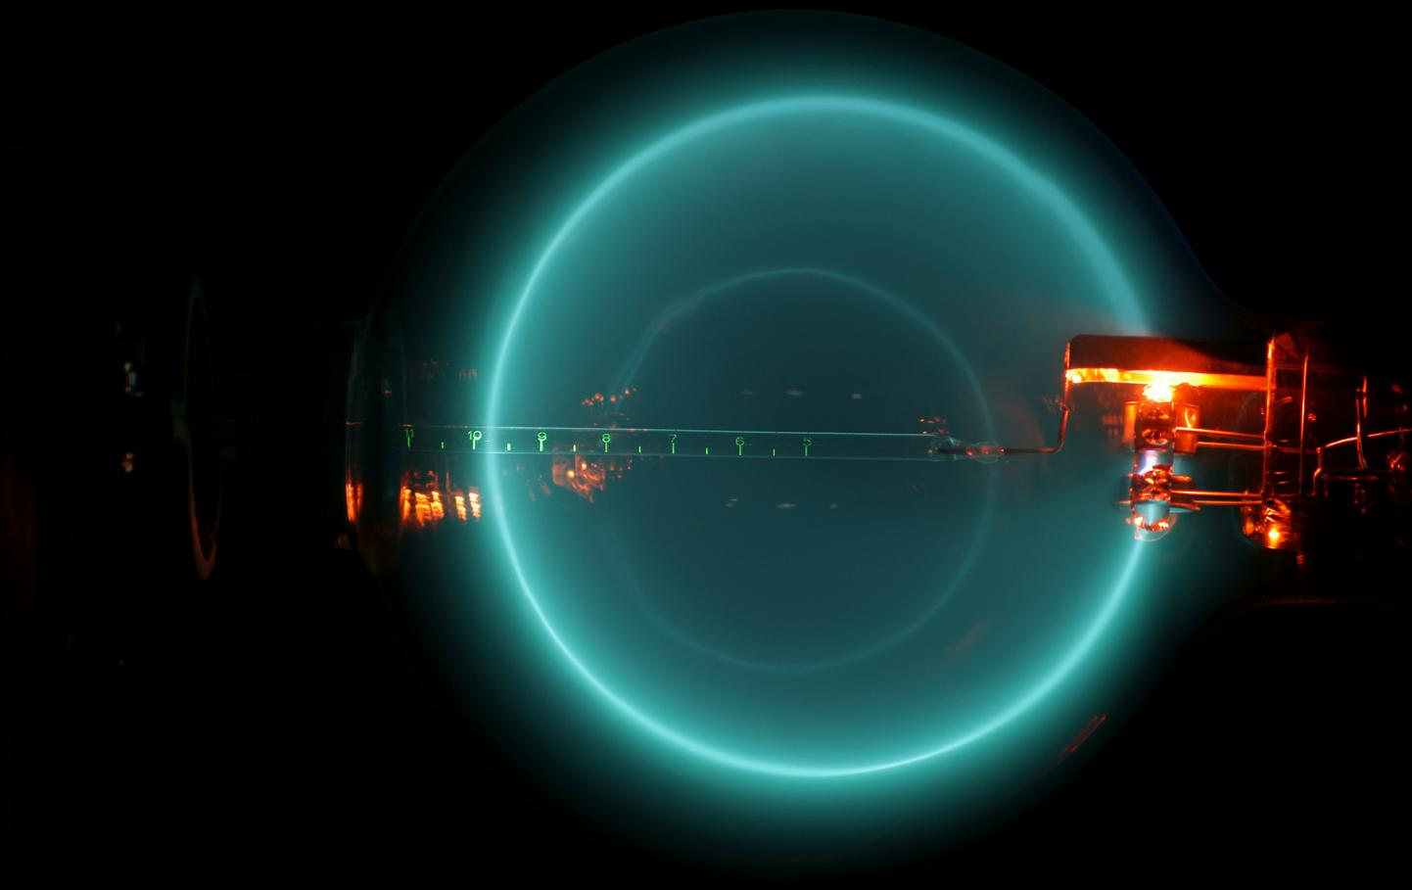

Slide 20
Use the sliders and mirrors to measure the diameter of orbit
Move the left slide so that its inner edge, mirror image and escape aperture lie on the same line of sight
Move the right slide so that its inner edge, mirror image and the right hand side of the circular electron beam all lie on the same line of sight
Question: Why are mirrors and sliders used?

Slide 21
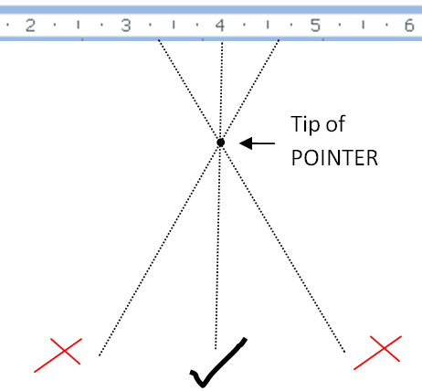
Answer
To eliminate parallax error

Slide 22
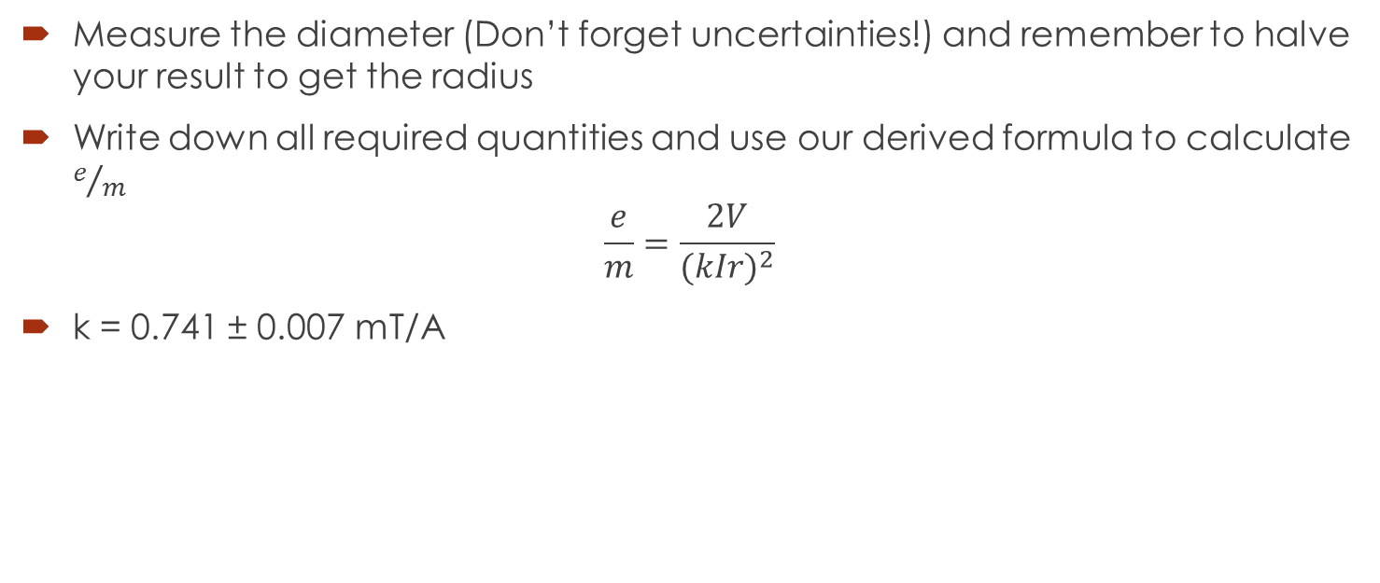
Final Result
Measure the diameter (Don’t forget uncertainties!) and remember to halve your result to get the radius
Write down all required quantities and use our derived formula to calculate $e/m$
$$\frac{e}{m}=\frac{2V}{{(kIr)}^{2}}$$
k = 0.741 ± 0.007 mT/A

Slide 23
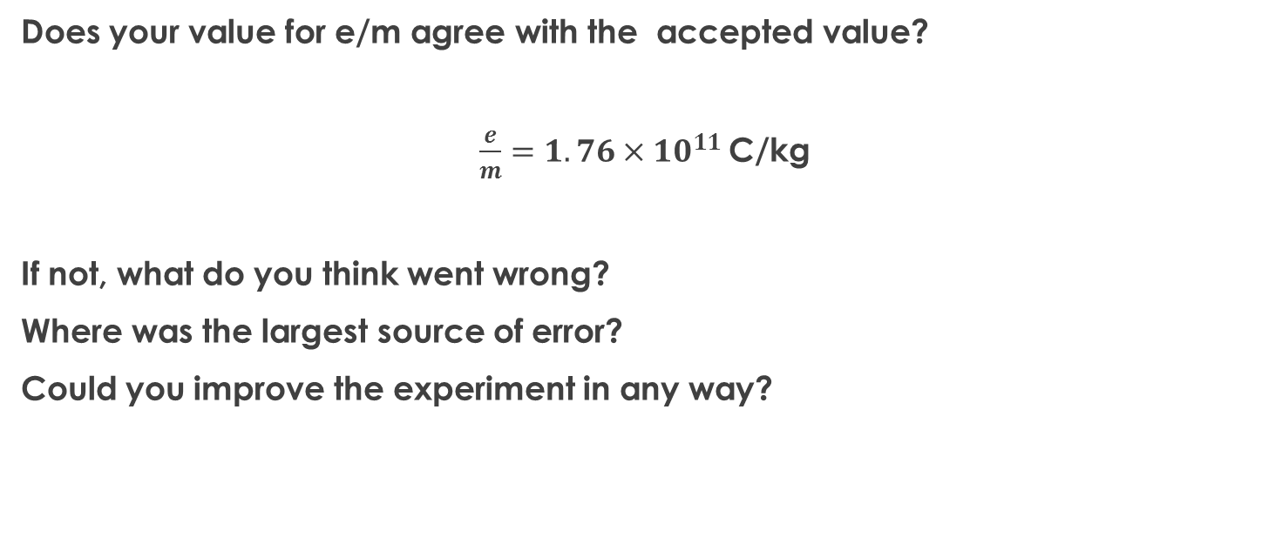
Conclusion
Does your value for e/m agree with the accepted value?
$\frac{e}{m}=1.76×{10}^{11}$C/kg
If not, what do you think went wrong?
Where was the largest source of error?
Could you improve the experiment in any way?

