Slide 1
The photoelectric effect

Slide 2
Introduction and aims
The development of Quantum theory in the early 20th century drastically changed our views on the nature of light, allowing us to consider it as a particle as well as a wave.
It was Einstein who first brought forward the theory of the photoelectric effect, which explains the liberation of electrons from metal surfaces by light, when it is considered to behave as a particle.
Today you will witness the photoelectric effect and use it to measure the Planck's constant.

Slide 3
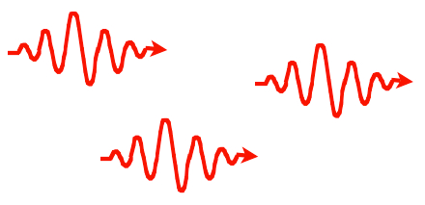
Vital points
Imagine a beam of Electromagnetic radiation (light) incident on a metal
Light has a particle nature and a wave nature
Light travels and arrives in wave packets known as photons (imagine them as little chunks of waves)

Slide 4
If the frequency of radiation is v, then the energy of each photon is hv, where h is the Planck’s constant.
The intensity of the radiation is a measure of the number of photons per second striking the metal
A photon liberates one electron only

Slide 5
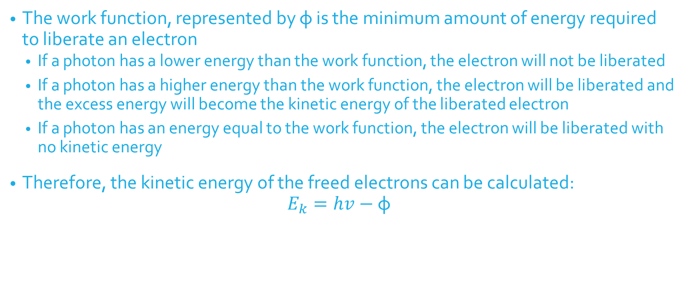
The Work Function φ
The work function, represented by φ is the minimum amount of energy required to liberate an electron
  If a photon has a lower energy than the work function, the electron will not be liberated
  If a photon has a higher energy than the work function, the electron will be liberated and the excess energy will become the kinetic energy of the liberated electron
  If a photon has an energy equal to the work function, the electron will be liberated with no kinetic energy
Therefore, the kinetic energy of the freed electrons can be calculated:
$$E_{k}=hv−\text{φ}$$

Slide 6
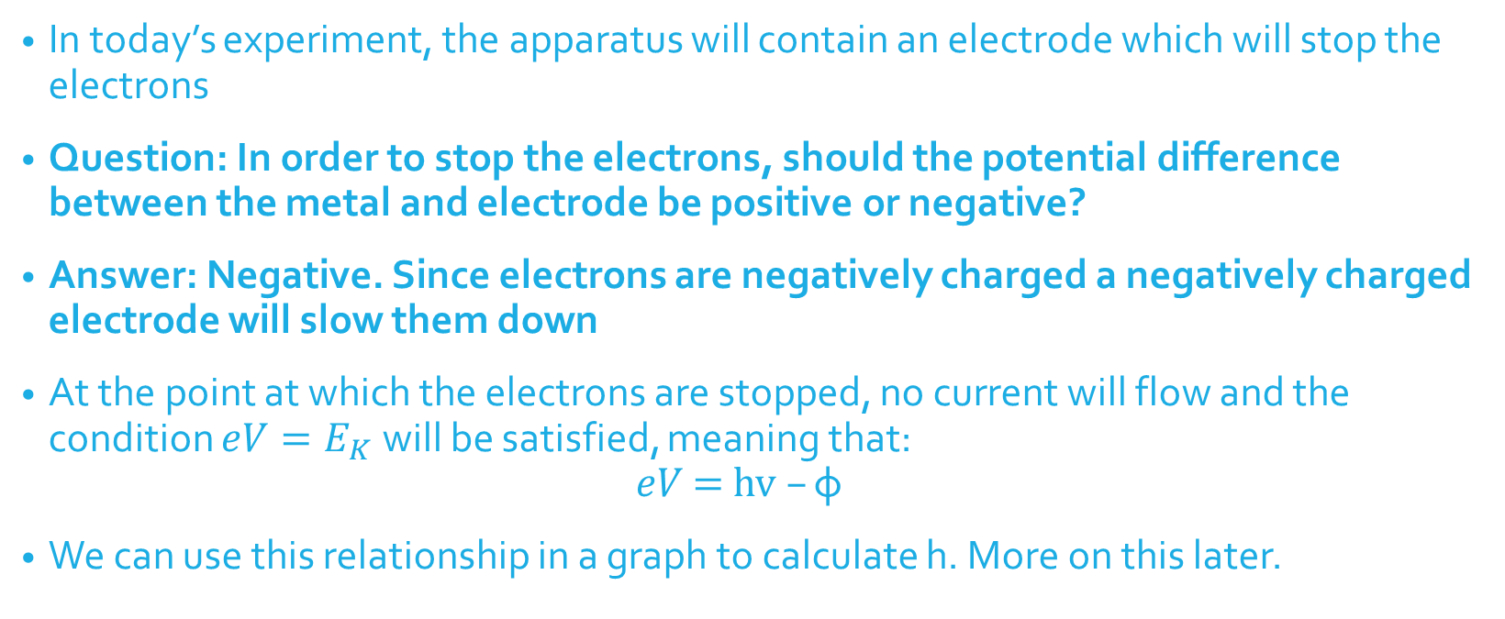
Add an electrode
In today’s experiment, the apparatus will contain an electrode which will stop the electrons
Question: In order to stop the electrons, should the potential difference between the metal and electrode be positive or negative?
Answer: Negative. Since electrons are negatively charged a negatively charged electrode will slow them down
At the point at which the electrons are stopped, no current will flow and the condition $eV=E_{K}$will be satisfied, meaning that:
$$eV\text{ = }\text{hv} –\text{φ}$$
We can use this relationship in a graph to calculate h. More on this later.

Slide 7
Animation
An animation of a similar experiment can be found here:
https://www.youtube.com/watch?v=YQL2Q5ZArjs

Slide 8
In The Box
Inside the box you will find:
A Light tight box, which contains most of the apparatus
A variable voltage supply
An Ammeter
Light filters which allow a certain range of wavelengths of light to strike the metal

Slide 9
How it works
Inside the light tight box, there is a light bulb which is focused onto a photocell
The photocell consists of a film of potassium, an ammeter and a platinum loop
The platinum loop acts as the electrode and the voltage can be altered, making it possible for the liberated electrons to be stopped
Platinum is used for the electrode as it has a very high work function

Slide 10
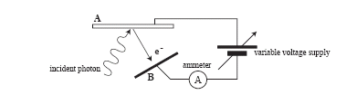
Diagram

Slide 11
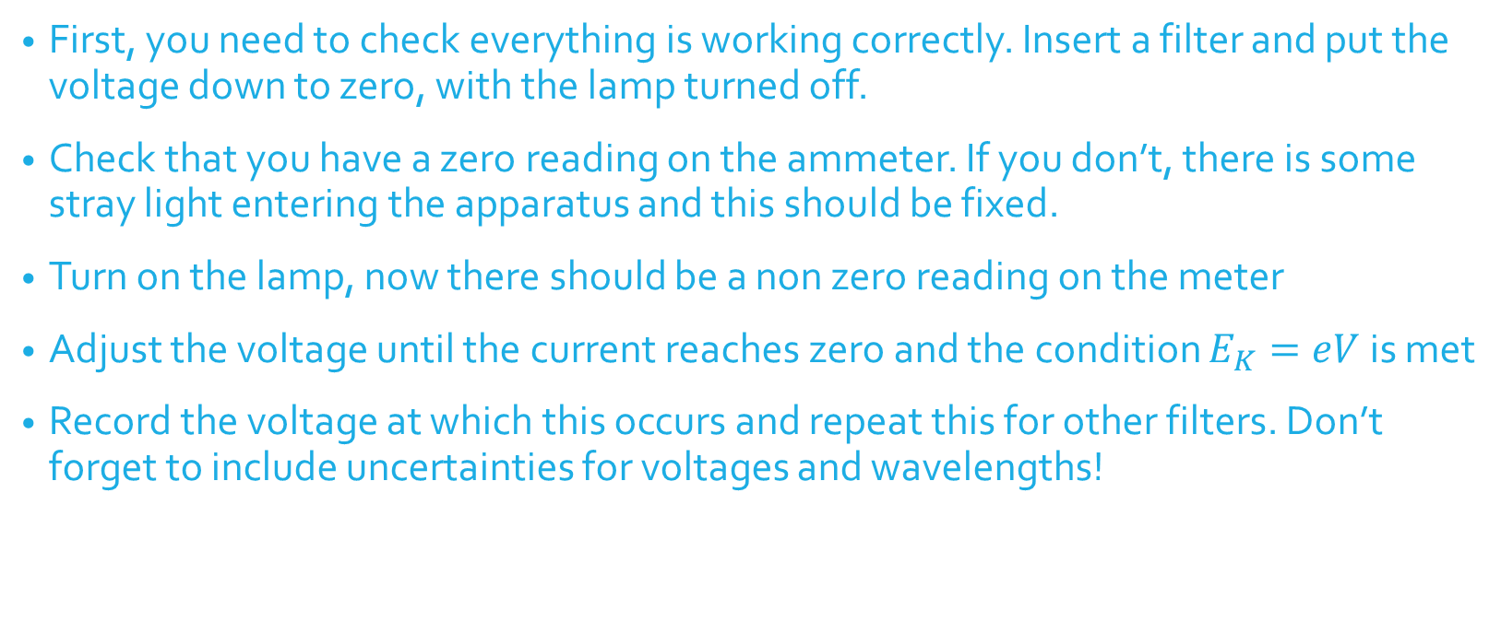
Procedure
First, you need to check everything is working correctly. Insert a filter and put the voltage down to zero, with the lamp turned off.
Check that you have a zero reading on the ammeter. If you don’t, there is some stray light entering the apparatus and this should be fixed.
Turn on the lamp, now there should be a non zero reading on the meter
Adjust the voltage until the current reaches zero and the condition $E_{K}=eV$ is met
Record the voltage at which this occurs and repeat this for other filters. Don’t forget to include uncertainties for voltages and wavelengths!

Slide 12
Video
This video may help with the procedure if anything is unclear:

Slide 13
Results
Once you have your results, plot a graph of stopping voltage against frequency
Question: The filters give you a wavelength measurement, how can you change this to frequency?
Answer: Divide the speed of light c by the wavelength value
Verify that your points make a straight line graph
Question: How can you calculate h from the graph?

Slide 14
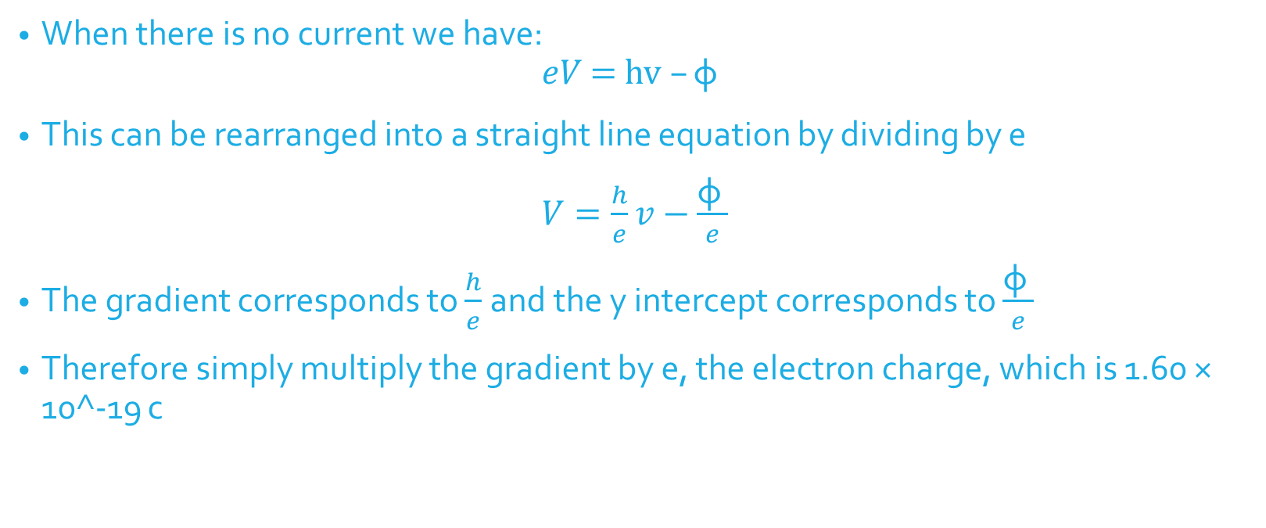
Answer
When there is no current we have:
$$eV\text{ = }\text{hv} –\text{φ}$$
This can be rearranged into a straight line equation by dividing by e
$V=\frac{h}{e}v−\frac{\text{φ} }{e}$
The gradient corresponds to $\frac{h}{e}$and the y intercept corresponds to $\frac{\text{φ} }{e}$
Therefore simply multiply the gradient by e, the electron charge, which is 1.60 × 10^-19 c

Slide 15
Analysis
Calculate h from the gradient and also φ from the gradient if you wish
Compare your value of h to the accepted value of 6.63 x 10^-34 Js
The work function for potassium is 3.69 x 10^-19 J
Question: Does your value agree with the accepted value within experimental uncertainty? If not, what went wrong?
Question: Could you improve the experiment in any way?

