Slide 1




Solar Park Impacts on Ecosystem Services
Academics: Dr Alona Armstrong & Prof Piran White
Postdoctoral research associates: Dr Joana Cruz & Dr Richard Randle-Boggis
October 2018
Notes:
LANCASTER UNIVERSITY POWERPOINT TEMPLATES
These PowerPoint templates are for use by all University staff. Please see below for further information regarding the use of these templates. Should you have any further queries, please contact the marketing team via webmaster@lancaster.ac.uk
Template slide 3: Insert a new slide
If you need to insert a new slide, from the ‘home’ toolbar, click on ‘new slide’ and select from the templates the style you require from the dropdown box.
Template slide 4: Typing new text and copying text from another document
New text should be typed over the text in the appropriate template. Copy and pasting text from another document will result in changing the style of the typography and layout. This is unavoidable as it is part of the Microsoft software. We appreciate that in sometimes you will need to copy text from another document into this template. Once you have pasted the existing text into the template, you will need to change the formatting so that they typefaces, sizes, colour, line spacing and alignment are consistent with the rest of the template.
Template slide 5: Inserting images
There are three choices of templates with images already inserted. Please use the template with the relevant image size and positioning. To insert an image, please go to ‘insert’ then ‘picture’ and find your image, highlight it and ‘insert’. Resize the image and position as per the example template.
Template slide 6: Text boxes
If a text box is deleted, either insert a new slide (using the appropriate template) or go to another slide and copy a text box. To select a text box for copying, please click on the outer edge of the text box so that the line goes solid (not dashed). Right click your mouse and select ‘copy’, then go back and ‘paste’ it into the slide where the text box is missing which should paste into the correct position on the slide.
Template slide 7: Other information
Typefaces, sizes and colours
All copy is Calibri.
Slide title copy throughout:
Size: 36 point
Colour Lancaster University red: (RGB) R: 181 G: 18 B: 27 (recent colours on PowerPoint)
Small copy on first and last slide:
Size: 16 point
Colour grey: (RGB) R: 102 G: 102 B: 102 (recent colours on PowerPoint)
Sub-headings:
Size: 24 point – italics
Colour grey: (RGB) R: 102 G: 102 B: 102 (recent colours on PowerPoint)
Bullets copy and body copy:
Size: 24 point (see below for a further option)
Colour grey: (RGB) R: 102 G: 102 B: 102 (recent colours on PowerPoint)
It isn’t advisable to have too much text on a slide, however on rare occasions it may be necessary, therefore there is a slide using 20 point bullet pointed text.
Line spacing and alignment
Single line spacing (apart from the main headings which is ‘exactly 35 point’)
All text is aligned left
Slide title options
There are two options for titles on the slides – one line or two lines for longer titles. Ideally, the one line title should be used, however on rare occasions a two line title maybe needed.

Slide 2
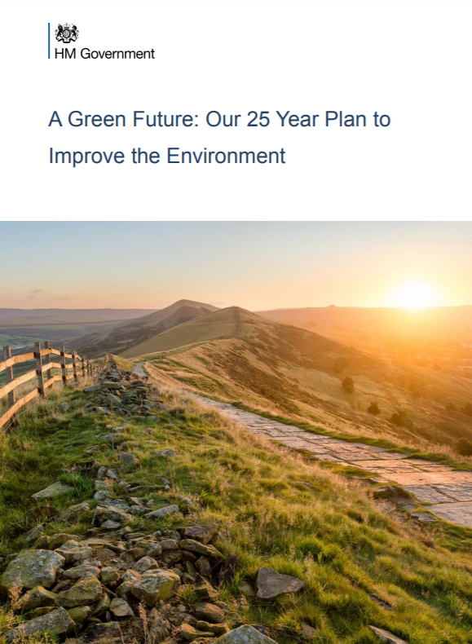
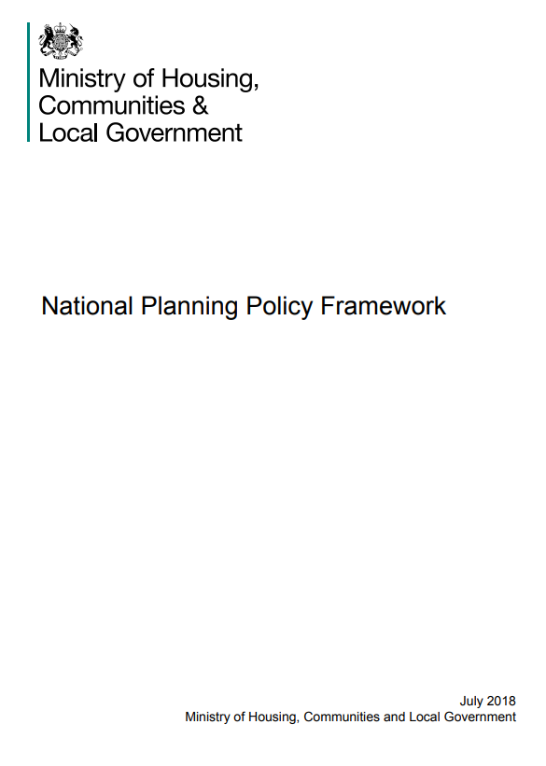
An opportunity
Can solar parks be designed, constructed and managed for environmental benefits beyond that of low carbon energy?
Click to link to Govt webpages

Slide 3

The SPIES tool
Web-based app
Compare management strategies: See how changing management strategies will affect ecosystem services
Investigate ecosystem services: See which management actions affect your selected ecosystem services

Slide 4
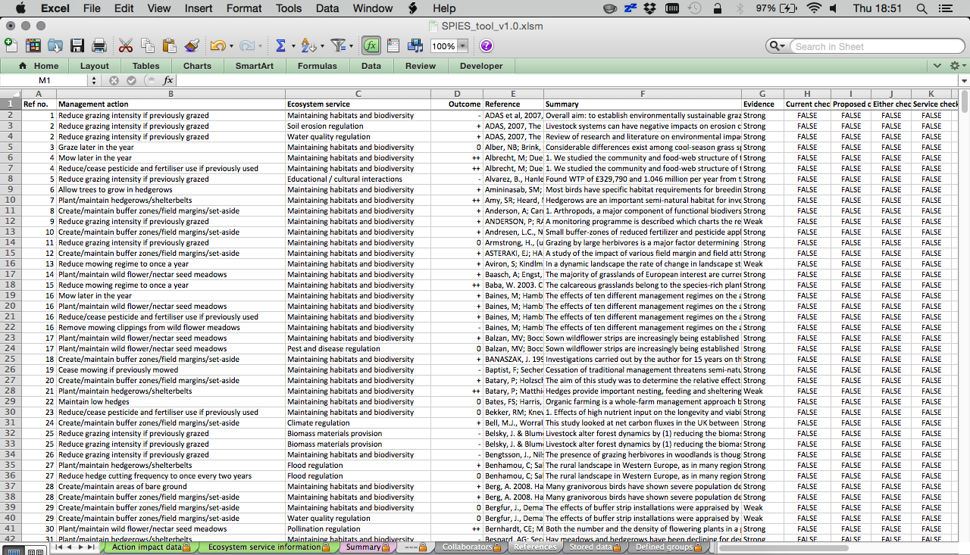
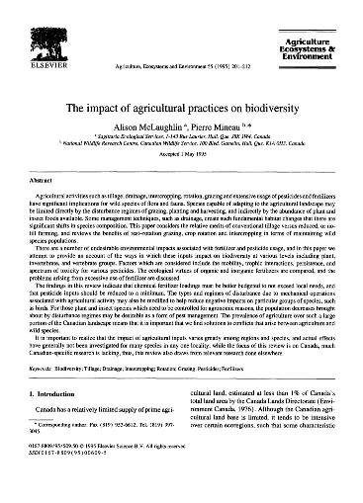
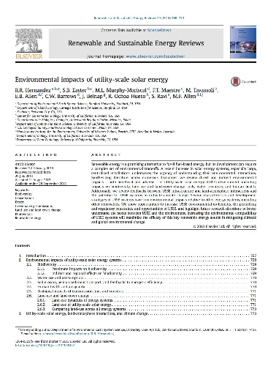
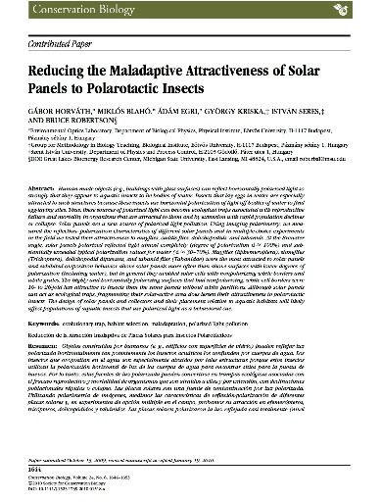
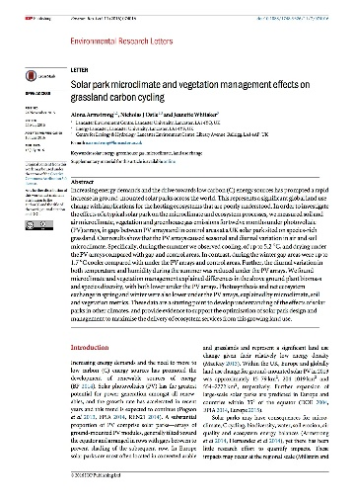
What we’ve developed
Optimised for solar parks and co-developed by cross-sectoral solar and nature conservation stakeholders
Focuses on management actions, not habitat change
Evidence-based: robust, unbiased, and trustworthy information
  704 pieces of evidence from 457 peer-reviewed published papers
  Users can access the evidence

Slide 5
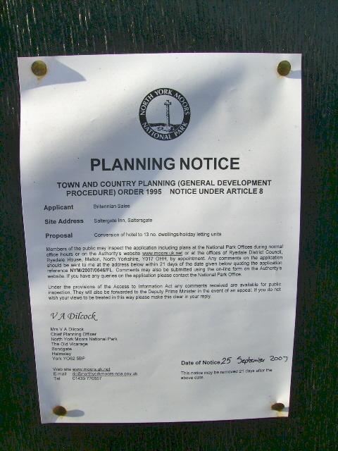
Benefits to the industry
Deliver to Government policies
A stronger business case
Streamline planning process
Social, environment and governance
Competitive edge

Slide 6
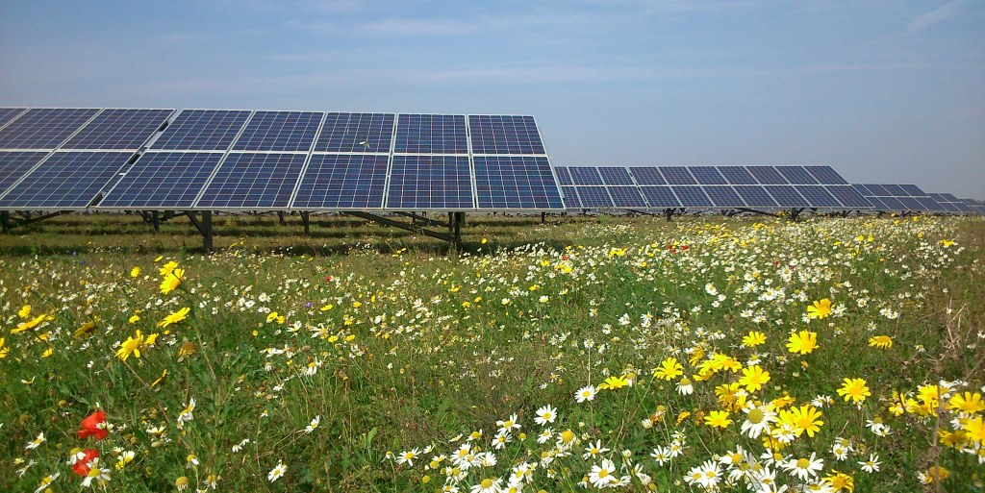
Thanks for listening!
If you are interested in learning more please download the briefing paper, the screen capture walk-through, the associated academic journal article and the SPIES tool log in details: www.lancaster.ac.uk/SPIES
Or email me: a.armstrong@lancaster.ac.uk

