Slide 1
Application of a Master-Worker Parallelism on Materials Modelling
PAX-HPC Meeting, Lancaster, 22th April 2024
Woongkyu Jee, University College London

Slide 2
On today’s talk
Introduction
Modelling stochastic processes in materials science
(e.g., ion-batteries/conductors, solid-oxide fuel cell, etcs.)
Master-Worker Parallelism and application
Implementation of the master-worker parallelism
Profiling results on ARCHER 2
Issues
Outlook
Future plan (upcoming tasks)
W. Jee, PAX-HPC Meeting, Lancaster, 22th April 2024

Slide 3
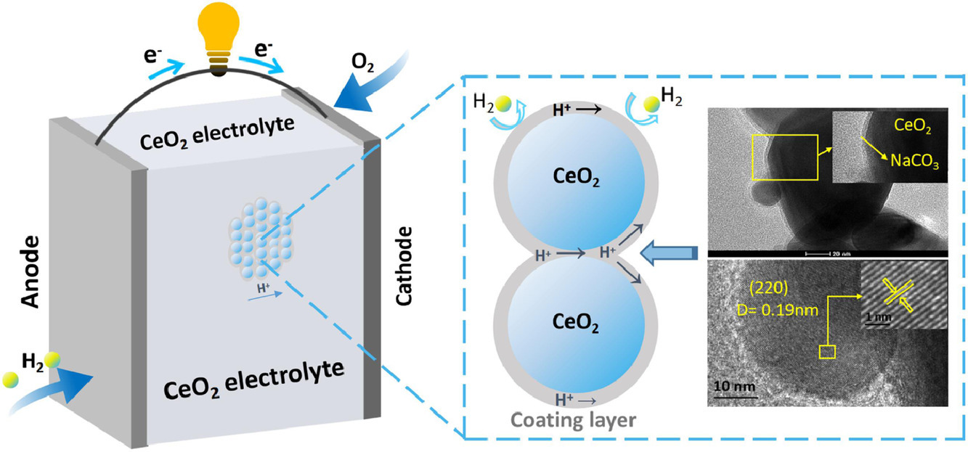
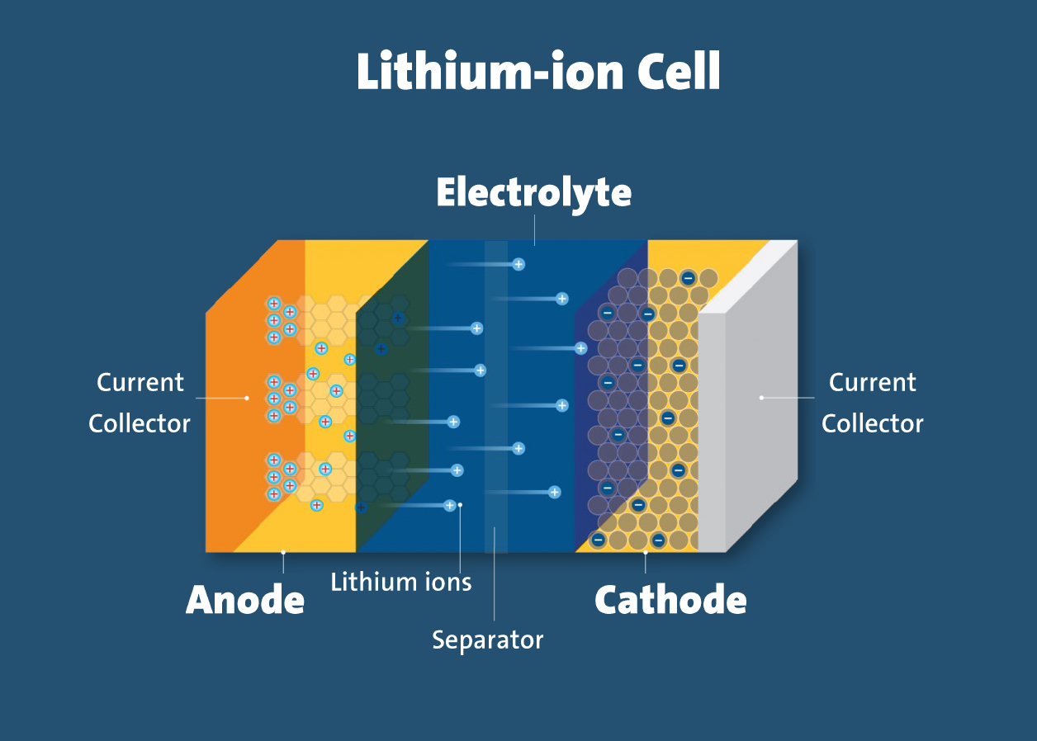
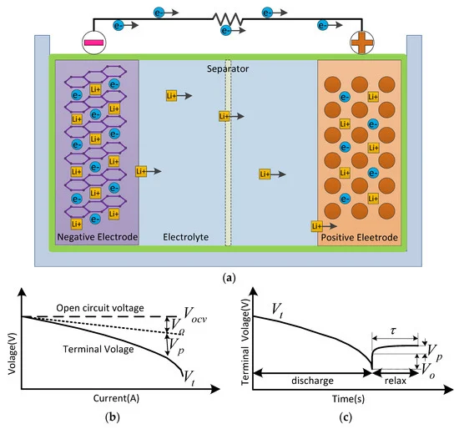
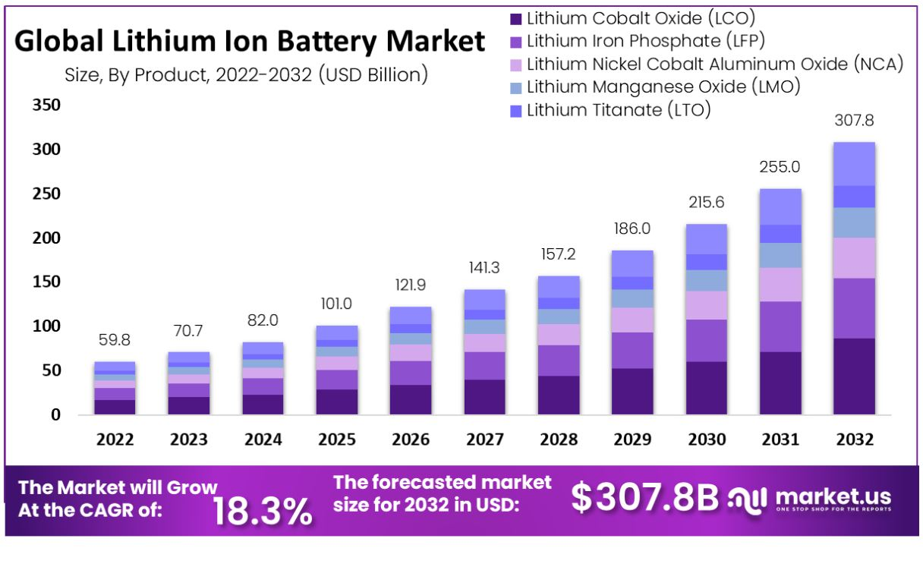

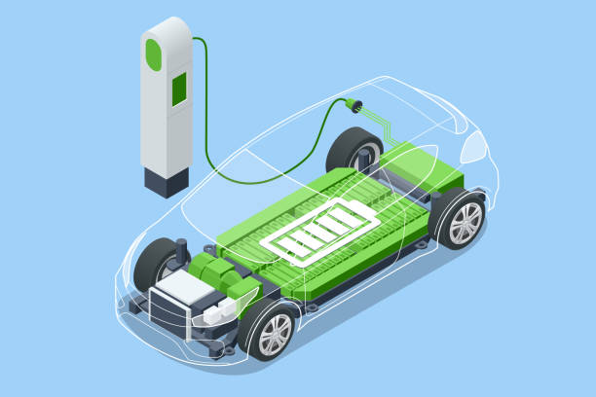
Introduction
Modelling stochastic processes in materials science
Fig 2 Ceria as electrolyte materials in hydrogen fuel cells
doi.org/10.1016/j.electacta.2021.139067
Fig 1 Schematic diagram of discharging reaction in a Li-ion battery
Mobile devices
Battery packs in EV
W. Jee, PAX-HPC Meeting, Lancaster, 22th April 2024
Fig 2 Market expectation of various cathode materials

Slide 4
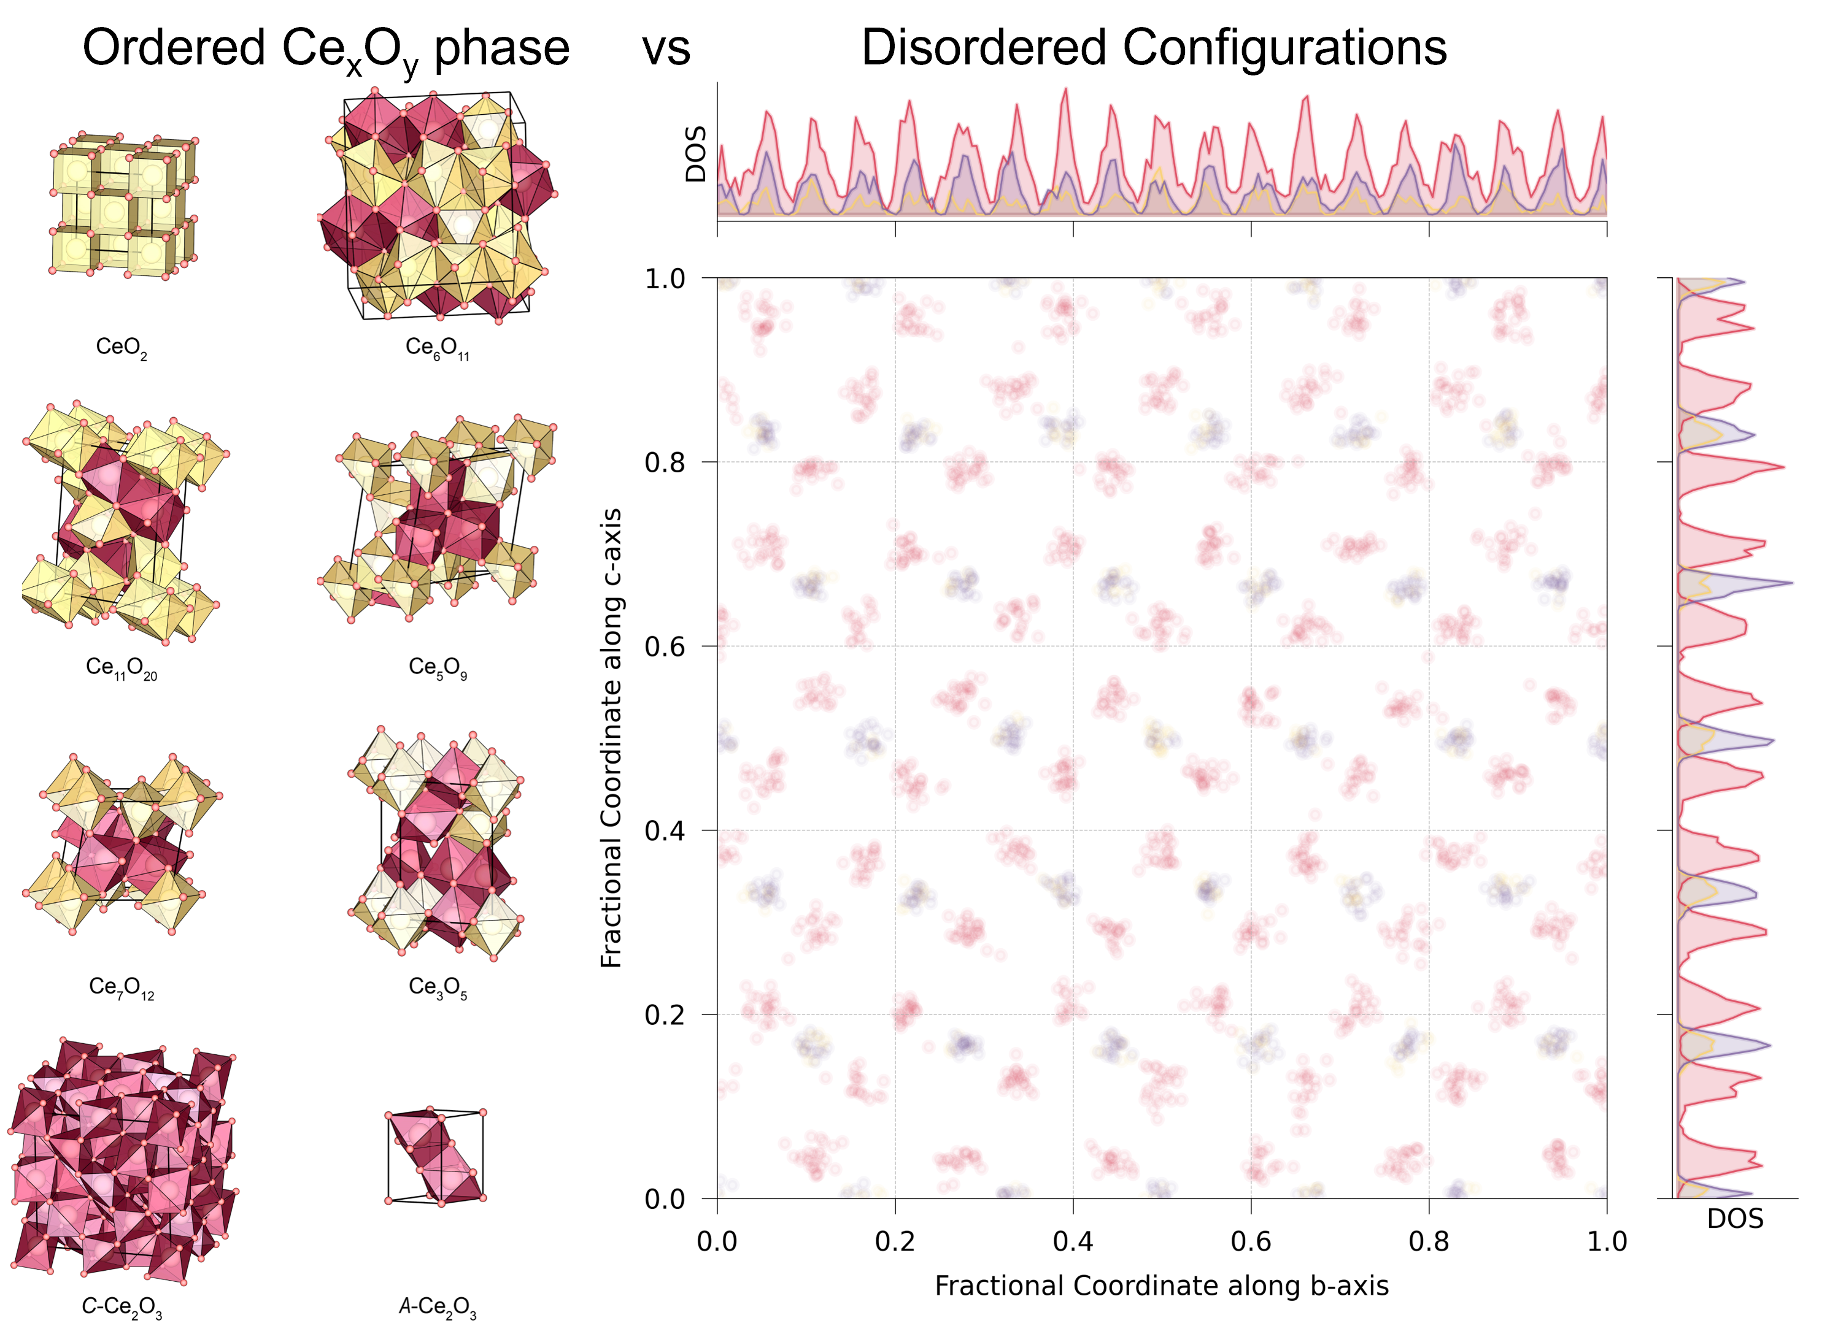
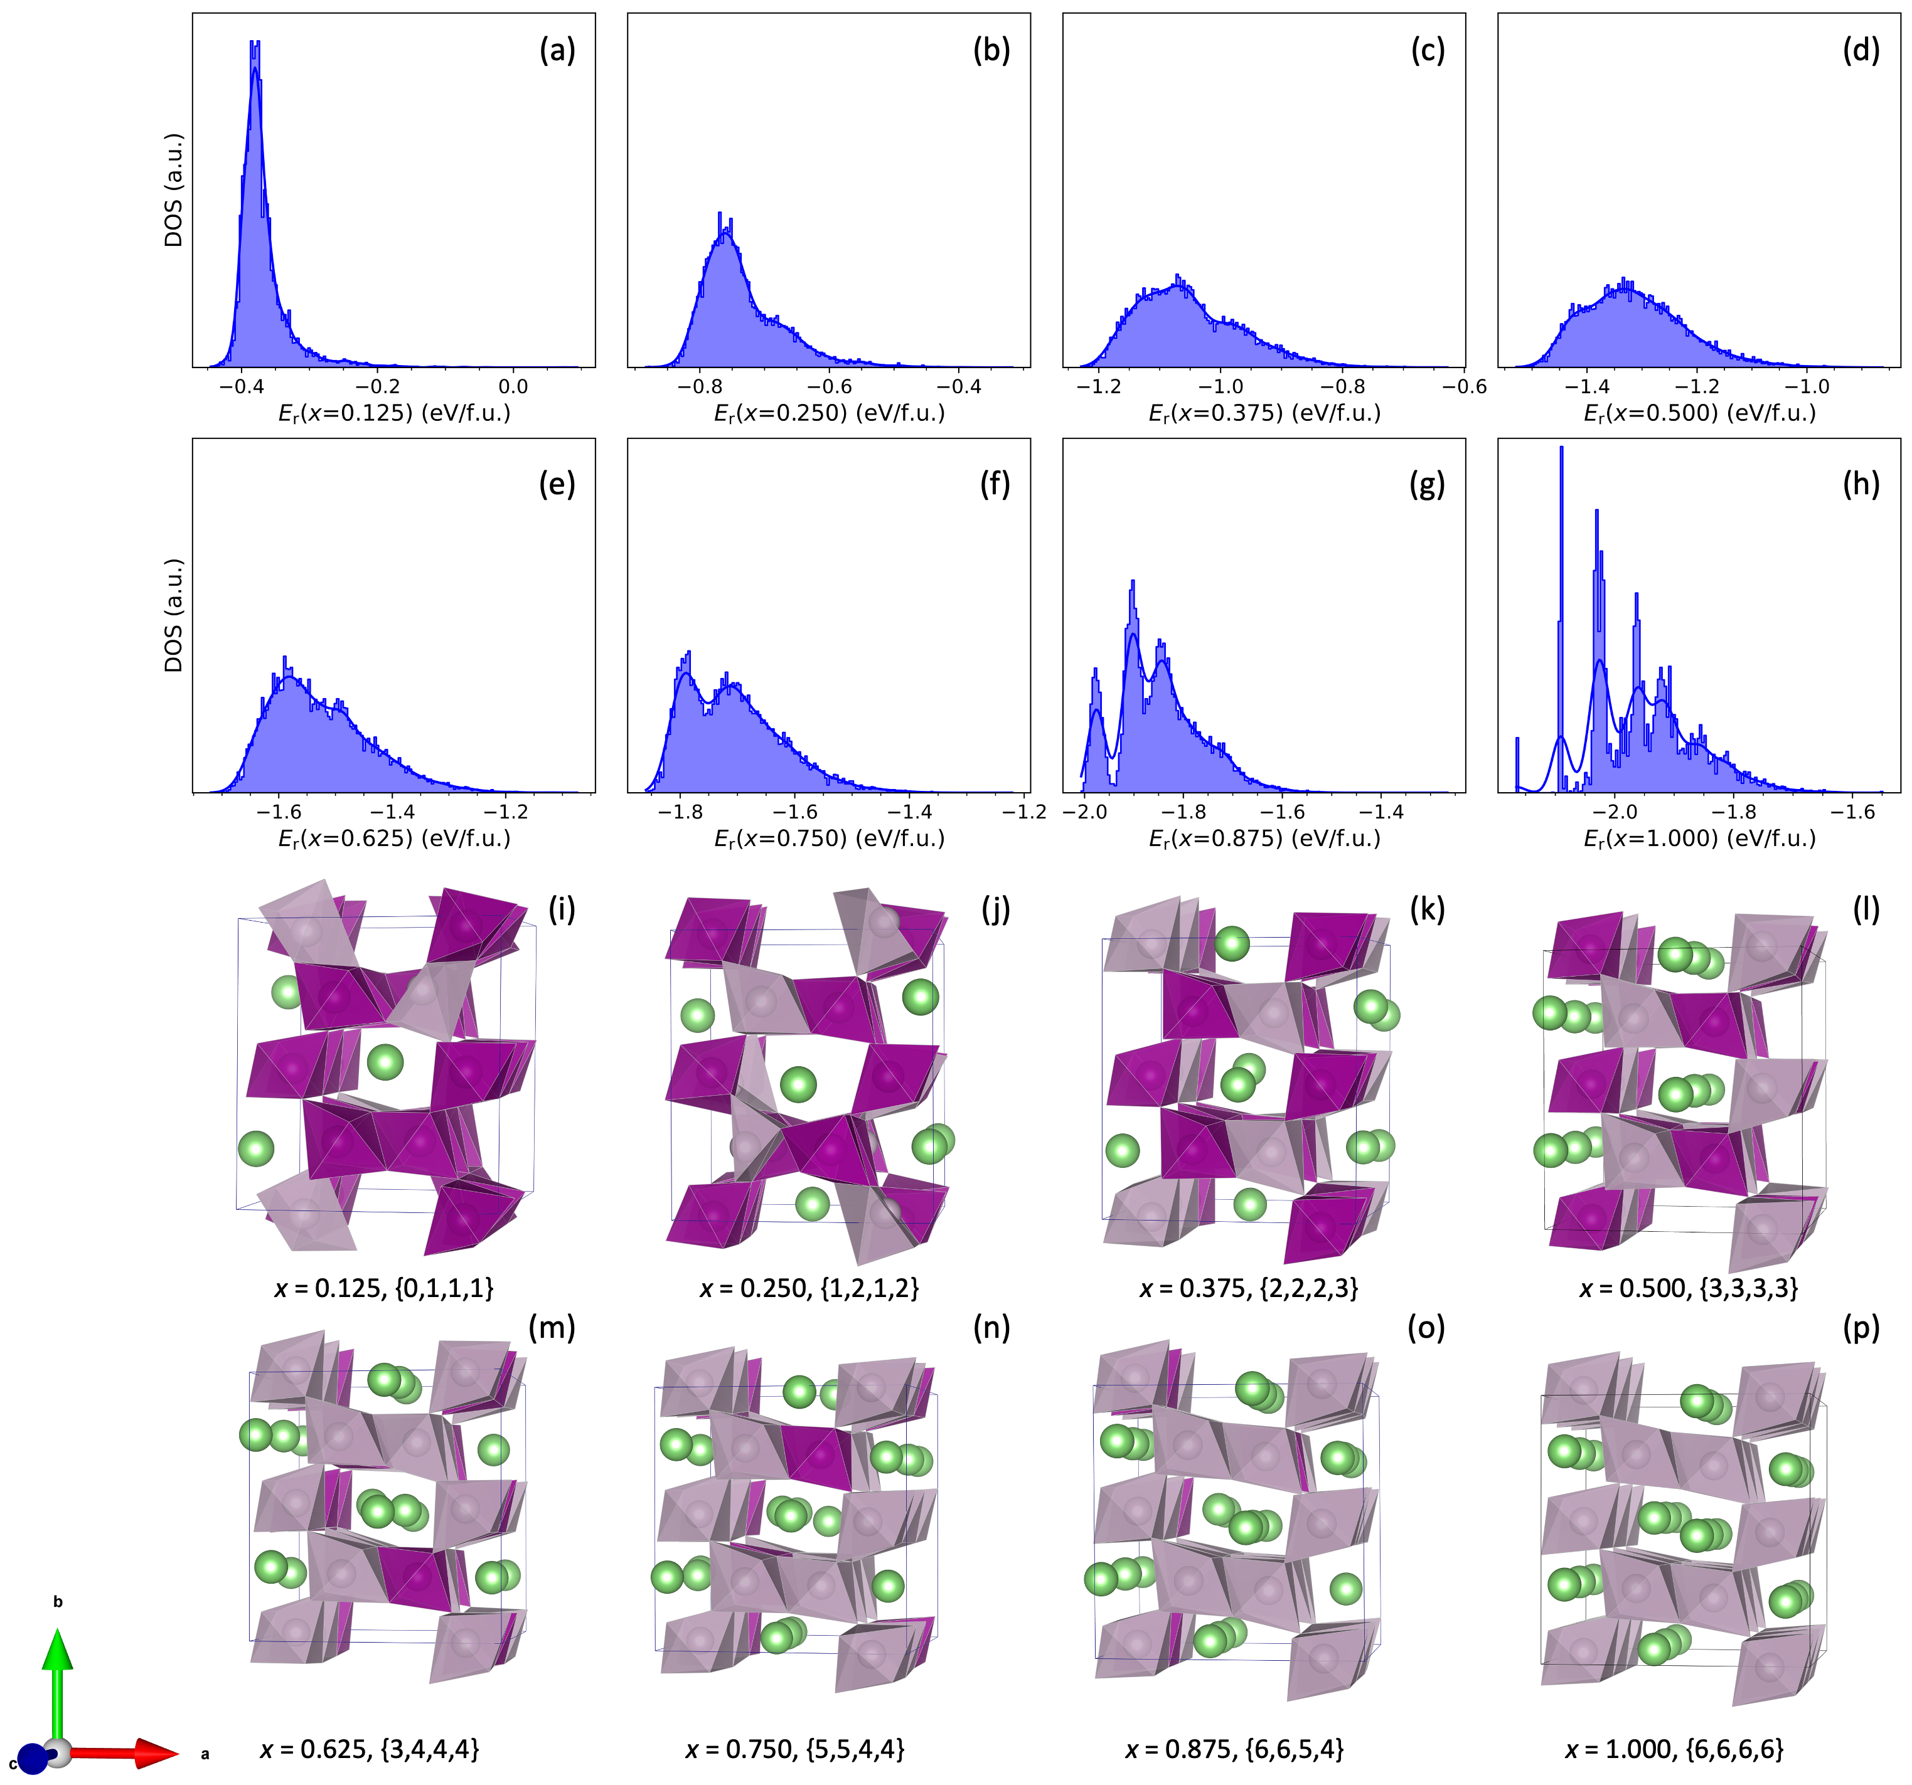
Introduction
stochastic processes in materials science
X. Zhang et al, 2024
W. Jee et al, 2024
Fig 2 Understanding order and disorder in reduced Ceria SOFC by large-scale Monte-Carlo simulations
Other Projects
Neutral Atom Quantum Annealing for the Configurational Analysis of Solid Solutions, B. Camino.
Study of Magnesium Intercalation Mechanism in Spinel-MnO₂, J. A. Nasir.
Fig 1 Li intercalation energy distribution and the global minimum structure of Ramsdellite Li_{x}MnO2.
W. Jee, PAX-HPC Meeting, Lancaster, 22th April 2024

Slide 5
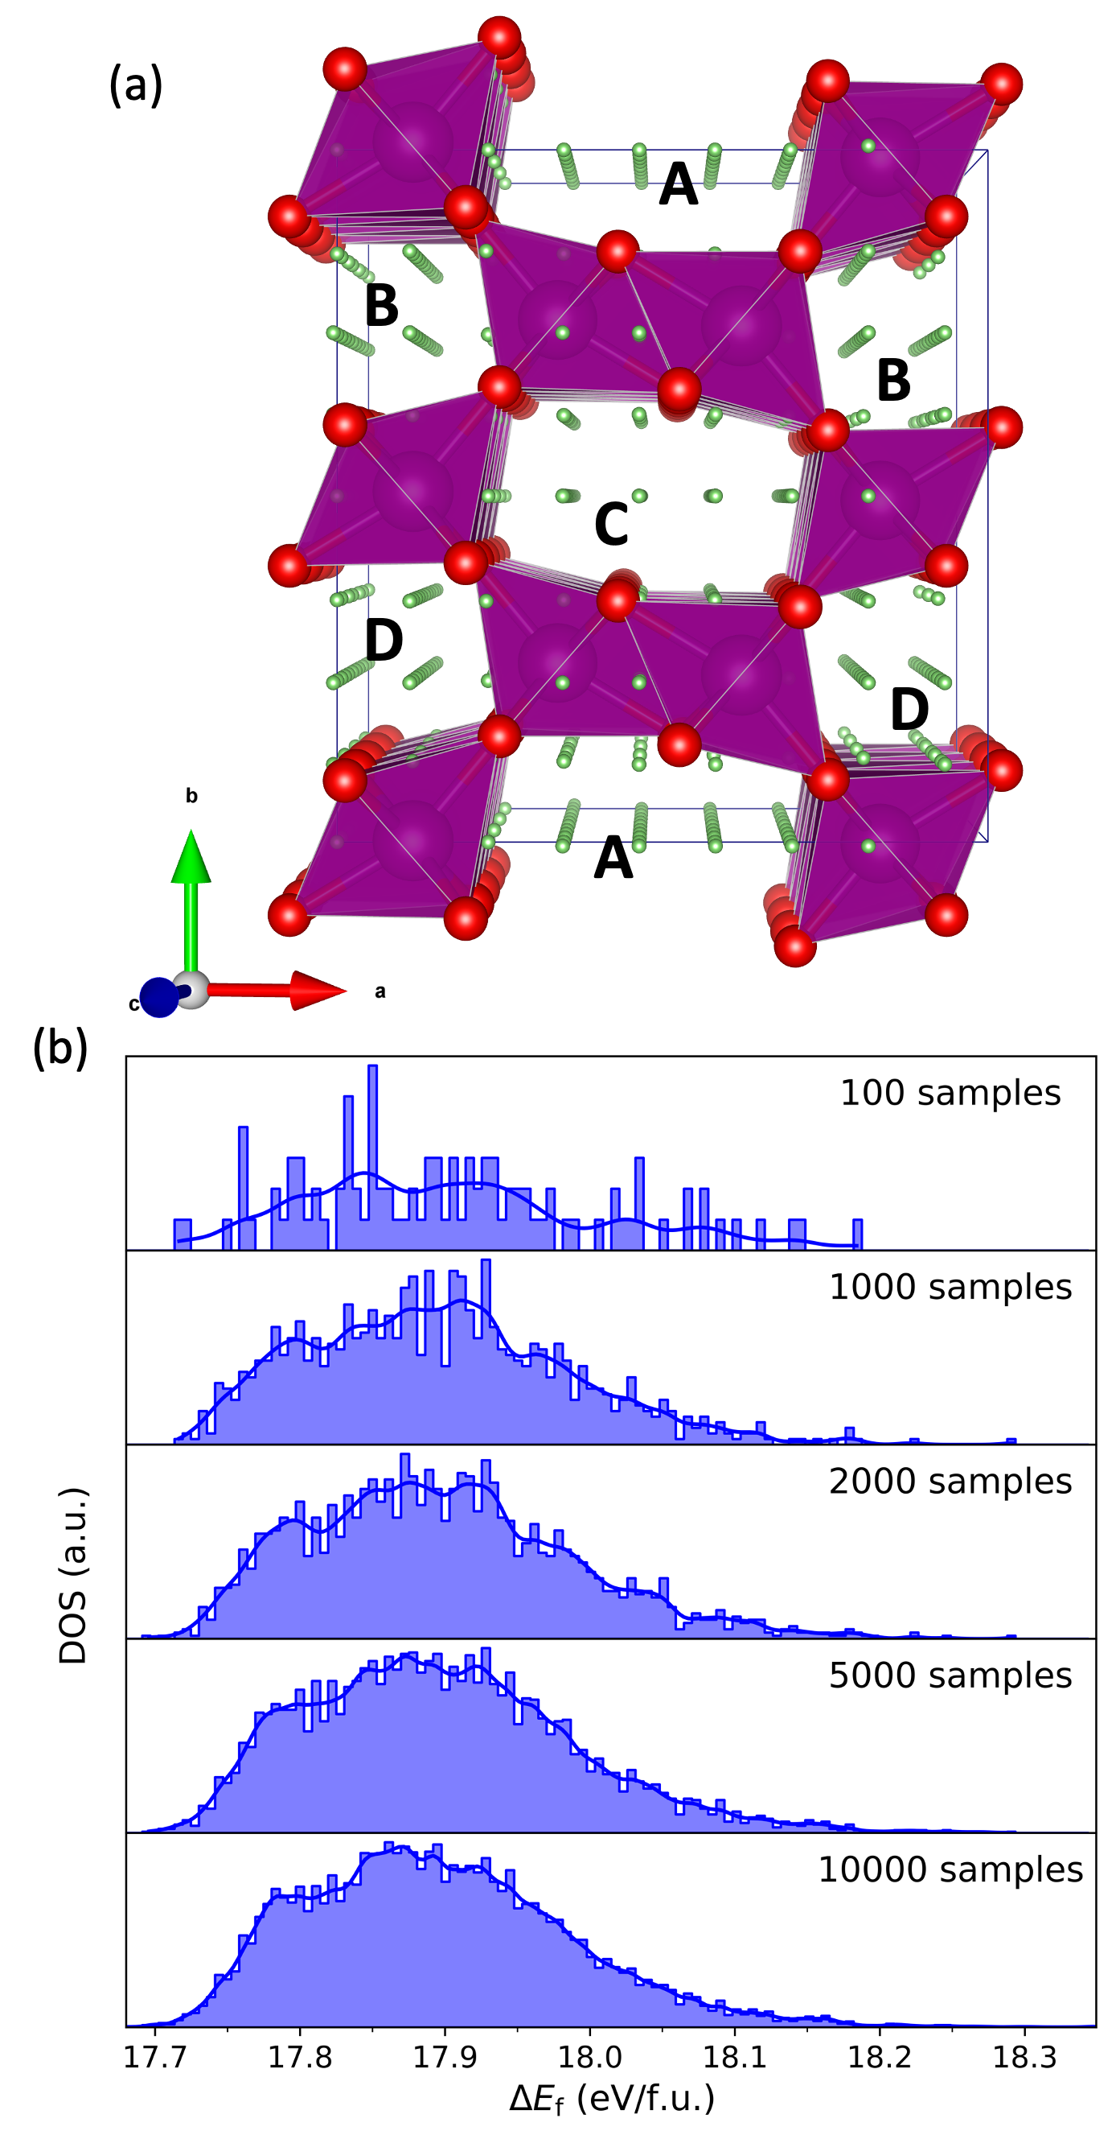
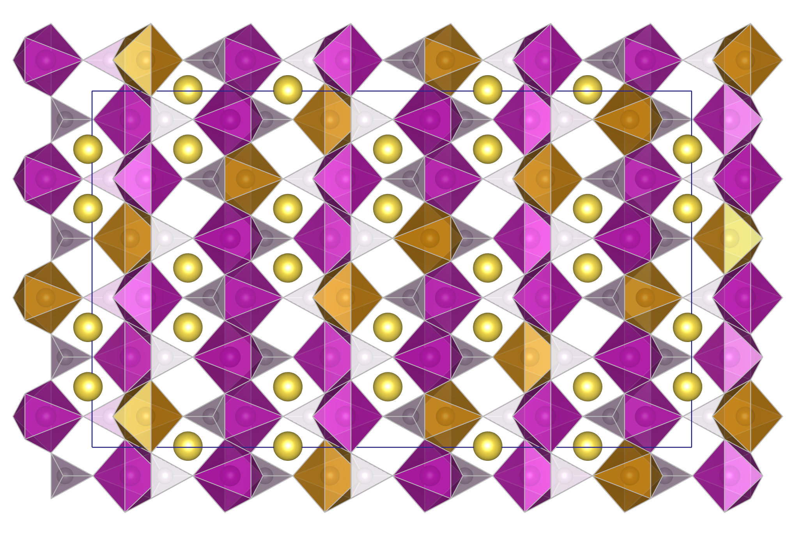
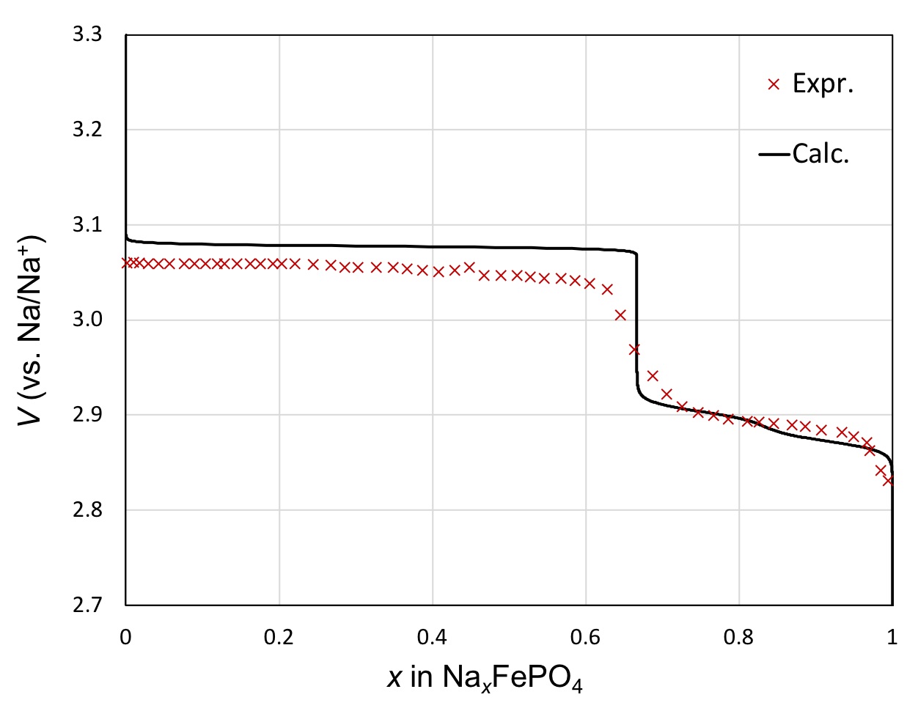
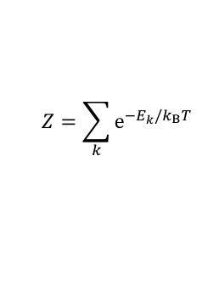
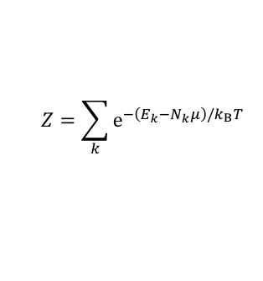
Introduction
stochastic processes in materials science
3. Calculate desired properties
1. Monte-Calro appraoch
For instance, sampling Li intercalation sites in Li_{x}MnO₂
2. Apply statistical mechanics
Canonical
Grand canonical
$$Z=\sum_{k}{{\text{e}}^{−E_{k}/k_{B}T}}$$
$$Z=\sum_{k}{{\text{e}}^{−\left(E_{k}−N_{k}μ\right)/k_{B}T}}$$
Fig 2 Calculated and experimental voltage profile of Li_{x}MnO₂.
Fig 1 (a) Possible Li intercalation sites (green spheres) and (b) the energy density of states with selected different number of samples.
Na_{2/3}FePO₄
crystal structure
Fig 3 Calculated and experimental voltage profile of Na_{x}FePO₄.
W. Jee, PAX-HPC Meeting, Lancaster, 22th April 2024

Slide 6

Master-Worker Parallelism
Introducing Master-worker parallelism
Stochastic energy sampling
Introducing Master-Worker Parallelism
Calculating energies of each samples are independent
1. Monte-Calro appraoch
For instance, sampling Li intercalation sites in Li_{x}MnO₂
HPC node 1
MPI enabled App
worker 1
MPI enabled App
worker 2
MPI enabled App
worker n
…
Master CPU
Materials Application
HPC node 2
MPI enabled App
worker 1
MPI enabled App
worker 2
MPI enabled App
worker n
Task Manager
Send-Recv
Packaging/Collecting
…
Task Queue
$$⋮$$
HPC node N
MPI enabled App
worker 1
MPI enabled App
worker 2
MPI enabled App
worker n
…
Task Queue
Fig 1 (a) Possible Li intercalation sites (green spheres) and (b) the energy density of states with selected different number of samples.
Task 1
Task 2
Task 3
Task 4
…
Task N
W. Jee, PAX-HPC Meeting, Lancaster, 22th April 2024

Slide 7
Master-Worker Parallelism
Implementation
/* main program */
void main() {
ConfigureCommunicator();
…
if( rank == master )
Master();
else
Worker();
…
return;
W. Jee, PAX-HPC Meeting, Lancaster, 22th April 2024

Slide 8
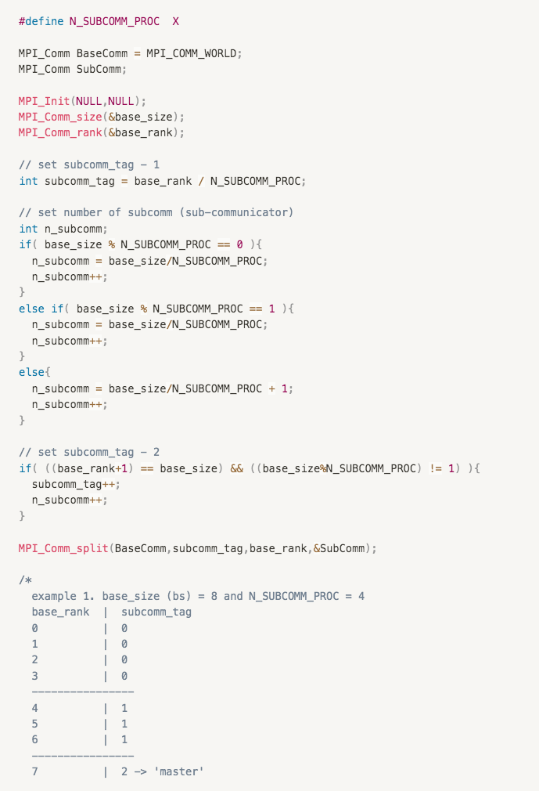
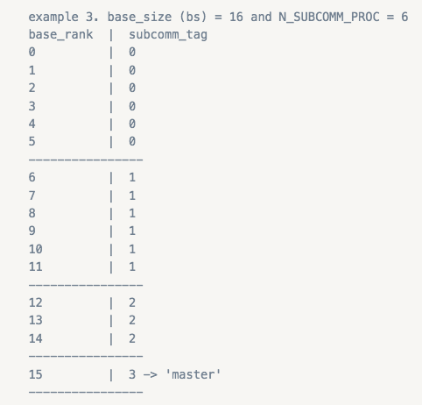
Master-Worker Parallelism
Implementation: Configure Communicator
ConfigureCommunicator();
/* main program */
void main() {
ConfigureCommunicator();
…
if( rank == master )
Master();
else
Worker();
…
return;
Splitting Resource
BaseComm (master)
SubComm (worker or workgroup)
W. Jee, PAX-HPC Meeting, Lancaster, 22th April 2024
Notes:
Keeping ‘subcomm_tag’ will be useful to access desired ‘subcomm (or worker)’ later!

Slide 9
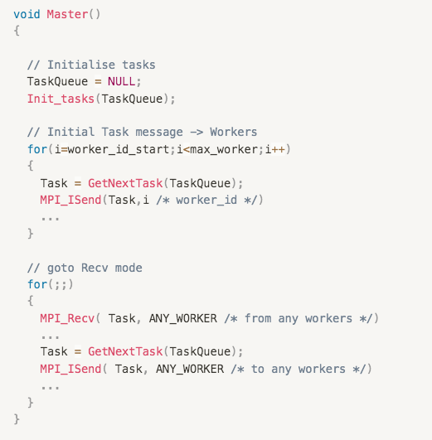
Master-Worker Parallelism
Implementation: Master()
Master();
/* main program */
void main() {
ConfigureCommunicator();
…
if( rank == master )
Master();
else
Worker();
…
return;
W. Jee, PAX-HPC Meeting, Lancaster, 22th April 2024

Slide 10
Master-Worker Parallelism
Implementation: Master()
Master();
/* main program */
void main() {
ConfigureCommunicator();
…
if( rank == master )
Master();
else
Worker();
…
return;
Init_tasks();
Filling-up the TaskQueue. Each task may require desired input-files or information
Read-in input files from disk
For runtime generation in worker-level, setting-up desired instructions.
W. Jee, PAX-HPC Meeting, Lancaster, 22th April 2024

Slide 11
Master-Worker Parallelism
Implementation: Master()
Master();
/* main program */
void main() {
ConfigureCommunicator();
…
if( rank == master )
Master();
else
Worker();
…
return;
Initial Task Messaging
GetNextTask() return a task from TaskQueue
W. Jee, PAX-HPC Meeting, Lancaster, 22th April 2024

Slide 12
Master-Worker Parallelism
Implementation: Master()
Master();
/* main program */
void main() {
ConfigureCommunicator();
…
if( rank == master )
Master();
else
Worker();
…
return;
Recv-Send
Recv Task (which could be a derived datatype, including desired task results, e.g., struct, class, module …)
Send Task, sending next task in the TaskQueue.
W. Jee, PAX-HPC Meeting, Lancaster, 22th April 2024
Notes:
Send Task, this message could be sent to where the right previous Recv message came from. (RECV->SEND-BACK)
If TasksQueue is empty. For instance, returned NULL or False, call break the for loop and send ’kill message’ to workers. (kill message is for asking them to return).

Slide 13
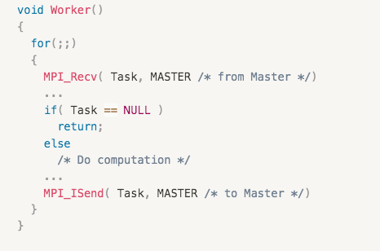
Master-Worker Parallelism
Implementation: Worker()
Worker();
/* main program */
void main() {
ConfigureCommunicator();
…
if( rank == master )
Master();
else
Worker();
…
return;
W. Jee, PAX-HPC Meeting, Lancaster, 22th April 2024
Notes:
Worker also include infinite loop, waiting for task message from Master.

Slide 14
Master-Worker Parallelism
Implementation: Worker()
Worker();
/* main program */
void main() {
ConfigureCommunicator();
…
if( rank == master )
Master();
else
Worker();
…
return;
Recv Task
If received task message is valid, do computation.
Computation includes launching materials application.
materials application can be launched through (1) system call or (2) called as a function.
W. Jee, PAX-HPC Meeting, Lancaster, 22th April 2024
Notes:
Send Task, this message could be sent to where the right previous Recv message came from. (RECV->SEND-BACK)
If TasksQueue is empty. For instance, returned NULL or False, call break the for loop and send ’kill message’ to workers. (kill message is for asking them to return).

Slide 15
Master-Worker Parallelism
Implementation: Worker()
Worker();
/* main program */
void main() {
ConfigureCommunicator();
…
if( rank == master )
Master();
else
Worker();
…
return;
Send Task (result)
Send task result back to master
(result may include desired information taken from the materials application)
W. Jee, PAX-HPC Meeting, Lancaster, 22th April 2024
Notes:
Send Task, this message could be sent to where the right previous Recv message came from. (RECV->SEND-BACK)
If TasksQueue is empty. For instance, returned NULL or False, call break the for loop and send ’kill message’ to workers. (kill message is for asking them to return).

Slide 16
Master-Worker Parallelism
Profiling on ARCHER 2
Closer look of a Worker communicating with Master
Master
Recv / Send
Master
Recv / Send
Master (time)
Worker
Send_{t} – Recv_{t}
…
…
app_elapsed_t
Worker (time)
Master
Recv_{t} – Send_{t}
application-level measured ~ pure computation time consumed by the application
overhead from before (unpacking task and preparing app-launching) and after (packing result) launching application
overhead from MPI (Send/Recv) + Master-Worker architecture (delay in Master looping workers)
Master
Worker
W. Jee, PAX-HPC Meeting, Lancaster, 22th April 2024
Notes:
Red (application level elapt) : ‘app_elap_t’
Green: ‘app_launch_overhead’
Blue: ’mpi_overhead’

Slide 17
Master-Worker Parallelism
Profiling on ARCHER 2
Na_{2/3}FePO₄
crystal structure
~ 400 atoms
Na_{2/3}FePO₄ 100,000 samples (energy model: IP - GULP)
ARCHER 2 : 64 nodes 16 cores per worker (512 workers)
Using prepared TaskQueue from disk
(i.e., no preparation overhead)
Overheads (blue/green) are negligible compared to application runtime (red)
W. Jee, PAX-HPC Meeting, Lancaster, 22th April 2024
Notes:
Na_{2/3}FePO₄ - 400 atoms system

Slide 18
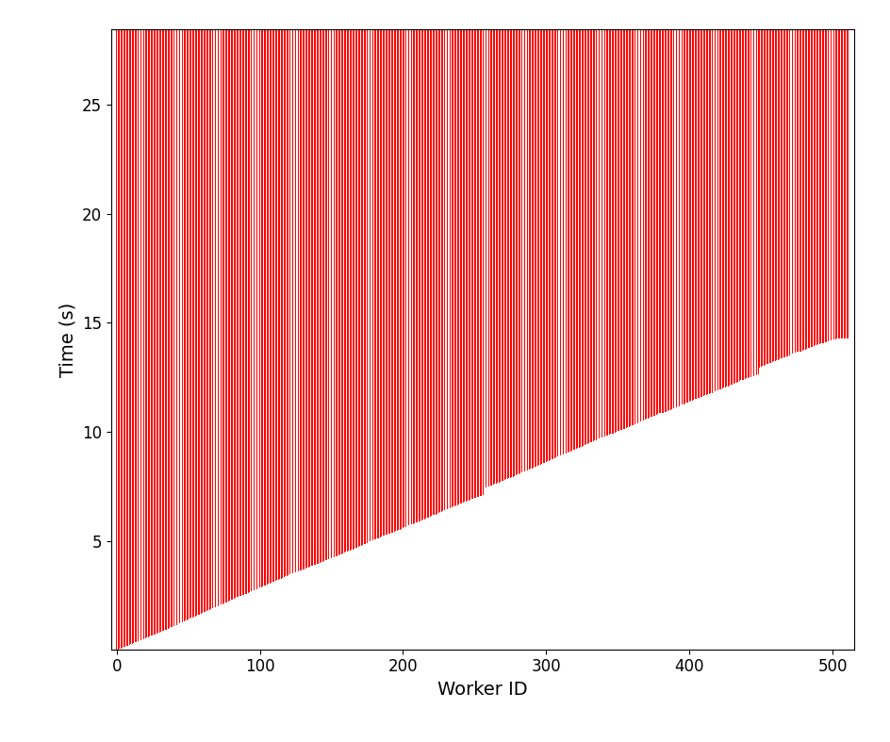
Master-Worker Parallelism
Profiling on ARCHER 2 - Overview
14.26 s
Na_{2/3}FePO₄ 100,000 samples (energy model: IP - GULP)
ARCHER 2 : 64 nodes 16 cores per worker (512 workers)
Using prepared TaskQueue from disk
(i.e., no preparation overhead)
14.26 / 512 = 0.02785 seconds (MPI_Send) per workgroup
W. Jee, PAX-HPC Meeting, Lancaster, 22th April 2024
Notes:
Na_{2/3}FePO₄ - 400 atoms system
14.26 / 512 = 0.02785 seconds (MPI_Send per workgroup)

Slide 19
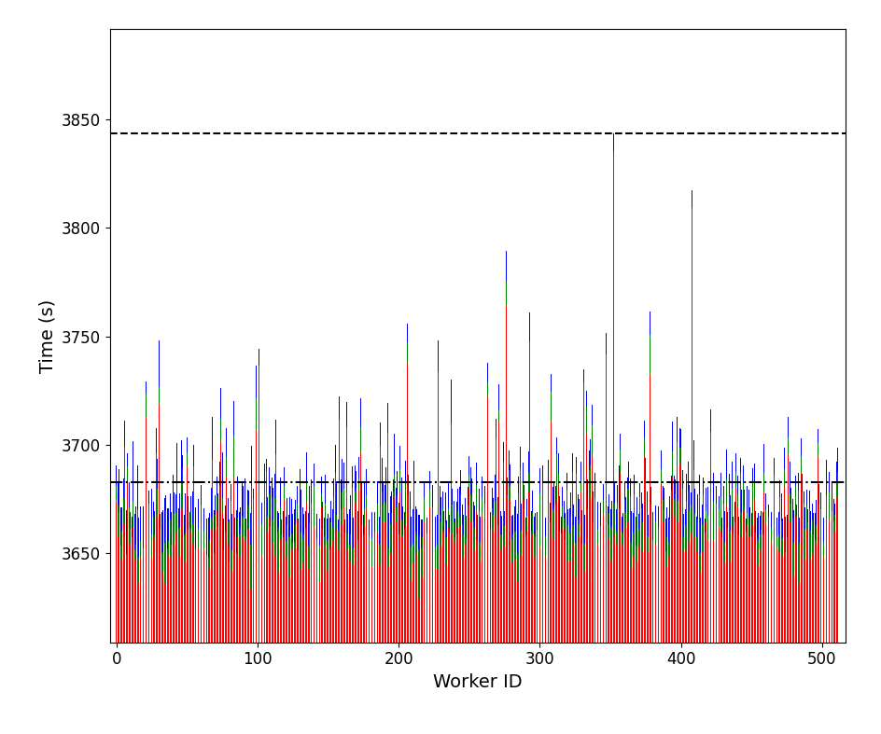
Master-Worker Parallelism
Profiling on ARCHER 2 - Overview
main program return
160.78 s
Ave. time
Na_{2/3}FePO₄ 100,000 samples (energy model: IP - GULP)
ARCHER 2 : 64 nodes 16 cores per worker (512 workers)
Using prepared TaskQueue from disk
(i.e., no preparation overhead)
160.78 s : such late delay varies depending on samples.
W. Jee, PAX-HPC Meeting, Lancaster, 22th April 2024
Notes:
Na_{2/3}FePO₄ - 400 atoms system

Slide 20
Master-Worker Parallelism
Profiling on ARCHER 2 – Initial delay
51.29 s
26.33 s
14.26 s
64 nodes 16 cores per worker (512 workers)
128 nodes 16 cores per worker (1024 workers)
256 nodes 16 cores per worker (2048 workers)
0.02785 seconds (MPI_Send) per workgroup
0.02572 seconds (MPI_Send) per workgroup
0.02504 seconds (MPI_Send) per workgroup
Initial delay scales up linearly
Necessary to introduce multiple masters to reduce this delay?
W. Jee, PAX-HPC Meeting, Lancaster, 22th April 2024
Notes:
Na_{2/3}FePO₄ - 400 atoms system

Slide 21
Master-Worker Parallelism
Profiling on ARCHER 2 – late delay
main program return
160.78 s
171.71 s
171.93 s
Ave. time
64 nodes 16 cores per worker (512 workers)
128 nodes 16 cores per worker (1024 workers)
256 nodes 16 cores per worker (2048 workers)
4.18 % out of 3843.74 s (total elapsed time)
8.79 % out of 2044.69 s (total elapsed time)
15.32 % out of 1122.42 s (total elapsed time)
These late delays can be caused by …
Undesired behaviour of application (e.g., energy relaxation got stuck, usually caused by unphysical initial atomic configuration, etcs)
Possible solutions?
Limit the number of maximum energy relaxation cycles
Apply pre-screener to filter undesired initial configuration
Fundamentally? Limit the runtime in application level (pass the runtime as an input parameter).
W. Jee, PAX-HPC Meeting, Lancaster, 22th April 2024
Notes:
Trial run (single node – get optimal size) – main run (many nodes)
More extreme case – 256 nodes with 4 cores per worker
Typically, increasing cores (after certain number) linear scaling (ideal speed up) breaks. And therefore allocating small number of cpus per worker will be ideal.
However, when this type of late delay occurs, since small number of cores result in much more delay. This is because, for a given number of relaxation cycles for the sample (if system is large) it takes more time to run over, while the rest of worker already finished their tasks and waiting!!!

Slide 22
Master-Worker Parallelism
Possible pitfalls of using libridised materials application
Master-worker parallelism is implemented in KLMC (Knowledge-Led Master Code)
KLMC is linked to GULP & FHIaims library
Fortran stop is destructive (crashing entire program, instead of returning back to main)
Subroutines in GULP – stopnow() / FHIaims – aims_stop()
This occurs, when application finds something that doesn’t look right
For instance,
* unphysical atomic configuration (GULP and FHIaims)
* undesired input tolerance used – lowering accuracy – call stop SCF convergence (FHIaims)
Solution?
W. Jee, PAX-HPC Meeting, Lancaster, 22th April 2024
Notes:
unphysical atomic configuration (GULP and FHIaims)
This could be tackled by applying pre-screening filter in KLMC level.

Slide 23
Outlook
Upcoming Tasks
Master-worker parallelism is implemented in KLMC (Knowledge-Led Master Code)
KLMC is designed to support various types of stochastic sampling:
1. Solid Solutions
2. Basin-Hopping or Random Quenching
3. Genetic algorithm for nanoclusters
4. Nanoclusters on surfaces
5. Simulated annealing – Metropolis Monte-Carlo
As materials simulation applications, supporting: GULP (2023) and FHI-aims (2023)
W. Jee, PAX-HPC Meeting, Lancaster, 22th April 2024

Slide 24
Thank you very much for your attention
W. Jee, PAX-HPC Meeting, Lancaster, 22th April 2024

